Slide 1
ICS 321 Data Storage & Retrieval High Level Database Models
Prof. Lipyeow Lim
Information & Computer Science Department
University of Hawaii at Manoa

Slide 2
Database Design & Deployment
Requirements Analysis
Conceptual Database Design
Business Processes
Logical Database Design
SQL Operations & program code
iterate
Physical Database Design (DDL/DML)
Testing
Production

Slide 3
Overview Database Design
Conceptual Design
Use entity-relationship (aka ER) model represented pictorially as ER diagrams
Map ER model to relational schema
Questions to ask yourself
What are the entities and relationships in the application?
What information about these entities and relationships should we store in the database?
What are the integrity constraints or business rules that hold?

Slide 4
ER Model Basics: Entities
name
ssn
lot
Employees
Entity: Real-world object distinguishable from other objects. An entity is described (in DB) using a set of attributes.
Entity Set: A collection of similar entities. E.g., all employees.
All entities in an entity set have the same set of attributes. (Until we consider ISA hierarchies, anyway!)
Each entity set has a key.
Each attribute has a domain.

Slide 5
ER Model Basics: Relationships
since
name
dname
ssn
lot
did
budget
Employees
Works_In
Departments
Relationship: Association among two or more entities.
Relationship Set: Collection of similar relationships.
An n-ary relationship set R relates n entity sets E1 ... En; each relationship in R involves entities e1 E1, ..., en En
Same entity set could participate in different relationship sets, or in different “roles” in same set.

Slide 6
Cardinality Ratios of Relationships
Consider binary relationships, i.e., between two entity sets
Alternate notation: 1:1, 1:M, M:1, M:N
1-to-1
1-to Many
Many-to-1
Many-to-Many

Slide 7
Key Constraints
name
since
dname
ssn
lot
did
budget
Employees
Manages
Departments
Works_In
since
Consider Works_In: An employee can work in many depts; a dept can have many employees : m-to-m
Consider Manages: each dept has at most one manager
Dept has a key constraint on Manages: each instance of dept appears in at most one instance of manages
Denoted by an arrow: given a dept entity we can uniquely identify the manages relationship in which it appears

Slide 8
Participation constraints
since
since
name
name
dname
dname
ssn
did
did
budget
lot
budget
Employees
Manages
Departments
Does every dept have a manager?
If so, this is a participation constraint: the participation of dept in Manages is said to be total (vs. partial). Denoted by thick/double line
Meaning that every Dept entity must appear in an instance of the Manages relationship

Slide 9
Set Theoretic Formulation
A
1
B
2
C
3
D
Employees
Manages (1:m)
Departments
Partial Partiticipation: Not all members of the Employees entity set take part in the manages relations
Total Partiticipation: All members of the Dept entity set take part in the manages relationship
Dept has a key constraint on Manages: each member of the dept entity set takes part in at most one member of the manages relationship set

Slide 10
Weak Entities
name
ssn
lot
cost
pname
age
Employees
Policy
Dependents
A weak entity can be identified uniquely only by considering the primary key of another (owner) entity.
Owner entity set and weak entity set must participate in a one-to-many relationship set (one owner, many weak entities).
Weak entity set must have total participation in this identifying relationship set.
Denoted by a box with double or thick lines

Slide 11
Design Choices
Should a concept be modeled as an entity or an attribute?
Should a concept be modeled as an entity or a relationship?
Identifying relationships: Binary or ternary? Aggregation?
How much semantics to capture in the form of constraints ?

Slide 12
Entity vs. Attribute
address
has
Employee
address
Employee
Depends upon how we want to use the address information, and the semantics of the data:
If we have several addresses per employee, address must be an entity (since attributes cannot be set-valued).
If the structure (city, street, etc.) is important, e.g., we want to retrieve employees in a given city, address must be modeled as an entity (since attribute values are atomic).

Slide 13
Logical DB Design: ER to Relational
Entity sets to tables:
CREATE TABLE Employees
(ssn CHAR(11),
name CHAR(20),
lot INTEGER,
PRIMARY KEY (ssn))
name
ssn
lot
Employees
Notes:
3
The slides for this text are organized into several modules. Each lecture contains about enough material for a 1.25 hour class period. (The time estimate is very approximate--it will vary with the instructor, and lectures also differ in length; so use this as a rough guideline.) This covers Lectures 1 and 2 (of 6) in Module (5).
Module (1): Introduction (DBMS, Relational Model)
Module (2): Storage and File Organizations (Disks, Buffering, Indexes)
Module (3): Database Concepts (Relational Queries, DDL/ICs, Views and Security)
Module (4): Relational Implementation (Query Evaluation, Optimization)
Module (5): Database Design (ER Model, Normalization, Physical Design, Tuning)
Module (6): Transaction Processing (Concurrency Control, Recovery)
Module (7): Advanced Topics

Slide 14
Relationship Sets to Tables
Attributes of the relation must include:
Keys for each participating entity set (as foreign keys).
This set of attributes forms a superkey for the relation.
All descriptive attributes.
CREATE TABLE Works_In(
ssn CHAR(11),
did INTEGER,
since DATE,
PRIMARY KEY (ssn, did),
FOREIGN KEY (ssn)
REFERENCES Employees,
FOREIGN KEY (did)
REFERENCES Departments)
since
name
dname
ssn
lot
did
budget
Employees
Works_In
Departments
Notes:
5

Slide 15
Translating ER Diagrams with Key Constraints
A
ssn
since
did
1
B
Manages
C
2
Employees
Departments
3
D
Emp.
Manages (1:m)
Depts
Map relationship to a table:
Note that did is the key now!
Since each department has a unique manager, we could instead combine Manages and Departments.
CREATE TABLE Manages(
ssn CHAR(11), did INTEGER, since DATE,
PRIMARY KEY (did),
FOREIGN KEY (ssn) REFERENCES Employees,
FOREIGN KEY (did) REFERENCES Departments)
CREATE TABLE Dept_Mgr(
did INTEGER,
dname CHAR(20),
budget REAL,
ssn CHAR(11), since DATE,
PRIMARY KEY (did),
FOREIGN KEY (ssn) REFERENCES Employees)
Notes:
7

Slide 16
Participation Constraints in SQL
We can capture participation constraints involving one entity set in a binary relationship, but little else (without resorting to CHECK constraints).
CREATE TABLE Dept_Mgr(
did INTEGER,
dname CHAR(20),
budget REAL,
ssn CHAR(11) NOT NULL,
since DATE,
PRIMARY KEY (did),
FOREIGN KEY (ssn) REFERENCES Employees,
ON DELETE NO ACTION)
Notes:
9

Slide 17
Translating Weak Entity Sets
Weak entity set and identifying relationship set are translated into a single table.
When the owner entity is deleted, all owned weak entities must also be deleted.
CREATE TABLE Dep_Policy (
pname CHAR(20),
age INTEGER,
cost REAL,
ssn CHAR(11) NOT NULL,
PRIMARY KEY (pname, ssn),
FOREIGN KEY (ssn) REFERENCES Employees,
ON DELETE CASCADE)
Notes:
11

Slide 18
ISA Hierarchies
name
ssn
lot
As in C++, or other PLs, attributes are inherited.
If we declare A ISA B, every A entity is also considered to be a B entity.
hourly_wages
Employees
hours_worked
ISA
contractid
Hourly_Emps
Contract_Emps
Overlap constraints: Can Joe be an Hourly_Emps as well as a Contract_Emps entity? (Allowed/disallowed)
Covering constraints: Does every Employees entity also have to be an Hourly_Emps or a Contract_Emps entity? (Yes/no)
Notes:
12

Slide 19
Translating ISA Hierarchies to Relations
General approach:
3 relations: Employees, Hourly_Emps and Contract_Emps.
Hourly_Emps: Every employee is recorded in Employees. For hourly emps, extra info recorded in Hourly_Emps (hourly_wages, hours_worked, ssn); must delete Hourly_Emps tuple if referenced Employees tuple is deleted).
Queries involving all employees easy, those involving just Hourly_Emps require a join to get some attributes.
Alternative: Just Hourly_Emps and Contract_Emps.
Hourly_Emps: ssn, name, lot, hourly_wages, hours_worked.
Each employee must be in one of these two subclasses.
Notes:
13

Slide 20
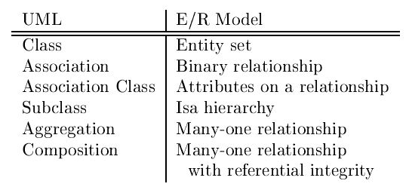
Unified Modeling Language
Standardized general-purpose modeling language for software design
Based on object-oriented model
Class diagrams

Slide 21
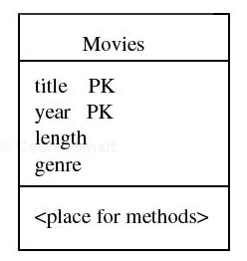
UML Classes
Class name
length
year
genre
Methods section typically not used in data modeling
title
Movies
ER Entity Set
UML Class

Slide 22
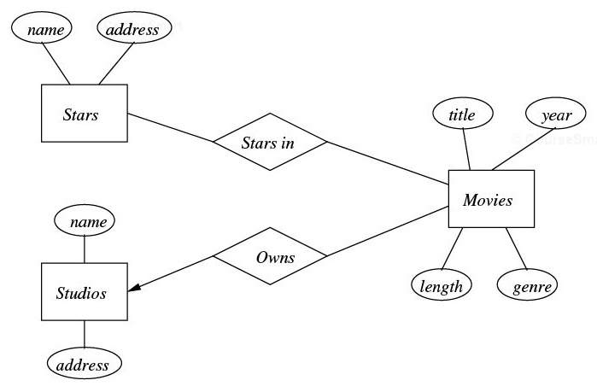
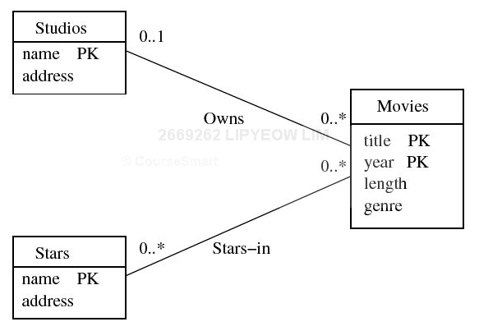
Associations
Cardinality constraints : one instance of Stars can be connected to at least 0 instance of movies and at most inifinite instances of movies

Slide 23
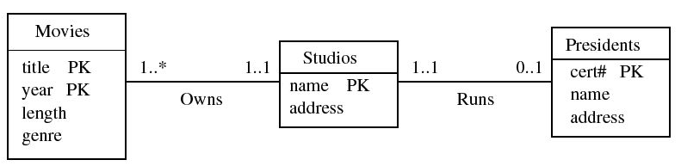
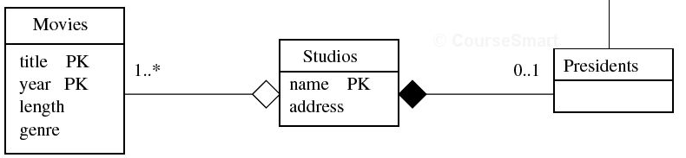
Referential Integrity
Aggregation: Must be 0..1 (includes 1..1)
Composition : Must be 1..1
Every president runs exactly one studio
Aggregation never named

Slide 24
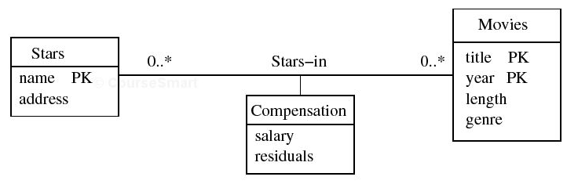
Association Classes

Slide 25
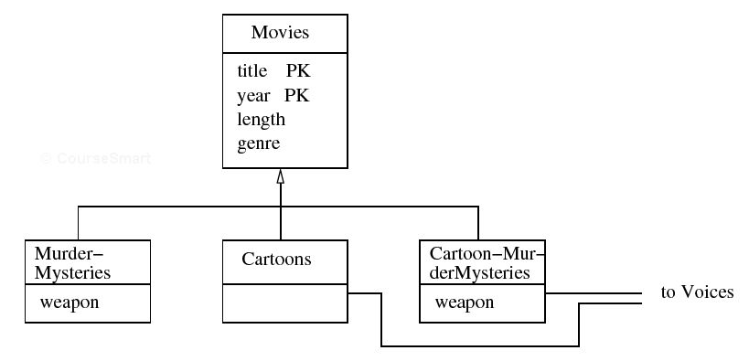
Sub-Class Hierarchies

Slide 26
Modeling Tips
Faithful to the semantics of the application
Model only what is needed in the application
Minimize redundancy (why?)
Simple is good
If the model is getting too complicated, take a step back and ask
Am i conceptualizing the right entities ?
Am i thinking of the right relationships ?
Should some relationships become entities ? Vice versa ?
Should some attributes become entities ? Vice versa ?

