Slide 1
ICS 321 Data Storage & Retrieval Semi-structured Data Model
Asst. Prof. Lipyeow Lim
Information & Computer Science Department
University of Hawaii at Manoa

Slide 2
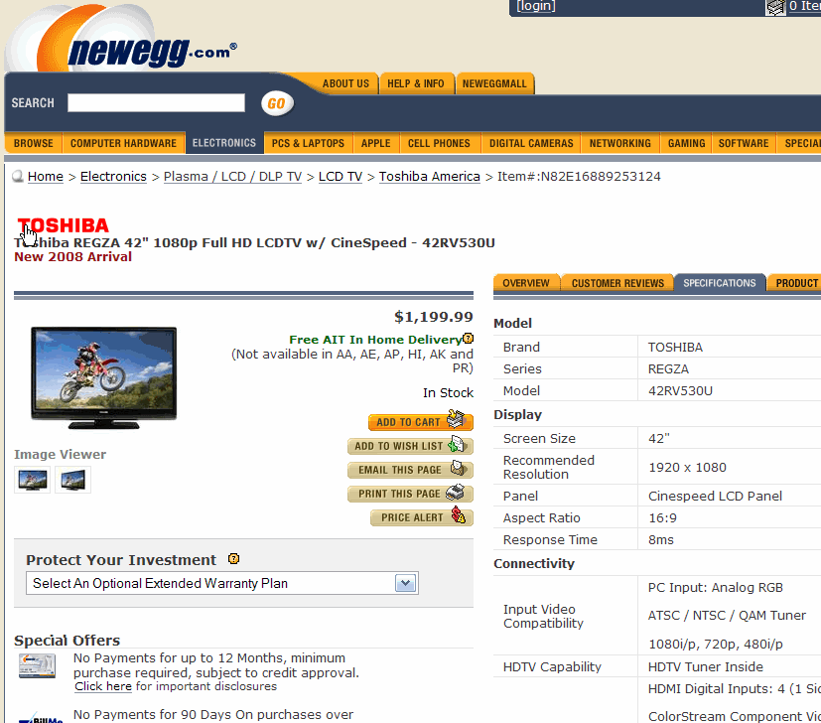
Schema Variability
Model
Brand = TOSHIBA
Series = REGZA
Model = 52HL167
Cabinet Color = Black
Display
Screen Size = 52“
Recommended Resolution = 1920 x 1080
Aspect Ratio =16:9
…
LCDTV
Structured data conforms to rigid schemas.
Relational data
Unstructured data – the other extreme.
Eg. Free text
Certain types of data are inbetween
Semi-structured
Schema variability across instances as well as time.
Eg. E-catalogs
XML supports a very flexible “schema”
Model
Brand = ViewSonic
Model = PJ551D
Cabinet Color = Black
Type = DLP
Display
Panel = 0.55" DMD
Lens = Manual zoom/focus
Lamp =180W, 3,500 hours normal, up to 4,000 eco mode
Aspect Ratio = 4:3 (native), 16:9
Projector

Slide 3
eXtended Markup Language (XML)
Design goals:
straightforwardly usable over the Internet.
support a wide variety of applications.
compatible with SGML.
easy to write programs which process XML docs.
optional features in XML kept to the absolute minimum.
human-legible and reasonably clear.
easy to create.
Terseness in XML markup is of minimal importance.
<item rdf:about="http://news.slashdot.org/story/09/11/17/2245241/Hackers-Broke-Into-Brazil-Grid-Last-Thursday?from=rss">
<title>Hackers Broke Into Brazil Grid Last Thursday</title>
<link> http://rss.slashdot.org/~r/Slashdot/slashdot/~3/JcTR_BoVsgI/Hackers-Broke-Into-Brazil-Grid-Last-Thursday</link>
<description>An anonymous reader writes "A week ago, 60 Minutes had a story (we picked it up too) claiming that hackers had caused power outages in Brazil. While this assertion is now believed to be in error, hackers were inspired by the story actually to do what was claimed.…”
</description>
<dc:creator>kdawson</dc:creator>
<dc:date>2009-11-17T23:41:00+00:00</dc:date>
<dc:subject>security</dc:subject>
<slash:department>wolf-no-really-this-time-i-mean-it</slash:department>
<slash:section>news</slash:section>
<slash:comments>38</slash:comments>
<slash:hit_parade>38,37,32,22,9,2,0</slash:hit_parade>
<feedburner:origLink> http://news.slashdot.org/story/09/11/17/2245241/Hackers-Broke-Into-Brazil-Grid-Last-Thursday?from=rss</feedburner:origLink>
</item>

Slide 4
Examples
Internet:
RSS, Atom
XHTML
Webservice formats: SOAP, WSDL
File formats:
Microsoft Office, Open Office, Apple’s iWork
Industrial
Insurance: ACORD
Clinical trials: cdisc
Financial: FIX, FpML
Mortgages: MISMO
Many applications use XML as a data format for persistence or for data exchange

Slide 5
XML Data Model
XML Document
Tags or element names
<dblp>
<inproceedings key="conf/cikm/HassanzadehKLMW09" >
<author>Oktie Hassanzadeh</author>
<author>Anastasios Kementsietsidis</author>
<author>Lipyeow Lim</author>
<author>Renée J. Miller</author>
<author>Min Wang</author>
<title>
A framework for semantic link discovery over relational data.</title>
<pages>1027-1036</pages>
<year>2009</year>
<booktitle>CIKM</booktitle>
</inproceedings>
</dblp>
dblp
Parent-child relationship
attributes
inproceedings
@key
booktitle
conf…
author
year
CIKM
Oktie…
author
pages
2009
Anast…
author
title
Lipyeow…
author
1027-..
author
Renee…
A framework…
Min…
Text values

Slide 6
Processing XML
Parsing
Event-based
Simple API for XML (SAX) : programmers write callback functions for parsing events eg. when an opening “<author>” is encountered.
The XML tree is never materialized
Document Object Model (DOM)
The XML tree is materialized in memory
XML Query Languages
XPath : path navigation language
XQuery
XSLT : transformation language (often used in CSS)

Slide 7
XPath
Looks like paths used in Filesystem directories.
Relative vs absolute
Examples:
/dblp/inproceedings/author
//author
//inproceedings[year=2009 and booktitle=CIKM]/title
Results are sequences of nodes.
Think of a node as the XML fragment for the subtree rooted at that node.
dblp
inproceedings
@key
booktitle
conf…
author
year
CIKM
Oktie…
author
pages
2009
Anast…
author
title
Lipyeow…
author
1027-..
author
Renee…
A framework…
Min…

Slide 8
XPath Axes
An XPath is a sequence of location steps separated by “/” of the form
Axisname::nodetest[predicate]
An axis defines a node-set relative to the current node:
self, parent, child, attribute
following, following-sibling
descendent, descendent-or-self
ancestor, ancestor-or-self
namespace
preceding, preceding-sibling
Examples
/child::dblp/child::inproceedings/attribute::author
/dblp/inproceedings/@key
/descendent-or-self::author
//author

Slide 9
XPath Predicates
dblp
An XPath is a sequence of location steps separated by “/” of the form
Axisname::nodetest[predicate]
Predicates can be comparisons of atomic values or path expressions
//inproceedings[ year=“2009” and booktitle=“CIKM”]/title
A predicate is true if there exists some nodes that satisfy the conditions
//inproceedings[author=“Renee”]
inproceedings
@key
booktitle
conf…
author
year
CIKM
Oktie…
author
pages
2009
Anast…
author
title
Lipyeow…
author
1027-..
author
Renee…
A framework…
Min…

Slide 10
XQuery
For-Let-Where-Return expressions
Examples:
FOR $auth in doc(dblp.xml)//author
LET $title=$auth/../title
WHERE $author/../year=2009
RETURN
<author>
<name>$auth/text()</name>
<title>$title/text()</title>
<author>
FOR $auth in doc(dblp.xml)//author[../year=2009]
RETURN
<author>
<name>$auth/text()</name>
<title>$auth/../title/text()</title>
<author>
dblp
inproceedings
@key
booktitle
conf…
author
year
CIKM
Oktie…
author
pages
2009
Anast…
author
title
Lipyeow…
author
1027-..
author
Renee…
A framework…
Min…

Slide 11
XML & RDBMS
How do we store XML in DBMS ?
Inherent mismatch between relational model and XML data model
Approach #1: BLOBs
Parse on demand
Approach #2: shredding
Decompose XML data to multiple tables
Translate XML queries to SQL on those tables
Approach #3: Native XML store
Hybrid storage & query engine
Columns of type XML

Slide 12
DB2’s Hybrid Relational-XML Engine
CREATE TABLE Product( id INTEGER, Specs XML );
INSERT INTO Product VALUES(1,
XMLParse( DOCUMENT
’<?xml version=’1.0’>
<ProductInfo>
<Model>
<Brand>Panasonic</Brand>
<ModelID>
TH-58PH10UK
</ModelID>
</Model>
<Display>
<ScreenSize>58in
</ScreenSize>
<AspectRatio>16:9
</AspectRatio>
<Resolution>1366 x 768
</Resolution>
…
</ProductInfo>’)
);
DB2/XML
id
type
price
detail
A
1
Burgundy
30
B
B
C
2
Riesling
20
A
D
D
3
Zinfandel
15
B
B
C
Hybrid Relational-XML data
D
D
SELECT id FROM Product AS P WHERE XMLExists(‘$t/ProductInfo/Model/Brand/Panasonic’ PASSING BY REF P.Specs AS "t")

Slide 13
SQL/XML
XMLParse – parses an XML document
XMLexists – checks if an XPath expression matches anything
XMLTable – converts XML into one table
XMLQuery – executes XML query
SELECT X.*
FROM emp, XMLTABLE ('$d/dept/employee' passing doc as "d"
COLUMNS
empID INTEGER PATH '@id',
firstname VARCHAR(20) PATH 'name/first',
lastname VARCHAR(25) PATH 'name/last') AS X
SELECT XMLQUERY(
‘$doc//item[productName=“iPod”]'
PASSING PO.Porder as “doc”)
AS "Result"
FROM PurchaseOrders PO;

Slide 14
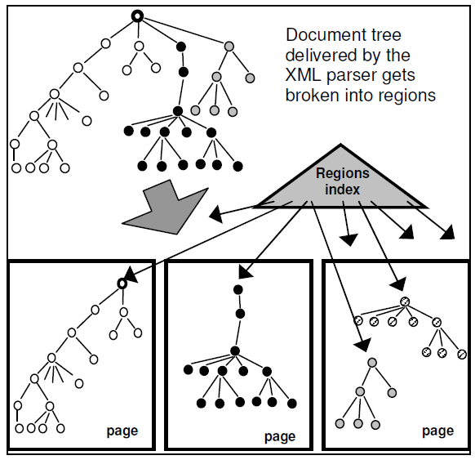
XML Storage (DB2 pureXML)
String IDs for Namespace, Tag names
Path IDs for paths
XML tree partitioned into regions & packed into pages.
Regions index track the pages associated with the XML structure

Slide 15
XML Indexing
Users create specific value indexes associated with specific XPaths.
CREATE INDEX idx1 ON dept(deptdoc) GENERATE KEY USING XMLPATTERN ‘/dept/employee/name’ AS SQL VARCHAR(35)
Index matching requires both the path and the type to match.
Queries involving /dept/employee/name and explicitly uses varchar or string for the type associated with the element can exploit the valued index

Slide 16
B+ Trees for XML Indexing
Non-leaf
Pages
Leaf
Pages
(Sorted by search key)
For XML value indexes we want to map the value associated with an XML pattern to nodes in the XML data tree
Key part of index entry is the “value”
Instead of a rid, an index entry stores the (region ID, node ID)

