Slide 1
ICS 321 Data Storage & Retrieval Other Data Models : Unstructured, Graph, Key-Value Pairs
Asst. Prof. Lipyeow Lim
Information & Computer Science Department
University of Hawaii at Manoa

Slide 2
Outline
Unstructured Data and Inverted Indexes
Web Search Engines
RDF & Linking Open Data
Big Table, CouchDB, & Cassandra

Slide 3
Unstructured Data
What are some examples of unstructured data?
How do we model unstructured data ?
How do we query unstructured data ?
How do we process queries on unstructured data ?
How do we index unstructured data ?

Slide 4
Unstructured Text Data
Field of “Information Retrieval”
Data Model
Collection of documents
Each document is a bag of words (aka terms)
Query Model
Keyword + Boolean Combinations
Eg. DBMS and SQL and tutorial
Details:
Not all words are equal. “Stop words” (eg. “the”, “a”, “his” ...) are ignored.
Stemming : convert words to their basic form. Eg. “Surfing”, “surfed” becomes “surf”

Slide 5
Inverted Indexes
Recall: an index is a mapping of search key to data entries
What is the search key ?
What is the data entry ?
Inverted Index:
For each term store a list of postings
A posting consists of <docid,position> pairs
What is the data in an inverted index sorted on ?
lexicon
Posting lists
DBMS
doc01
10
18
20
doc02
5
38
doc03
13
SQL
doc06
1
12
doc09
4
9
doc20
12
trigger
doc01
12
15
doc09
14
21
25
doc10
11
55
...
...

Slide 6
Lookups using Inverted Indexes
lexicon
Posting lists
DBMS
doc01
10
18
20
doc02
5
38
doc01
13
SQL
doc06
1
12
doc09
4
9
doc20
12
trigger
doc01
12
15
doc09
14
21
25
doc10
11
55
...
...
Given a single keyword query “k” (eg. SQL)
Find k in the lexicon
Retrieve the posting list for k
Scan posting list for document IDs [and positions]
What if the query is “k1 and k2” ?
Retrieve document IDs for k1 and k2
Perform intersection

Slide 7
Too Many Matching Documents
Rank the results by “relevance”!
Vector-Space Model
Documents are vectors in hi-dimensional space
Each dimension in the vector represents a term
Queries are represented as vectors similarly
Vector distance (dot product) between query vector and document vector gives ranking criteria
Weights can be used to tweak relevance
PageRank (later)
Star
Doc about movie stars
Doc about astronomy
Doc about behavior
Diet

Slide 8
Internet Search Engines
World Wide Web
Keyword Query
Search Engine Web Server
Ranked Results
Snipplets
Web Crawler
Query
Postings
etc
Doc IDs
Web Page Repository
Inverted
Index
Indexer

Slide 9
Ranking Web Pages
Google’s PageRank
Links in web pages provide clues to how important a webpage is.
Take a random walk
Start at some webpage p
Randomly pick one of the links and go to that webpage
Repeat for all eternity
The number of times the walker visits a page is an indication of how important the page is.
1
2
3
4
5
6
Vertices represent web pages.
Edges represent web links.

Slide 10

Resource Description Framework (RDF)
ID | Author | Title | Publisher | Year
Isbn0-00-651409-X | Id_xyz | The glass palace | Id_qpr | 2000
ID | Name | Homepage
Id_xyz | Ghosh, Amitav | http://www.amitavghosh.com
ID | Publisher Name | City
Id_qpr | Ghosh, Amitav | London

Slide 11
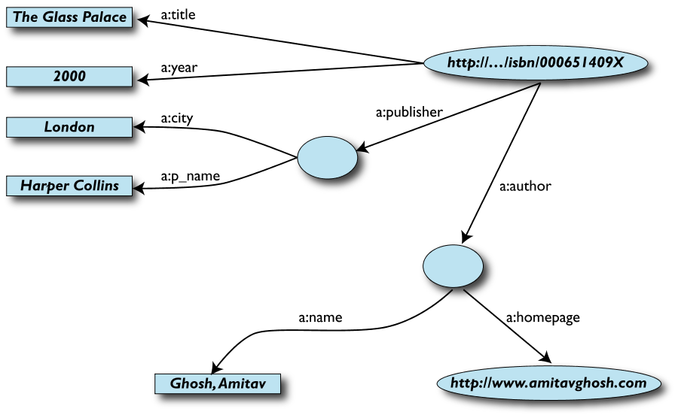
RDF Graph Data Model
Edges represent relationships or properties
Nodes can also represent an entity
Nodes can be literals

Slide 12
More formally
An RDF graph consists of a set of RDF triples
An RDF triple (s,p,o)
“s”, “p” are URI-s, ie, resources on the Web;
“o” is a URI or a literal
“s”, “p”, and “o” stand for “subject”, “property” (aka “predicate”), and “object”
here is the complete triple: (<http://...isbn...6682>, <http://..//original>, <http://...isbn...409X>)
RDF is a general model for such triples
RDF can be serialized to machine readable formats:
RDF/XML, Turtle, N3 etc

Slide 13
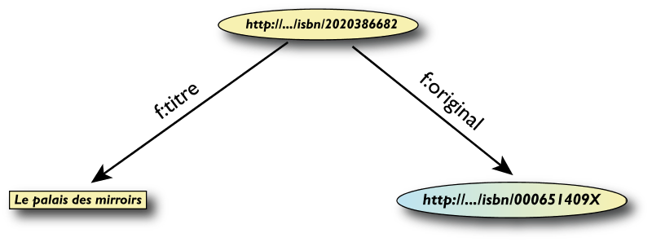
RDF/XML
<rdf:Description rdf:about="http://…/isbn/2020386682">
<f:titre xml:lang="fr">Le palais des mirroirs</f:titre>
<f:original rdf:resource="http://…/isbn/000651409X"/>
</rdf:Description>

Slide 14
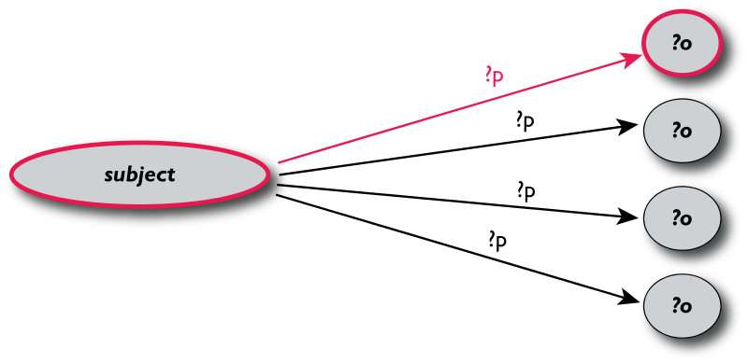
Querying RDF using SPARQL
The fundamental idea: use graph patterns
the pattern contains unbound symbols
by binding the symbols, subgraphs of the RDF graph are selected
if there is such a selection, the query returns bound resources
SELECT ?p ?o
WHERE {subject ?p ?o}
Where-clause defines graph patterns. ?p and ?o denote “unbound” symbols

Slide 15
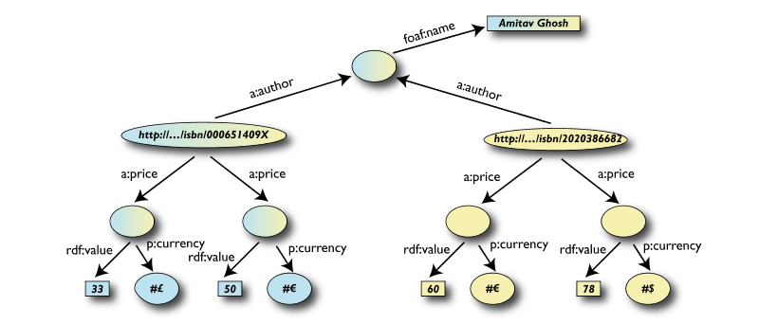
Example: SPARQL
SELECT ?isbn ?price ?currency # note: not ?x!
WHERE {?isbn a:price ?x.
?x rdf:value ?price.
?x p:currency ?currency.}

Slide 16
Linking Open Data
Goal: “expose” open datasets in RDF
Set RDF links among the data items from different datasets
Set up, if possible, query endpoints
Example: DBpedia is a community effort to
extract structured (“infobox”) information from Wikipedia
provide a query endpoint to the dataset
interlink the DBpedia dataset with other datasets on the Web

Slide 17
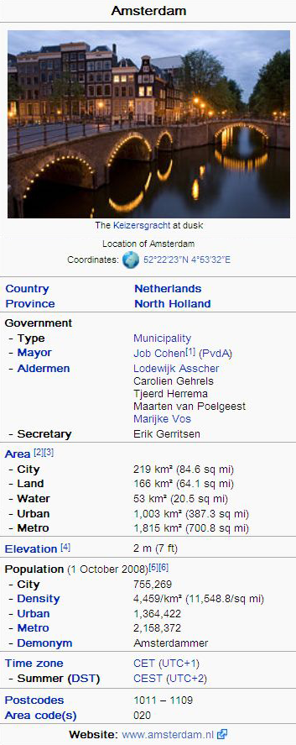
DBPedia
@prefix dbpedia <http://dbpedia.org/resource/>.
@prefix dbterm <http://dbpedia.org/property/>.
dbpedia:Amsterdam dbterm:officialName "Amsterdam" ; dbterm:longd "4” ;
dbterm:longm "53" ;
dbterm:longs "32” ; dbterm:leaderName dbpedia:Job_Cohen ;
...
dbterm:areaTotalKm "219" ;
...
dbpedia:ABN_AMRO
dbterm:location dbpedia:Amsterdam ;
...

Slide 18
Linking the Data
<http://dbpedia.org/resource/Amsterdam> owl:sameAs <http://rdf.freebase.com/ns/...> ;
owl:sameAs <http://sws.geonames.org/2759793> ;
...
<http://sws.geonames.org/2759793>
owl:sameAs <http://dbpedia.org/resource/Amsterdam>
wgs84_pos:lat "52.3666667" ;
wgs84_pos:long "4.8833333";
geo:inCountry <http://www.geonames.org/countries/#NL> ;
...

Slide 19
Google’s Bigtable
“Bigtable is a sparse, distributed, persistent multidimensional sorted map”
It is a type key-value store:
Key: (row key, column key, timestamp)
Value: uninterpreted array of bytes
Read & write for data associated with a row key is atomic
Data ordered by row key and range partition into “tablets”
Column keys are organized into column families:
A column key then is specified using <family:qualifier>
Timestamp is a 64 bit integer timestamp in microseconds

Slide 20
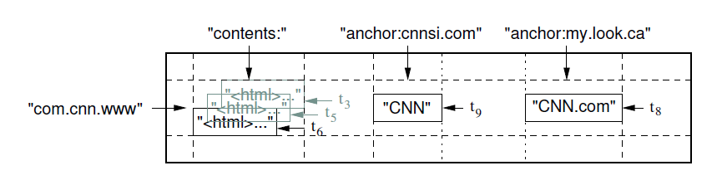
Example: Webpages using Bigtable
Row key = reversed string of a webpage’s URL
Column keys:
contents:
anchor:cnnsi.com
anchor:my.look.ca
Timestamps: t3, t5, t6, t8, t9

Slide 21
CouchDB
A distributed document database server
Accessible via a RESTful JSON API.
Ad-hoc and schema-free
robust, incremental replication
Query-able and index-able
ACID
A couchDB document is a set of key-value pairs
Each document has a unique ID
Keys: strings
Values: strings, numbers, dates, or even ordered lists and associative maps

Slide 22
Example: couchDB Document
"Subject": "I like Plankton"
"Author": "Rusty"
"PostedDate": "5/23/2006"
"Tags": ["plankton", "baseball", "decisions"]
"Body": "I decided today that I don't like baseball. I like plankton."
CouchDB enables views to be defined on the documents.
Views retain the same document schema
Views can be materialized or computed on the fly
Views need to be programmed in javascript

Slide 23
Cassandra
Another distributed, fault tolerant, persistent key-value store
Hierarchical key-value pairs (like hash/maps in perl/python)
Basic unit of data stored in a “column”: (Name, Value, Timestamp)
A column family is a map of columns: a set of name:column pairs. “Super” column families allow nesting of column families
A row key is associated with a set of column families and is the unit of atomicity (like bigtable).
No explicit indexing support – need to think about sort order carefully!

Slide 24
Example: Cassandra
mccv
Users
emailAddress
"name":"emailAddress",
"value":"foo@bar.com"
webSite
"name":"webSite", "value":"http://bar.com"
Stats
visits
"name":"visits", "value":"243"
user2
Users
emailAddress
"name":"emailAddress", "value":"user2@bar.com"
twitter
"name":"twitter", "value":"user2"

Slide 25
MongoDB
Document-oriented JSON store
Queries: field, range queries, regex, aggregation, geospatial, text
Indexing: fields can be indexed
Replication for High Availability with automatic failover
Sharding for load balance

Slide 26
ACID vs BASE
ACID: Transaction is complete => data is consistent across replicas.
Basic Availability – works most of the time
Soft State – replicas don’t have to be consistent all the time
Eventual consistency – replicas become consistent at some later time during reads

