Slide 1
ICS 421 Spring 2010 Non-Relational DBMS
Asst. Prof. Lipyeow Lim
Information & Computer Science Department
University of Hawaii at Manoa

Slide 2
XML Data Model
XML Document
Tags or element names
<dblp>
<inproceedings key="conf/cikm/HassanzadehKLMW09" >
<author>Oktie Hassanzadeh</author>
<author>Anastasios Kementsietsidis</author>
<author>Lipyeow Lim</author>
<author>Renée J. Miller</author>
<author>Min Wang</author>
<title>
A framework for semantic link discovery over relational data.</title>
<pages>1027-1036</pages>
<year>2009</year>
<booktitle>CIKM</booktitle>
</inproceedings>
</dblp>
dblp
Parent-child relationship
attributes
inproceedings
@key
booktitle
conf…
author
year
CIKM
Oktie…
author
pages
2009
Anast…
author
title
Lipyeow…
author
1027-..
author
Renee…
A framework…
Min…
Text values

Slide 3
Processing XML
Parsing
Event-based
Simple API for XML (SAX) : programmers write callback functions for parsing events eg. when an opening “<author>” is encountered.
The XML tree is never materialized
Document Object Model (DOM)
The XML tree is materialized in memory
XML Query Languages
XPath : path navigation language
XQuery
XSLT : transformation language (often used in CSS)

Slide 4
XPath
Looks like paths used in Filesystem directories.
Common Axes: child, descendent, parent, ancestor, self
Examples:
/dblp/inproceedings/author
//author
//inproceedings[year=2009 and booktitle=CIKM]/title
dblp
inproceedings
@key
booktitle
conf…
author
year
CIKM
Oktie…
author
pages
2009
Anast…
author
title
Lipyeow…
author
1027-..
author
Renee…
A framework…
Min…

Slide 5
XQuery
For-Let-Where-Return expressions
Examples:
FOR $auth in doc(dblp.xml)//author
LET $title=$auth/../title
WHERE $author/../year=2009
RETURN
<author>
<name>$auth/text()</name>
<title>$title/text()</title>
<author>
FOR $auth in doc(dblp.xml)//author[../year=2009]
RETURN
<author>
<name>$auth/text()</name>
<title>$auth/../title/text()</title>
<author>
dblp
inproceedings
@key
booktitle
conf…
author
year
CIKM
Oktie…
author
pages
2009
Anast…
author
title
Lipyeow…
author
1027-..
author
Renee…
A framework…
Min…

Slide 6
XML & RDBMS
How do we store XML in DBMS ?
Inherent mismatch between relational model and XML data model
Approach #1: BLOBs
Parse on demand
Approach #2: shredding
Decompose XML data to multiple tables
Translate XML queries to SQL on those tables
Approach #3: Native XML store
Hybrid storage & query engine
Columns of type XML

Slide 7
DB2’s Hybrid Relational-XML Engine
CREATE TABLE Product( id INTEGER, Specs XML );
INSERT INTO Product VALUES(1,
XMLParse( DOCUMENT
’<?xml version=’1.0’>
<ProductInfo>
<Model>
<Brand>Panasonic</Brand>
<ModelID>
TH-58PH10UK
</ModelID>
</Model>
<Display>
<ScreenSize>58in
</ScreenSize>
<AspectRatio>16:9
</AspectRatio>
<Resolution>1366 x 768
</Resolution>
…
</ProductInfo>’)
);
DB2/XML
id
type
price
detail
A
1
Burgundy
30
B
B
C
2
Riesling
20
A
D
D
3
Zinfandel
15
B
B
C
Hybrid Relational-XML data
D
D
SELECT id FROM Product AS P WHERE XMLExists(‘$t/ProductInfo/Model/Brand/Panasonic’ PASSING BY REF P.Specs AS "t")

Slide 8
SQL/XML
XMLParse – parses an XML document
XMLexists – checks if an XPath expression matches anything
XMLTable – converts XML into one table
XMLQuery – executes XML query
SELECT X.*
FROM emp, XMLTABLE ('$d/dept/employee' passing doc as "d"
COLUMNS
empID INTEGER PATH '@id',
firstname VARCHAR(20) PATH 'name/first',
lastname VARCHAR(25) PATH 'name/last') AS X
SELECT XMLQUERY(
‘$doc//item[productName=“iPod”]'
PASSING PO.Porder as “doc”)
AS "Result"
FROM PurchaseOrders PO;

Slide 9

Resource Description Framework (RDF)
ID | Author | Title | Publisher | Year
Isbn0-00-651409-X | Id_xyz | The glass palace | Id_qpr | 2000
ID | Name | Homepage
Id_xyz | Ghosh, Amitav | http://www.amitavghosh.com
ID | Publisher Name | City
Id_qpr | Ghosh, Amitav | London

Slide 10
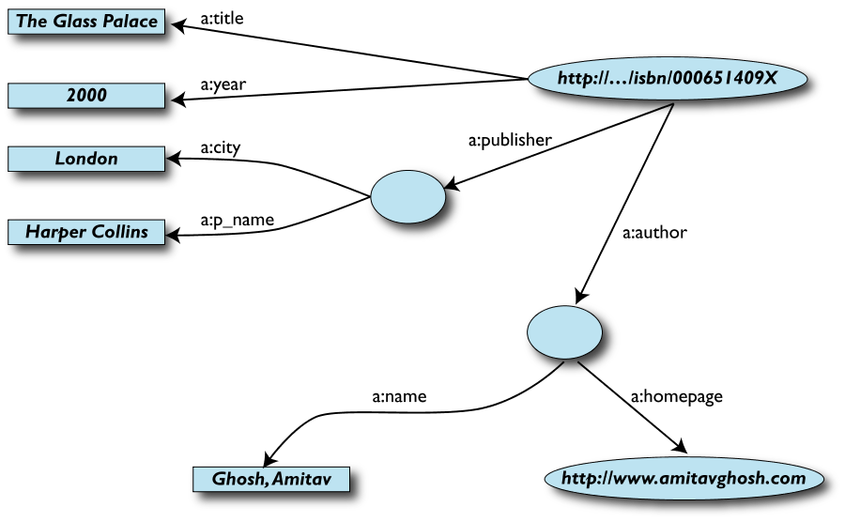
RDF Graph Data Model
Edges represent relationships or properties
Nodes can also represent an entity
Nodes can be literals

Slide 11
More formally
An RDF graph consists of a set of RDF triples
An RDF triple (s,p,o)
“s”, “p” are URI-s, ie, resources on the Web;
“o” is a URI or a literal
“s”, “p”, and “o” stand for “subject”, “property” (aka “predicate”), and “object”
here is the complete triple: (<http://...isbn...6682>, <http://..//original>, <http://...isbn...409X>)
RDF is a general model for such triples
RDF can be serialized to machine readable formats:
RDF/XML, Turtle, N3 etc

Slide 12
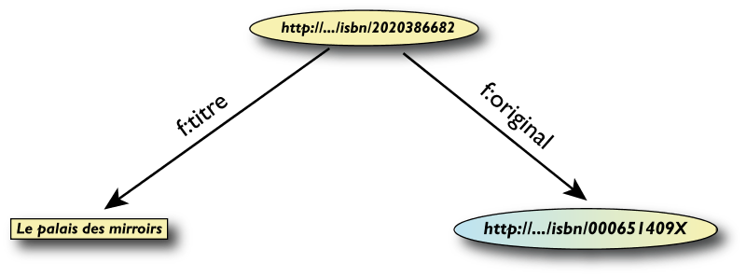
RDF/XML
<rdf:Description rdf:about="http://…/isbn/2020386682">
<f:titre xml:lang="fr">Le palais des mirroirs</f:titre>
<f:original rdf:resource="http://…/isbn/000651409X"/>
</rdf:Description>

Slide 13
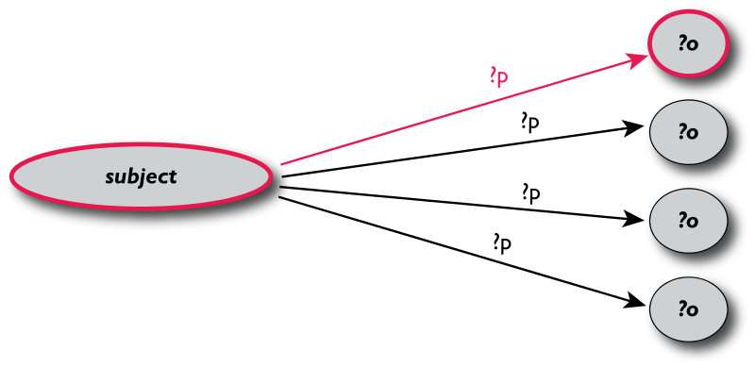
Querying RDF using SPARQL
The fundamental idea: use graph patterns
the pattern contains unbound symbols
by binding the symbols, subgraphs of the RDF graph are selected
if there is such a selection, the query returns bound resources
SELECT ?p ?o
WHERE {subject ?p ?o}
Where-clause defines graph patterns. ?p and ?o denote “unbound” symbols

Slide 14
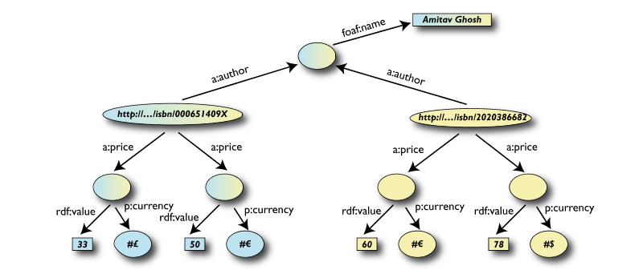
Example: SPARQL
SELECT ?isbn ?price ?currency # note: not ?x!
WHERE {?isbn a:price ?x.
?x rdf:value ?price.
?x p:currency ?currency.}

Slide 15
Linking Open Data
Goal: “expose” open datasets in RDF
Set RDF links among the data items from different datasets
Set up, if possible, query endpoints
Example: DBpedia is a community effort to
extract structured (“infobox”) information from Wikipedia
provide a query endpoint to the dataset
interlink the DBpedia dataset with other datasets on the Web

Slide 16
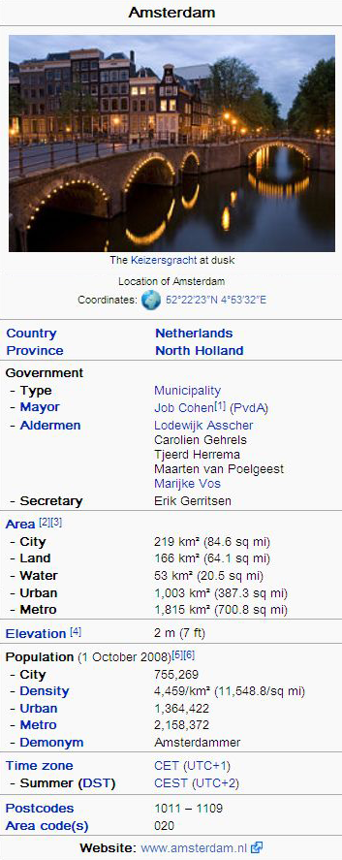
DBPedia
@prefix dbpedia <http://dbpedia.org/resource/>.
@prefix dbterm <http://dbpedia.org/property/>.
dbpedia:Amsterdam dbterm:officialName "Amsterdam" ; dbterm:longd "4” ;
dbterm:longm "53" ;
dbterm:longs "32” ; dbterm:leaderName dbpedia:Job_Cohen ;
...
dbterm:areaTotalKm "219" ;
...
dbpedia:ABN_AMRO
dbterm:location dbpedia:Amsterdam ;
...

Slide 17
Linking the Data
<http://dbpedia.org/resource/Amsterdam> owl:sameAs <http://rdf.freebase.com/ns/...> ;
owl:sameAs <http://sws.geonames.org/2759793> ;
...
<http://sws.geonames.org/2759793>
owl:sameAs <http://dbpedia.org/resource/Amsterdam>
wgs84_pos:lat "52.3666667" ;
wgs84_pos:long "4.8833333";
geo:inCountry <http://www.geonames.org/countries/#NL> ;
...

Slide 18
Google’s Bigtable
“Bigtable is a sparse, distributed, persistent multidimensional sorted map”
It is a type key-value store:
Key: (row key, column key, timestamp)
Value: uninterpreted array of bytes
Read & write for data associated with a row key is atomic
Data ordered by row key and range partition into “tablets”
Column keys are organized into column families:
A column key then is specified using <family:qualifier>
Timestamp is a 64 bit integer timestamp in microseconds

Slide 19
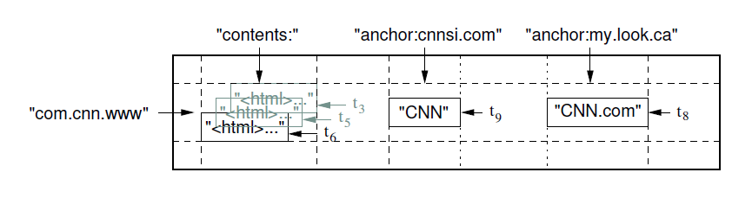
Example: Webpages using Bigtable
Row key = reversed string of a webpage’s URL
Column keys:
contents:
anchor:cnnsi.com
anchor:my.look.ca
Timestamps: t3, t5, t6, t8, t9

Slide 20
CouchDB
A distributed document database server
Accessible via a RESTful JSON API.
Ad-hoc and schema-free
robust, incremental replication
Query-able and index-able
A couchDB document is a set of key-value pairs
Each document has a unique ID
Keys: strings
Values: strings, numbers, dates, or even ordered lists and associative maps

Slide 21
Example: couchDB Document
"Subject": "I like Plankton"
"Author": "Rusty"
"PostedDate": "5/23/2006"
"Tags": ["plankton", "baseball", "decisions"]
"Body": "I decided today that I don't like baseball. I like plankton."
CouchDB enables views to be defined on the documents.
Views retain the same document schema
Views can be materialized or computed on the fly
Views need to be programmed in javascript

Slide 22
Cassandra
Another distributed, fault tolerant, persistent key-value store
Hierarchical key-value pairs (like hash/maps in perl/python)
Basic unit of data stored in a “column”: (Name, Value, Timestamp)
A column family is a map of columns: a set of name:column pairs. “Super” column families allow nesting of column families
A row key is associated with a set of column families and is the unit of atomicity (like bigtable).
No explicit indexing support – need to think about sort order carefully!

Slide 23
Example: Cassandra
mccv
Users
emailAddress
"name":"emailAddress",
"value":"foo@bar.com"
webSite
"name":"webSite", "value":"http://bar.com"
Stats
visits
"name":"visits", "value":"243"
user2
Users
emailAddress
"name":"emailAddress", "value":"user2@bar.com"
twitter
"name":"twitter", "value":"user2"

