Slide 1
ICS 621 Spring 2012 Dynamic Programming
Asst. Prof. Lipyeow Lim
Information and Computer Sciences Department
University of Hawaii at Mānoa

Slide 2
Call Graph for m(1,4)

Slide 3
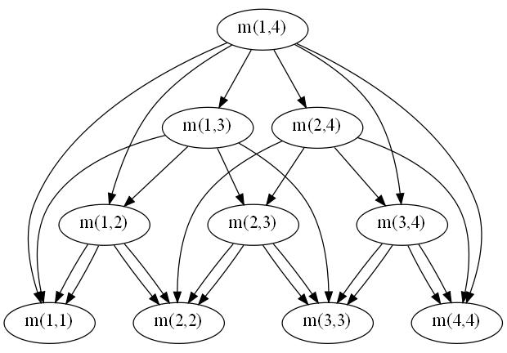
Dependency Graph for m(1,4)

Slide 4
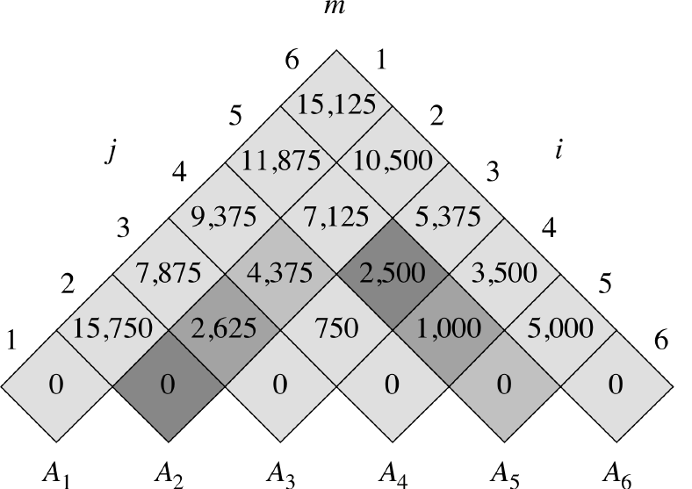
Bottom-Up Ordering

Slide 5
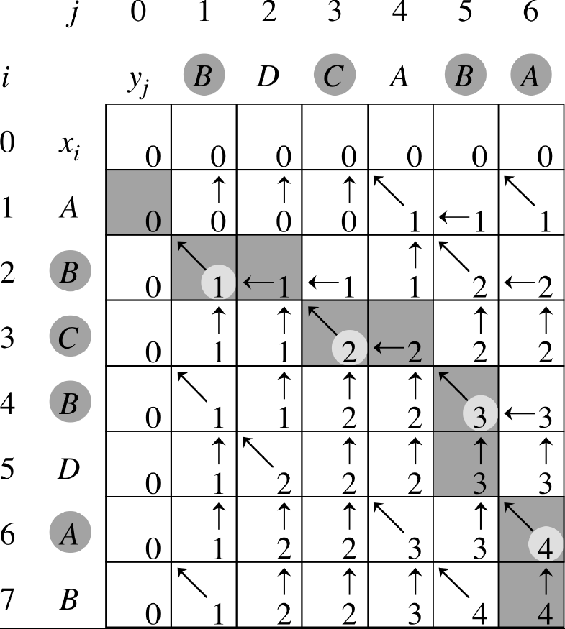
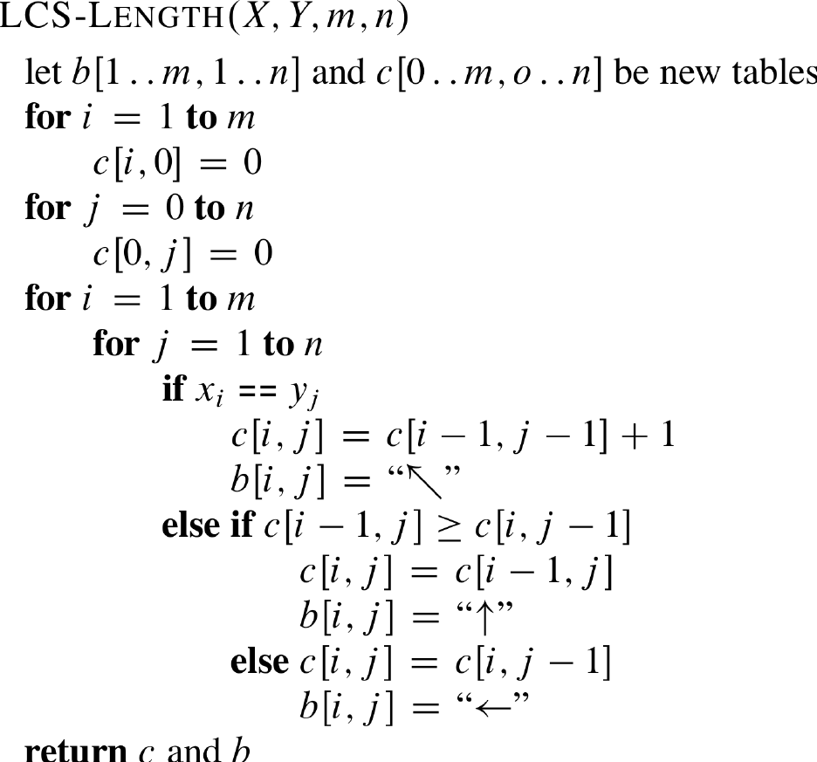
Longest Common Subsequence

