Slide 1
ICS 621 Spring 2012 Fibonacci Heaps
Asst. Prof. Lipyeow Lim
Information and Computer Sciences Department
University of Hawaii at Mānoa

Slide 2
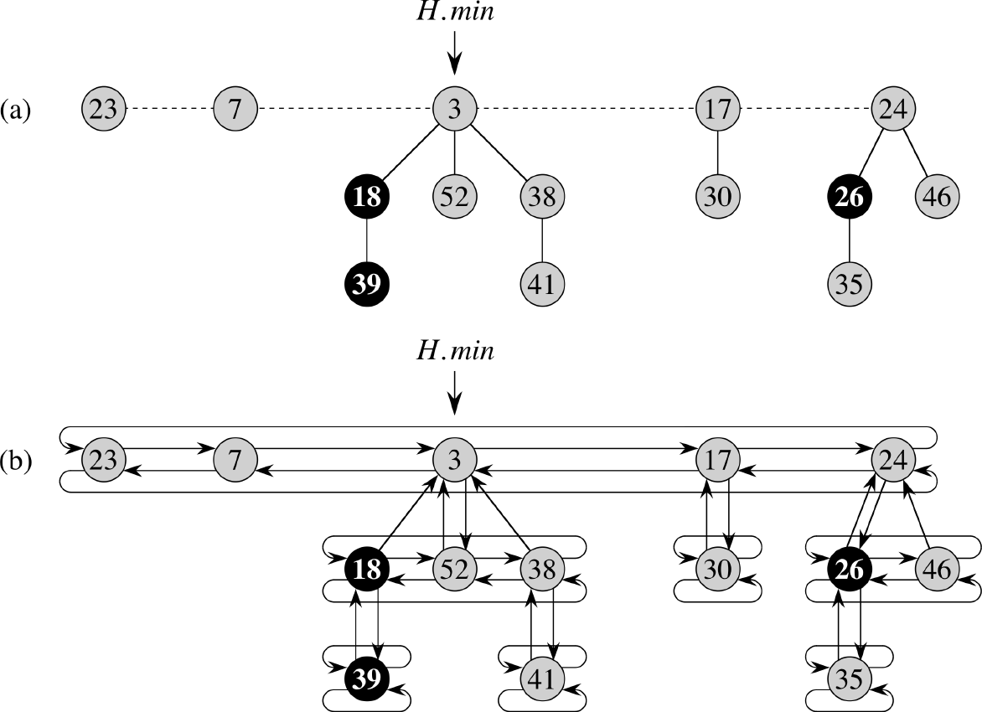
Implementation of Fibonacci Heaps

Slide 3
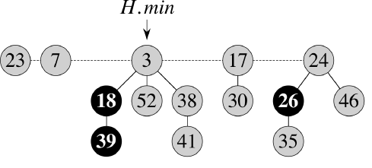
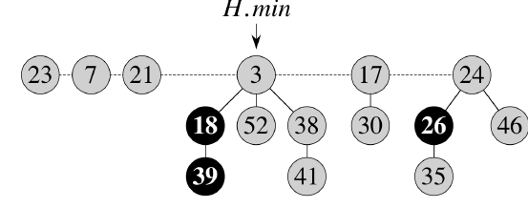
Insert(H, 21)

Slide 4
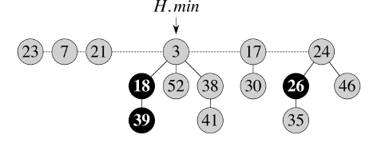
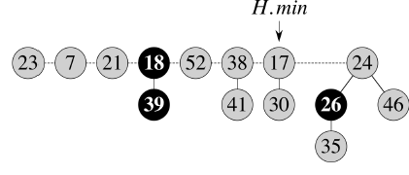
Extract-Min(H)

Slide 5
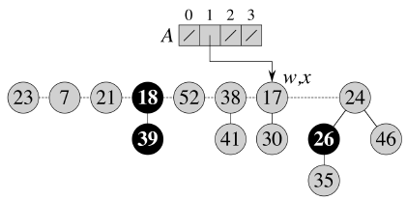
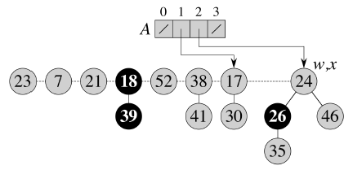
Consolidate Trees with Same Degree
End Scan at 38
Start Scan at 17

Slide 6
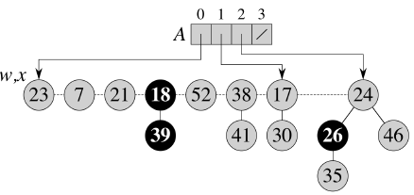
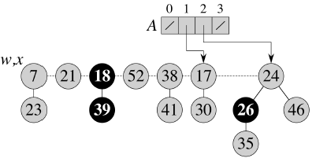
Consolidate Trees (2)

Slide 7
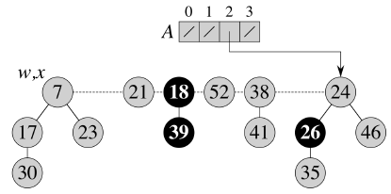
Consolidate Trees (3)

Slide 8
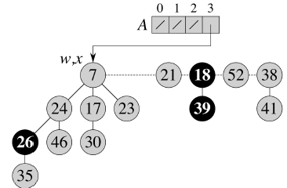
Consolidate Trees (4)

Slide 9
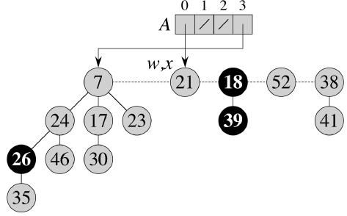
Consolidate Trees (5)

Slide 10
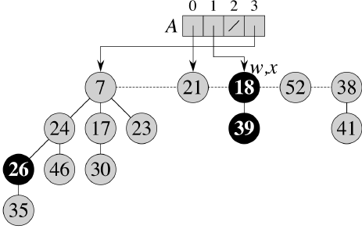
Consolidate Trees (6)

Slide 11
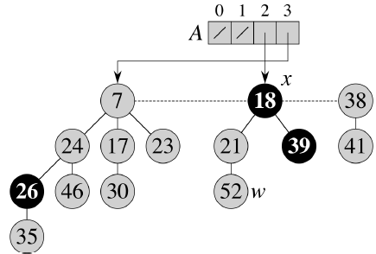
Consolidate Trees (7)

Slide 12
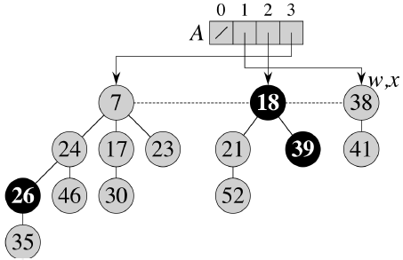
Consolidate Trees (8)
End Scan at 38

Slide 13
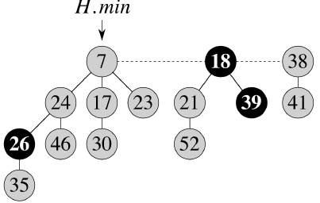
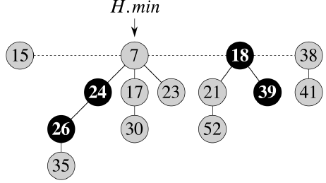
Decrease-Key : 46 to15
Decrease-Key 46 to 15
Parent not marked, so mark it

Slide 14
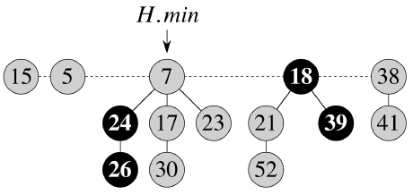
Decrease-Key : 35 to 5
Decrease-Key 35 to 5
Parent is marked, so cascading cut!

Slide 15
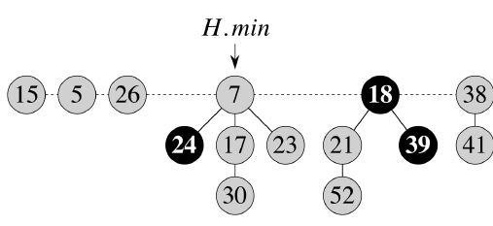
Cascading-Cut (1)
Parent is marked, so cascading cut!

Slide 16
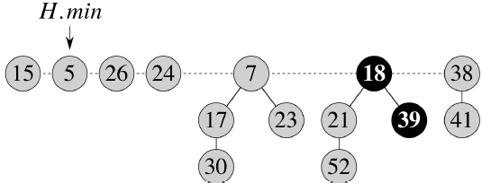
Cascading-Cut (2)

