Slide 1
Spring 2012 ICS621 Graph Algorithms
Lipyeow Lim

Slide 2
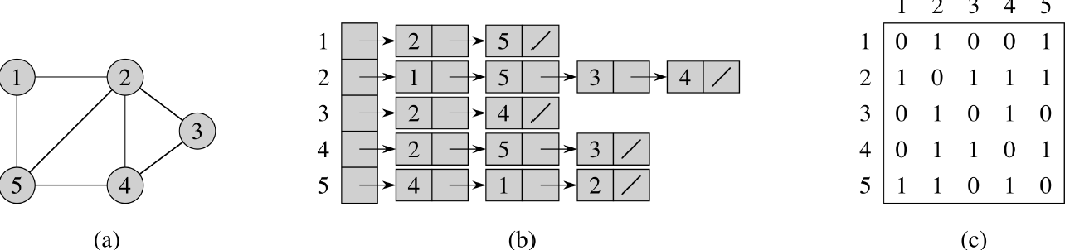
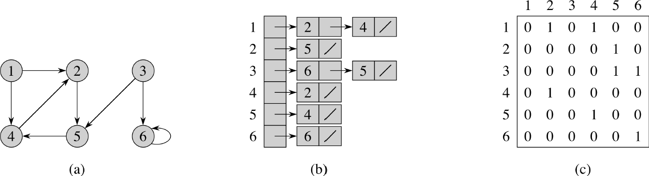
Data Structures for Graphs

Slide 3
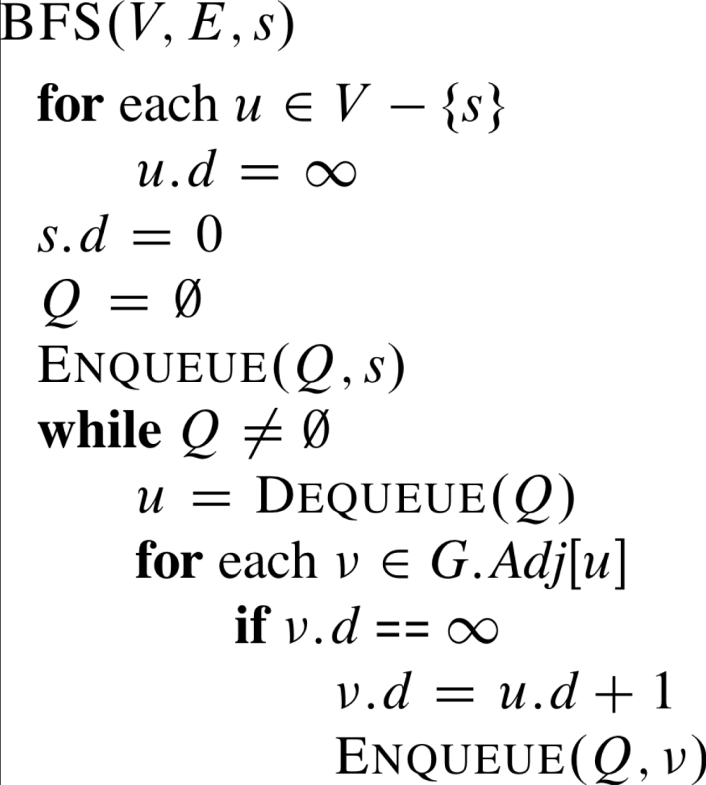
BFS for Graphs

Slide 4
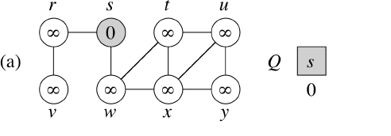
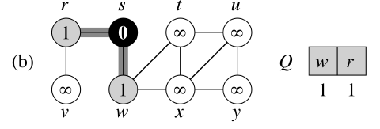
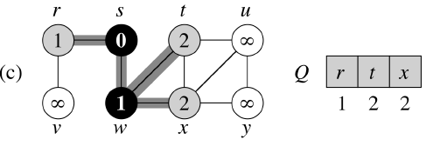
BFS Trace 1/3

Slide 5
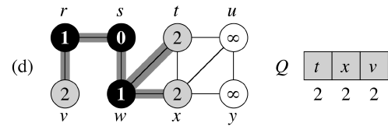
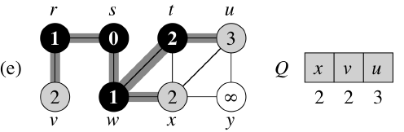
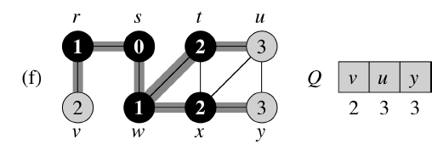
BFS Trace 2/3

Slide 6
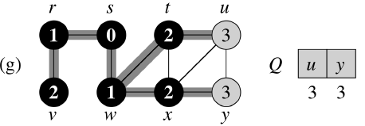
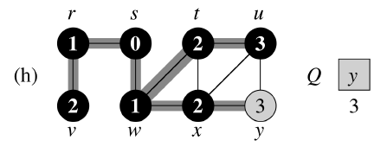
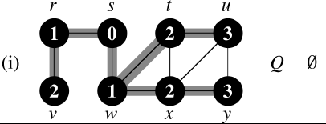
BFS Trace 3/3

Slide 7
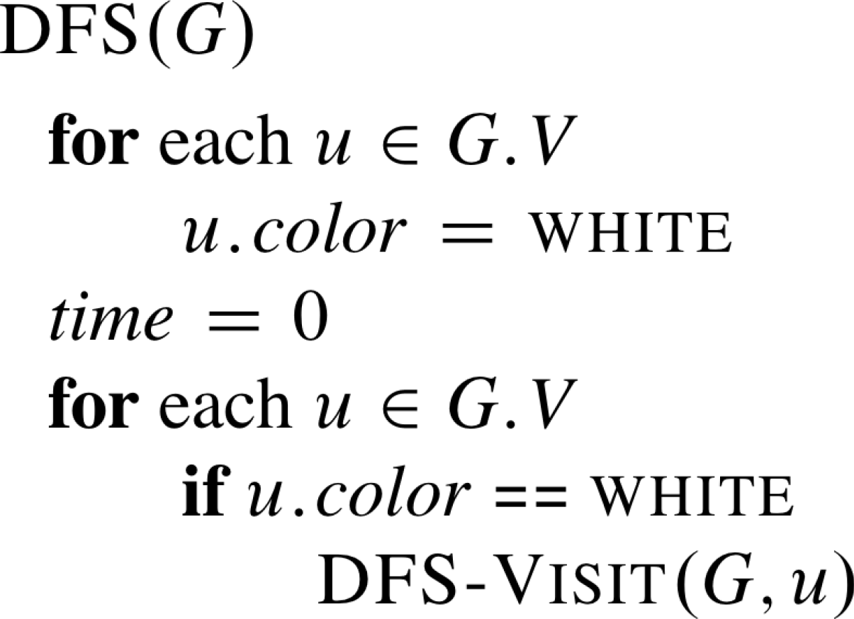
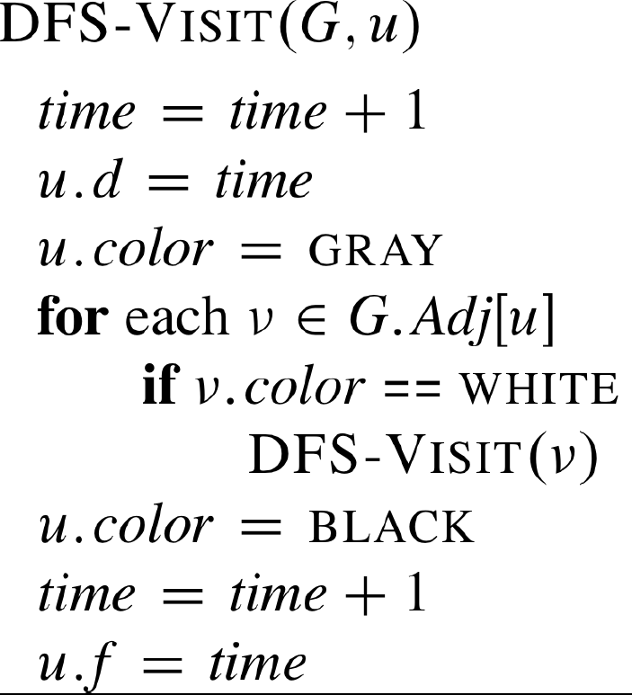
DFS for Graphs

Slide 8
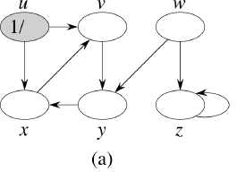
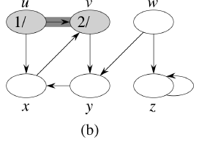
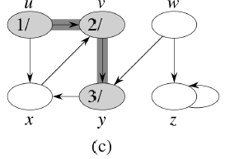
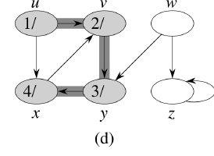
DFS Trace 1/4

Slide 9
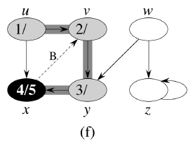
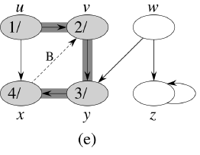
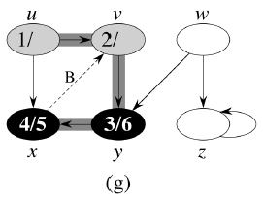
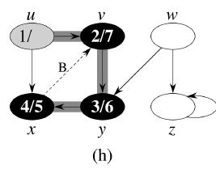
DFS Trace 2/4

Slide 10
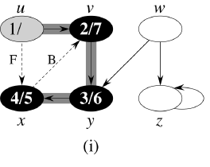
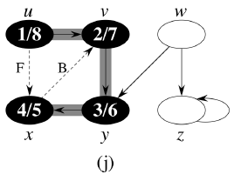
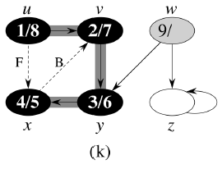
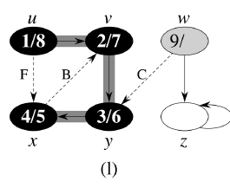
DFS Trace 3/4

Slide 11
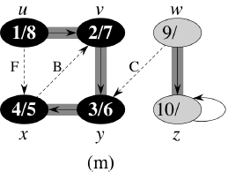
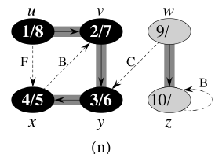
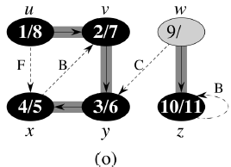
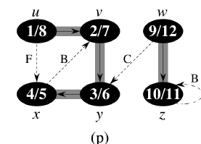
DFS Trace 4/4

Slide 12
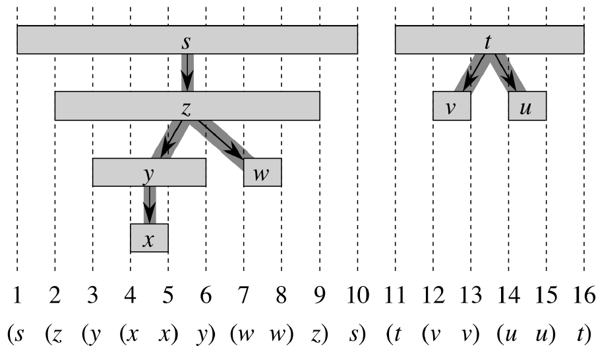
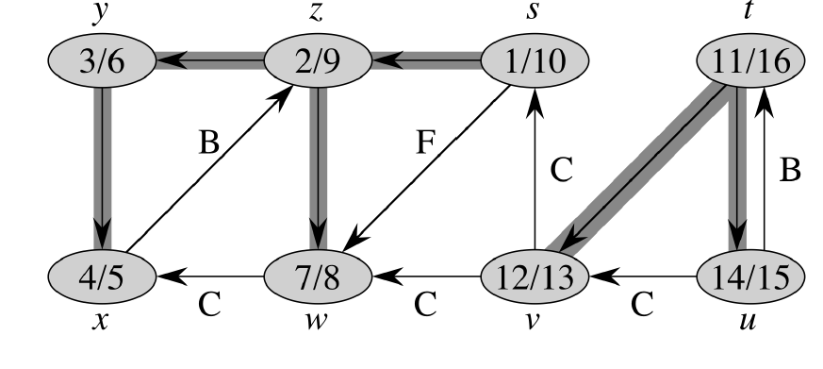
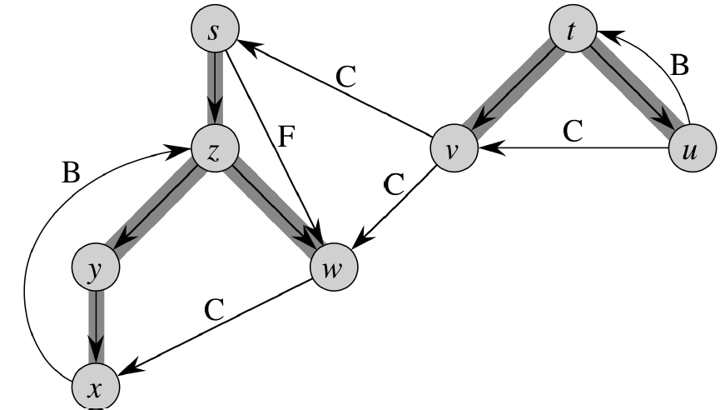
DFS Timestamps

Slide 13
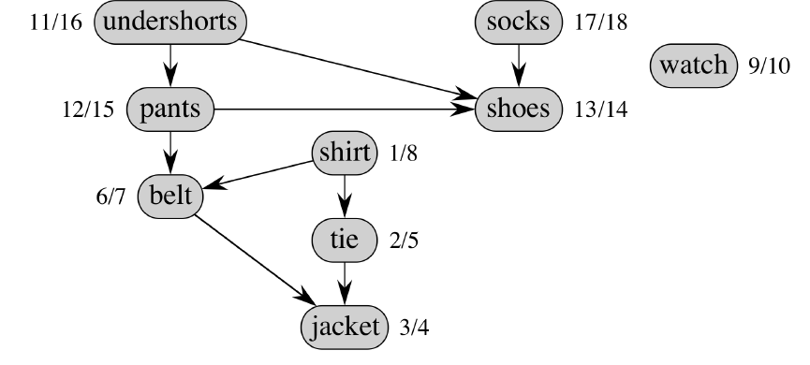
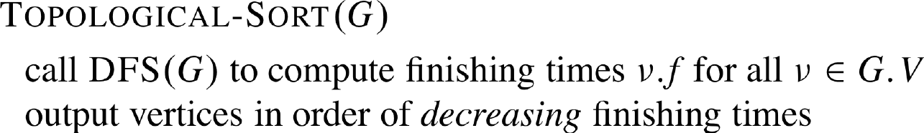
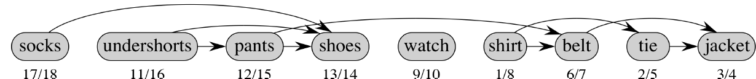
Topological Sort
Input: directed acyclic graph G=(V,E)
Output: a linear ordering of the vertices s.t. if (u,v) in E, then u precedes v

Slide 14
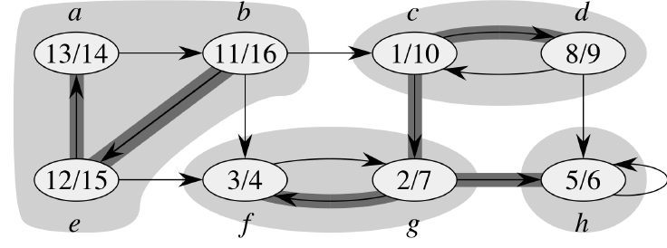
Strongly Connected Components
Input: Directed Graph G=(V,E)
Output: A collection of all strongly connected components (SCC) of G
A SCC of G is a maximal set of vertices C subset of V s.t. for all pair (u,v) in C, there is a path from u to v and from v to u.

Slide 15
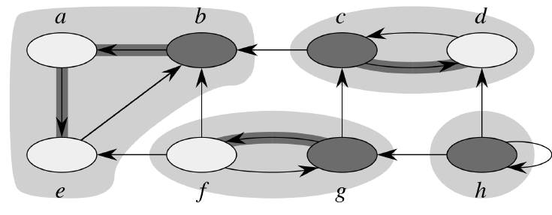
Finding Strongly Connected Components
14
Edges Reversed
14
16
10
9
15
4
7
6

Slide 16
Algorithm for finding SCC
DFS(G) to compute finishing times for each vertex
Compute G’ transpose of G (reverse edges)
DFS(G’) using decreasing order of finishing times
Output vertices of each tree in DFS forest formed in DFS(G’)

Slide 17
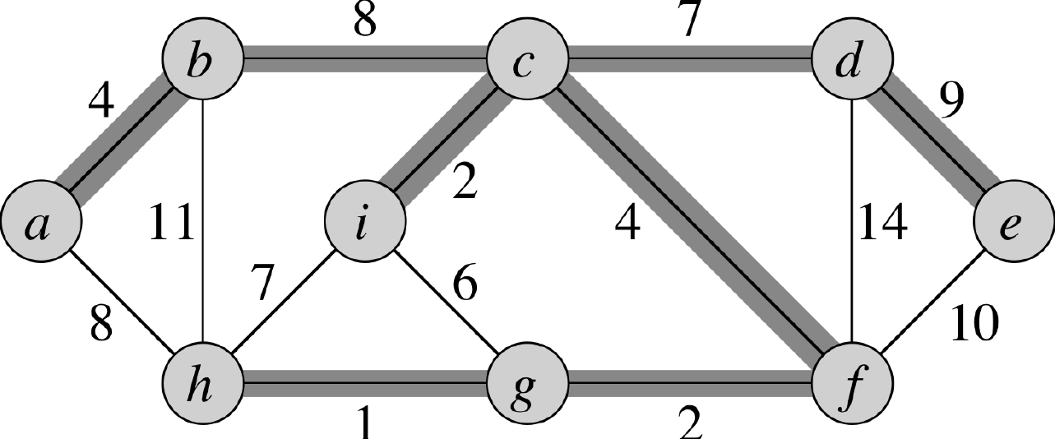
Minimum Spanning Trees
Input: undirected graph G=(V,E) with edge weights w(u,v)
Output: a tree T=(V’, E’) s.t.
T is a tree
V’ = V (hence spanning V)
Sum of w(u,v) for all (u,v) in E’ is minimal

Slide 18
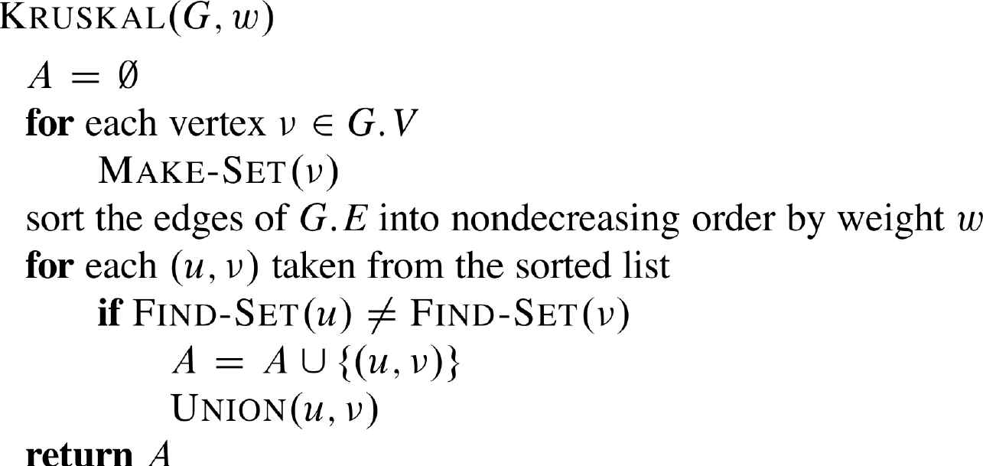
Kruskal’s Algo
Keep adding edges
with smallest weight
does not form cycles
Until V-1 edges are added.
Disjoint Set Ops = O(α(V)) (Ch21)
E = O(V*V)
O( E lg V)

Slide 19
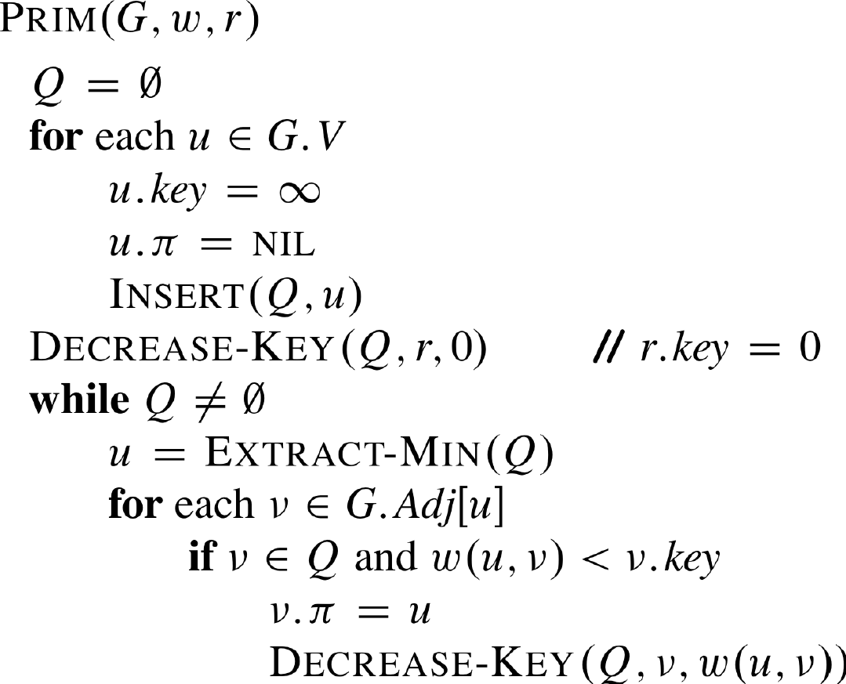
Prim’s Algo
Grow a tree by adding edges
with smallest weight
does not form cycles
Fib Heap
Dec Key = O(1)
Ext Min = O(lg V)
=> O( E + V lg V)

Slide 20
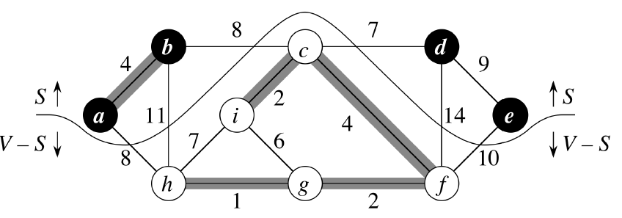
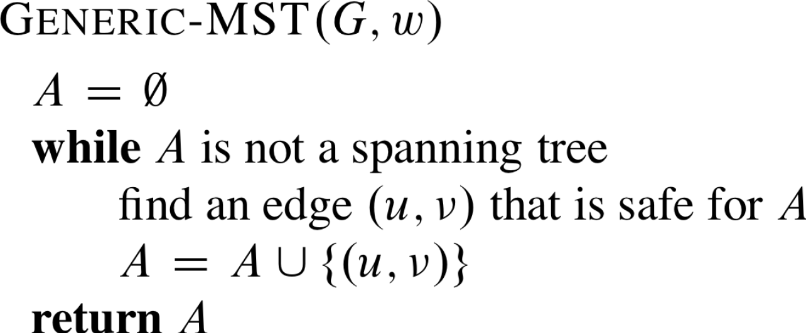
Generic Framework
Kruskal : A is a forest
Prim : A is a tree
Kruskal : safe edge connects 2 components
Prim : safe edge connects A to a new vertex

