Slide 1
Spring 2012 ICS621 Shortest Paths
Lipyeow Lim

Slide 2
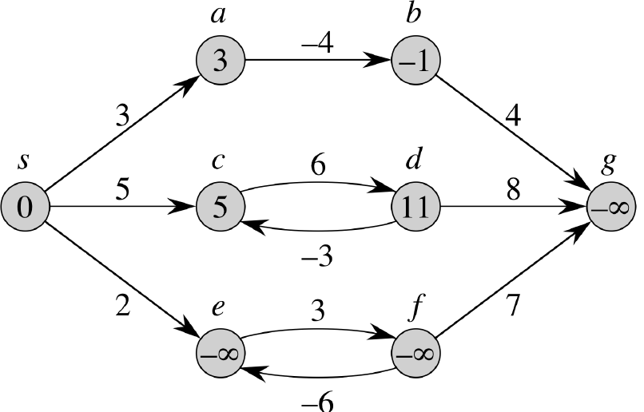
Negative Cycles

Slide 3
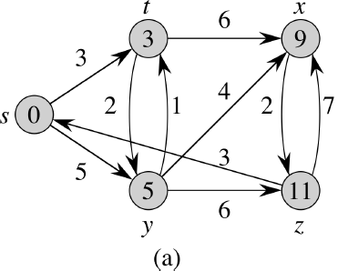
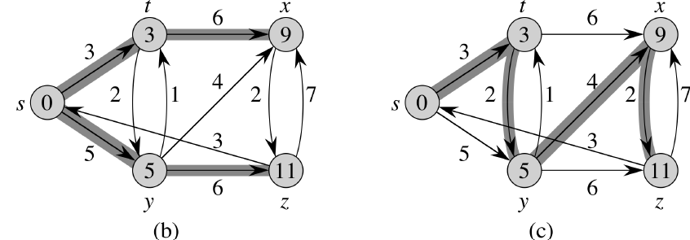
Examples of Shortest Paths

Slide 4
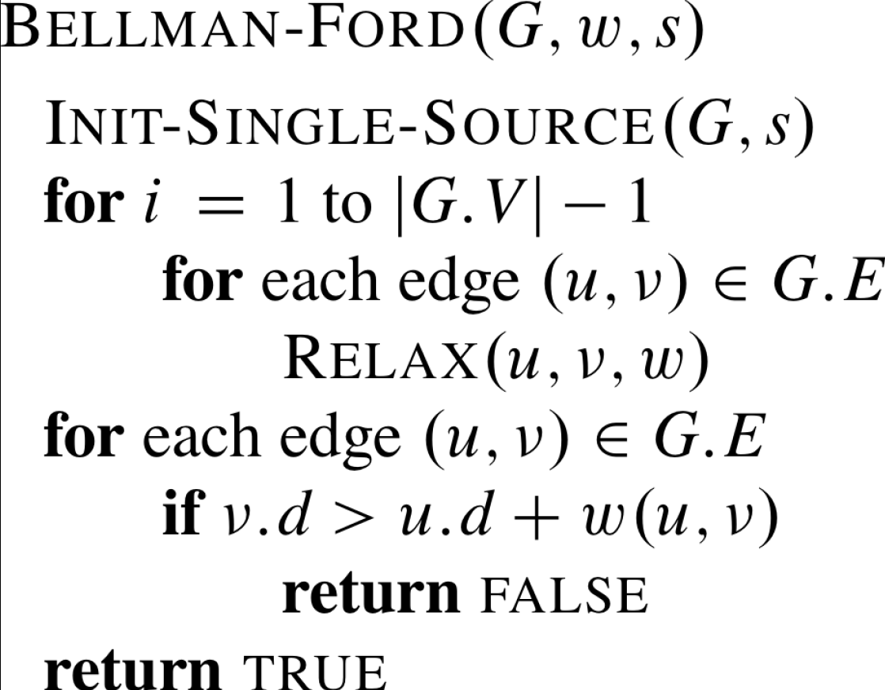
Bellman & Ford
|V|-1
|E|
|E|
O(VE) = O(V³)

Slide 5
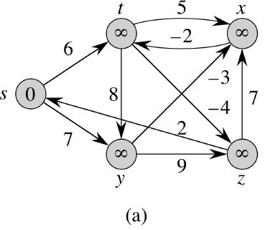
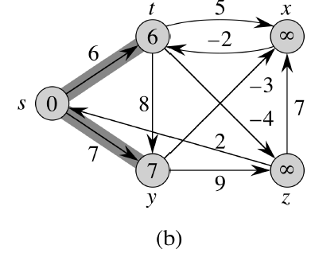
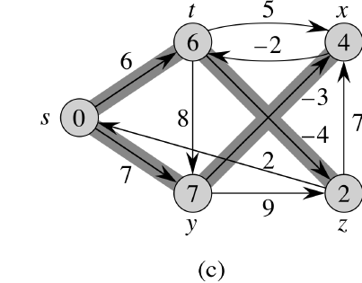
Bellman-Ford Trace 1/2

Slide 6
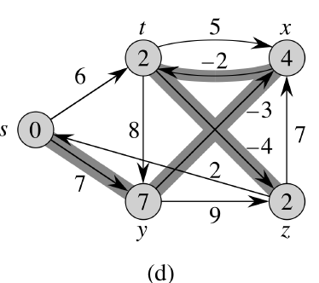
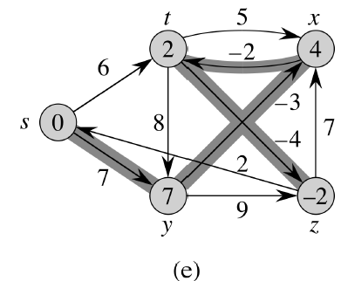
Bellman-Ford Trace 2/2

Slide 7
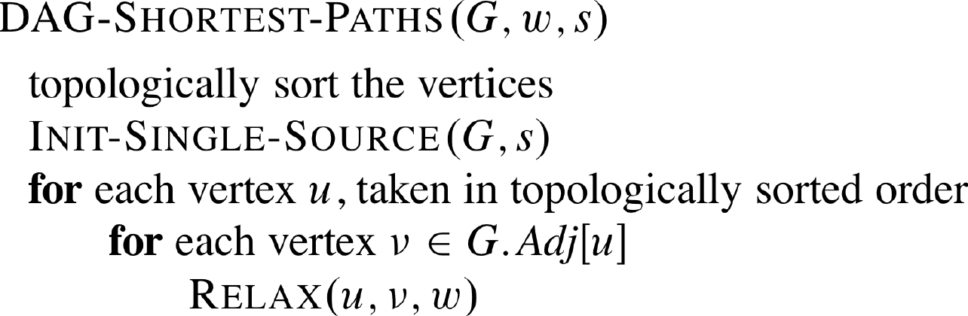
Shortest Paths for DAGs
O(V+E)
|E|

Slide 8
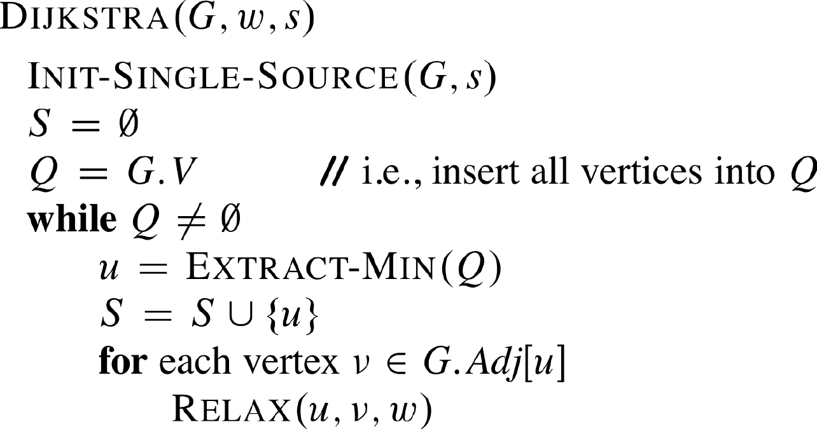
Dijkstra’s Algorithm
O(V lg V + E)
Using Fib Heaps
O(lg V)
|V|
|E|
O(1)
Calls Decrease-Key(Q,v.d,newd)

Slide 9
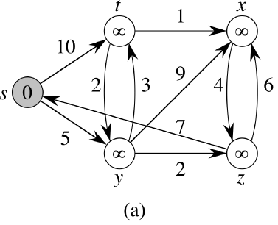
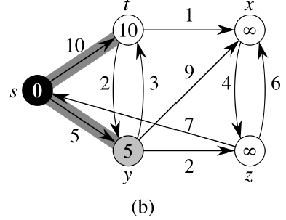
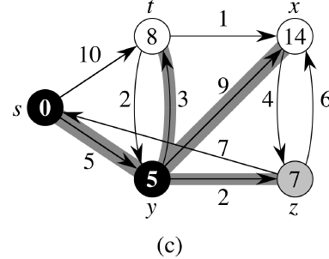
Dijkstra’s Trace 1/3

Slide 10
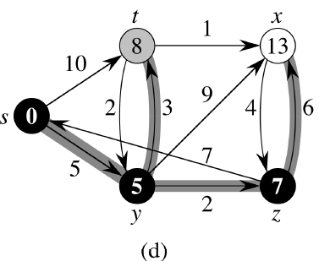
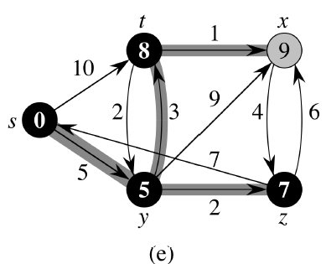
Dijkstra’s Trace 2/3

Slide 11
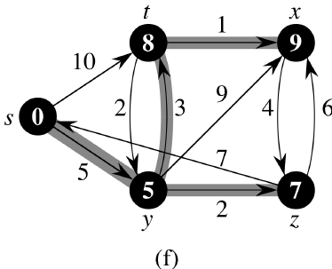
Dijkstra’s Trace 3/3

Slide 12
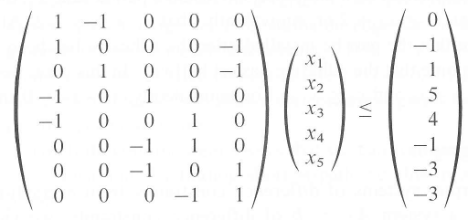
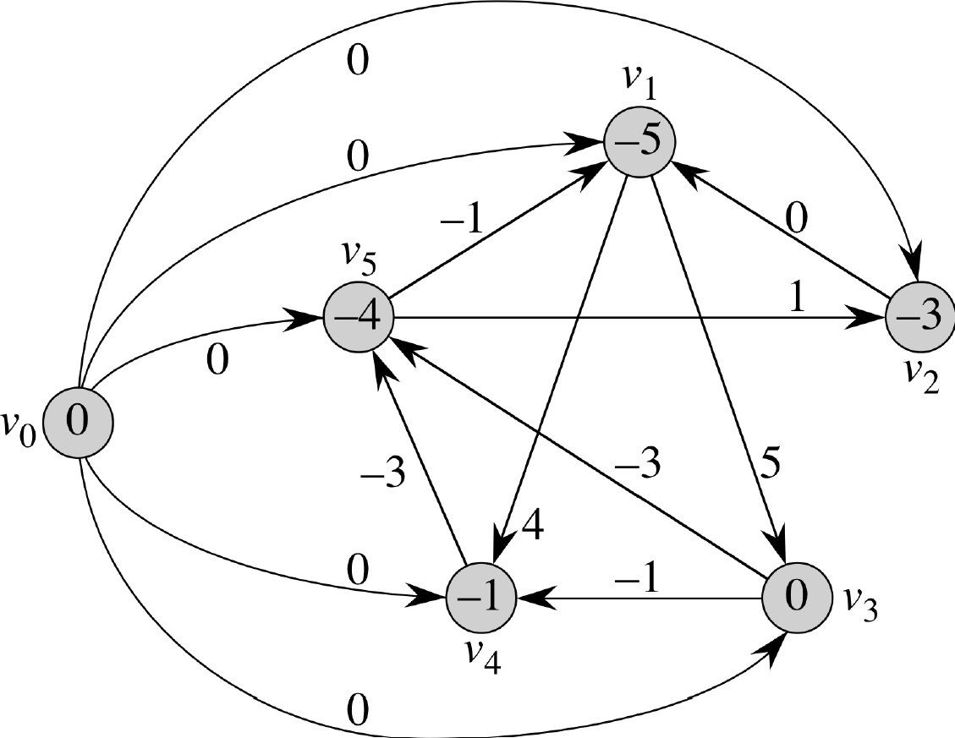
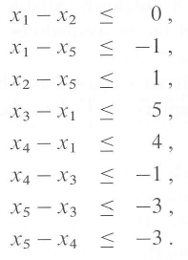
System of Difference Constraints
n
m

