Slide 1
Spring 2012 ICS621 All Pairs Shortest Paths
Lipyeow Lim

Slide 2
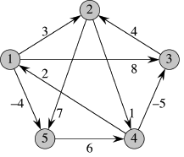
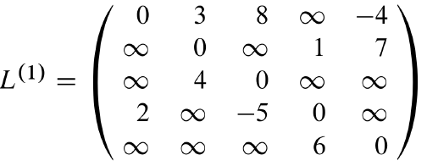
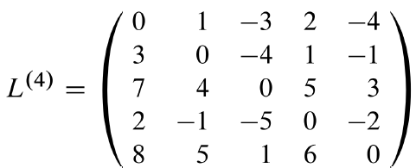
Example

Slide 3
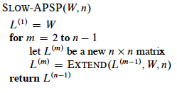
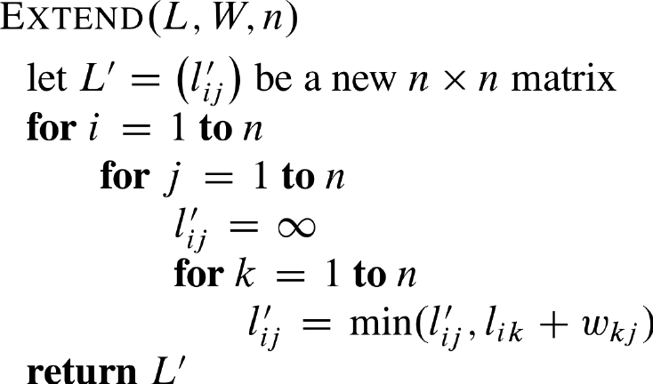

Dynamic Programming Solution 1

Slide 4



Dynamic Programming Solution 2
x

Slide 5
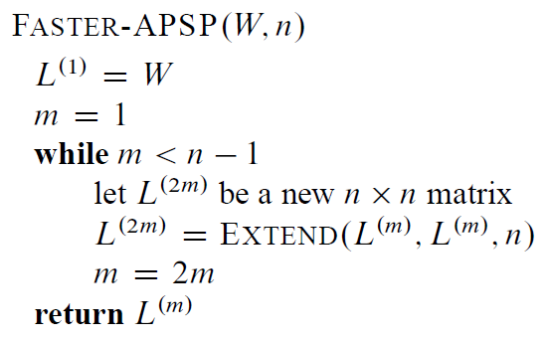

Faster Algo

Slide 6


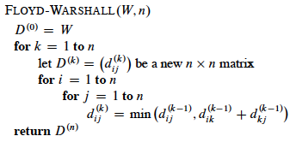

Floyd Warshall Algo

Slide 7
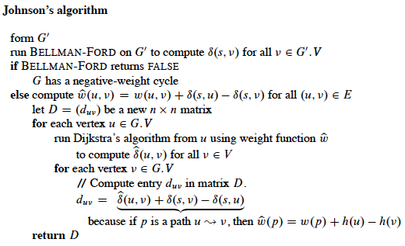
Johnson’s Algo

Slide 8
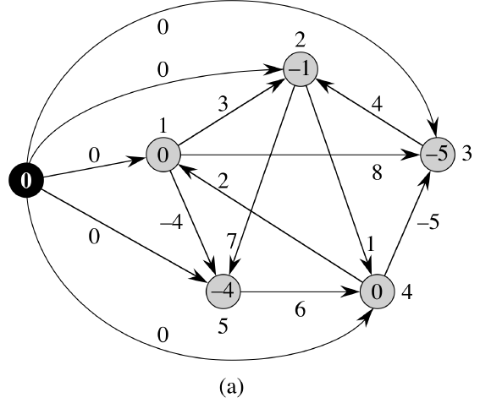
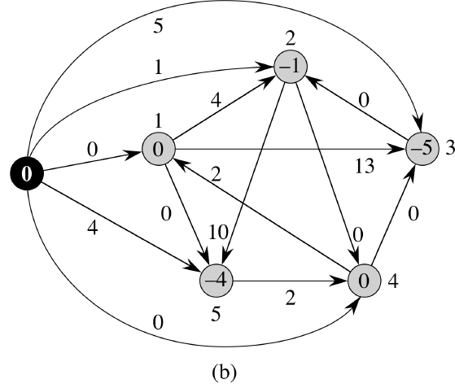
Construction of G

