Slide 1
BIRCH: Is It Good for Databases?
A review of BIRCH: An And Efficient Data Clustering Method for Very Large Databases by Tian Zhang, Raghu Ramakrishnan and Miron Livny
Daniel Chang
ICS624 Spring 2011 Lipyeow Lim
University of Hawaii at Manoa

Slide 2
Clustering in general
Clustering can be thought of as a kind of data mining problem.
The C in BIRCH is for clustering.
Authors claim that it is suitable for large databases.
BIRCH performs some clustering in a single pass for data sets larger than memory allows.
Reduces IO cost.
Noise in the form of outliers is handled.
What is noise in terms of data in a database?

Slide 3
Clustering some data
In a large set of multidimensional data, the space is not uniformly occupied.
Clustering clusters the data, thereby identifying groups that share some measurable similarity.
The problem is finding a minimal solution.
It’s further complicated by database-related constraints of memory and IO.
Notes:
DBs want everything to be in memory but can’t have it.
DBs never want to spend time in IO but are forced to because there isn’t enough memory.

Slide 4
Other approaches
Probability-based approach
Assumes statistical independence
Large overhead in computation and storage
Distanced-based approach
Assumes all data points are given in advance and can be continually scanned
Global examination of data
Local minima
High sensitivity to starting partition

Slide 5
CLARANS
Based on randomized search
Cluster is represented by its medoid
Most centrally located data point
Clustering is accomplished by searching a graph
Not IO efficient
May not find the real local minimum

Slide 6
What’s special about BIRCH?
Incrementally maintains clusters.
IO is reduced significantly
Treats data in terms of densities of data points instead of individual data points.
Outliers are rejected.
The clustering takes place in memory.
It can perform useful clustering in a single read of the data.
How effective is this for a database application?

Slide 7
BIRCH’s trees
The key to BIRCH is the CF tree.
A CF tree consists of Clustering Features arranged in a binary tree that is height balanced.
Clustering Features or CF vectors
Summarize subsets of data in terms of the number of data points, the linear sum of the data points and the squared sum of the data points.
It doesn’t include all the data points.
How is this useful for a database?
Notes:
Math given in section 4

Slide 8
CF tree
Self-balancing
Parameters: branching factor and threshold
Nodes have to fit in P.
Tree size is determined by T.
Nonleaf nodes contain B entries at most.
Leaves and non-leaves are determined by d.
Clustering happens through building the tree.
Notes:
A leaf node has no children.
A non-leaf node has children.
Each leaf node entry is a subcluster but can be
Clustering takes place in much the same way that sorting is accomplished with a B+-tree

Slide 9
Building the tree
Identify the leaf.
If the subcluster can be added to the leaf then add it
Otherwise, split the node
Recursively, determine the node to split
Merge if possible since splits are dependent on page size

Slide 10
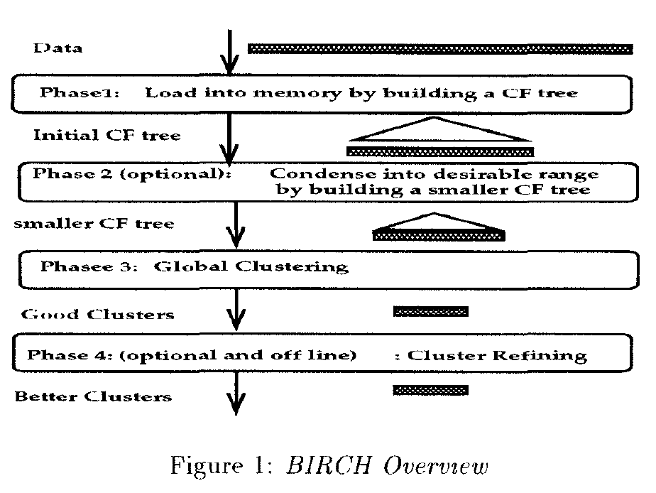
Overview of BIRCH

Slide 11
After the tree is built in Phase 1
No IO operations are needed
Clusters can be refined by clustering subclusters
Outliers are eliminated
Authors claim greater accuracy
How does this improve DB applications?
A tree is an ordered structure

Slide 12
Not everything is perfect
The input order gets skewed because of the page size restriction
Phase 3 clusters all the leaf nodes in a global way
Subclusters are treated as single points
Or CF vectors can be used
This reduces the problem space significantly
But what detail is lost as a result?

Slide 13
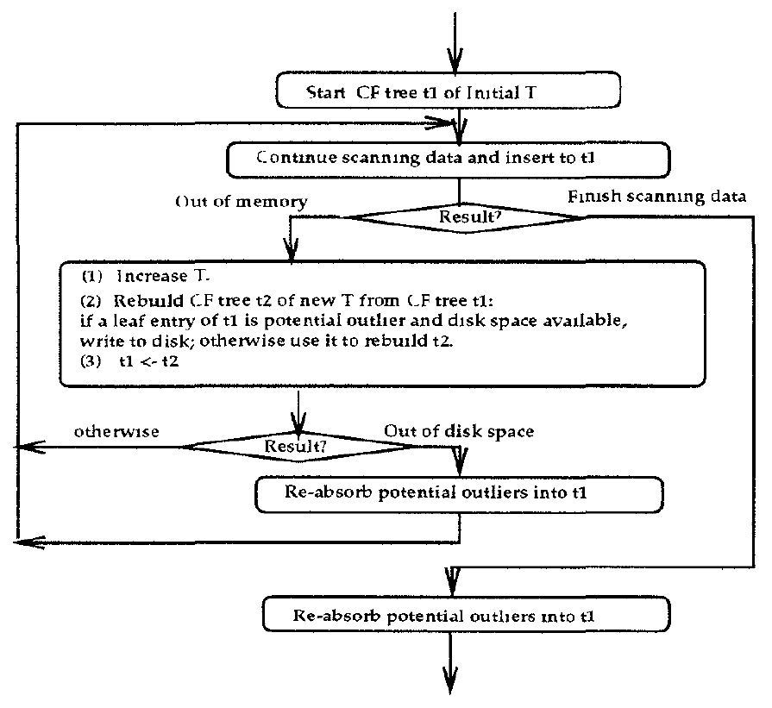
Control flow of Phase 1

Slide 14
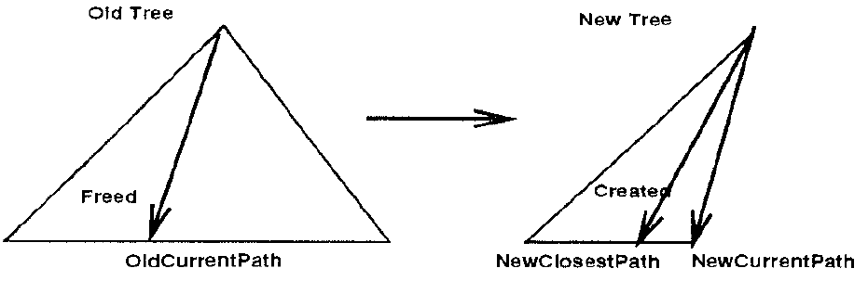
CF tree rebuilding
Notes:
A CF tree can be reduced
This requires scanning only the tree and data does not need to be read again
Increasing T can result in building a smaller tree under limited memory conditions

Slide 15
Refinements
Phase 4 can clean up the clusters as much as desired
Outliers are written to disk if disk is available.
All detail is not lost
Efficiency is reduced because of IO

Slide 16
In practical terms
Threshold T needs to be configured
Different data sets are going to have different optimal thresholds

Slide 17
Testing
Synthetic data (2-d K clusters)
Independent normal distribution
Grid
Clusters centers placed on sqrt(K) * sqrt(K) grid
Sine
Cluster centers arranged in a sine curve
Random
Cluster centers are placed randomly
Noise is added

Slide 18
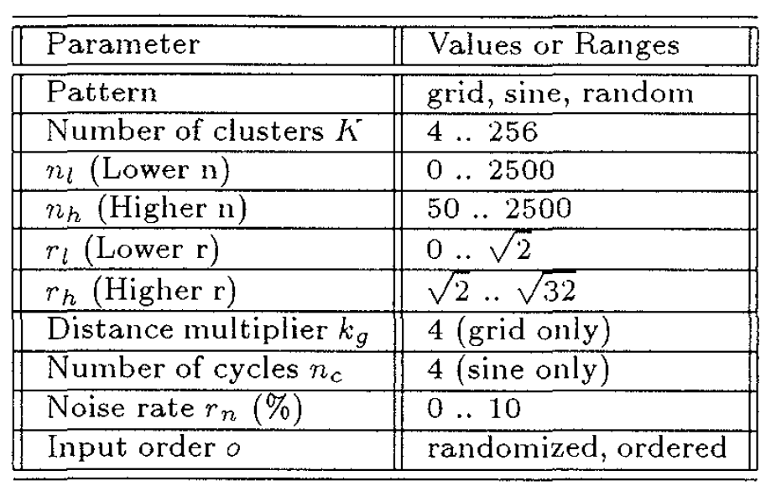
Data generation parameters

Slide 19
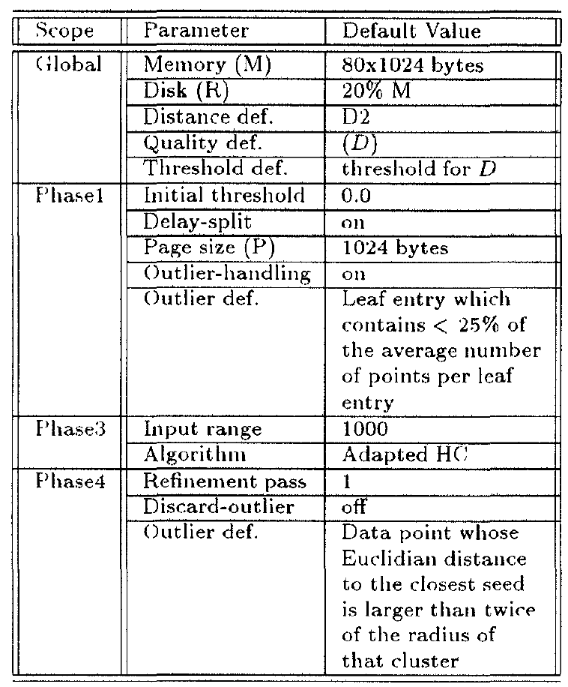
BIRCH parameters

Slide 20
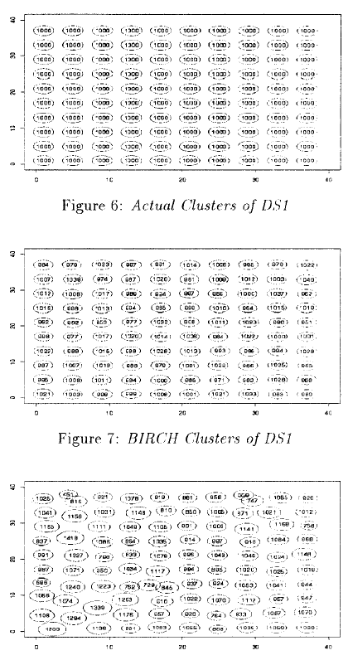
Data set 1 compared to CLARANS

Slide 21
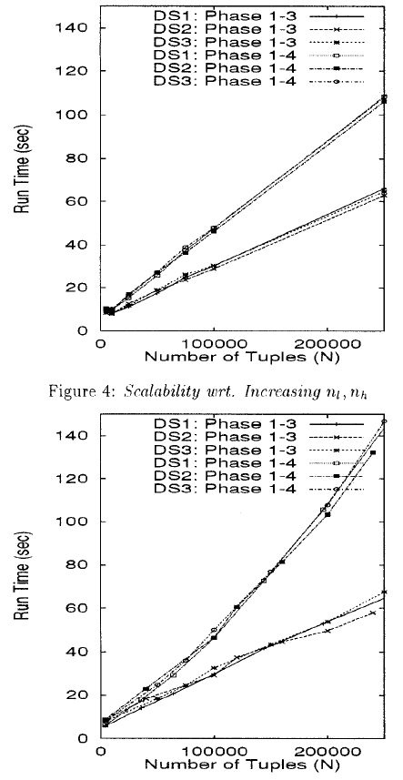
Scalability w.r.t. K

Slide 22
BIRCH summary
Incremental single-pass IO
Optimizes use of memory
Outliers can be written to disk
Extremely fast tree structure
Inherent ordering
Refinements only address subclusters
Accurate clustering results
Dependent upon parameter setting
Better than CLARANS

Slide 23
Open Questions
How well does clustering work for DBs?
Can BIRCH really be used for database applications?
What are the data dependencies for BIRCH to be effective?
The authors claim that BIRCH is “suitable” for very large databases
None of their testing reflected an actual database application
Therefore, BIRCH has theoretical potential but requires additional testing to be truly considered suitable for databases

