Slide 1
Analyzing the Energy Efficiency of a Database Server D. Tsirogiannis (U of Toronto), S. Harizopoulos, M. Shah (HP Labs), SIGMOD’10
Shimin Chen
Big Data Reading Group
Presented and modified by Randall Parabicoli

Slide 2
Goals
Assess and explore ways to improve energy efficiency
Energy efficiency of:
Single-machine instance of DBMS
Standard server-grade hardware components
A wide spectrum of database tasks

Slide 3
Machine Configuration
HP xw8600 workstation
64-bit Fedora 4 Linux (kernel 2.6.29)
Two Intel Xeon E5430 2.66GHz quad core CPUs (32K L1, 6MB L2)
16GB RAM
4 HDDs (Seagate Savvio 10K.3)
4 SSDs (Intel X-25E)

Slide 4
Power Measurement
Total system power:
power meter
Individual components:
SSDs, HDDs, and CPUs
clamp meter to measure 5V and 12V lines from the power supply
Multiplying the current with the line voltage (5V / 12V) gets the power measurement.

Slide 5
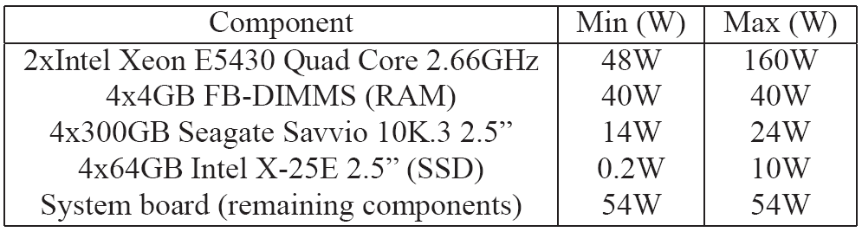
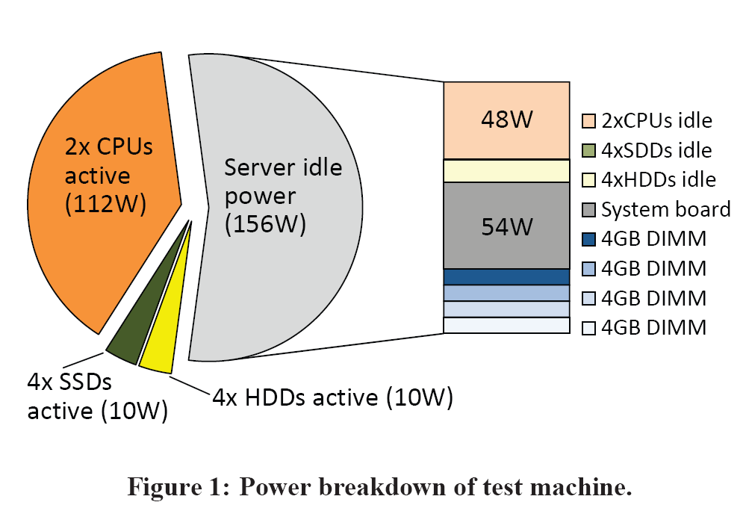
Component Power Range:

Slide 6
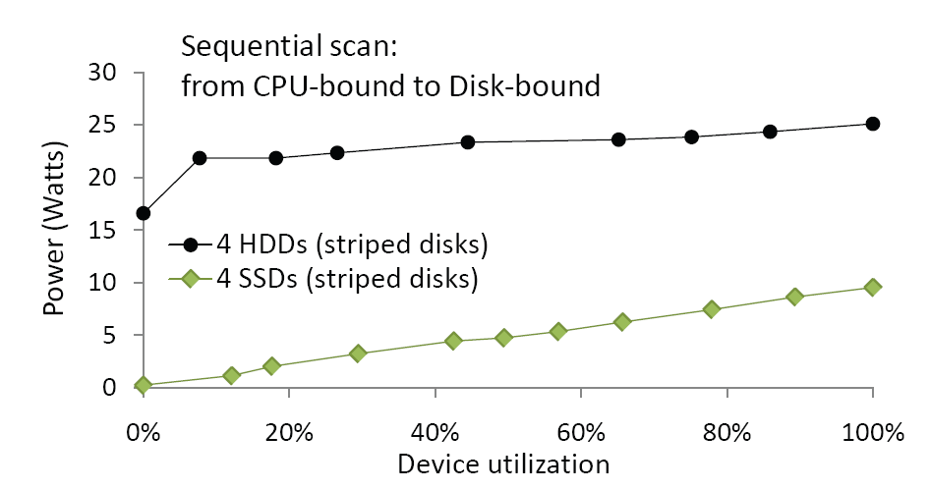
Power Proportionality of Disks
Configure 4 disks (SSDs) as RAID-0. Read a 100GB file sequentially, varying disk utilization by increasing CPU computation overhead

Slide 7
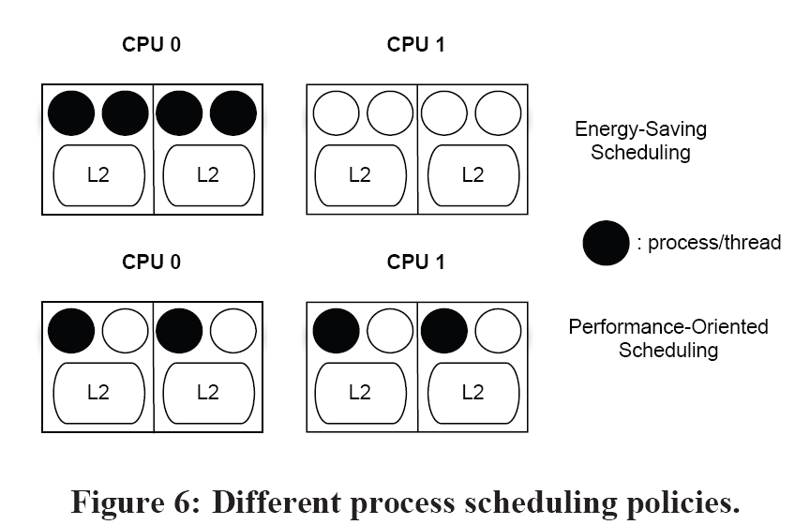
CPUs
Consumes 85% of dynamic power
Use four micro-benchmarks to study CPU power
Hashjoin, Sort, RowScan, ComprColScan
Two scheduling policies:
Performance Oriented vs Energy-Saving
Each core fully utilized
Freq adjusted by OS

Slide 8
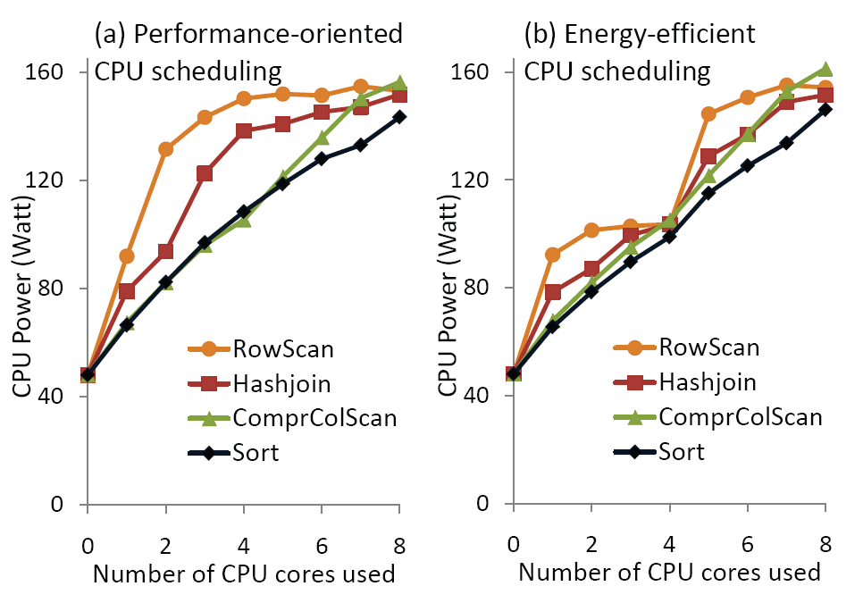
Big jump when a CPU becomes active
Hash join and row scan consumes more power

Slide 9
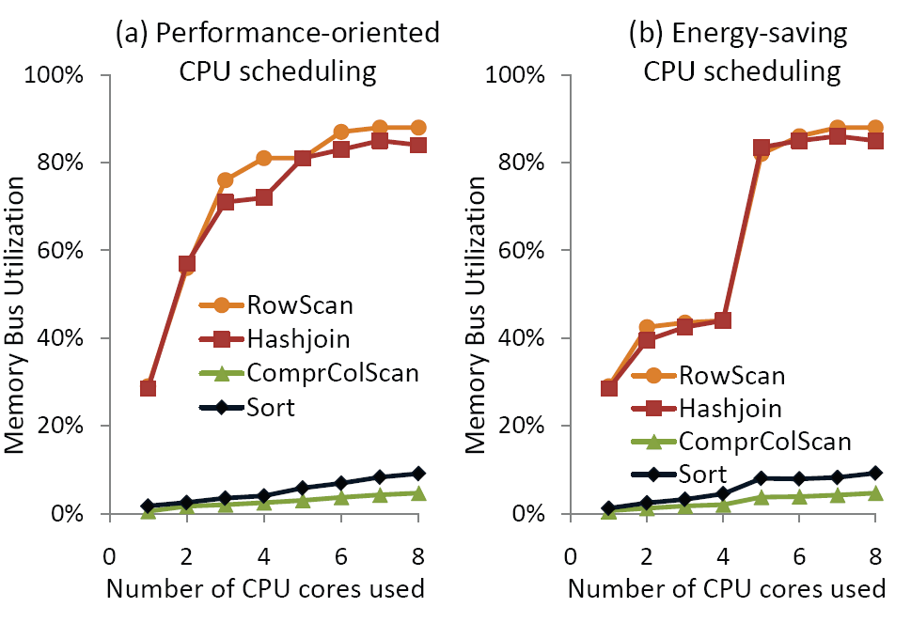
Operators put more stress on memory subsystem of CPU, thus leading to more power consumption.

Slide 10
CPU power is not a linear function of the number of cores used
For a fixed configuration, different operators may differ significantly (60% in the experiments) in power consumption

Slide 11
Energy vs. Performance
Energy efficiency vs. performance for a large number of DB configurations
DB: algorithm kernels, PostgreSQL, commercial System-X
Knobs:
Execution plan selection (algorithms)
Intra-operator parallelism (# of cores for a single operator)
Inter-query parallelism (# of independent queries in parallel)
Physical layout (row vs. column scans)
Storage layout (striping)
Choice of storage medium (HDD vs. SDD)
Scheduling policies and frequency settings (from before)

Slide 12
Energy vs. Performance
Energy-Efficiency
Tuples / Joule
Amount of work that can be done per unit of energy
Performance
1 / Time
More performance = less time spent

Slide 13
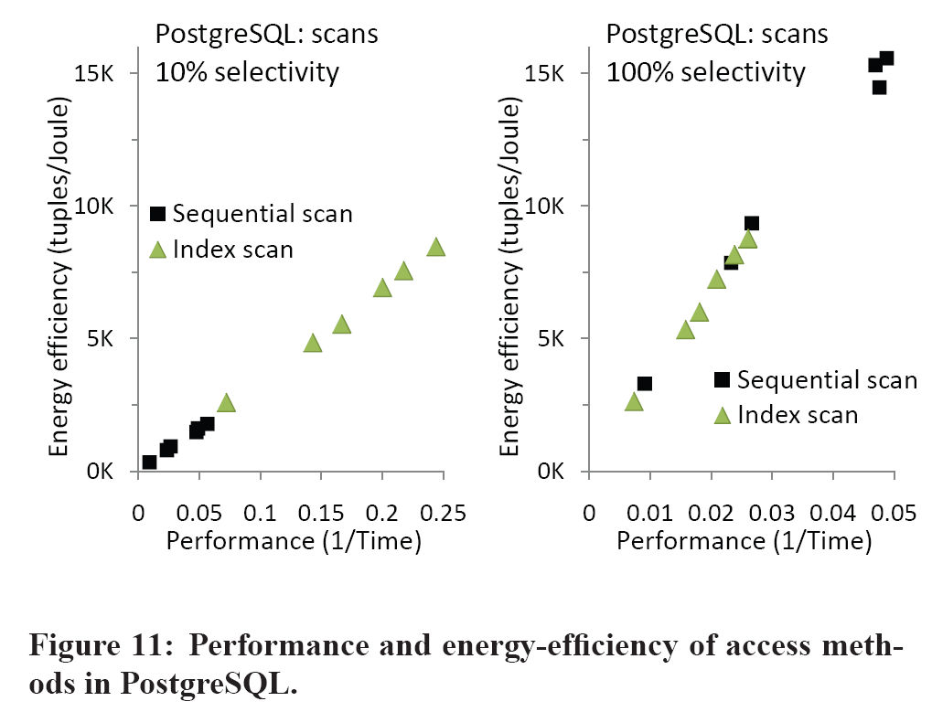
Dynamic power range among the points is small, 165W + 19%
Power remains relatively constant
Energy efficiency varies directly with performance.

Slide 14
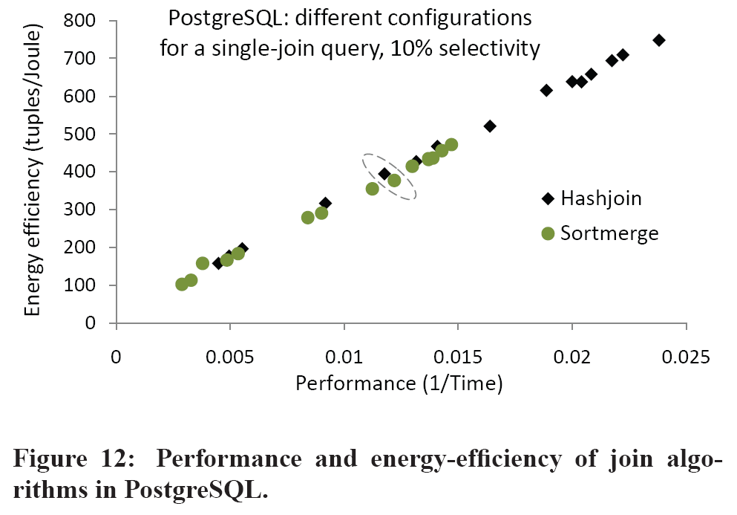
Again: 169W+14%
Therefore the linear relationship

Slide 15
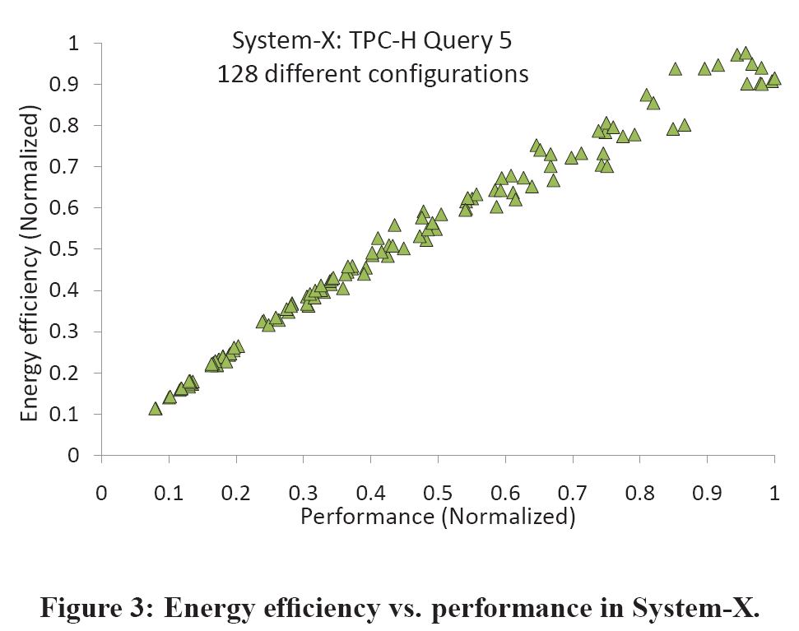
Linear relationship with less than 10% variance

Slide 16
This means
For this current server, the best performing DB execution plan is also good enough for energy efficiency
Regardless of query complexity and knobs

Slide 17
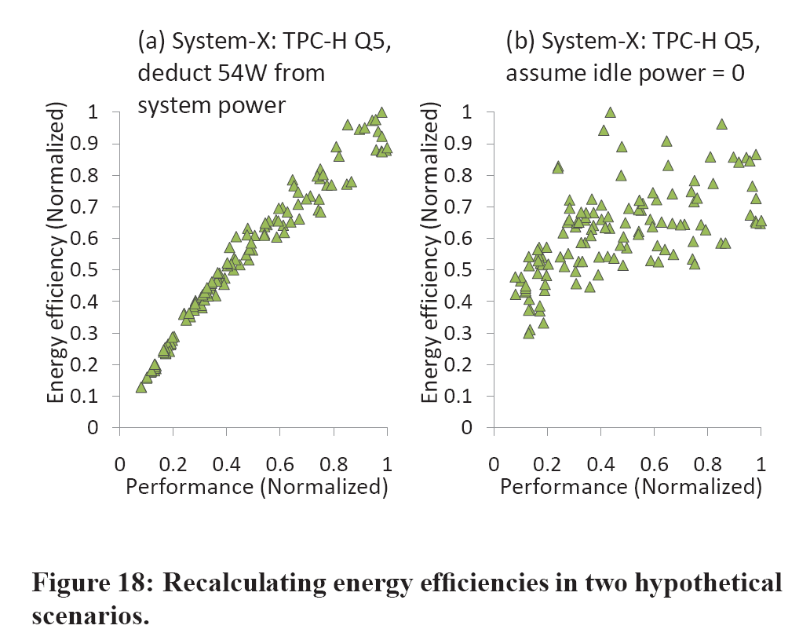
More variance as idle power is reduced

Slide 18
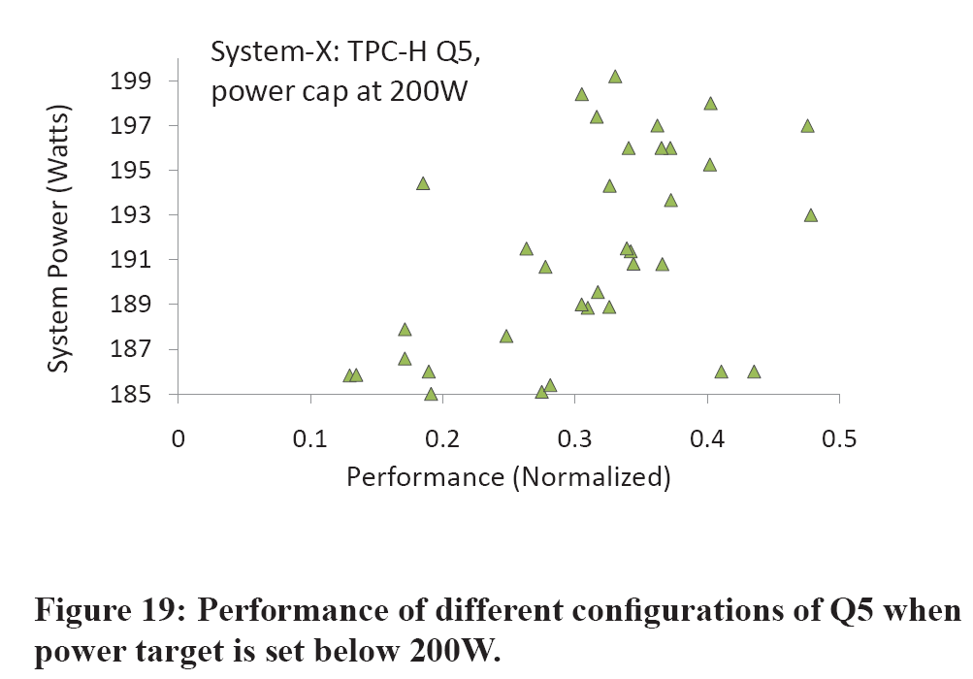
Power capping leads to more interesting configurations

Slide 19
Summary
Key Contributions
Study of power-performance of core database operators.
Using modern scale-out (shared-nothing) hardware.
Analysis of the effects of hardware/software knobs on energy efficiency of complex queries.
PostgreSQL
System-X
Highest performing configuration is the most energy-efficient.
Contrary to previous studies’ suggestions.
Suggests that performance and energy efficiency are highly co-related.

Slide 20
Summary
As server hardware becomes more energy efficient, idle power may reduce, leading to more variance

Slide 21
Future Research
Shared-nothing energy efficiency
Resource consolidation across underutilized nodes.
Saves power without sacrificing performance.
Alternative energy-efficient hardware
Lower fixed-power costs.
Software mechanisms to cap power consumption while maximizing performance.

Slide 22
Discussion Questions
How could OLTP (Online Transaction Processing) applications improve energy efficiency?
Why do RowScan and HashJoin take up more memory bus utilization and CPU power consumption than ComprColScan and Sort?

