Slide 1
NiagaraCQ
A Scalable Continuous Query System
for Internet Databases
Jianjun Chen, David J DeWitt, Feng Tian, Yuan Wang
University of Wisconsin – Madison 2000
Slides adapted from Rachel Pottlinger and Yehoshua Sagiv
Presented by Andrea Connell

Slide 2
Problem
Lack of a scalable and efficient system which supports persistent queries, that allow users to receive new results when they become available:
Notify me whenever the price of Dell or Micron stock drops by more than 5% and the price of Intel stock remains unchanged over next three months.
The internet has a large amount of frequently updating data – how do we manage CQs efficiently
NiagaraCQ

Slide 3


Approach
Incremental Grouping by similar query structure
  Grouped CQs share computation and data
  Reduce I/O
  Reduce unnecessary query invocations
Change-based or timer-based queries
Incremental Evaluation
User Interface - high level query language
NiagaraCQ

Slide 4
Command Language
Create continuous query:
  CREATE CQ_name
  XML-QL query
  DO action
  {START start_time} {EVERY time_interval}
  {EXPIRE expiration_time}
Delete continuous query:
    DELETE CQ_name
NiagaraCQ

Slide 5
Expression Signature
Represent the same syntax structure, but possibly different constant values, in different queries.
Where <Quotes> <Quote>
<Symbol>INTC</>
</> </> element_as $g
in “http://www.cs.wisc.edu/db/quotes.xml”
construct $g
Where <Quotes> <Quote>
<Symbol>MSFT</>
</> </> element_as $g
in “http://www.cs.wisc.edu/db/quotes.xml”
construct $g
=
Quotes.Quote.Symbol constant
in quotes.xml
NiagaraCQ

Slide 6
Query Plan
Trigger Action I
Trigger Action J
Select Symbol=“INTC”
Select Symbol=“MSFT”
File Scan
File Scan
quotes.xml
quotes.xml
NiagaraCQ

Slide 7
Groups
Groups are created for queries based on their expression signatures. Consists of three parts:
Group Signature
Group Constant table
Group Query Plan
NiagaraCQ

Slide 8
Groups
Groups are created for queries based on their expression signatures. Consists of three parts:
Group Signature
Group Constant table
Group Query Plan
=
Quotes.Quote.Symbol constant
in quotes.xml
NiagaraCQ

Slide 9
Groups
Groups are created for queries based on their expression signatures. Consists of three parts:
Group Signature
Group Constant table
Group Query Plan
Constant_value | Destination_buffer
… | …
INTC | Dest . I
MSFT | Dest . J
… | …
Stored on disk
NiagaraCQ

Slide 10
Groups
Groups are created for queries based on their expression signatures. Consists of three parts:
Group Signature
Group Constant table
Group Query Plan
.....
Action I
Action J
Split
Stored in memory-resident hash table
Join
Symbol = Constant_value
File Scan
File
quotes.xml
Constant Table
NiagaraCQ

Slide 11
Incremental Grouping Algorithm
Group optimizer traverses the query plan bottom up.
Matches the query’s expression signature with the signatures of existing groups
Group optimizer breaks the query plan into two parts
Lower – removed
Upper – added to the group plan.
Adds the constant and action to the constant table.
Trigger Action
Select Symbol=“AOL”
File Scan
quotes.xml
Groups may not be optimal
NiagaraCQ

Slide 12
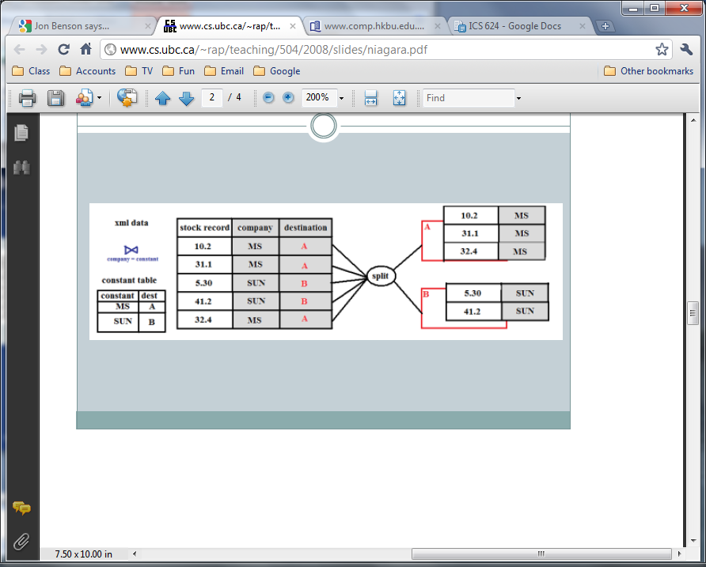
Example
Using the constant table, the split function moves all values for MS to buffer A and SUN to buffer B
What are these buffers? How do they work?
NiagaraCQ

Slide 13

Pipeline Approach
Tuples are pipelined directly from the output of one operator into the input of the next operator. All parts of the group are combined (including trigger actions), creating a single execution plan.
Disadvantages
Doesn’t work for grouping timer-based queries.
Split operator may become a bottleneck.
Not all trigger actions may need to be executed.
NiagaraCQ

Slide 14
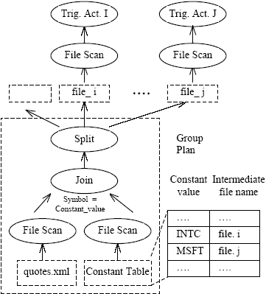
Intermediate Files
Figure 3.8
NiagaraCQ

Slide 15

Intermediate Files
Advantages
Each query is scheduled independently
Intermediate files and original data sources are monitored in the same way
The potential bottleneck problem of the pipelined approach is avoided.
Disadvantages
Extra disk I/Os.
Split operator becomes a blocking operator.
NiagaraCQ

Slide 16
Range Queries
What if we want to return every stock with a price increase of more than 5%?
A range query may have an upper bound and a lower bound, so the constant table is modified to include these two columns.
Where <Quotes> <Quote>
<Change_ratio>$c</>
</> </> element_as $g
in “quotes.xml”, $c>0.05
construct $g
Where <Quotes> <Quote>
<Change_ratio>$c</>
</> </> element_as $g
in “quotes.xml”, $c>0.15
construct $g
Overlap in intermediate files
NiagaraCQ

Slide 17
Virtual Intermediate Files
All outputs from split operator are stored in one real intermediate file.
This file has clustered index on the range.
Virtual intermediate files store a value range.
The value range is used to retrieve data from the real intermediate file.
Modification of virtual intermediate files can trigger upper-level queries.
NiagaraCQ

Slide 18
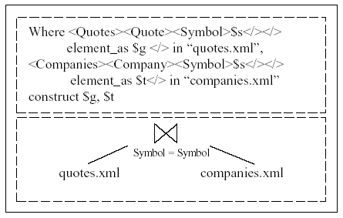
Grouping of Join Operators
Since joins can be very expensive, joins with the same expression are grouped.
Which order: Join first, or Selection first?
This paper says Selection; Future work says join
NiagaraCQ

Slide 19
Event Detection
Types of Events
Data-source change
  Push-based (inform NiagaraCQ of changes)
  Pull-based (checked periodically by NiagaraCQ)
Timer
  Set to a specific time interval
  Grouped with other timer-based queries
  Only fired if data has changed
NiagaraCQ

Slide 20
Incremental Evaluation
Queries are invoked only on changed data
For each file, NiagaraCQ keeps a “delta file”
Queries are run over delta files when possible
Incremental evaluation of join operators requires complete data files
Time stamp is added to each tuple in the delta file in order to support timer-based queries
Tuples remain in delta file for the longest time interval within the group
NiagaraCQ

Slide 21
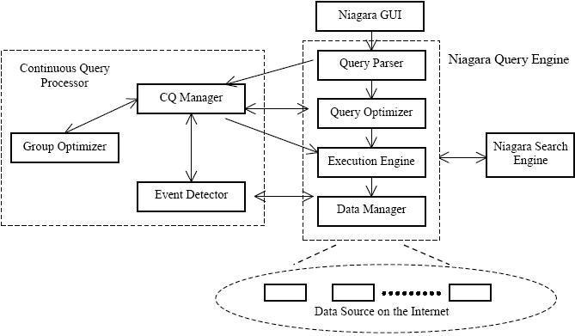
System Architecture
Figure 4.1
NiagaraCQ

Slide 22
Continues Queries Processing
Continuous Query Manager (CQM)
1
Event Detector (ED)
5
6
2
NiagaraCQ
Niagara
, 3
4
7
Query Engine (QE)
Data Manager (DM)
8
1. CQM adds continuous queries with file and timer information to enable ED to monitor the events
4. DM informs ED of changes to pushed-based data sources
3. When a timer event happens, ED asks DM the last modified time of files
5. If file changes and timer events are satisfied, ED provides CQM with a list of firing CQs
8. DM only returns changes between last fire time and current fire time
7. File scan operator calls DM to retrieve selected documents
2. ED asks DM to monitor changes to files
6. CQM invokes QE to execute firing CQs
Figure 4.2
NiagaraCQ

Slide 23
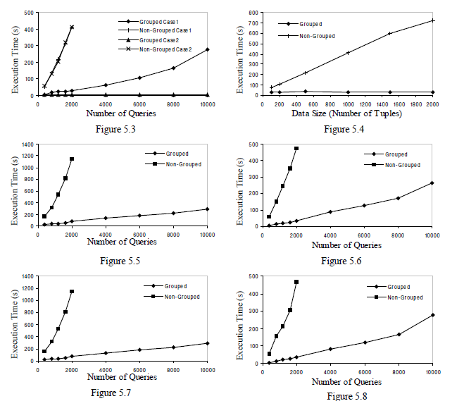
Experimental Results
Simple Selection
Range Selection
Equal & Range
Selection & Join
Mixed Queries
NiagaraCQ

Slide 24

References
NiagaraCQ: A Scalable Continuous Query System for Internet Databases
http://www.cs.wisc.edu/niagara/papers/NiagaraCQ.pdf
Design and Evaluation of Alternative Selection Placement Strategies in Optimizing Continuous Queries
http://www.cs.wisc.edu/niagara/papers/Icde02.pdf
Dynamic Re-grouping of Continuous Queries
http://www.cs.wisc.edu/niagara/papers/507.pdf
Follow Up Papers
NiagaraCQ

Slide 25
Discussion
What kinds of applications other than stock quotes would this be appropriate for? What would it not work for?
NiagaraCQ is somewhat similar to RSS. What types of applications are better with RSS and which are better with NiagaraCQ?
Are expression signatures too simple? Do they group together enough of the kinds of queries that this system is meant to handle? Do you think they would work better or worse for SQL queries instead of XML?
NiagaraCQ

