Slide 1
SPADE: The System S Declarative Stream Processing Engine
Bugra Gedik, Henrique Andrade, Kun-Lung Wu, Philip S Yu, MyungCheol Doo
Presented by: Zhou Lu

Slide 2
Abstract
System S is a large-scale, distributed data stream processing middleware under development at IBM T. J. Watson Research Center.
It provides:
(1) an intermediate language for flexible composition of parallel and distributed data-flow graphs
(2) a toolkit of type-generic, built-in stream processing operators, that support scalar as well as vectorized processing and can seamlessly inter-operate with user-defined operators
(3) a rich set of stream adapters to ingest/publish data from/to outside sources.

Slide 3
Usage of System S
IBM and the University of Ontario Institute of Technology (UOIT) are using System S to help doctors detect subtle changes in the condition of critically ill premature babies.
The software ingests a constant stream of biomedical data, such as heart rate and respiration, along with clinical information about the babies. Monitoring "preemies" as a patient group is especially important as certain life-threatening conditions such as infection may be detected up to 24 hours in advance by observing changes in physiological data streams.
The type of information that will come out of the use of System S is not available today. Currently, physicians monitoring preemies rely on a paper-based process that involves manually looking at the readings from various monitors and getting feedback from the nurses providing care.

Slide 4
SPADE
Stream Processing Application Declarative Engine.
It is a programming language and a compilation infrastructure, specifically built for streaming systems.
It provides:
An intermediate language for flexible composition of parallel and distributed data-flow graphs.
A toolkit of type-generic built-in stream processing operators.
A broad range of stream adapters.

Slide 5
System Overview
System S is a large-scale distributed data stream processing middleware.
It supports structured as well as unstructured data stream processing
can be scaled from one to thousands of compute nodes.
Execute a large number of long-running jobs (queries) that take the form of Data-Flow Graphs.
Processing Elements (PEs) connected by streams
Stream Data Objects (SDOs)
The PEs communicate via input and output ports
hard-coded links or implicit links
allows System S to support incremental application development and deployment

Slide 6
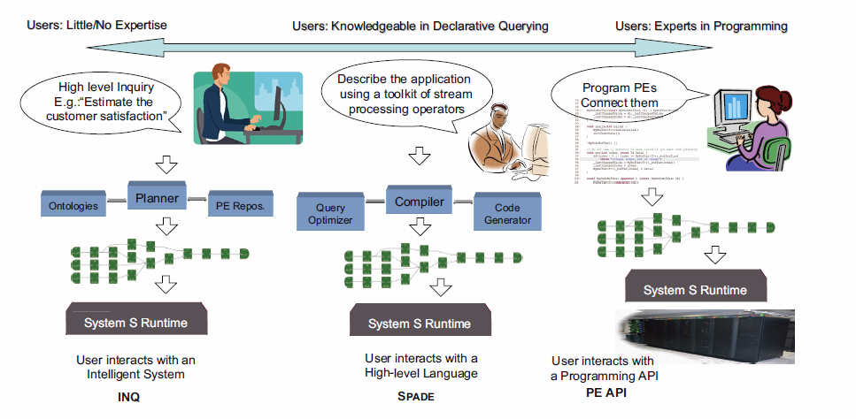
System S from an application developer’s perspective

Slide 7
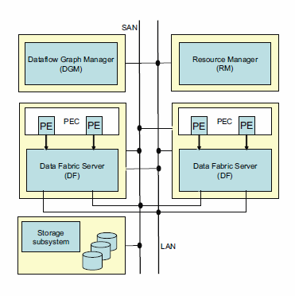
Stream Processing Core Runtime
The Dataflow Graph Manager (DGM) --determines stream connections among Pes
The Data Fabric (DF) -- is the distributed data transport component. Establishes the transport connections between PEs and moves SDOs from producer PEs to consumer PEs.
Resource Manager (RM) -- collects runtime statistics from the DF daemons and the PE Execution Containers
PE Execution Container (PEC) -- provides a runtime context and access to the System S middleware.

Slide 8
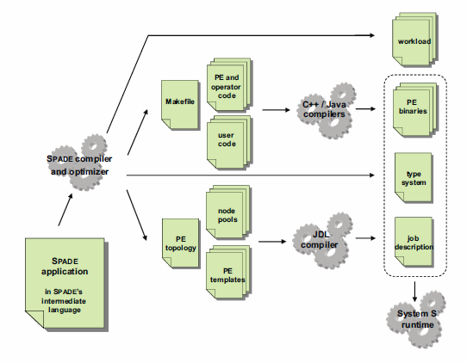
SPADE’s Code Generation Framework

Slide 9
The SPADE Programming Language
Hides the complexities associated with:
(1) basic data streaming manipulations
(2) application decomposition in a distributed computing environment
(3) the underlying computing infrastructure and data transport issues

Slide 10
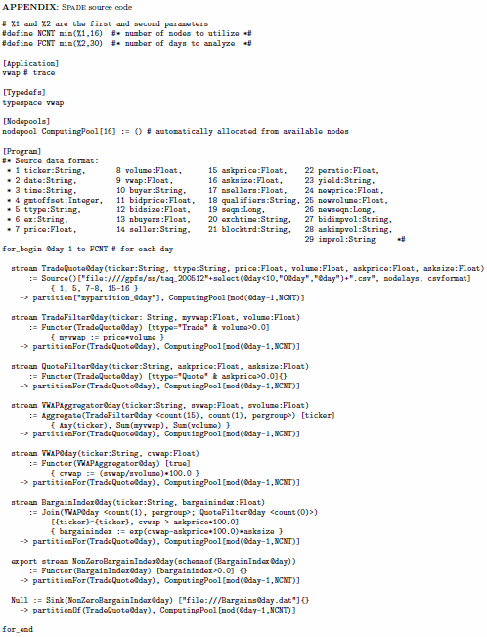
Example
Application metainformation
Type definitions
External libraries
Node pools
Program body

Slide 11
Operators
Functor
Aggregate
Join
Sort
Barrier
Punctor
Split
Delay

Slide 12
Edge Adapters
Source: A Source operator is used for creating a stream from data flowing from an external source. This operator is capable of performing parsing and tuple creation, and can interact with a diverse set of external devices.
Sink: A Sink operator is used for converting a stream into a flow of tuples that can be used by components that are not part of System S. Its main task consists of converting tuples into objects accessible externally through devices such as the file system or the network.

Slide 13
User-Defined Operators
SPADE has a toolkit of type-generic, built-in stream processing operators, that can seamlessly inter-operate with user-defined operator

Slide 14
Advanced Features
List Types and Vectorized Operations
Flexible Windowing Schemes
Pergroup Aggregates and Joins

Slide 15
Application Interoperability
processing elements can be connected to each other by hardwiring a connection or dynamically, by having a processing element specify a subscription flow specification expression, which determines the properties of streams to be consumed.
A SPADE application can, in a controllable fashion, interoperate with other SPADE applications as well as with any other System S application at runtime.

Slide 16
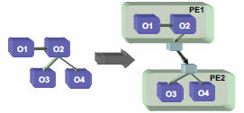
Compiler Optimizations
Operator Grouping Optimization When PEs are in different nodes, tuples are marshaled into SDOs and transferred over the network from output buffers to input buffers When PEs are in same nodes, only a pointer is passed around.
Execution Model Optimization multi-threading becomes an important aspect of high-performance applications
Vectorized Processing Optimization SPADE utilizes Streaming SIMD Extensions (SSE) on the Intel processors to accelerate the basic arithmetic operations on list types.

Slide 17
Optimizing Partitioner
Operator Fusion
Statistics Collection
Optimization Goal minimizing the total inter-PE communication, while respecting the constraint that the total load imposed by the operators within a PE should not exceed the capacity of a single processor.

Slide 18
Operator Fusion
SPADE uses code generation to fuse operators into PEs. For all intra-PE connections between the operators, it fuses the outputs of operators with the inputs of downstream ones using function calls. It results in a depth-first traversal. It supports multi-threaded operators. Can be cut short in certain branches.

Slide 19
Statistics Collection
In order to decide on how to best partition the operators into PEs, SPADE needs to know resource usage characteristics of operators. Before compiling a SPADE job for the final execution, we compile it in a special statistics collection mode first. The application is then used to collect runtime information. These statistics include metrics such as CPU load and network traffic. After this information is collected, the application is compiled for a second time.

Slide 20
Example -- Bargain Index Computation
Scenario: Stock trading
Aim: find bargains to buy
Bargain: a sell quote for a given stock when its price is cheaper than its moving average price as seen in recent trades
Bargain index: a scalar value representing the magnitude of the bargain

Slide 21
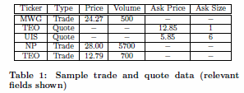
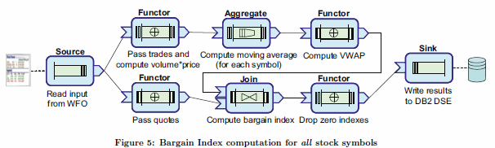

Slide 22
A Parallel Version for Historical Data
22 days’ ticker data = 3000 stocks = 250 million transactions = 20 GBs data
Organized as one file per day of total 22 files
Stored on General Parallel File System (GPFS)

Slide 23
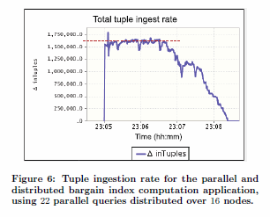
Results
Tuple ingestion rate: 1.6 million tuples/sec
Total time consumed: <3.5 min

Slide 24
Questions?
Other implementation of this system?
How it affects our life?
What’s the future of streaming?

