Slide 1
The Wisdom of Social Multimedia: Using Flickr For Prediction and Forecast
Liangliang Cao, Andrew Gallagher, Jiawei Han, Xin Jin, Jiebo Luo
Slides by Tony Gaskell

Slide 2
Outline
Criteria
Flickr: Meta-information
Querying Flickr
Prediction models
Experiments
Evaluation

Slide 3

Criteria of a ‘wise’ crowd
Diversity
Independence
Decentralization
Aggregation
Notes:
Diversity - Each person should have private information even if it's just an eccentric interpretation of the known facts.
Independence - People's opinions aren't determined by the opinions of those around them.
Decentralization - People are able to specialize and draw on local knowledge.
Aggregation - Some mechanism exists for turning private judgments into a collective decision.

Slide 4

Criteria of a ‘wise’ crowd
Diversity
Independence
Decentralization
Aggregation
Notes:
Diversity - Each person should have private information even if it's just an eccentric interpretation of the known facts.
Independence - People's opinions aren't determined by the opinions of those around them.
Decentralization - People are able to specialize and draw on local knowledge.
Aggregation - Some mechanism exists for turning private judgments into a collective decision.

Slide 5
Flickr: Meta-Information
T, set of all terms
U , set of all users
I , set of all images
D , set of dates (days)
M , set of dates (month)
Q , set of dates (quarter)
Y , set of dates (year)

Slide 6
Flickr: Meta-Information (cont.)
T(i), the set of tag annotations for image i.
D(i), the day image i was taken.
M(i), the month image i was taken.
Q(i), the quarter image i was taken.
Y(i), the year image i was taken.
I(u), the set of images uploaded by user u.
I(q), the set of relevant images to query q.

Slide 7
IPD and TIPD
Images per day (IPD)
  Looks at the number of relevant images that match a query on a certain day day.
Tagged images per day (TIPD)
  Images may or may not be tagged, we need to differentiate the two.
Notes:
i is an element of all images relevant to a query q.

Slide 8
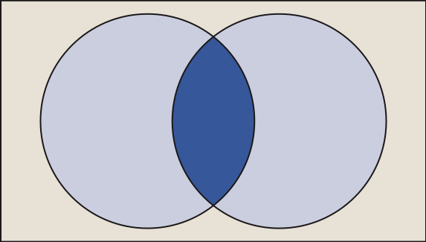
Unique users per day (UPD)
I(u,d)
I(q,d)
I_{U}(q,d)
Notes:
Multiple uploads of the same object is counted only once.

Slide 9
First- time Unique users per day (FUPD)
I(u,d)
I(q,d)
I_{F}(q,d)
D_{first}(u,q) represents the first day a user uploaded an image that matched a certain query.
Notes:
i is an element of all images relevant to a query q.

Slide 10
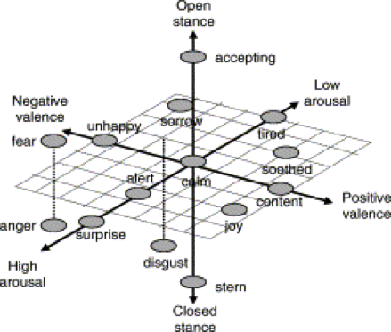
Image Visual Relevance
Color / edge histograms
Texture
Color Correlogram
Shape
N-dimensional feature space
Quantifying emotions
Notes:
n-dimensional graphs. Clustering.

Slide 11
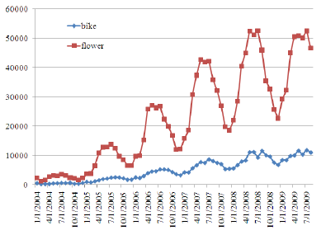
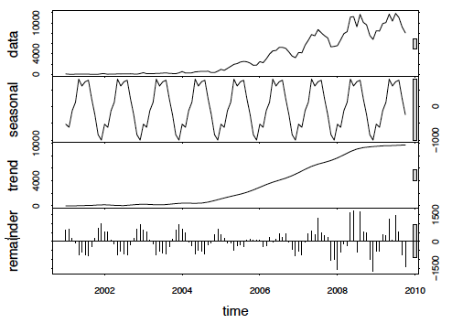
Flickr Background Model
STL decomposition
  Separates raw data into seasonal, trend, and remaining data.
F_{B} = Average trend of all general Flickr queries

Slide 12
Prediction Models
Autoregressive (AR)
  Attempts to predict the outcome of a system based on previous inputs.
Seasonal Autoregressive (SAR)
  Like AR, but has a seasonal factor to consider.
Bass Diffusion
  Describes the process of how products get adopted as an interaction between users and potential users.

Slide 13
Flickr Index
λΘF_{t}
Scaling value
Makes a correlation ratio between ‘product sales’ and Flickr feature value.

Slide 14
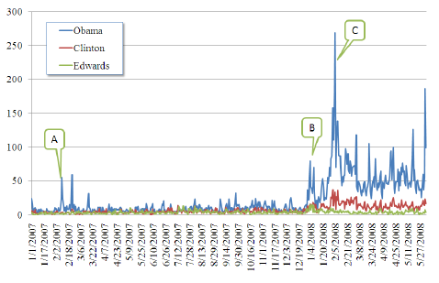
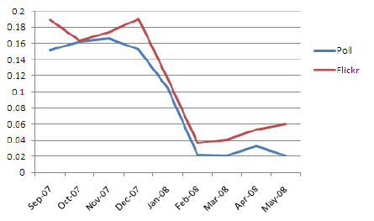
2008 Elections and Poll Results
2008 Democratic Primaries
John Edwards popularity poll vs Flickr index

Slide 15
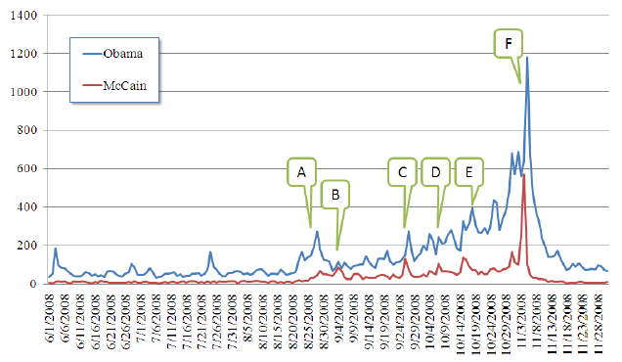
2008 General Election

Slide 16
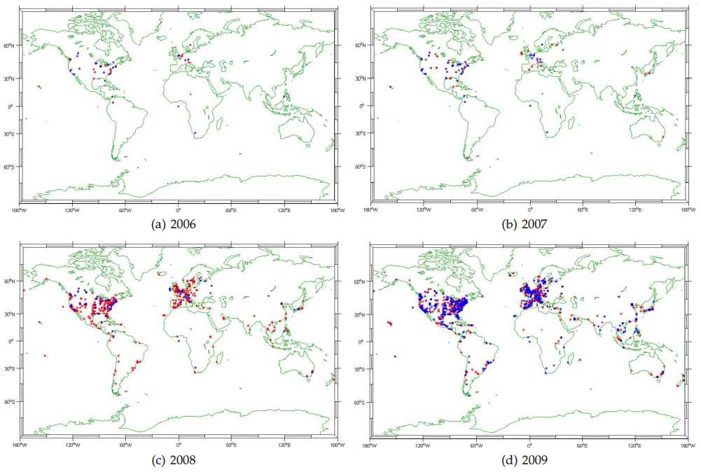
Product Distribution

Slide 17
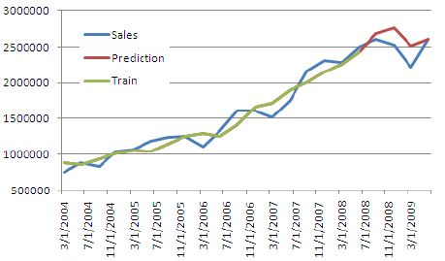
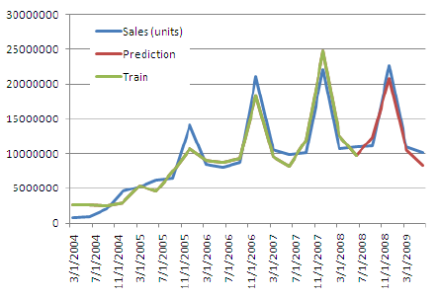
Sales Prediction
iPod
Mac

Slide 18
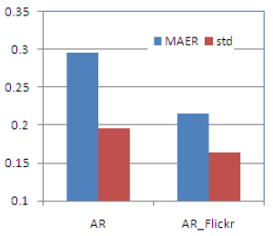
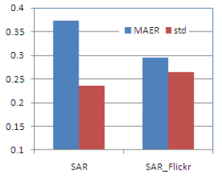
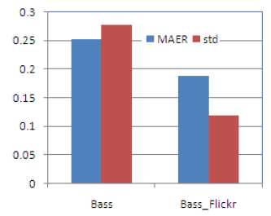
Evaluation
AR
SAR
Bass
Comparison results showed that the extended Flickr models were more accurate!
Why do you think that it was?

Slide 19
Questions
How do you feel about using social multimedia for scientific purposes?
What other online resources could be mined, and for what applications?

