Slide 1
StableBuffer: Optimizing Write Performance for DBMS Applications on Flash Devices
Paper by: Yu Li, Jianliang Xu, Byron Choi, and Haibo Hu
Department of Computer Science
Hong Kong Baptist University
Slides and Presentation By: Justin Weaver

Slide 2
Introduction
Flash devices offer…
Much faster random reads compared to HDDs
Lower power consumption
But random writes can be very slow
Proposed solution called StableBuffer
Takes advantage of efficient write patterns
Implemented as DBMS buffer manager add-on
No need for firmware or OS driver updates

Slide 3
Why So Slow?
Why are random writes to NAND flash so slow?
Only empty cells can be written to
Writes at page level, but erases operate on blocks
Overwrite operation: read, erase, modify, write

Slide 4
The StableBuffer Solution
Execute all writes to empty “slots” in a pre-allocated buffer on the flash device
Take note of the writes’ actual destinations and look for efficient write patterns
Flush the buffer by writing the discovered patterns to their actual locations

Slide 5
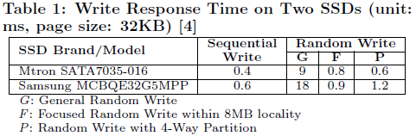
Efficient Write Patterns
Sequential Writes – consecutive addresses
Focused Writes – addresses within a specific range
Partitioned Writes – mix of sequential writes to several areas

Slide 6
Design Challenges
How should the space inside of the StableBuffer be managed?
How should efficient write patterns be recognized without too much overhead?
Which write patterns should be flushed to their destinations, and when should this happen?

Slide 7
Data Structures
StableBuffer
Pre-allocated area on the flash device
Broken into slots, each the size of a page
Example: 4MB SB, 4KB pages ➔ 1,024 slots
Translation Table
In-memory table that maps actual destinations with slot numbers
Example entry: <0x1234ABCD, 42>
Implemented as hash table, key is destination address
Bitmap for Free Slots
“1” ➔ empty , “0” ➔ occupied
Free slot pointer points to next open slot
Metadata added to pages for fault tolerance

Slide 8
StableBuffer Manager
Reader
Writer
Flush Manager

Slide 9
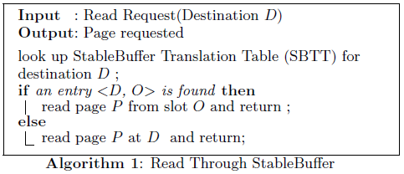
Reader
Checks to see if page is in SB first
If it is, read it from the SB
If not, read it from the actual destination
Paper claims the overhead is negligible because of hashing

Slide 10
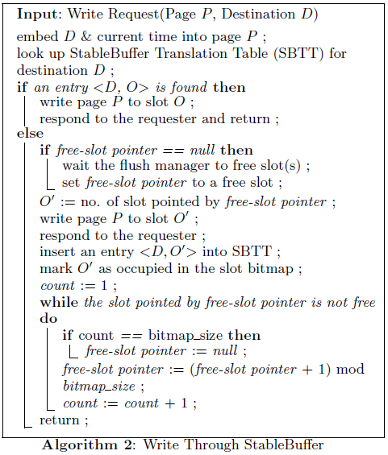
Writer
Overwrite page in table if destination is already there, then return
OR ...
Invoke flushing if free slot pointer is null
Write page to free slot
Update table and bitmap
Update free slot pointer

Slide 11
Flush Manager
Write pattern recognition
On-Demand
Incremental
Pattern Flush Strategies
Passive
Proactive

Slide 12
On-Demand vs. Incremental
On-Demand
Finds efficient write patterns upon request
Scan on sorted destination addresses finds sequential and partitioned patterns
Sliding window on sorted addresses finds focused area patterns
Incremental
Maintains pattern information; updated after every write
Maintain set of S_{i} = (addr_{min}, addr_{max}) to find sequential writes
Maintain set of P_{l} where each entry points to all S_{i} with size l; each P_{l} is a candidate partitioned write pattern
Maintain set of F_{i} = (addr_{min}, addr_{max}, set_{addr}) where set_{addr} is a set of addresses between min and max; each F_{i} is a candidate focused write pattern

Slide 13
Passive vs. Proactive
Passive
Flushes pages when there are no open slots
Triggers on-demand pattern recognition OR chooses incrementally generated patterns
Chooses to flush the longest instance that is expected to be written fastest
Proactive
Flushes pages during any write operation when qualified to do so
Requires incremental pattern recognition
Runs in the background, detecting good efficient write patterns
Checks if maintained patterns are qualified for flushing
Qualified patterns have a threshold value higher than θ_{x} where x is one of the three write patterns
θ_{seq} = l_{min} / l θ_{par} = θ_{seq} * T _{par} / T _{seq} θ_{focus} = θ_{seq} * T _{focus} / T _{seq}

Slide 14
Experiment Setup
Three flash devices
16GB SSD
8GB USB flash drive
8GB SDHC card
Three StableBuffer configurations
Ondemand+Passive
Incremental+Passive
Incremental+Proactive
TPC-C benchmark on PostgreSQL 8.4

Slide 15
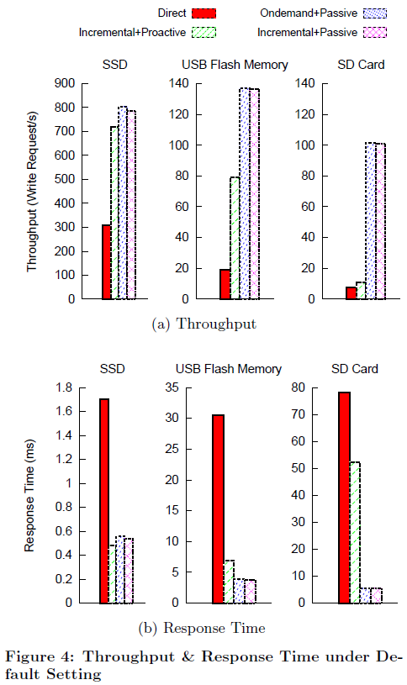
Throughput and Response Time
All measurements outperform direct method
SD card has poor performance with incremental+proactive
Incremental+passive and ondemand+passive perform the best

Slide 16
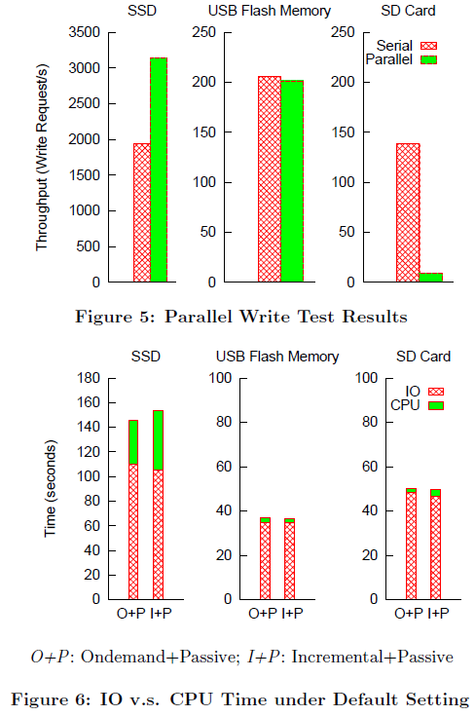
Other Tests
SD card performs very poorly in parallel write test
USB flash drive and SD card are clearly IO bound, not CPU bound

Slide 17
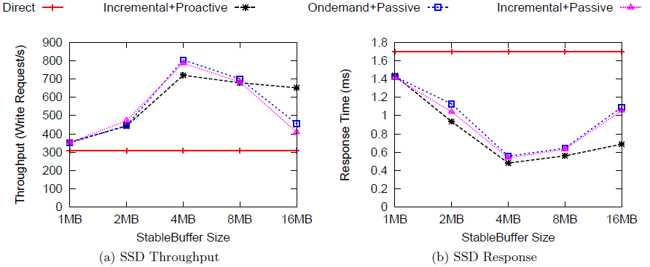
StableBuffer Size
Best performance achieved when StableBuffer size was set to 4MB for this particular drive

Slide 18
Paper Conclusions
Using the StableBuffer DBMS add-on, random write performance on flash memory was shown to dramatically increase
No firmware or OS driver updates were needed

Slide 19
Questions
Comprehension questions?
...
Presentation questions...
Does optimal performance rely too heavily on the need to benchmark each specific device model first?
Could developments in firmware and/or OS drivers make an add-on like StableBuffer no longer necessary?
USB flash drives and SD cards would probably never be used for DBMS storage; why not just test several different SSD models instead?
Could OS support for the TRIM command help with random write performance within a DBMS?

