Slide 1
Fault-Tolerance in the Borealis Distributed Stream Processing System
Magdalena Balazinska, Hari Balakrishnan,
Samuel Madden, and Michael Stonebraker
MIT computer science & Artificial Intelligence Lab.
Original Slides: Youngki Lee
Modified by: Bao Huy Ung
Notes:
Hello, everyone
Today, I am going to present a paper about Fault-Tolerance in the borealis distributed stream processing system.
This work is affiliated with these people at MIT.
This paper is the 4th paper of Borealis project, and published at SIGMOD 2005.
You will know two of other three papers and another is about high-availability.

Slide 2
Abstract
Present a replication-based approach to fault-tolerant distributed stream processing in the face of node failures, network failures, and network partitions.
Aims to reduce degree of inconsistency in system while guaranteeing available inputs are processed within a specified time threshold.

Slide 3
Time Threshold
User defined delay constraint is X
Data processing delay is P
A node cannot buffer inputs longer than αX, where αX < X – P

Slide 4
Motivation scenario
SPE
FAILURE
SPE
X: 3 seconds
Downstream
neighbor
SPE
X: 60 seconds
Upstream
neighbor
X: 3 seconds
SPE
X: 1 second
Downstream neighbors want
1. new tuples to be processed within time threshold X
2. to get eventual correct result
Notes:
This picture shows a scenario of distributed stream processing network. Data stream generated in the sensor network is processed as it goes through the chain of SPEs. (upstream neighbor, downstream neighbor 설명) In the scenario, they assume that, downstream neighbors want ~~~. At this point, let me assume that a node in the processing chain fails. Failure happens when a node can’t get one of its input streams within a appropriate time so that it can’t process new tuples within the user-specified time threshold. Once a node fails, it starts to generate tentative results. To solve this problem, they put one or more replicas for each node. If there are replicas, a downstream neighbor can connect to the one of the replicas when a failure of upstream neighbor is detected. With this approach they can solve the failure of a node. However, due to many reasons such as previous upstream failures, long network delay or concurrent system failures, there could be no upstream neighbors, which produces correct results. In that case, one of the upstream nodes must produce tentative result using partially available inputs to meet the user-defined availability. This tentative result might propagate to the next downstream node. (this makes sense in the stream processing domain) (So~, user defined threshold is long, ~~~ whereas if it is short ~~~) Once a failure heals, the node start to correct the previously generated results. There are two reasons to do this. One is to deliver the correct result to the users, which is the target requirement of the Borealis system and another is to keep the consistency between replicas.

Slide 5
Fault-Tolerance Approach
If an input stream fails, find another replica
No replica available, produce tentative tuples
Correct tentative results after failures
STABLE
UPSTREAM
FAILURE
Missing or tentative inputs
Failure heals
Reconcile state
Corrected output
Another upstream failure in progress
STABILIZATION
Notes:
To address those challenges, they design a node to have three possible states and transit from one to another, I will show and explain the state diagram.
Before I present the diagram, the approach could be summarized as follows. A nodes are in a STABLE state when it gets all the necessary input streams which are not tentative, and produces correct results within user-specified time threshold. During stable state, if a node can’t get one of input streams or if a node get tentative input streams it change its state to UPSTREAM FAILIRE. In this state the node itself generate tentative result. Generating tentative result could result in two problems. , (1) Continuing leads to inaccurate results, (2) Continuing leads to replica divergence. So, once a failure heals the node changes its state to Stabilizing and reconcile its internal states and generate corrected output. When stabilizing is over it goes to STABLE state again. However, if another upstream failure occurs during stabilizing process it goes back to UPSTREAM FAILURE state.

Slide 6
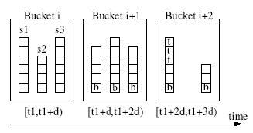
Fault-Tolerance Approach : STABLE
Only need to keep consistency among replicas
Deterministic operators
SUNION
TCP connection
Node 1
SUNION
Σ
s₁
s₂
s₃
Node 1’
SUNION
Σ
Notes:
I’ll explain what will happen in each state more specifically. First in the stable all the inputs are available and nothing for a SPE to care about. But, because there are several replicas for a node they could ensure the consistency between the nodes. Before I talk about the consistency between nodes you need to know the meaning of deterministic operators. An operator is deterministic if its results do not depend on the times at which its inputs arrive. They solve the consistency problem only when there are deterministic operators. . If all operators are deterministic we only need to ensure that replicas of the same operator process data in the same order to maintain consistency. When a SPE node process single stream, the problem becomes very easy. A single stream can be serialized by just using TCP connections. However, when a SPE get many streams as its input, it is not typical problem. To serialize inputs from many stream sources they introduce SUNION operator. Basically the SUNION operator collects all the input streams, in this example three, and deterministically sorts the tuples by time. To help this, each stream sends boundary tuples with boundary time, SUNION operator put the tuples between two boundary tuples together and sort them. With this method SUNION can serialize input streams from more than one sources.

Slide 7
Fault-Tolerance Approach : UPSTREAM FAILURE
If an upstream neighbor is no longer in the STABLE state or is unreachable
Switch to another STABLE replica
If no STABLE replica exists, it continues with data from a replica in the UP_FAILURE state
Suspend processing until failure heals and stable data is produced from upstream neighbors
Delay new tuples as much as possible(X-P) and process
Or just process without any delay

Slide 8
Fault-Tolerance Approach : STABILIZATION
State reconciliation
Checkpoint/redo
Undo/redo
Stabilizing output streams
Processing new tuples during reconciliation
If (Reconciliation time < X-P) then suspend else delay, or process
Failed node recovery
Notes:
Once a node get into the stabilization state, there are several things to do. First it must correct the states of operators for consistency and also stabilize output streams to send the eventual correct result to users. There are two methods for state reconciliation. One is checkpoint/redo and another is undo/redo.
(1)checkpoint during stable state(save the states of all operators) -> buffer input streams after last check point

Slide 9
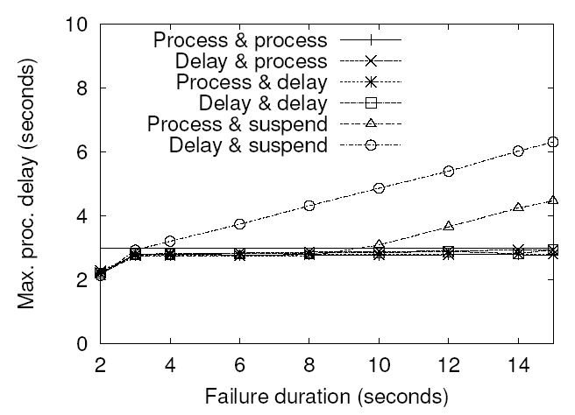
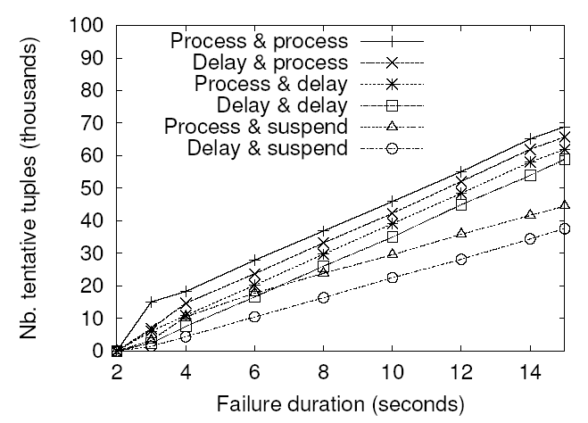
Experimental results
Notes:
6 Combinations

Slide 10
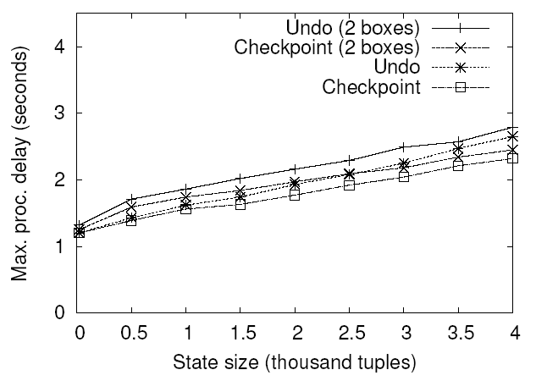
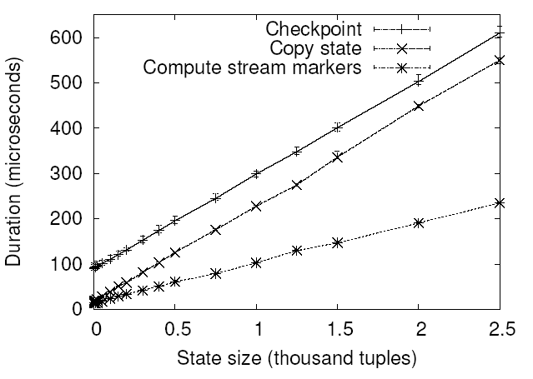
Experimental results
Reconciliation (performance & overhead)
Notes:
Reconciliation ->performance in terms of delay, and overhead

Slide 11
Questions?
What kind of advantages can using a content distribution stream network provide?
Replicas communicate with each other in the event of long failures to reach a mutually consistent state. Are there any benefits to having them always be communicating with each other?

