Slide 1
Cost-based optimization in DB2 XML
Paper by: A. Balmin, T. Eliaz, J. Hornibrook, L. Lim,
G. M. Lohman, D. Simmen, M. Wang, C. Zhang
Slides and Presentation By: Justin Weaver

Slide 2
Introduction
XML accepted as the language for data interchange
Relational database investment
IBM developed DB2 XML
Supports XML as native data format
XQuery supported as second query language
Paper focuses on extensions made to DB2’s cost-based optimizer

Slide 3
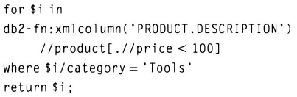
XQuery Language
Largely declarative, like SQL
FLWOR statements
Zero or more FOR and LET clauses
Optional WHERE clause
Optional ORDER BY clause
RETURN clause
Example…

Slide 4
Challenges
XML data model is inherently heterogeneous and hierarchical
XML schemas are likely to change, or be unavailable or unknown
Developing a hybrid optimizer for XML and relational access paths that works with both SQL and XQuery

Slide 5
Related Work
Existing native XML data management systems: Lore, Niagra, TIMBER, Natix, Tox
DB2 XML goes further by representing XQuery queries as query graph models
No prior work describes a cost-based optimizer for an XQuery compiler
Two path expression evaluation techniques: structural joins and holistic algorithms
DB2 XML uses holistic approach using TurboXPath algorithm
Reduces number of plans & does not sacrifice plan quality

Slide 6
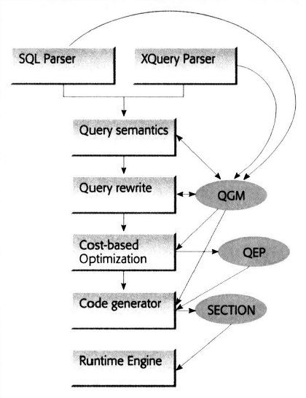
Query Compilation
Mapping of SQL or XQuery to query graph model (QGM)
Rewrite to more optimization-friendly representation
Cost-based optimizer chooses best query execution plan
QEP mapped to sequence of execution engine calls, called a section
Runtime engine executes the section when query is executed

Slide 7
Execution Plan Generation
Number of QEPs is typically very large
Three key aspects of the architecture…
Operators – query processing primitives that consume and produce tables
Rules – define how operators may be combined into QEPs
Configurable Enumeration Engine – invokes the plan generation rules and determines which sequences of joins to evaluate

Slide 8
Cost and Cardinality
QEP operators maintain a running total of projected resources required
Most critical cost model input is number of records to be processed
The model estimates filtering effect of predicates based on statistics about the database
Based on the probabilistic model proposed in System R
Each filtering operation is assigned a selectivity
Building an accurate cost model for operators that manipulate XML data is much more difficult

Slide 9
New Operators
Encapsulation of runtime functions as QEP operators allowed new operators to be added more easily
XSCAN operator – scans and navigates through XML to evaluate an XPath expression
XISCAN operator – Same as a relational index scan; returns RIDs of documents that satisfy an index expression
XANDOR operator – n-way merge of individual index scans by ANDing and ORing

Slide 10
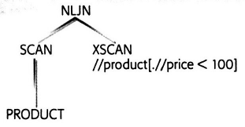
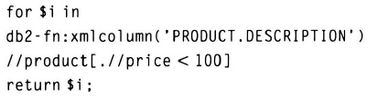
Plan Generation Extensions
Changes were made to access rules to support construction of plans using the new XML operators
Access rules extended for XSCANs…
Same as a relational system’s table scan
Returns references to qualifying nodes

Slide 11
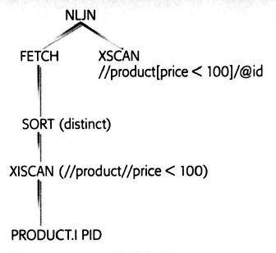
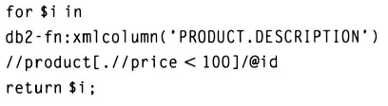
Plan Generation Extensions Continued
Extensions for generating XML index plans
More complicated than XSCAN plans
XSCAN is necessary to eliminate false positives
SORT removes duplicate
documents

Slide 12
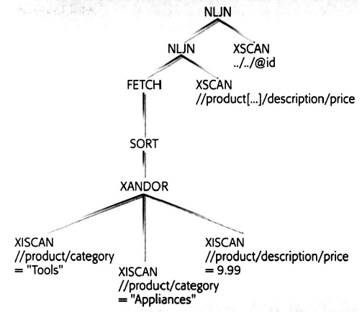
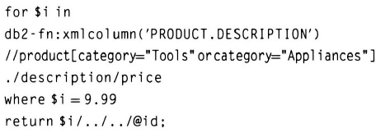
Plan Generation Extensions Continued
Extensions for generating XANDOR plans…
Combines index ANDing and ORing
Can dynamically skip processing of some inputs

Slide 13
Cardinality and Cost
Cardinality greatly affects cost and is very hard to estimate
Current DB2 infrastructure for cardinality and cost estimation was extended to support XML
Changes made to three general areas…
generalized predicate selectivity estimation to support XPath predicates and navigation; compute fanout
cardinality estimation extended to support XSCAN, XISCAN, and XANDOR
modified existing and designed new cost algorithms

Slide 14
Fanout
The average number of result XML items produced per input XML item
To estimate fanout, two assumptions are made…
Fanout uniformity – there will be the same number of B elements within each A result if A is an ancestor of B
Predicate uniformity – XML data items that bind to X and satisfy condition Y are uniformly distributed among all items that bind to X

Slide 15
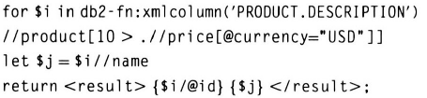
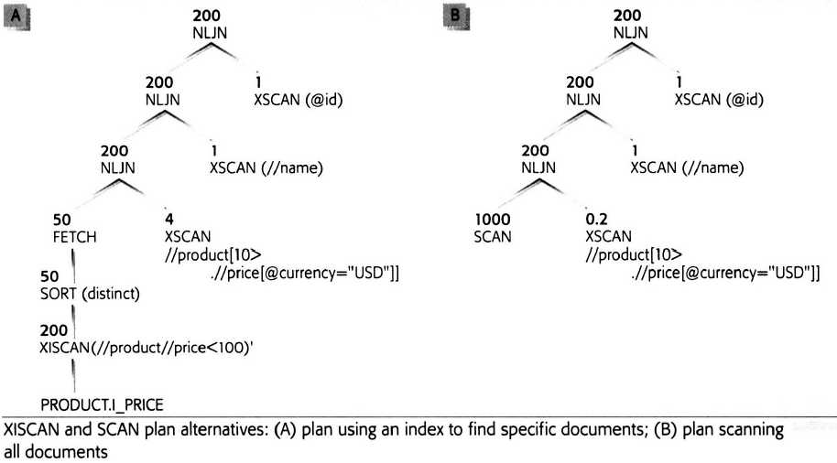
Cardinality Estimation
Cardinality of XSCAN operator estimated to be product of fanout of XPath expression, selectivity of predicates, and sequence size of input column
Sequence size is the
average number of XML
items per XML sequence
flowing through a column
Estimated cardinality
is shown at each step in
this example

Slide 16
Cost Estimation
Added cost estimation for the three new operators and modified existing related operators such as SORT and FILTER
Cost modeling is much more difficult due to semantic differences and complexity of the operators, and versatility and complexity of XML data
Structures for data distribution statistics would be as large as the data, and estimation would take longer than the actual query
The relational and XML models must be consistent in their level of detail in a mixed environment to avoid bias

Slide 17
Statistics Collection
Performed by a utility called runstats, which was extended to support XML stat collection during a table scan
Two types of linear paths…
Simple Paths – end in element nodes only
Path-Value Pairs – could end in attribute values or text values
Two types of occurrence counts…
Node counts
Document counts
For each XML column, collects both types of counts for both types of paths
Bloom filter used to remember distinct paths and cap memory utilization
Reservoir sampling used to cap memory for frequent value statistics

Slide 18
Future Work
Exploit individual nodes returned from XML index scans
Consider additional plans that would defer XSCANs after index scans
reduce the number of documents scanned
increase the number of alternative plans
Investigate extending index ANDing heuristics
Extend statistics and cardinality estimation model to consider structural relationships between predicates
Collect data type specific statistics
Use more automated techniques to develop operator cost models
Extend the optimizer’s order optimization architecture to support bind order and document order

Slide 19
Conclusions
Reusing DB2 infrastructure to support XQuery and SQL/XML was far faster than starting from scratch
Extending plan generation, cardinality and costing, and statistics components was challenging
Made possible by…
introducing an XML column type
modeling SQL, XQuery, SQL/XML uniformly
representing XPath expressions as table functions

Slide 20
Questions
Comprehension questions?
...
Presentation questions…
Paper is from 2006; what is the current state of DB2 XML?
Does it make sense to store entire XML documents in a single cell in a relational database?
In the future, does it make sense to maintain the relational model, with XML as an extension?

