Slide 1
MapReduce: Theory and Implementation
CSE 490h – Intro to Distributed Computing, Modified by George Lee
Except as otherwise noted, the content of this presentation is licensed under the Creative Commons Attribution 2.5 License.

Slide 2
Outline
Lisp/ML map/fold review
MapReduce overview
Example

Slide 3

Map
map f lst: (’a->’b) -> (’a list) -> (’b list)
Creates a new list by applying f to each element of the input list; returns output in order.

Slide 4

Fold
fold f x₀ lst: ('a*'b->'b)->'b->('a list)->'b
Moves across a list, applying f to each element plus an accumulator. f returns the next accumulator value, which is combined with the next element of the list

Slide 5
Implicit Parallelism In map
In a purely functional setting, elements of a list being computed by map cannot see the effects of the computations on other elements
If order of application of f to elements in list is commutative, we can reorder or parallelize execution
This is the “secret” that MapReduce exploits

Slide 6
MapReduce

Slide 7
Motivation: Large Scale Data Processing
Want to process lots of data ( > 1 TB)
Want to parallelize across hundreds/thousands of CPUs
… Want to make this easy

Slide 8
MapReduce
Automatic parallelization & distribution
Fault-tolerant
Provides status and monitoring tools
Clean abstraction for programmers

Slide 9
Programming Model
Borrows from functional programming
Users implement interface of two functions:
  map (in_key, in_value) ->
  (out_key, intermediate_value) list
  reduce (out_key, intermediate_value list) ->
  out_value list

Slide 10
map
Records from the data source (lines out of files, rows of a database, etc) are fed into the map function as key*value pairs: e.g., (filename, line).
map() produces one or more intermediate values along with an output key from the input.

Slide 11
reduce
After the map phase is over, all the intermediate values for a given output key are combined together into a list
reduce() combines those intermediate values into one or more final values for that same output key
(in practice, usually only one final value per key)

Slide 12
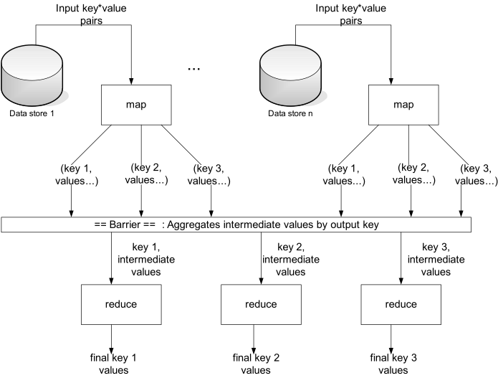

Slide 13
Parallelism
map() functions run in parallel, creating different intermediate values from different input data sets
reduce() functions also run in parallel, each working on a different output key
All values are processed independently
Bottleneck: reduce phase can’t start until map phase is completely finished.

Slide 14
Example: Count word occurrences
map(String input_key, String input_value):
// input_key: document name
// input_value: document contents
for each word w in input_value:
EmitIntermediate(w, "1");
reduce(String output_key, Iterator intermediate_values):
// output_key: a word
// output_values: a list of counts
int result = 0;
for each v in intermediate_values:
result += ParseInt(v);
Emit(AsString(result));

Slide 15
Example vs. Actual Source Code
Example is written in pseudo-code
Actual implementation is in C++, using a MapReduce library
Bindings for Python and Java exist via interfaces
True code is somewhat more involved (defines how the input key/values are divided up and accessed, etc.)

Slide 16
Locality
Master program divvies up tasks based on location of data: tries to have map() tasks on same machine as physical file data, or at least same rack
map() task inputs are divided into 64 MB blocks: same size as Google File System chunks

Slide 17
Fault Tolerance
Master detects worker failures
  Re-executes completed & in-progress map() tasks
  Re-executes in-progress reduce() tasks
Master notices particular input key/values cause crashes in map(), and skips those values on re-execution.
  Effect: Can work around bugs in third-party libraries!

Slide 18
Optimizations
No reduce can start until map is complete:
  A single slow disk controller can rate-limit the whole process
Master redundantly executes “slow-moving” map tasks; uses results of first copy to finish

Slide 19
Optimizations
“Combiner” functions can run on same machine as a mapper
Causes a mini-reduce phase to occur before the real reduce phase, to save bandwidth
Under what conditions is it sound to use a combiner?

Slide 20
MapReduce Conclusions
MapReduce has proven to be a useful abstraction
Greatly simplifies large-scale computations at Google
Functional programming paradigm can be applied to large-scale applications
Fun to use: focus on problem, let library deal w/ messy details

Slide 21
PageRank and MapReduce

Slide 22
PageRank: Formula
Given page A, and pages T₁ through T_{n} linking to A, PageRank is defined as:
PR(A) = (1-d) + d (PR(T₁)/C(T₁) + ... +
PR(T_{n})/C(T_{n}))
C(P) is the cardinality (out-degree) of page P
d is the damping (“random URL”) factor

Slide 23
PageRank: Intuition
Calculation is iterative: PR_{i+1} is based on PR_{i}
Each page distributes its PR_{i} to all pages it links to. Linkees add up their awarded rank fragments to find their PR_{i+1}
d is a tunable parameter (usually = 0.85) encapsulating the “random jump factor”
PR(A) = (1-d) + d (PR(T₁)/C(T₁) + ... + PR(T_{n})/C(T_{n}))

Slide 24
PageRank: First Implementation
Create two tables 'current' and 'next' holding the PageRank for each page. Seed 'current' with initial PR values
Iterate over all pages in the graph (represented as a sparse adjacency matrix), distributing PR from 'current' into 'next' of linkees
current := next; next := fresh_table();
Go back to iteration step or end if converged

Slide 25
Distribution of the Algorithm
Key insights allowing parallelization:
  The 'next' table depends on 'current', but not on any other rows of 'next'
  Individual rows of the adjacency matrix can be processed in parallel
  Sparse matrix rows are relatively small

Slide 26
Distribution of the Algorithm
Consequences of insights:
  We can map each row of 'current' to a list of PageRank “fragments” to assign to linkees
  These fragments can be reduced into a single PageRank value for a page by summing
  Graph representation can be even more compact; since each element is simply 0 or 1, only transmit column numbers where it's 1

Slide 27
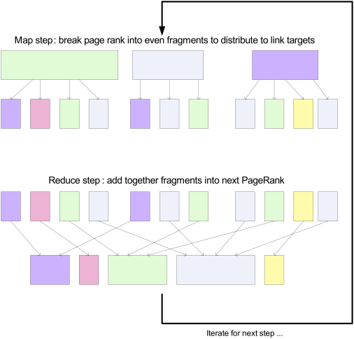

Slide 28
Phase 1: Parse HTML
Map task takes (URL, page content) pairs and maps them to (URL, (PR_{init}, list-of-urls))
  PR_{init} is the “seed” PageRank for URL
  list-of-urls contains all pages pointed to by URL
Reduce task is just the identity function

Slide 29
Phase 2: PageRank Distribution
Map task takes (URL, (cur_rank, url_list))
  For each u in url_list, emit (u, cur_rank/|url_list|)
  Emit (URL, url_list) to carry the points-to list along through iterations
PR(A) = (1-d) + d (PR(T₁)/C(T₁) + ... + PR(T_{n})/C(T_{n}))

Slide 30
Phase 2: PageRank Distribution
Reduce task gets (URL, url_list) and many (URL, val) values
  Sum vals and fix up with d
  Emit (URL, (new_rank, url_list))
PR(A) = (1-d) + d (PR(T₁)/C(T₁) + ... + PR(T_{n})/C(T_{n}))

Slide 31
Finishing up...
A non-parallelizable component determines whether convergence has been achieved (Fixed number of iterations? Comparison of key values?)
If so, write out the PageRank lists - done!
Otherwise, feed output of Phase 2 into another Phase 2 iteration

Slide 32
Conclusions
MapReduce isn't the greatest at iterated computation, but still helps run the “heavy lifting”
Key element in parallelization is independent PageRank computations in a given step
Parallelization requires thinking about minimum data partitions to transmit (e.g., compact representations of graph rows)
  Even the implementation shown today doesn't actually scale to the whole Internet; but it works for intermediate-sized graphs

Slide 33
Controversial Views
http://databasecolumn.vertica.com/database-innovation/mapreduce-a-major-step-backwards/
http://databasecolumn.vertica.com/database-innovation/mapreduce-ii/

