Slide 1

Megastore: Providing Scalable, Highly Available Storage for Interactive Services
J. Baker, C. Bond, J.C. Corbett, JJ Furman, A. Khorlin,
J. Larson, J-M Léon, Y. Li, A. Lloyd, V. Yushprakh
Google Inc.
Originally presented at CIDR 2011 by James Larson
Presented by George Lee

Slide 2
With Great Scale Comes Great
Responsibility
A billion Internet users
  Small fraction is still huge
Must please users
  Bad press is expensive - never lose data
  Support is expensive - minimize confusion
  No unplanned downtime
  No planned downtime
  Low latency
Must also please developers, admins

Slide 3
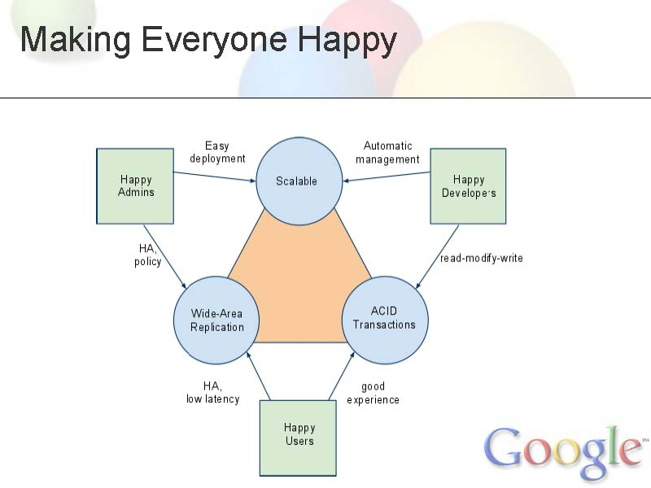

Slide 4
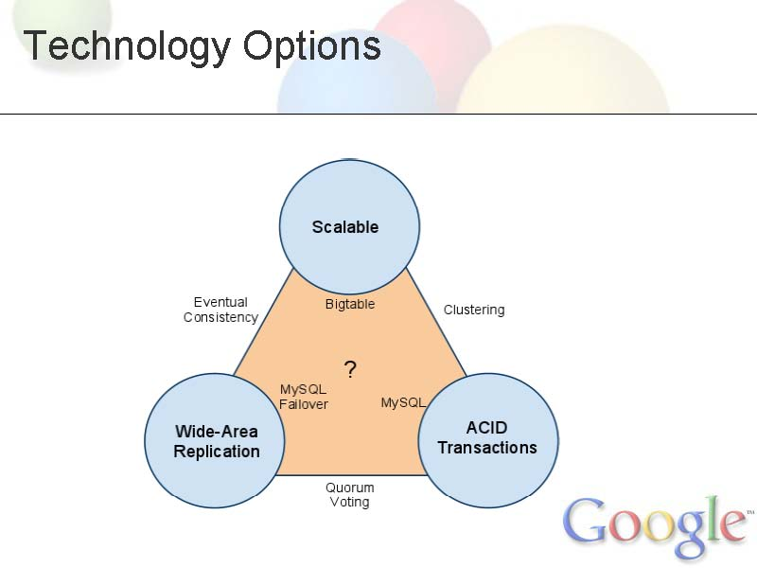

Slide 5
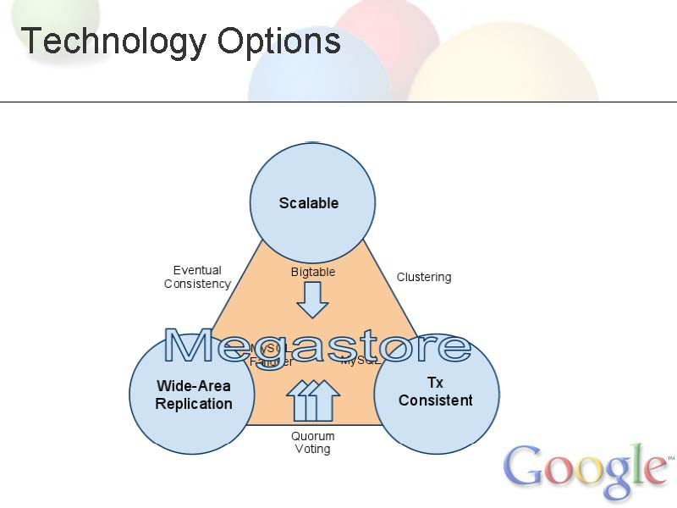

Slide 6
Megastore
Started in 2006 for app development at Google
Service layered on:
  Bigtable (NoSQL scalable data store per datacenter)
  Chubby (Config data, config locks)
Turnkey scaling (apps, users)
Developer-friendly features
Wide-area synchronous replication
  partition by "Entity Group"

Slide 7
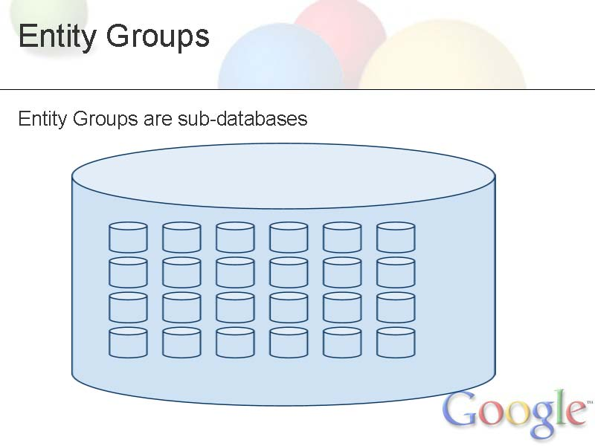

Slide 8
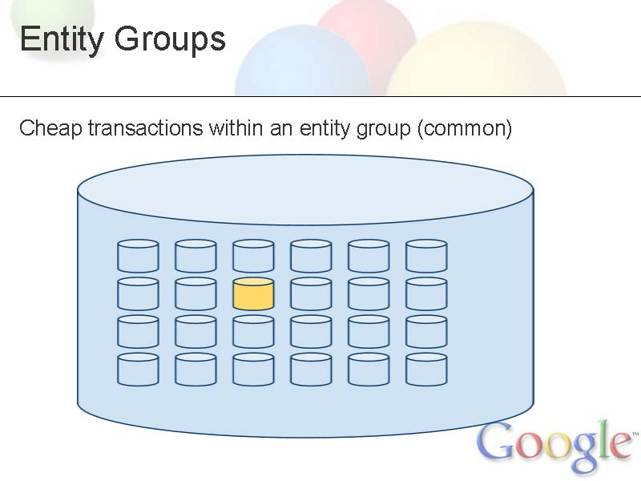

Slide 9
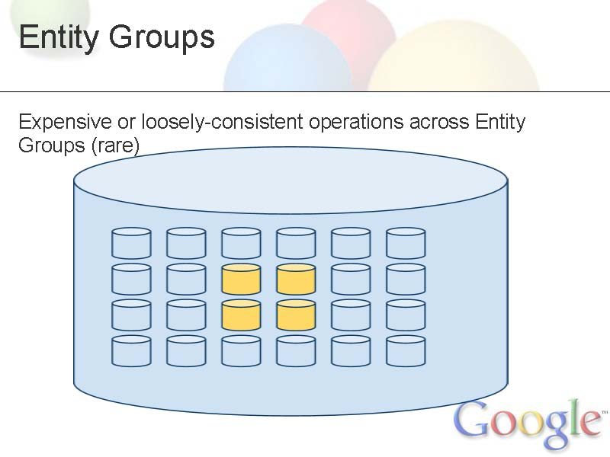

Slide 10
Entity Group Examples
Application | Entity Groups | Cross-EG Ops
Email | User accounts | none
Blogs | Users, Blogs | Access control, notifications, global indexes
Mapping | Local patches | Patch-spanning ops
Social | Users, Groups | Messages, relationships, notifications
Resources | Sites | Shipments

Slide 11
Achieving Technical Goals
Scale
  Bigtable within datacenters
  Easy to add Entity Groups (storage, throughput)
ACID Transactions
  Write-ahead log per Entity Group
  2PC or Queues between Entity Groups
Wide-Area Replication
  Paxos
  Tweaks for optimal latency

Slide 12
Two Phase Commit
Commit request/Voting phase
  Coordinator sends query to commit
  Cohorts prepare and reply
Commit/Completion phase
  Success: Commit and acknowledge
  Failure: Rollback and acknowledge
Disadvantage: Blocking protocol

Slide 13
Basic Paxos
Prepare and Promise
  Proposer selects proposal number N and sends promise to acceptors
  Acceptors accept or deny the promise
Accept! and Accepted
  Proposer sends out value
  Acceptors respond to proposer and learners

Slide 14
Message Flow: Basic Paxos
Client Proposer Acceptor Learner
| | | | | | |
X-------->| | | | | | Request
| X--------->|->|->| | | Prepare(N)
| |<---------X--X--X | | Promise(N,{Va,Vb,Vc})
| X--------->|->|->| | | Accept!(N,Vn)
| |<---------X--X--X------>|->| Accepted(N,Vn)
|<---------------------------------X--X Response
| | | | | | |

Slide 15
Paxos: Quorum-based Consensus
"While some consensus algorithms, such as Paxos, have started to find their way into [large-scale distributed storage systems built over failure-prone commodity components], their uses are limited mostly to the maintenance of the global configuration information in the system, not for the actual data replication."
-- Lamport, Malkhi, and Zhou, May 2009

Slide 16
Paxos and Megastore
In practice, basic Paxos is not used
Master-based approach?
Megastore’s tweaks
  Coordinators
  Local reads
  Read/write from any replica
  Replicate log entries on each write

Slide 17
Omissions
These were noted in the talk:
No current query language
  Apps must implement query plans
  Apps have fine-grained control of physical placement
Limited per-Entity Group update rate

Slide 18
Is Everybody Happy?
Admins
  linear scaling, transparent rebalancing (Bigtable)
  instant transparent failover
  symmetric deployment
Developers
  ACID transactions (read-modify-write)
  many features (indexes, backup, encryption, scaling)
  single-system image makes code simple
  little need to handle failures
End Users
  fast up-to-date reads, acceptable write latency
  consistency

Slide 19
Take-Aways
Constraints acceptable to most apps
  Entity Group partitioning
  High write latency
  Limited per-EG throughput
In production use for over 4 years
Available on Google App Engine as HRD (High Replication Datastore)

Slide 20
Questions?
Rate limitation on writes are insignificant?
Why not lots of RDBMS?
Why not NoSQL with “mini-databases”?

