Slide 1
ICS 624 Spring 2011 Multi-Dimensional Clustering
Asst. Prof. Lipyeow Lim
Information & Computer Science Department
University of Hawaii at Manoa

Slide 2
Clustered vs Unclustered Index
Suppose data records are stored in a Heap file.
To build clustered index, first sort the Heap file (with some free space on each page for future inserts).
Overflow pages may be needed for inserts. (Thus, order of data recs is `close to’, but not identical to, the sort order.)
Index entries
UNCLUSTERED
CLUSTERED
direct search for
data entries
Data entries
Data entries
(Index File)
(Data file)
Data Records
Data Records

Slide 3
Accessing Data on Disk
Seek time: time to move disk heads over the required track
Rotational delay: time for desired sector to rotate under the disk head.
Assume uniform distribution, on average time for half a rotation
Transfer time: time to actually read/write the data
tracks
sector
Arms move
over tracks
spindle
rotates

Slide 4
Example: Barracuda 1TB HDD (ST31000528AS)
What is the average time to read 2048 bytes of data ?
= Seek time + rotational latency + transfer time
= 8.5 msec + 4.16 msec + ( 2048 / 512 ) / 63 * (60 000 msec / 7200 rpm )
= 8.5 + 4.16 + 0.265
cylinders | 121601
Bytes/cylinder | 16065*512
Blocks/cylinder | 8029
Sectors/track | 63
Heads | 255
Sprindle Speed | 7200 rpm
Average Latency | 4.16 msec
Random read seek time | < 8.5 msec
Random read Write time | < 9.5 msec

Slide 5
Motivating Examples
SELECT Sum(S.sales)
FROM Sales S
WHERE S.yearOd=1997
SELECT Sum(S.sales)
FROM Sales S
WHERE S.region=‘Mexico’ AND
S.itemID=2 AND
S.yearOd=1997
SELECT Sum(S.sales)
FROM Sales S
WHERE S.region=‘Canada’
Suppose
Sales table is sorted by year
Index on region
Index on itemID
Index on yearOd
Index entries are <key,rids>

Slide 6
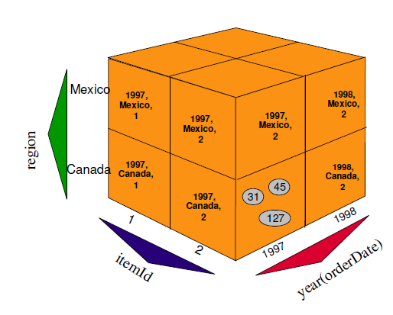
Multi-Dimensional Clustering (MDC)
DB2 v8 and above.
Physical layout mimics a multi-dimensional cube
Associates a physical region called blocks for each unique combination of dimension attribute values.
These blocks are the units of addressability for our clusters.
A block index that addresses these blocks.
CREATE TABLE Sales(
int storeId, date orderDate, int region, int itemId, float price, int yearOd generated always as year(orderDate)) ORGANIZE BY DIMENSIONS
(region, yearOd, itemId)
See Multi-Dimensional Clustering: A New Data Layout Scheme in DB2. SIGMOD 2003: 637-641

Slide 7
MDC Storage Layout
Conventional
Heap File
Tuples and pages sorted by eg. time
MDC Storage Layout
Pages grouped into blocks by multi-dimensional values
Blocks sorted by multi-dimensional values.

Slide 8
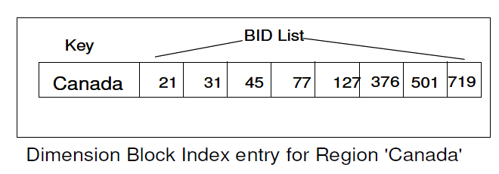
Dimension Block Index
MDC Storage Layout
Regular B-tree indexes except that data entries contain <key,bid list>
One index for each dimension
SELECT Sum(S.sales)
FROM Sales S
WHERE S.region=‘Canada’

Slide 9
Issues & Questions
Choosing the MDC dimensions
Overhead in maintaining the additional level of indirection
Maintaining the clustering with updates

