Slide 1
Parallel Database Systems
The Future of High Performance Database Systems
Authors: David DeWitt and Jim Gray
Presenter: Jennifer Tom
Based on Presentation by Ajith Karimpana

Slide 2
Outline
Why Parallel Databases?
Parallel Database Implementation
Parallel Database Systems
Future Directions and Research Problems

Slide 3
Why Parallel Databases?
Relational Data Model – Relational queries are ideal candidates for parallelization
Multiprocessor systems using inexpensive microprocessors provide more power and scalability than expensive mainframe counterparts
Why do the relational queries allow for parallelization?
Notes:
Operations can be executed in parallel on parallel streams of data
Operations can be composed into dataflow graphs

Slide 4


Properties of Ideal Parallelism
Linear Speedup – An N-times large system yields a speedup of N
Linear Scaleup – An N-times larger system performs an N-times larger job in the same elapsed time as the original system
Why are linear speedup and linear scaleup indicators of good parallelism?
Notes:
Linear Speedup: Performance improvements grows linearly as the number of processors increases (good scalability)
Linear Scaleup: A system has the same performance when a job and the number of processors are both increased N times (maintain performance with larger jobs by increasing the number of processors)

Slide 5
Types of Scaleup
Transactional – N-times as many clients submit N-times as many requests against an N-times larger database.
Batch – N-times larger problem requires an N-times larger computer.
Should we look at both transactional scaleup and batch scaleup for all situations when assessing performance?
Notes:
Transactional scaleup: Banking,

Slide 6
Barriers to Linear Speedup and
Linear Scaleup
Startup: The time needed to start a parallel operation dominates the total execution time
Interference: A slowdown occurs as new processes are added when accessing shared resources
Skew: A slowdown occurs when the variance exceeds the mean in job service times
Give example situations where you might come across interference and skew barriers?

Slide 7
Shared-Nothing Machines
Shared-memory – All processors have equal access to a global memory and all disks
Shared-disk – Each processor has its own private memory, but has equal access to all disks
Shared-nothing – Each processor has its own private memory and disk(s)
Why do shared-nothing systems work well for database systems?
Notes:
Shared-memory: Interference. The interconnect must have the bandwidth of the sum of the processors and disks. Need a large private cache, but this degrades processor performance. As parallelism increases, interference on shared resources limits performance
Shared-disk: Ok for read-only db with no concurrent sharing, but not effective for concurrent read and writes to a shared db.
Shared-nothing: Reduces interference and it scales well. Good for shared database applications.

Slide 8
Parallel Dataflow Approach
Relational data model operators take relations as input and produce relations as output
Allows operators to be composed into dataflow graphs (operations can be executed in parallel)
How would you compose a set of operations for an SQL query to be done in parallel?

Slide 9
Pipelined vs. Partitioned Parallelism
Pipelined: The computation of one operator is done at the same time as another as data is streamed into the system.
Partitioned: The same set of operations is performed on tuples partitioned across the disks. The set of operations are done in parallel on partitions of the data.
Can you give brief examples of each? Which parallelism is generally better for databases?
Notes:
Partitioned Parallelism: Better opportunities for speedup and scaleup. Uses divide and conquer to achieve increased performance.

Slide 10
Data Partitioning
Round-robin – For n processors, the i^{th} tuple is assigned to the “i mod n” disk.
Hash partitioning – Tuples are assigned to the disks using a hashing function applied to select fields of the tuple.
Range partitioning – Clusters tuples with similar attribute values on the same disk.
What operations/situations are ideal (or not ideal) for the above partitioning types?
What issues to database performance may arise due to partitioning?
Notes:
Round-Robin
Ideal for applications that wish to read entire relation sequentially for each query.
Not ideal for point and range queries, since each of the n disks must be searched.
Hash
Ideal for point queries based on the partitioning attribute.
Ideal for sequential scans of the entire relation.
Not ideal for point queries on non-partitioning attributes.
Not ideal for range queries on the partitioning attribute.
Range
Ideal for point and range queries on the partitioning attribute.

Slide 11
Skew Problems
Data skew – The number of tuples vary widely across the partitions.
Execution skew – Due to data skew, more time is spent to execute an operation on partitions that contain larger numbers of tuples.
How could these skew problems be minimized?
Notes:
Hashing and round-robin.
Range partitioning: pick non-uniformly-distributed partitioning criteria.

Slide 12
Parallel Execution of Relational Operators
Rather than write new parallel operators, use parallel streams of data to execute existing relational operators in parallel
Relational operators have (1) a set of input ports and (2) an output port
Parallel dataflow – partitioning and merging of data streams into the operator ports
Are there situations in which parallel dataflow does not work well?
Notes:
Sort-merge join and data skew

Slide 13
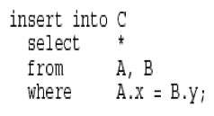
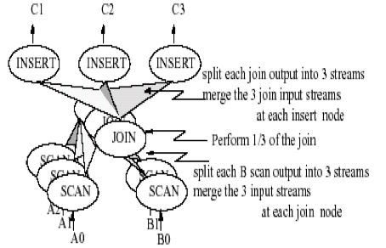
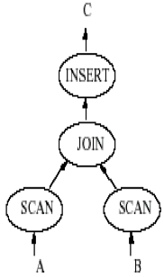
Simple Relational Dataflow Graph

Slide 14
Parallelization of Hash-Join
Sort-merge join does not work well if there is data skew
Hash-join is more resistant to data skew
To join 2 relations, we divide the join into a set of smaller joins
The union of these smaller joins should result in the join of the 2 relations
How might other relational algorithms/operations (like sorting) be parallelized to improve query performance?

Slide 15
Parallel Database Systems
Teradata – Shared-nothing systems that use commodity hardware. Near linear speedup and scaleup on relational queries.
Tandem NonStop SQL – Shared-nothing architecture. Near linear speedup and scaleup for large relational queries.
Gamma – Shared-nothing system. Provides hybrid-range partitioning. Near linear speed and scaleup measured.
The Super Database Computer – Has special-purpose components. However, is shared-nothing architecture with dataflow.
Bubba – Shared-nothing system, but uses shared-memory for message passing. Uses FAD rather than SQL. Uses single-level storage
Should we focus on the use of commodity hardware to build parallel database systems?

Slide 16
Database Machines and Grosch’s Law
Grosch’s Law – The performance of computer systems increase as the square of their cost. The more expensive systems have better cost to performance ratios.
Less expensive shared-nothing systems like Gamma, Tandem, and Teradata achieve near-linear performance (compared to mainframes)
Suggests that Grosch’s Law no longer applies

Slide 17
Future Directions and Research Problems
Concurrent execution of simple and complex queries
  Problem with locks and large queries
  Priority scheduling (priority inversion scheduling)
Parallel Query Optimization – Optimizers do not take into account parallel algorithms. Data skew creates poor query plan cost estimates.
Application Program Parallelization – Database applications are not parallelized. No effective way to automate the parallelization of applications.

Slide 18
Future Directions and Research Problems
Physical Database Design – Tools are needed to determine indexing and partitioning schemes given a database and its workload.
On-line Data Reorganization – Availability of data for concurrent reads and writes as database utilities create indices, reorganize data, etc. This process must be (1) online, (2) incremental, (3) parallel, and (4) recoverable.
Which of these issues may be extremely difficult to resolve?

