Slide 1
ICS 624 Spring 2011 Graph Data & RDF
Asst. Prof. Lipyeow Lim
Information & Computer Science Department
University of Hawaii at Manoa

Slide 2

Resource Description Framework (RDF)
ID | Author | Title | Publisher | Year
Isbn0-00-651409-X | Id_xyz | The glass palace | Id_qpr | 2000
ID | Name | Homepage
Id_xyz | Ghosh, Amitav | http://www.amitavghosh.com
ID | Publisher Name | City
Id_qpr | Ghosh, Amitav | London

Slide 3
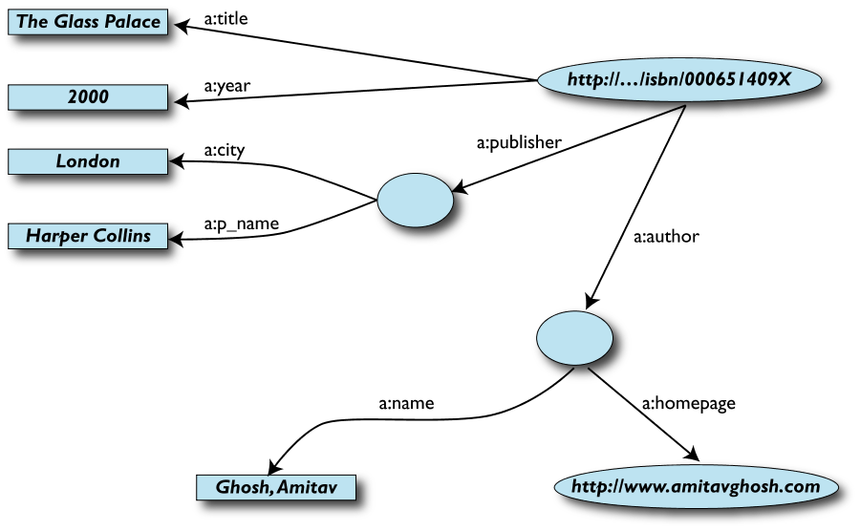
RDF Graph Data Model
Edges represent relationships or properties
Nodes can also represent an entity
Nodes can be literals

Slide 4
More formally
An RDF graph consists of a set of RDF triples
An RDF triple (s,p,o)
“s”, “p” are URI-s, ie, resources on the Web;
“o” is a URI or a literal
“s”, “p”, and “o” stand for “subject”, “property” (aka “predicate”), and “object”
here is the complete triple: (<http://...isbn...6682>, <http://..//original>, <http://...isbn...409X>)
RDF is a general model for such triples
RDF can be serialized to machine readable formats:
RDF/XML, Turtle, N3 etc

Slide 5
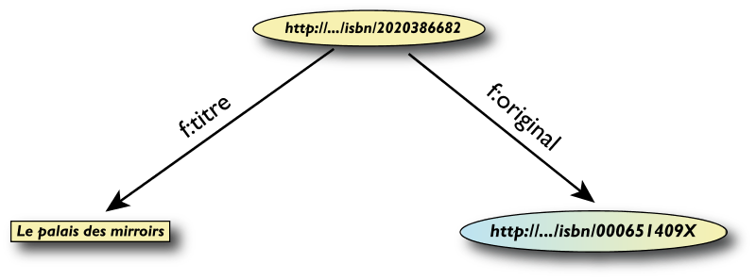
RDF/XML
<rdf:Description rdf:about="http://…/isbn/2020386682">
<f:titre xml:lang="fr">Le palais des mirroirs</f:titre>
<f:original rdf:resource="http://…/isbn/000651409X"/>
</rdf:Description>

Slide 6
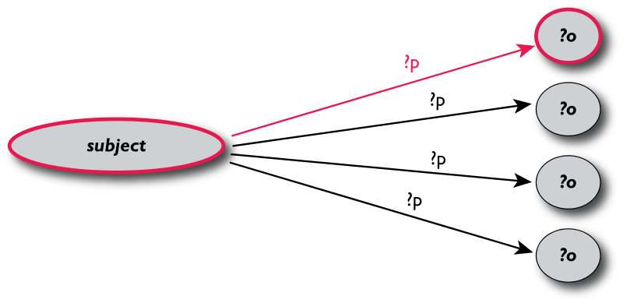
Querying RDF using SPARQL
The fundamental idea: use graph patterns
the pattern contains unbound symbols
by binding the symbols, subgraphs of the RDF graph are selected
if there is such a selection, the query returns bound resources
SELECT ?p ?o
WHERE {subject ?p ?o}
Where-clause defines graph patterns. ?p and ?o denote “unbound” symbols

Slide 7
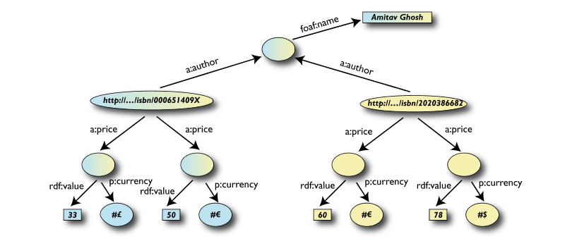
Example: SPARQL
SELECT ?isbn ?price ?currency # note: not ?x!
WHERE {?isbn a:price ?x.
?x rdf:value ?price.
?x p:currency ?currency.}

Slide 8
Linking Open Data
Goal: “expose” open datasets in RDF
Set RDF links among the data items from different datasets
Set up, if possible, query endpoints
Example: DBpedia is a community effort to
extract structured (“infobox”) information from Wikipedia
provide a query endpoint to the dataset
interlink the DBpedia dataset with other datasets on the Web

Slide 9
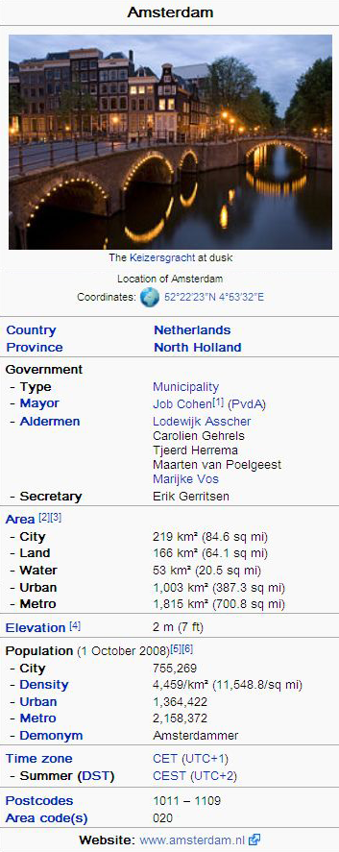
DBPedia
@prefix dbpedia <http://dbpedia.org/resource/>.
@prefix dbterm <http://dbpedia.org/property/>.
dbpedia:Amsterdam dbterm:officialName "Amsterdam" ; dbterm:longd "4” ;
dbterm:longm "53" ;
dbterm:longs "32” ; dbterm:leaderName dbpedia:Job_Cohen ;
...
dbterm:areaTotalKm "219" ;
...
dbpedia:ABN_AMRO
dbterm:location dbpedia:Amsterdam ;
...

Slide 10
Linking the Data
<http://dbpedia.org/resource/Amsterdam> owl:sameAs <http://rdf.freebase.com/ns/...> ;
owl:sameAs <http://sws.geonames.org/2759793> ;
...
<http://sws.geonames.org/2759793>
owl:sameAs <http://dbpedia.org/resource/Amsterdam>
wgs84_pos:lat "52.3666667" ;
wgs84_pos:long "4.8833333";
geo:inCountry <http://www.geonames.org/countries/#NL> ;
...

