Slide 1
Toward Scalable Keyword Search over Relational Data
Akanksha Baid, Ian Rae, Jiexing Li, AnHai Doan, and Jeffrey Naughton
University of Wisconsin
VLDB 2010
2011. 02. 18.
Original Slides by Jaehui Park
2011. 04. 18
Modified by Bao Huy Ung

Slide 2
Introduction
The success of search engines
Significant attention on Keyword Search over Relational Databases
Robustness, Accuracy, Reliability, and Privacy
Performance related issues
Unpredictable running times
KWS solutions often require the solution of sub-problems that are NP-complete.
But, users want answers under an absolute time limit.
Basic idea
Combining KWS systems with forms
Producing answers that can be generated quickly as in today's KWS systems
Showing users query forms that characterize the unexplored portion of the answer space

Slide 3
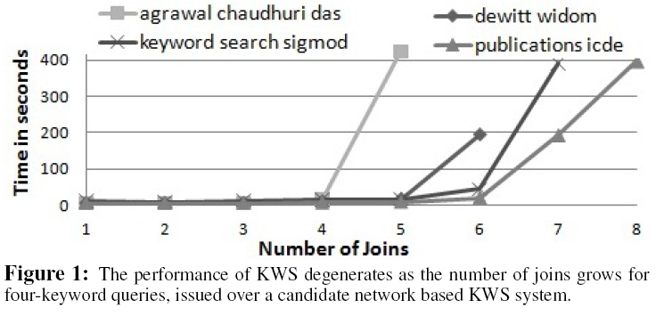
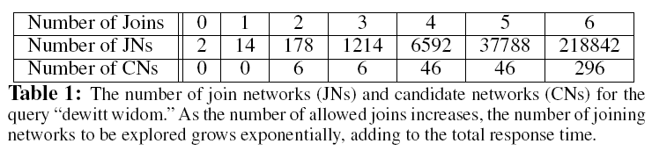
Problems in current KWS solutions
Running time increases as the number of joins is increased.
Core problem
Dealing with the problem of searching a graph to find all sub-graphs that satisfy certain properties. (Steiner tree problem: NP-hard)
Existing Solutions
Bounding maximum number of joins
Considering top-k answers

Slide 4
KWS-F: Keyword Search using Forms
How can we enable naïve users to pose complex SQL queries
Generate a set of SQL queries that are most likely to be asked by naïve users
Generate a set of query forms that encode those SQL queries
Two indexes
DataIndex
keyword -> schema-term
generating a set of form queries
FormIndex
returning form-ids
Limitations
A tedious process
The user must examine the forms that KWS-F returns, select promising ones, fill them out, submit them, examine the results, and potentially repeat it.

Slide 5
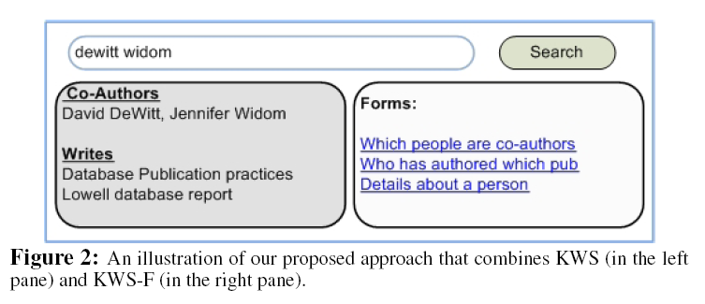
Combining KWS and KWS-F
To achieve predictable performance and good coverage
Time limit
when the time limit has been reached, a result must be returned
missing answers
the system give the user an idea about what the unexplored portion of the answer space "look like"

Slide 6
Combining KWS and KWS-F
When ranking cannot help
Cases where a good ranking function does not exist
When many result tuples having the same score are returned
Forms offer a "guidance effect"
Offering a good transition to go from an unstructured keyword query to the results of a structured query
partially structured query

Slide 7
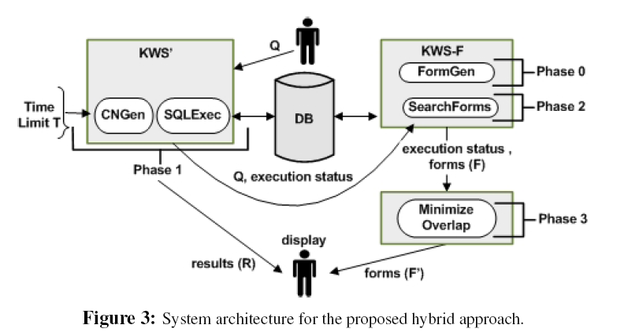
The Hybrid Approach
Phase 0
generating a large set of forms offline
Phase 1
given the user query Q and the time limit T, the system KWS' attempts to only generate those CNs and executes those SQL queries that can be completed within time T
Phase 2
send Q together with a status report on its execution
obtaining a ranked list of forms
Phase 3
examines the status report
remove forms have been covered by the KWS'

Slide 8
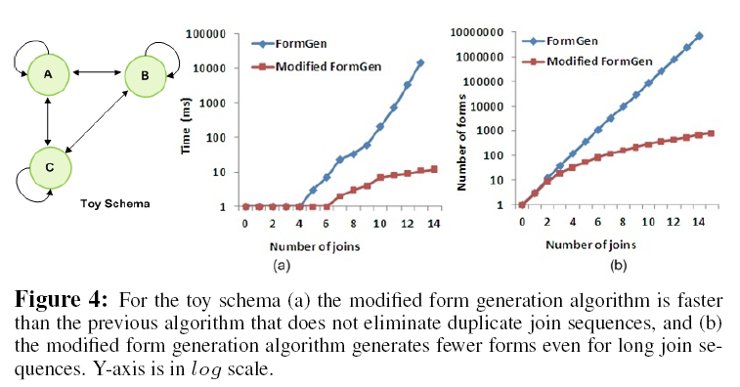
KWS-F: Form generation (Phase 0)
Generating forms based only on the primary key-foreign key relationships in the underlying schema graph
Many duplicates in generating forms
ex) 29304 duplicates in 29523 forms (219 unique join sequences)
Duplicate form elimination
Exploiting the property that joins are both associative and commutative

Slide 9
KWS: CN generation and SQL Execution (Phase 1)
Modified KWS system
Options
Waiting for CN generation to terminate before starting the SQL query execution
Dividing the time budget T into two parts
Failure to estimate this division accurately
Interleaving CN generation and SQL query execution
(Algorithm 2)Producer-consumer fashion using two separate threads
While CN generation continues, SQL queries are executed based on where they occur in the priority queue
Order by query execution cost (disk page fetches)

Slide 10
KWS-F: Search (Phase 2)
Once KWS' has terminated, the results are displayed to users
The query and the execution status of KWS's are passed to the KWS-F
Form search step
Full-text index Form Index over the forms was generated in Phase 0
Returning forms that is multiple conjunctive schema term queries

Slide 11
KWS-F: Minimizing overlap (Phase 3)
Why overlap minimization is important
Redundant forms and limited screen size
Two conditions: Discard a form f only if
All CNs that map to the form f have been generated in Phase 1. The list of CN templates populated in Phase 1 is used to verify this condition.
All SQL queries corresponding to the form f have been executed in Phase 1. The list of unexecuted queries is used to verify this condition.

Slide 12
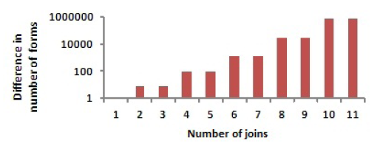
Experimental Evaluation
Data sets
DBLP
680MB (in XML) , 1340MB (in RDB)
DBLife
40MB (801189 tuples in 14 tables)
The new algorithm generates 30%-40% fewer forms than the baseline algorithm

Slide 13
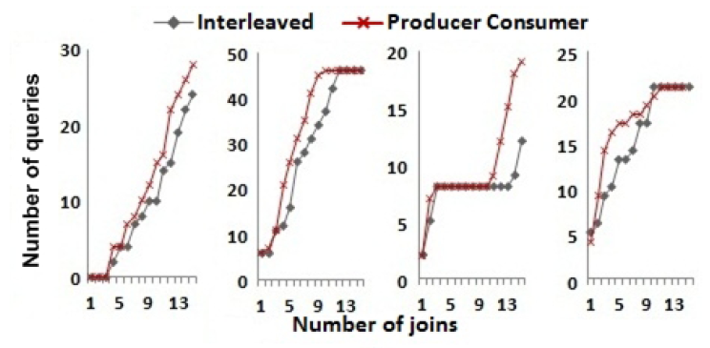
Experimental Evaluation
Time out based strategy
Time limit = 15s
The number of SQL queries executed by each approach
The producer-consumer based approach performs better

Slide 14
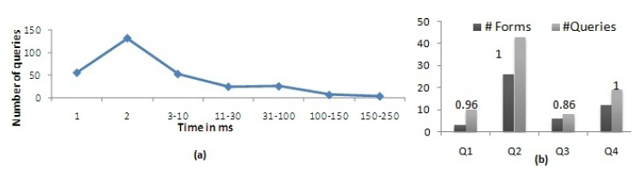
Experimental Evaluation
The distribution of the SQL queries generated in response to the keyword query "dewitt widom"
Ordering the queries by estimated execution cost does yield some benefit
The overlap minimization algorithm
The number of forms and the number of SQL queries eliminated for each query

Slide 15
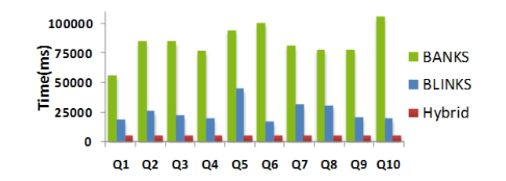
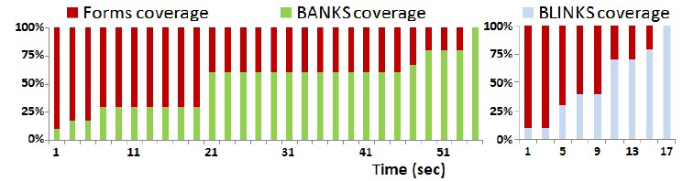
Experimental Evaluation
The hybrid approach apply to recent systems
BANKS, BLINKS, EASE

Slide 16
Questions
What is a reasonable time restraint for users?
What types of forms are used in KWSF systems?
Designed with novice users in mind, what kind of real world applications?

