Slide 1
ICS 624 Spring 2011 Entity Resolution with Evolving Rules Preface to Steven Whang’s slides
Asst. Prof. Lipyeow Lim
Information & Computer Science Department
University of Hawaii at Manoa

Slide 2
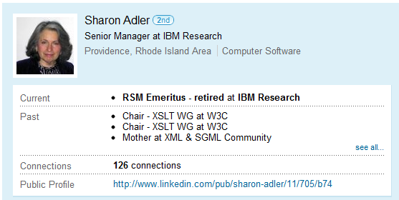
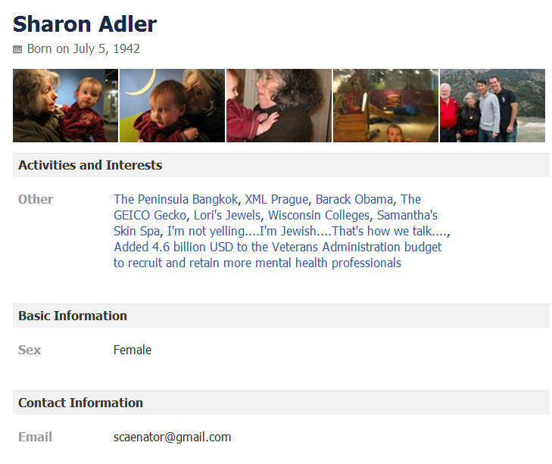
Outline
Facebook
LinkedIn
Are these two pages referring to the same person ?

Slide 3
Entity Resolution (ER)
comparison shopping
mailing lists
classified ads
customer files
counter-terrorism
r1
Name | Address | Credit Card | Phone
Sharon | RI | 123122 | 303-123-9989
r2
Name | Affiliation | Phone
Sharon | IBM | 303-123-9989
Are these two records referring to the same entity ?

Slide 4
Entity Resolution Problem Statement
Given a table of records (about some entities), partition the records according to the “entities” that they refer to.
Name | Address | Credit Card | Phone
Sharon | RI | 123122 | 303-123-9989
Sharon | NY | 122223 | 303-123-9989
John | NY | 333222 | 212-222-4433
John | NJ | 222333 | 212-222-4433
Entity: Sharon
Entity: John

Slide 5
ER Rules
Name | Address | Credit Card | Phone
Sharon | RI | 123122 | 303-123-9989
Sharon | NY | 122223 | 303-123-9989
John | NY | 333222 | 212-222-4433
John | NJ | 222333 | 212-222-4433
ER Rule
Entity: Sharon
Entity: John
ER Rules: ER algorithm that computes the mapping of records to entities (“partition”)
Match-based: boolean rules like
“if the name in the two records are the same, then they belong to the same partition”
Distance-based: uses a distance function

Slide 6
Sorted Neighborhood (SN)
Avoids comparing all O(n²) pairs of records by:
Sorting records based on some column(s)
Comparing all pairs of records in a sliding window
Merging connected components into entities
Sort
Find pairs
Name | Address | Credit Card | Phone
Sharon | RI | 123122 | 303-123-9989
Sharon | NY | 122223 | 303-123-9989
John | NY | 333222 | 212-222-4433
John | NJ | 222333 | 212-222-4433

Slide 7
HC_{B}: Hierarchical Clustering Boolean
Similar to bottom-up hierarchical agglomerative clustering
Merge two clusters if a boolean comparison rule B returns true.
Apply rule B on one chosen tuple in each of the two clusters
Name | Address | Credit Card | Phone
Sharon | RI | 123122 | 303-123-9989
Sharon | NY | 122223 | 303-123-9989
John | NY | 333222 | 212-222-4433
John | NJ | 222333 | 212-222-4433
B(r1,r2) = true if r1.name=r2.name

Slide 8
HC_{BR}: Hierarchical Clustering Boolean
Same as HC_{B} except in how comparison is evaluated.
Apply rule B on all pairs of tuples in each of the two clusters
Merge clusters if B is true on at least one pair
Name | Address | Credit Card | Phone
Sharon | RI | 123122 | 303-123-9989
Sharon | NY | 122223 | 303-123-9989
John | NY | 333222 | 212-222-4433
John | NJ | 222333 | 212-222-4433
B(r1,r2) = true if r1.name=r2.name

Slide 9
ME: Monge-Elkan Clustering
Sort records according to some column(s)
Initialize an empty fixed length queue of clusters
Scan through sorted records and match each record to clusters in queue
If record matches existing cluster, move cluster to front
Else make record into a new cluster at front of queue
If queue is full, last cluster is dropped
Name | Address | Credit Card | Phone
Sharon | RI | 123122 | 303-123-9989
Sharon | NY | 122223 | 303-123-9989
John | NY | 333222 | 212-222-4433
John | NJ | 222333 | 212-222-4433
Sort
Queue
Sharon

Slide 10
Distance-based ER Algorithms
Similar to bottom-up hierarchical agglomerative clustering with different variations on how distance is computed from two clusters
HC_{DS} Single-link : smallest possible distance between two records from the two clusters
HC_{DC} Complete-link : largest possible distance between two records from the two clusters
R1
R3
R2
R4

Slide 11
Evolving Rules
Input Records
ER Rule 1
Resolved Records R
ER Rule 2
Given Rule 1 and Rule 2, can we compute S from R?
ER Rule 3
Resolved Records S
Under what conditions would that be possible?

