Slide 1
Pregel: A System for Large-Scale Graph Processing
Paper by: Grzegorz Malewicz, Matthew Austern, Aart Bik, James Dehnert, Ilan Horn, Naty Leiser, Grzegorz Czajkowski (Google, Inc.)

Slide 2
What is it?
Model for fault-tolerant parallel processing of graphs
C++ API allowing users to apply this model

Slide 3
Why use it?
Problems solvable with graph algorithms are common
The alternatives aren’t very good
Develop distributed architecture for individual algorithms
Yuck.
Existing distributed platform (e.g., MapReduce)
Not very good at graph algorithms (multiple stages → lots of overhead)
Sometimes have to bend and twist problems into unnatural forms
Non-distributed graph library (e.g. LEDA, Boost Graph Library)
Not scalable (billions of vertices)
Existing parallel graph systems (e.g. Parallel BGL)
No fault tolerance
Don’t address other issues that Pregel (allegedly) does
The name sounds cool?

Slide 4
The Pregel model (1/2)
Master/Worker model
Each worker assigned a subset of a directed graph’s vertices
Vertex-centric model. Each vertex has:
An arbitrary “value” that can be get/set.
List of messages sent to it
List of outgoing edges (edges have a value too)
A binary state (active/inactive)

Slide 5
The Pregel model (2/2)
Bulk Synchronous Parallel model
Synchronous iterations of asynchronous computation
Master initiates each iteration (called a “superstep”)
At every superstep
Workers asynchronously execute a user function on all of its vertices
Vertices can receive messages sent to it in the last superstep
Vertices can send messages to other vertices to be received in the next superstep
Vertices can modify their value, modify values of edges, change the topology of the graph (add/remove vertices or edges)
Vertices can “vote to halt”
Execution stops when all vertices have voted to halt and no vertices have messages.
Vote to halt trumped by non-empty message queue

Slide 6
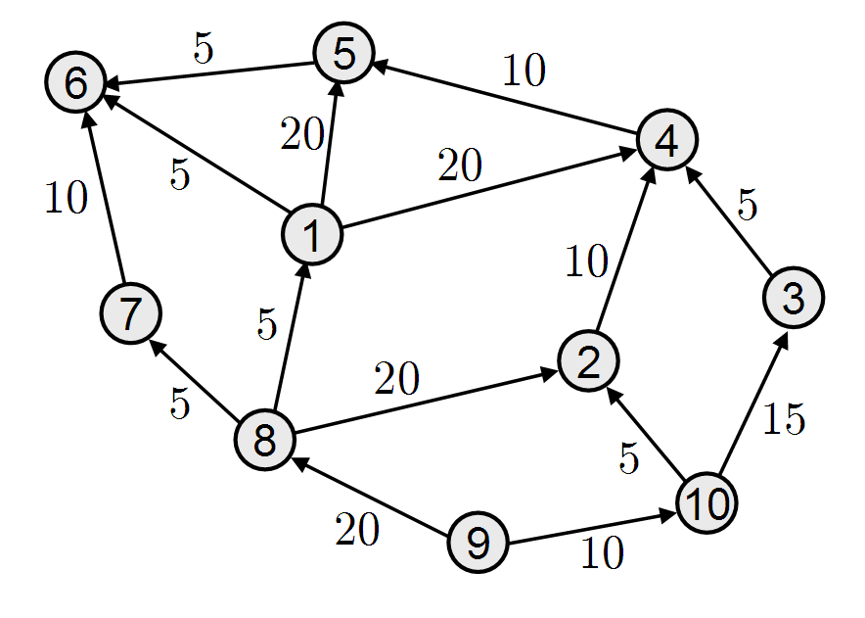
Illustration: vertex partitions
Worker 3
Worker 1
http://stochastix.files.wordpress.com/
Worker 2

Slide 7
Loading the graph input
Master assigns section of input to each worker
Vertex “ownership” determined by hash(v) mod N
N - number of partitions
Recall each worker is assigned one or more partitions
User can modify this to exploit data locality
Worker reads its section of input:
Stores vertices belonging to it
Sends other vertices to the appropriate worker
Input stored on something like GFS
Section assignments determined by data locality

Slide 8
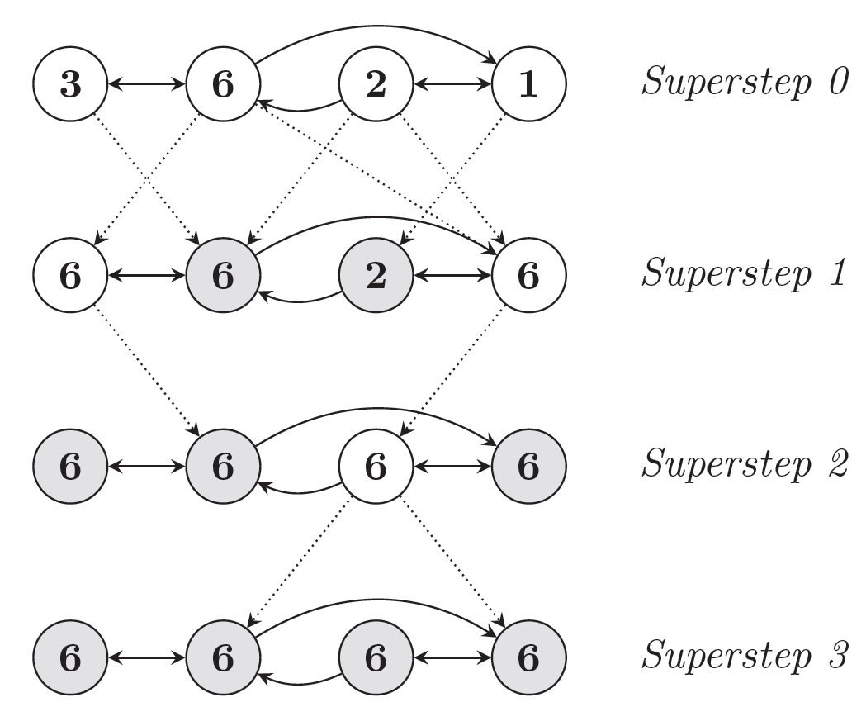
Simple example: find max
i_val := val
for each message m
if m > val then val := m
if i_val == val then
vote_to_halt
else
for each neighbor v
send_message(v, val)

Slide 9
Combiners
Sometimes vertices only care about a summary value for the messages it is sent (e.g., previous example)
Combiners allow for this (examples: min, max, sum, avg)
Messages combined locally and remotely
Reduces bandwidth overhead
User-defined, not enabled by default

Slide 10
Worker 1
Worker 2
v₀
v₂
v₃
v₅
v₁
v₄
Combiner
Combiner
Worker 3
Combiner
v_{s}

Slide 11
Aggregators
Compute aggregate statistics from vertex-reported values
During a superstep, each worker aggregates values from its vertices to form a partially aggregated value
At the end of a superstep, partially aggregated values from each worker are aggregated in a tree structure
Allows for the parallelization of this process
Global aggregate is sent to the master

Slide 12
master
global aggregate

Slide 13
Fault Tolerance (1/2)
At start of superstep, master tells workers to save their state:
Vertex values, edge values, incoming messages
Saved to persistent storage
Master saves aggregator values (if any)
This isn’t necessarily done at every superstep
That could be very costly
Authors determine checkpoint frequency using mean time to failure model

Slide 14
Fault Tolerance (2/2)
When master detects one or more worker failures:
All workers revert to last checkpoint
Continue from there
That’s a lot of repeated work!
At least it’s better than redoing the whole stinkin’ thing.

Slide 15
Confined Recovery
“Under development”
Workers log outgoing messages for each superstep
When a worker fails, it reverts to the last checkpoint
Other workers re-send messages sent to failed worker at each superstep occurring after the last checkpoint
Failed worker “catches up” to the rest.
Still have to wait on failed workers to catch up, but less use of resources (bandwidth, cpu, etc.)
Assumes determinism.

Slide 16
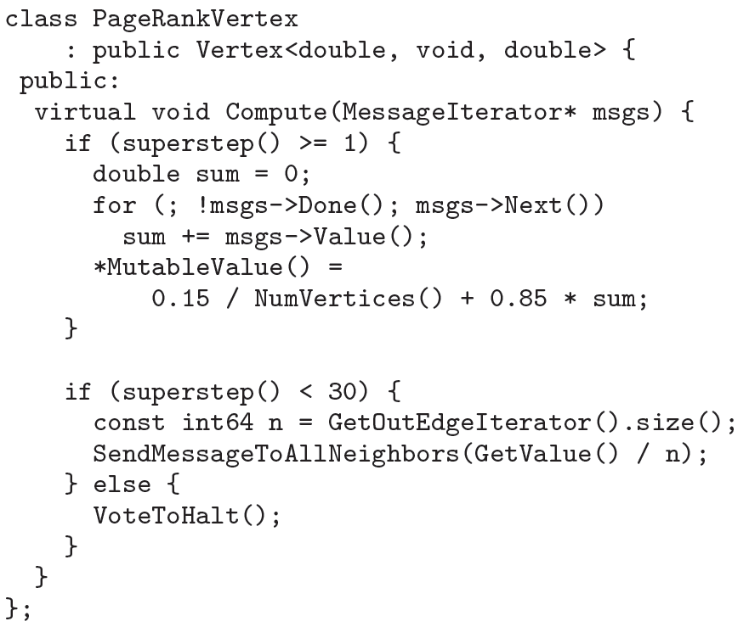

Example 1: PageRank
http://wikipedia.org

Slide 17
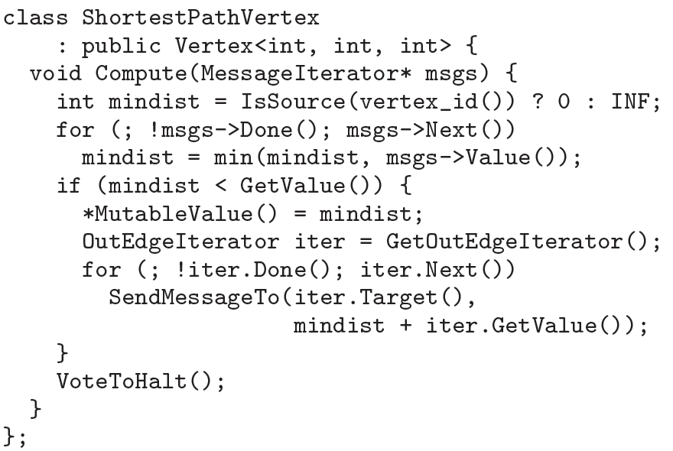
Example 2: Single Source Shortest Paths

Slide 18
At each superstep…
s
…
d₀
d₁
vertex receives messages
d_{v}
d₀ + w_{s}
d₀ + w_{t}
w_{s}
if min(d₀,d₁) < d_{v}, it sends messages to its neighbors
and updates its new minimum distance from s
else, it votes to halt
w_{t}
d_{s}
d_{t}
After execution, each vertex’s value is its minimum distance from s

Slide 19
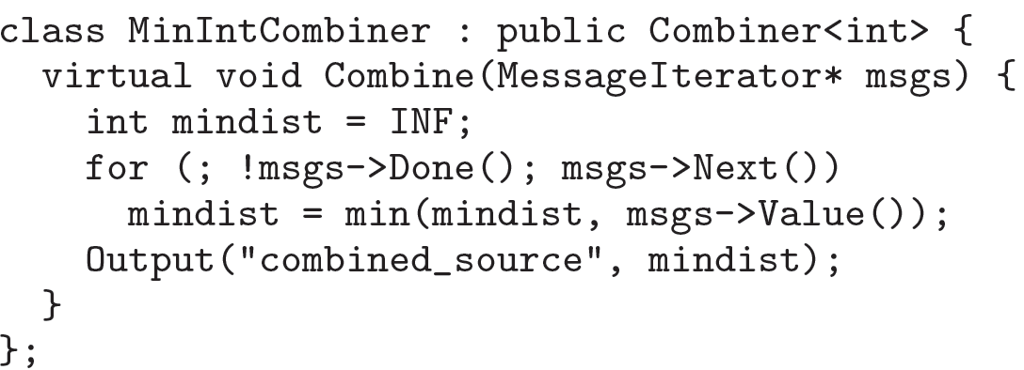
Example 2: SSSP Combiner
Each vertex interested only in minimum of its messages
Might as well use a combiner!

Slide 20
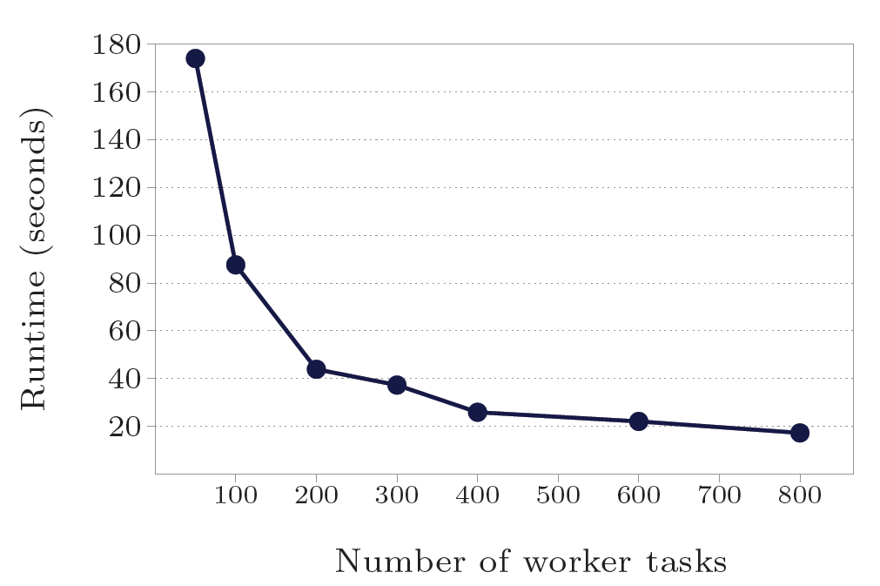
But does it blend…er…scale? (1/3)
Experiment 1:
SSSP on 1 billion vertex binary tree, vary number of workers

Slide 21
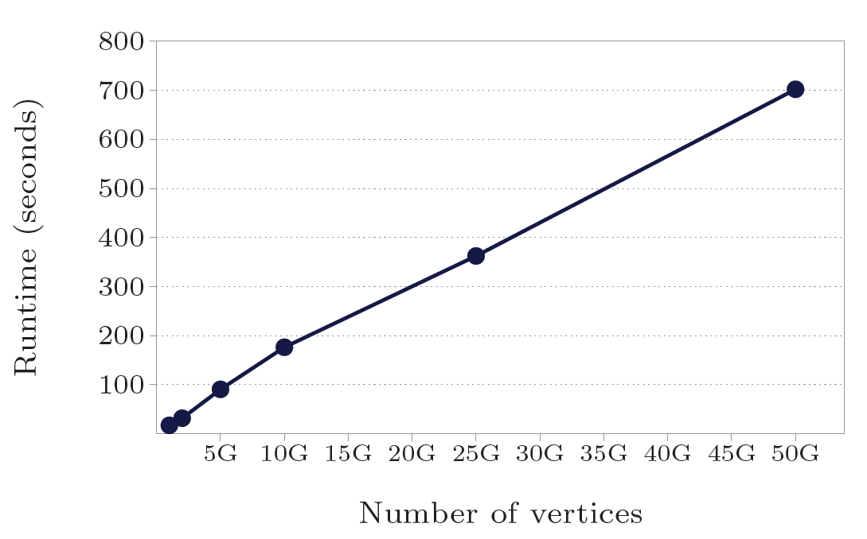
But does it blend…er…scale? (2/3)
Experiment 2:
SSSP on variable size binary trees, constant 800 workers

Slide 22
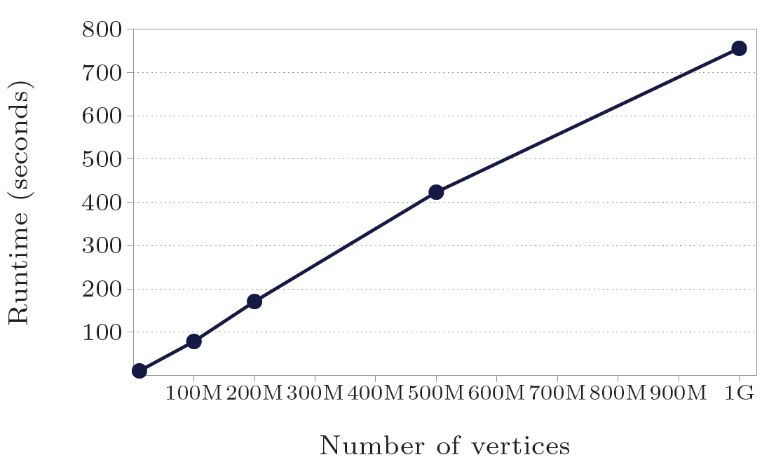
But does it blend…er…scale? (3/3)
Experiment 3:
SSSP on log-normal random graphs (mean out-degree = 127.1)
Previous experiments kinda meaningless – SSSP on binary trees isn’t exactly representative of hard graph problems.

Slide 23
Questions
Where are worker checkpoints saved? How are replacement workers given checkpoints from the dead workers they’re replacing?
Why so little focus on fault tolerance? Wasn’t that kinda the point of Pregel?
How much benefit is there in dynamic repartitioning?
Does master failure mean death?

