Slide 1
ICS 624 Spring 2013 One Size Fits All: An Idea Whose Time Has Come and Gone
Asst. Prof. Lipyeow Lim
Information & Computer Science Department
University of Hawaii at Manoa

Slide 2
One Size Fits All
Different applications have very different data management requirements
DBMS vendors try to sell DBMS as DM solution to almost every application
DBMSs are too bloated – “elephants” -- for many of today’s applications

Slide 3
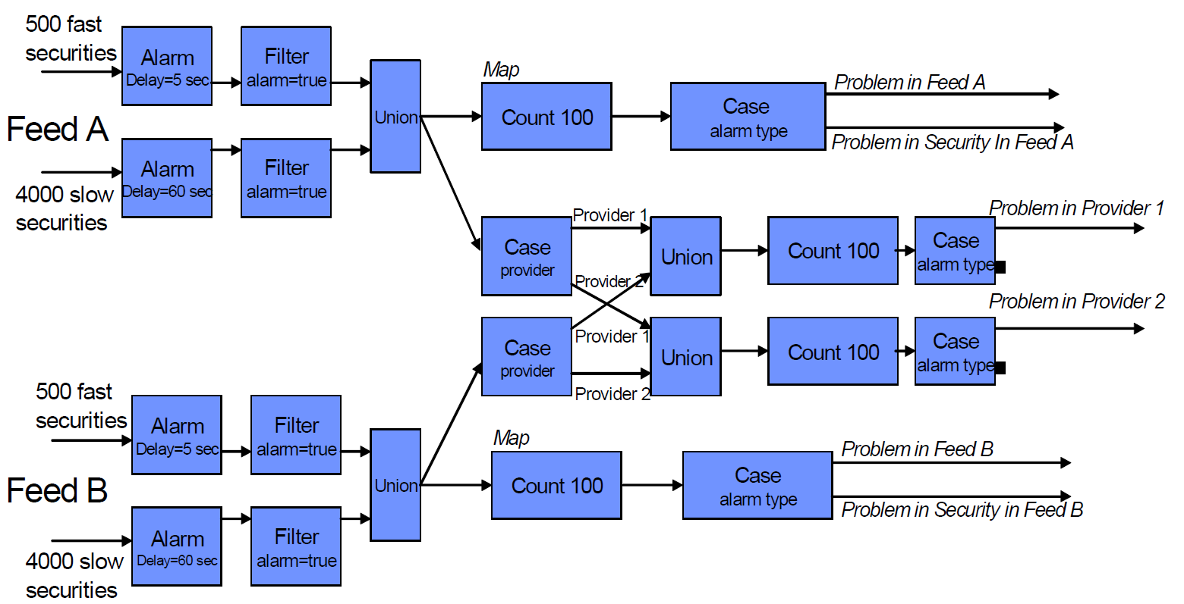
Financial-Feed Streaming Application
How would this app be implemented using DBMS technology ?

Slide 4
Outline
Background
Data Warehousing
Indexing
Views
Transactions
Stream Processing
High Availability
Row vs Column storage
Financial-Feed Streaming Application (revisited)
Other Applications
Software Architectures

Slide 5
Data Warehousing
Operational DBs
External Data Sources
ETL process periodicly (nightly, weekly) loads new data into data warehouse
DATA
MINING
OLAP
DB
DB
Extract, Transform, Load, Refresh
DB
Data Warehouse
Metadata
Multi-dimensional Data Model
Collection of numeric measures, which depend on a set of dimensions.
E.g., measure Sales, dimensions Product (key: pid), Location (locid), and Time (timeid).

Slide 6
Conceptual Design of Data Warehouses
timeID | Date | Week | Month | Quater | Year
Times
Sales (Fact Table)
Pid | Timeid | Locid | Sales
Locations
Products
Pid | Pname | Category | Price
Locid | City | State | Country
Fact table in BCNF; dimension tables un-normalized.
Dimension tables are small; updates/inserts/deletes are rare. So, anomalies less important than query performance.
This kind of schema is very common in OLAP applications, and is called a star schema; computing the join of all these relations is called a star join.

Slide 7
OLAP Queries
Influenced by SQL and by spreadsheets.
A common operation is to aggregate a measure over one or more dimensions.
Find total sales.
Find total sales for each city, or for each state.
Find top five products ranked by total sales.
Roll-up: Aggregating at different levels of a dimension hierarchy.
E.g., Given total sales by city, we can roll-up to get sales by state.

Slide 8
More OLAP Queries
Drill-down: The inverse of roll-up.
E.g., Given total sales by state, can drill-down to get total sales by city.
E.g., Can also drill-down on different dimension to get total sales by product for each state.
Pivoting: Aggregation on selected dimensions.
E.g., Pivoting on Location and Time yields this cross-tabulation:
Slicing and Dicing: Equality and range selections on one or more dimensions.
Year
Quarter
Month
Week
Year\State | WI | CA | Total
1995 | 63 | 81 | 144
1996 | 38 | 107 | 145
1997 | 75 | 35 | 110
Total | 176 | 223 | 339

Slide 9
Comparison with SQL Queries
The cross-tabulation obtained by pivoting can also be computed using a collection of SQLqueries:
SELECT SUM(S.sales)
FROM Sales S, Times T, Locations L
WHERE S.timeid=T.timeid AND S.locid=L.locid
GROUP BY T.year, L.state
Year\State | WI | CA | Total
1995 | 63 | 81 | 144
1996 | 38 | 107 | 145
1997 | 75 | 35 | 110
Total | 176 | 223 | 339
SELECT SUM(S.sales)
FROM Sales S, Times T
WHERE S.timeid=T.timeid
GROUP BY T.year
SELECT SUM(S.sales)
FROM Sales S, Location L
WHERE S.locid=L.locid
GROUP BY L.state

Slide 10
Views
CREATE VIEW YoungActiveStudents (name, grade) AS
SELECT S.name, E.grade
FROM Students S, Enrolled E
WHERE S.sid = E.sid and S.age<21
A view is just a relation, but we store a definition, rather than a set of tuples.
Views can be dropped using the DROP VIEW command.
What if table that the view is dependent on is dropped ?
DROP TABLE command has options to let the user specify this.
Notes:
18

Slide 11
Querying Views
CREATE VIEW YoungActiveStudents (name, grade) AS
SELECT S.name, E.grade
FROM Students S, Enrolled E
WHERE S.sid = E.sid and S.age<21
SELECT name
FROM YoungActiveStudents
WHERE grade = ‘A’
Query views as with any table
Conceptually, you can think of rewriting using a subquery
SELECT name
FROM (SELECT S.name, E.grade
FROM Students S, Enrolled E
WHERE S.sid = E.sid and S.age<21)
WHERE grade = ‘A’

Slide 12
Materialized Views
CREATE VIEW ParamountMovies AS
SELECT title, year
FROM movies
WHERE studioName=‘Paramount’
CREATE TABLE ParamountMovies AS
(SELECT title, year
FROM movies
WHERE studioName=‘Paramount’)
Views can be “materialized” for efficiency
Updating the materialized view (materialized query table in DB2) : incremental or batch
Queries on base relation may be able to exploit materialized views!
SELECT title
FROM movies
WHERE studioName=‘Paramount’
AND year=1990)

Slide 13
Indexes
An index on a file speeds up selections on the search key fields for the index.
Any subset of the fields of a relation can be the search key for an index on the relation.
Search key is not the same as key (minimal set of fields that uniquely identify a record in a relation).
An index contains a collection of data entries, and supports efficient retrieval of all data entries k* with a given key value k.
A data entry is usually in the form <key, rid>
Given data entry k*, we can find record with key k in at most one disk I/O. (Details soon …)

Slide 14
B+ Tree Indexes
Non-leaf
Pages
Leaf
Pages
(Sorted by search key)
index entry
P
K
P
K
P
K
P
m
0
1
1
2
2
m
Leaf pages contain data entries, and are chained (prev & next)
A data entry typically contain a key value and a rid.
Non-leaf pages have index entries; only used to direct searches:

Slide 15
Example B+ Tree
Note how data entries
in leaf level are sorted
Root
17
Entries <= 17
Entries > 17
5
13
27
30
2*
3*
5*
7*
8*
14*
16*
22*
24*
27*
29*
33*
34*
38*
39*
Find 28*? 29*? All > 15* and < 30*
Insert/delete: Find data entry in leaf, then change it. Need to adjust parent sometimes.
And change sometimes bubbles up the tree

Slide 16
Bitmap Indexes
Boats Relation
Bitmap index for color
bid | bname | color
101 | Interlake | Blue
102 | Interlake | Red
103 | Clipper | green
104 | Marine | Red
Blue | Red | Green
1 | 0 | 0
0 | 1 | 0
0 | 0 | 1
0 | 1 | 0
One bit vector for each distinct column value
Length of bit vector is the cardinality of the relation instance
Logical bitwise operations used to answer queries
Bit vectors can be encoded and compressed

Slide 17
Stream Processing
Continuous, unbounded, rapid, time-varying streams of data elements (tuples).
Examples of streaming applications
Network monitoring and traffic engineering, Sensor networks, RFID tags, Telecom call records, Financial applications, Web logs and click-streams, Manufacturing processes
DSMS = Data Stream Management System
DBMS | Streaming System
Persistent relations | Transient Streams (& relations)
One time queries | Continuous Queries
Random Access | Sequential Access
Access plan determined by DBMS | Unpredictable data characteristics

Slide 18
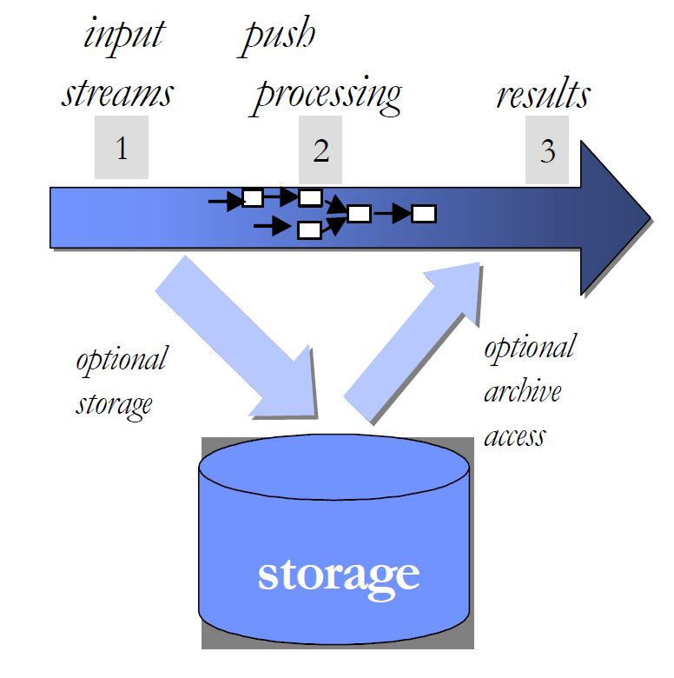
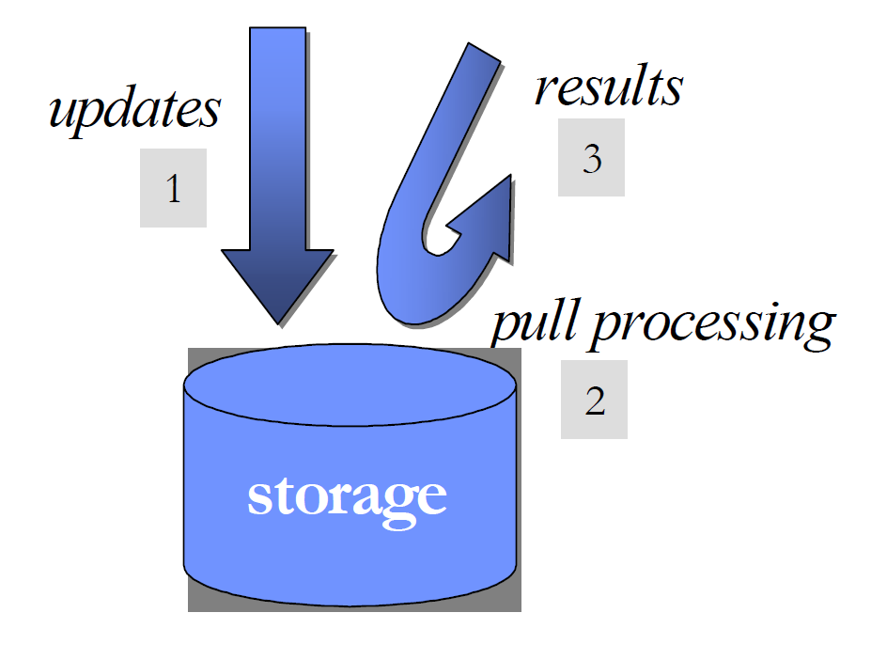
Pull vs Push

Slide 19
Process Model
An Operating System Process combines an operating system (OS) program execution unit (a thread of control) with an address space private to the process. This single unit of program execution is scheduled by the OS kernel and each process has its own unique address space.
Inter-Process
Communications
Application Process
DBMS Server Process

Slide 20
Transactions
Atomicity
Isolation
Consistency
Durability
Write Ahead Log
Locking Protocols
User enforced

Slide 21
The Log
The following actions are recorded in the log:
Ti writes an object: the old value and the new value.
Log record must go to disk before the changed page! (Write Ahead Log property)
Ti commits/aborts: a log record indicating this action.
Log records are chained together by Xact id, so it’s easy to undo a specific Xact.
Log is often duplexed and archived on stable storage.
All log related activities (and in fact, all CC related activities such as lock/unlock, dealing with deadlocks etc.) are handled transparently by the DBMS.

Slide 22
Recovering from a Crash
There are 3 phases in the Aries recovery algorithm:
Analysis: Scan the log forward (from the most recent checkpoint) to identify all Xacts that were active, and all dirty pages in the buffer pool at the time of the crash.
Redo: Redoes all updates to dirty pages in the buffer pool, as needed, to ensure that all logged updates are in fact carried out and written to disk.
Undo: The writes of all Xacts that were active at the crash are undone (by restoring the before value of the update, which is in the log record for the update), working backwards in the log. (Some care must be taken to handle the case of a crash occurring during the recovery process!)

Slide 23
Lock-based Concurrency Control
Strict Two-phase Locking (Strict 2PL) Protocol:
Each Xact must obtain a S (shared) lock on object before reading, and an X (exclusive) lock on object before writing.
All locks held by a transaction are released when the transaction completes
If an Xact holds an X lock on an object, no other Xact can get a lock (S or X) on that object.
Strict 2PL allows only serializable schedules.
Additionally, it simplifies transaction aborts

Slide 24
High Availability
Requests
DBMS Process
DBMS Process
Primary Server
Backup Server
Log
entries
Disk
Disk
A database system is highly available (HA) if it remains accessible to users in the face of hardware failures.
Transaction logging techniques already provides crash recovery
HA requires close to zero down time.

Slide 25
Row vs Column Storage
Column Store:
IBM 60.25 10,000 1/15/2006
MSFT 60.53 12,500 1/15/2006
Used in: Sybase IQ, Vertica
Row Store:
IBM 60.25 10,000 1/15/2006
MSFT 60.53 12,500 1/15/2006
Used in: Oracle, SQL Server, DB2, Netezza,…

Slide 26
Financial-Feed Streaming Application
How would this app be implemented using DBMS technology ?

Slide 27
Other Applications
Data Warehouse.
Sensor Networks. eg. Medical monitoring, smart homes, etc
Text Search. eg. Search engines
Scientific Databases. Eg. Astronomy, Meteorology, Oceanography
XML

Slide 28
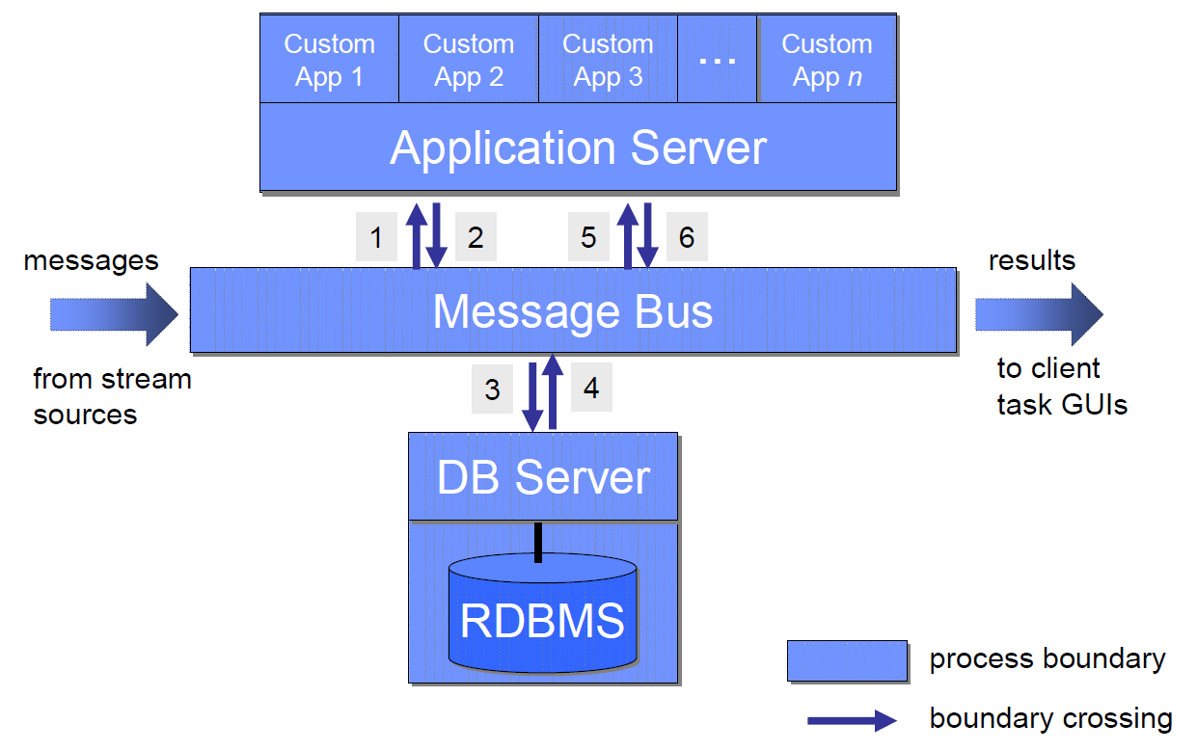
Software Architectures
Internet
Webserver
Application Server
Database Server
Three basic services
Message Transport
Storage of state
Execution of application logic

