Slide 1
ICS 624 Spring 2013 Parallel Databases & Map-Reduce
Asst. Prof. Lipyeow Lim
Information & Computer Science Department
University of Hawaii at Manoa

Slide 2
Why Parallel Data Access ?
SELECT *
FROM mydata
1 Terabyte
(= 1024 GB)
10 MB/s
1000 x parallel
10 MB/s
1.2 days to scan
1.5 mins to scan!

Slide 3
Parallel DBMS
eBay’s main Teradata data warehouse (DW):
> 2 petabytes of user data
10s of 1000s of users
Millions of queries per day
72 nodes
>140 GB/sec of I/O, or 2 GB/node/sec
eBay’s Greenplum DW
6 1/2 petabytes of user data
96 nodes
200 MB/node/sec of I/O
Walmart – 2.5 petabytes
Bank of America – 1.5 petabytes
Some parallel DBMSs besides the usual Oracle-IBM-MS trio:
Teradata
Netezza
Vertica
DATAllegro
Greenplum
Aster Data
Infobright
Kognitio, Kickﬁre, Dataupia, ParAccel, Exasol, ...

Slide 4
Parallelism
Pipeline parallelism
Partition parallelism
many machines each doing one step in a multi-step process.
many machines doing the same thing to different pieces of data.
Parallelism is natural to DBMS processing
Processing Query 1
Node 1
Node 2
Node 3
Q1:step1
Q1:step2
Q1:step3
Node 1
Q2:step1
Q2:step2
Q2:step3
Q3:step1
Q3:step2
Q3:step3
Node 2
Q4:step1
Q4:step2
Q5:step1
Node 3

Slide 5
Parallelism Terminology
Ideal
Speed-up
Same job + more resources = less time
Scale-up
Bigger job + more resouces = same time
Transaction scale-up
More clients + more resources = same time
Xact/sec.
(throughput)
degree of parallelism
Ideal
sec./Xact
(response time)
degree of parallelism

Slide 6
Parallel Architecture : Share What?
Shared Memory
(SMP)
Shared Disk
Shared Nothing
(network)
CLIENTS
CLIENTS
CLIENTS
Processors
Memory
Easy to program
Expensive to build
Difficult to scaleup
Hard to program
Cheap to build
Easy to scaleup
Sequent, SGI, Sun
VMScluster, Sysplex
Tandem, Teradata, SP2

Slide 7
Different Types of DBMS Parallelism
Intra-operator parallelism
get all machines working to compute a given operation (scan, sort, join)
Inter-operator parallelism
each operator may run concurrently on a different site (exploits pipelining)
Inter-query parallelism
different queries run on different sites
We’ll focus on intra-query parallelism

Slide 8
Parallel vs Distributed DBMS
A parallel database system
Parallelize various operations such as loading data, building indexes, evaluating queries
Often homogeneous: Every node runs same type of DBMS.
A distributed database system
Data is physically stored across several (geographical) sites
Distribution governed by factors like local ownership & increased availability
Often heterogeneous: Different sites run different DBMSs (different RDBMSs or even non-relational DBMSs).
The boundaries of these traditional definitions are blurring.

Slide 9
Data Partitioning & Fragmentation
TID
Parallel DB
Data partitioning
Distributed DB
Fragmentation
Same basic problem : How do we break up the data (tables) and spread them amongst the “nodes”
Horizontal vs Vertical
Range vs Hash
Replication
DB user’s view should be one single table.
t1
t2
t3
t4

Slide 10
Automatic Data Partitioning
Partitioning a table:
Range Hash Round Robin
A...E
F...J
K...N
O...S
T...Z
A...E
F...J
K...N
O...S
T...Z
A...E
F...J
K...N
O...S
T...Z
Good for equijoins,
range queries
group-by
Good for equijoins
Good to spread load
Shared disk and memory less sensitive to partitioning,
Shared nothing benefits from "good" partitioning

Slide 11
Shared-Nothing Architecture
CPU
CPU
CPU
CPU
Memory
Memory
Memory
Memory
Disk
Disk
Disk
Disk
Network

Slide 12
Logical Parallel DBMS Architecture
results
query
Parallel DB layer
Parallel DB layer
Catalog DB
DBMS
DBMS
DBMS
Data Fragments
Data Fragments
Network

Slide 13
Horizontal Fragmentation: Range Partition
sid | sname | rating | age
22 | dustin | 7 | 45
29 | brutus | 1 | 33
31 | lubber | 8 | 55
32 | andy | 4 | 23
58 | rusty | 10 | 35
64 | horatio | 7 | 35
Partition 1
sid | sname | rating | age
29 | brutus | 1 | 33
32 | andy | 4 | 23
Partition 2
sid | sname | rating | age
22 | dustin | 7 | 45
31 | lubber | 8 | 55
58 | rusty | 10 | 35
64 | horatio | 7 | 35
Range Partition on rating column
Partition 1: 0 <= rating < 5
Partition 2: 5 <= rating <= 10

Slide 14
Range Partition: Query Processing
Which partitions?
Better than non-parallel ?
Partition 1
sid | sname | rating | age
29 | brutus | 1 | 33
32 | andy | 4 | 23
SELECT *
FROM Sailors S
SELECT *
FROM Sailors S
WHERE rating = 2
Partition 2
sid | sname | rating | age
22 | dustin | 7 | 45
31 | lubber | 8 | 55
58 | rusty | 10 | 35
64 | horatio | 7 | 35
SELECT *
FROM Sailors S
WHERE age > 30
SELECT *
FROM Sailors S
WHERE rating < 2 and age < 30

Slide 15
Horizontal Fragmentation: Hash Partition
sid | sname | rating | age
22 | dustin | 7 | 45
29 | brutus | 1 | 33
31 | lubber | 8 | 55
32 | andy | 4 | 23
58 | rusty | 10 | 35
64 | horatio | 7 | 35
Partition 1
sid | sname | rating | age
31 | lubber | 8 | 55
32 | andy | 4 | 23
58 | rusty | 10 | 35
Partition 2
Hash partitioning using hash function
Partition = rating mod 2
sid | sname | rating | age
22 | dustin | 7 | 45
29 | brutus | 1 | 33
64 | horatio | 7 | 35

Slide 16
Hash Partition: Query Processing
Which partitions?
Better than non-parallel ?
Partition 1
sid | sname | rating | age
31 | lubber | 8 | 55
32 | andy | 4 | 23
58 | rusty | 10 | 35
SELECT *
FROM Sailors S
SELECT *
FROM Sailors S
WHERE rating = 2
Partition 2
SELECT *
FROM Sailors S
WHERE age > 30
sid | sname | rating | age
22 | dustin | 7 | 45
29 | brutus | 1 | 33
64 | horatio | 7 | 35
SELECT *
FROM Sailors S
WHERE rating < 2 and age < 30

Slide 17
Vertical Fragmentation/Partition
sid | sname | rating | age
22 | dustin | 7 | 45
29 | brutus | 1 | 33
31 | lubber | 8 | 55
32 | andy | 4 | 23
58 | rusty | 10 | 35
64 | horatio | 7 | 35
Partition 1
sid | sname | rating
22 | dustin | 7
29 | brutus | 1
31 | lubber | 8
32 | andy | 4
58 | rusty | 10
64 | horatio | 7
Partition 2
sid | age
22 | 45
29 | 33
31 | 55
32 | 23
58 | 35
64 | 35
Vertical partitioning
Use sid as row identifier

Slide 18
Vertical Partition: Query Processing
Which partitions?
Better than non-parallel ?
Partition 1
sid | sname | rating
22 | dustin | 7
29 | brutus | 1
31 | lubber | 8
32 | andy | 4
58 | rusty | 10
64 | horatio | 7
SELECT *
FROM Sailors S
Partition 2
SELECT sname
FROM Sailors S
sid | age
22 | 45
29 | 33
31 | 55
32 | 23
58 | 35
64 | 35
SELECT *
FROM Sailors S
WHERE rating = 2
SELECT sid
FROM Sailors S
WHERE age > 30
SELECT sid
FROM Sailors S
WHERE rating < 2 and age < 30

Slide 19
Fragmentation & Replication
Node 1
Node 2
Node 3
Node 4
P1
P4
P2
P1
P3
P2
P4
P3
Network
Suppose table is fragmented into 4 partitions on 4 nodes
Replication stores another partition on each node
What happens when 1 node fails ? 2 nodes ?
What happens when a row needs to be updated ?

Slide 20
What about joins ?
Partition 1
SELECT R.sid, R.bid
FROM Sailors S, Reserves R
WHERE S.sid=R.sid AND rating > 8
Sailors
Reserves
sid | sname | rating | age
31 | lubber | 8 | 55
32 | andy | 4 | 23
58 | rusty | 10 | 35
sid | bid | day
31 | 101 | …
29 | 103 | …
Sailors: hash
part = rating mod 2
Reserves: hash
part = sid mod 2
Where to perform join ?
What data to ship ?
Partition 2
Sailors
sid | sname | rating | age
22 | dustin | 7 | 45
29 | brutus | 1 | 33
64 | horatio | 7 | 35
Reserves
sid | bid | day
64 | 105 | …
58 | 103 | …

Slide 21
Distributed Joins
Node 1
Node 2
Node 3
Node 4
Boats1
Boats2
Reserves
Sailors
Network
Consider:
Reserves join Sailors
Depends on:
Which node get the query
Whether tables are fragmented/partitioned or not
Node 1 gets query
Perform join at Node 3 (or 4) ship results to Node 1 ?
Ship tables to Node 1 ?
Node 3 gets query
Fetch sailors in loop ?
Cache sailors locally ?

Slide 22
Distributed Joins over Fragments
Node 1
Node 2
Node 3
Node 4
Reserves1
Reserves2
Sailors1
Sailors2
Network
R join S
= σ _{R.sid=S.sid} (R × S)
= σ _{R.sid=S.sid} ((R1∪R2) × (S1∪ S2))
= σ _{R.sid=S.sid} ((R1 × S1) ∪ (R1 ×S2) ∪ (R2 × S1) ∪ (R2 ×S2))
= σ _{R.sid=S.sid} (R1 × S1) ∪ σ _{R.sid=S.sid} (R1 ×S2) ∪ σ _{R.sid=S.sid} (R2 × S1) ∪ σ _{R.sid=S.sid} (R2 ×S2)
= (R1 join S1) ∪ (R1 join S2) ∪ (R2 join S1) ∪ (R2 join S2)
This equivalence applies to splitting a relation into pages in a single server DBMS system too!
Equivalent to a union of joins over each pair of fragments

Slide 23
Distributed Nested Loop
Consider performing R1 join S2 on Node 1
Page-oriented nested loop join:
For each page r of R1
Fetch r from local disk
For each page s of S2
Fetch s if s∉cache
Output r join s
Cost = Npages(R1)* t_{d} + Npages(R1)*Npages(S2)*(t_{d} + t_{s})
If cache can hold entire S2, cost is Npages(R1)* t_{d} +Npages(S2)* t_{s} +Npages(R1)*Npages(S2)*t_{d}
Node 1
Node 2
R1
S2
Network
foreach
R1 page r
Fetch
S2 page s
r join s

Slide 24
Semijoins
Consider performing R1 join S2 on Node 1
S2 needs to be shipped to R1
Does every tuple in S2 join with R1 ?
Semijoin:
Don’t ship all of S2
Ship only those S2 rows that will join with R1
Assumes that the join causes a reduction in S2!
Cost = Npages(R1)*t_{d} + Npages(π_{sid}R1)*t_{s} + Cost(∩) + Npages(σ_{sid∈jsid}S2)*t_{s} + Cost(R1 join σ_{sid∈jsid}S2)
Node 1
Node 2
R1
S2
Network
π_{sid}R1
ρ(jsid,
π_{sid}R1
∩π_{sid}S2)
σ_{sid∈jsid}S2
R1 join
σ_{sid∈jsid}S2

Slide 25
Bloomjoins
Consider performing R1 join S2 on Node 1
Can we do better than semijoin ?
Bloomjoin:
Don’t ship all of (π_{sid}R1)
Node 1: Ship a “bloom filter” (like a signature) of (π_{sid}R1)
Hash each sid
Set the bit for hash value in a bit vector
Send the bit vector v1
Node 2:
Hash each (π_{sid}S2) to bit vector v2
Computer (v1 ∩ v2)
Send rows of S2 in the intersection
False positives
Node 1
Node 2
R1
S2
Network
v1=Bloom
(π_{sid}R1)
v2=Bloom(π_{sid}S2)
jsid=v1∩v2
σ_{sid∈jsid}S2
R1 join
σ_{sid∈jsid}S2

Slide 26
Google Map Reduce

Slide 27
Word Count over a Given Set of Web Pages
see 1
bob 1
throw 1
see 1
spot 1
run 1
bob 1
run 1
see 2
spot 1
throw 1
see bob throw
see spot run
Can we do word count in parallel?

Slide 28
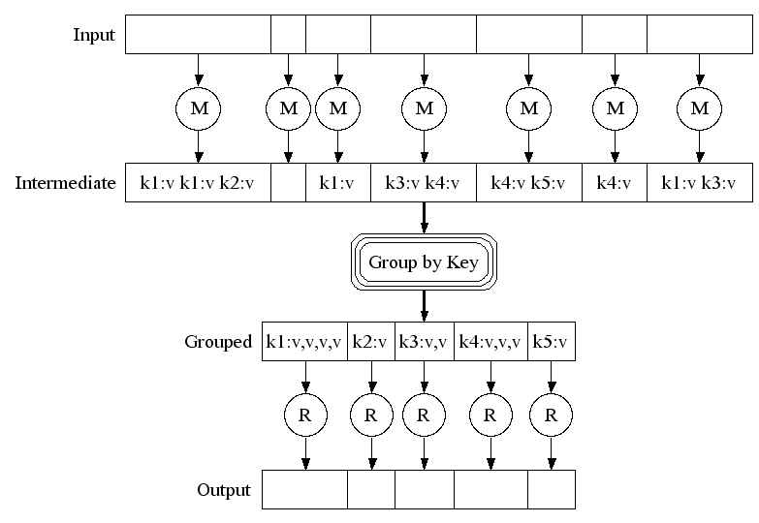
The MapReduce Framework (pioneered by Google)

Slide 29
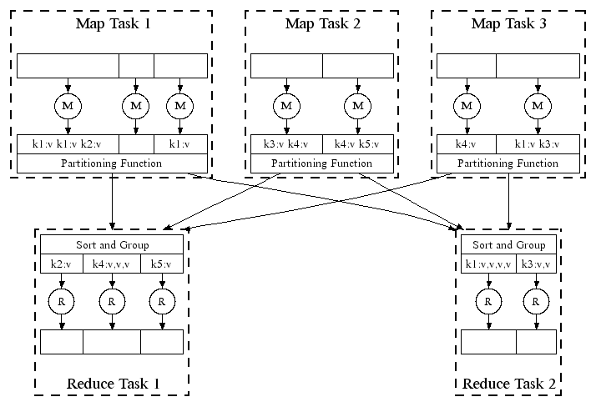
Automatic Parallel Execution in MapReduce (Google)
Handles failures automatically, e.g., restarts tasks if a node fails; runs multiples copies of the same task to avoid a slow task slowing down the whole job

Slide 30
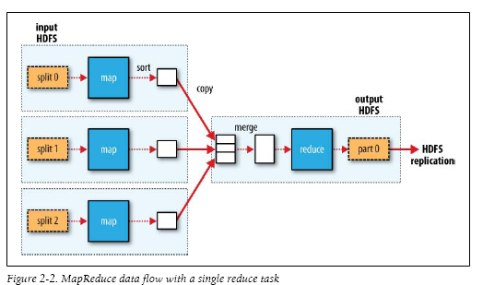
MapReduce in Hadoop (1)

Slide 31
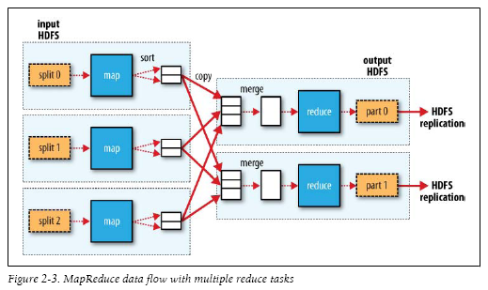
MapReduce in Hadoop (2)

Slide 32
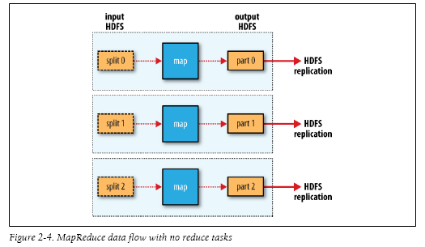
MapReduce in Hadoop (3)

