Slide 1
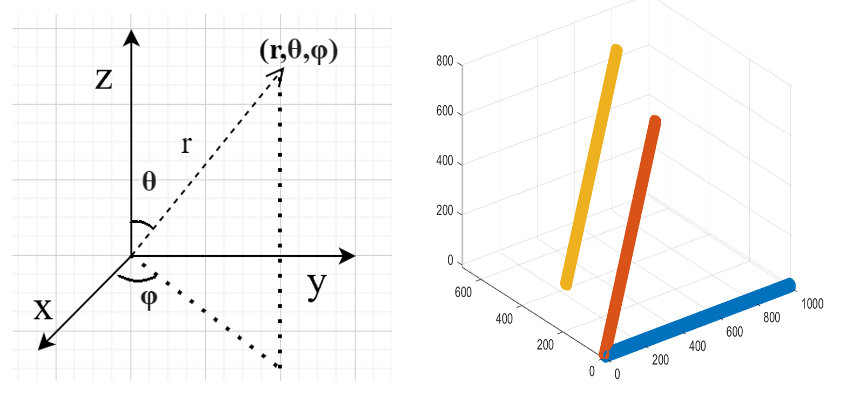
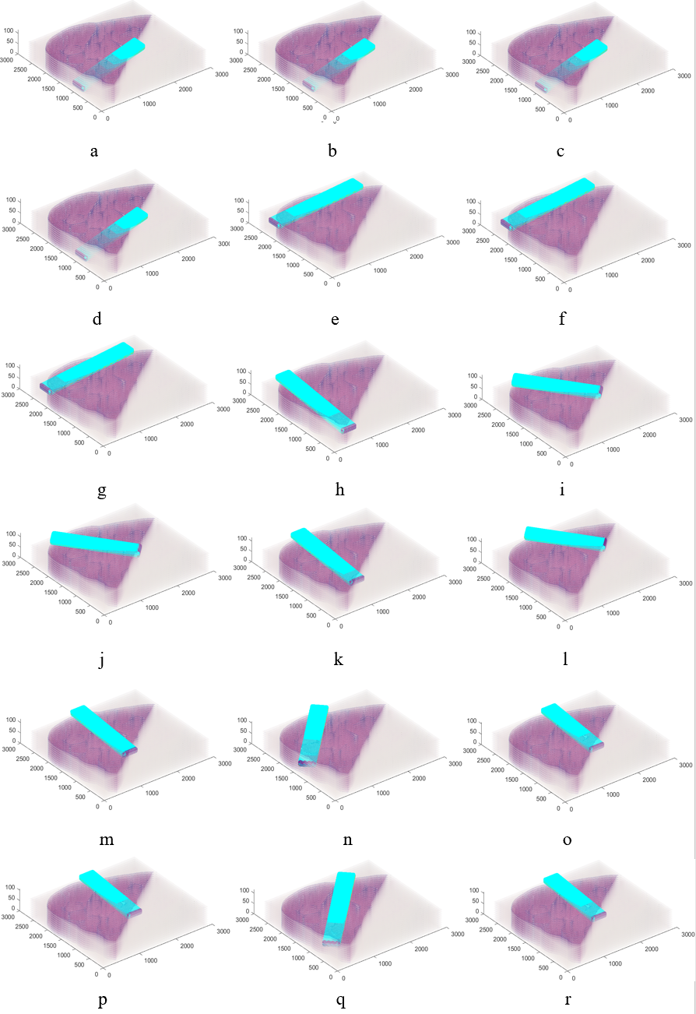
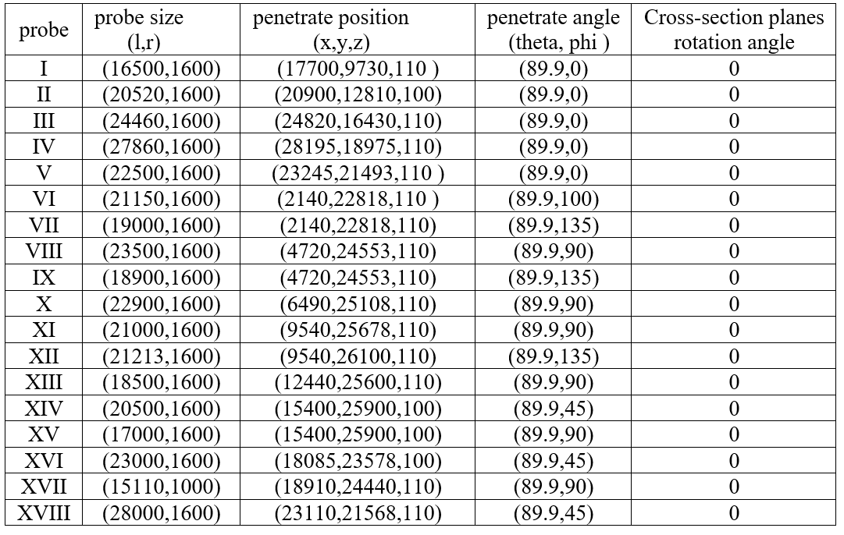
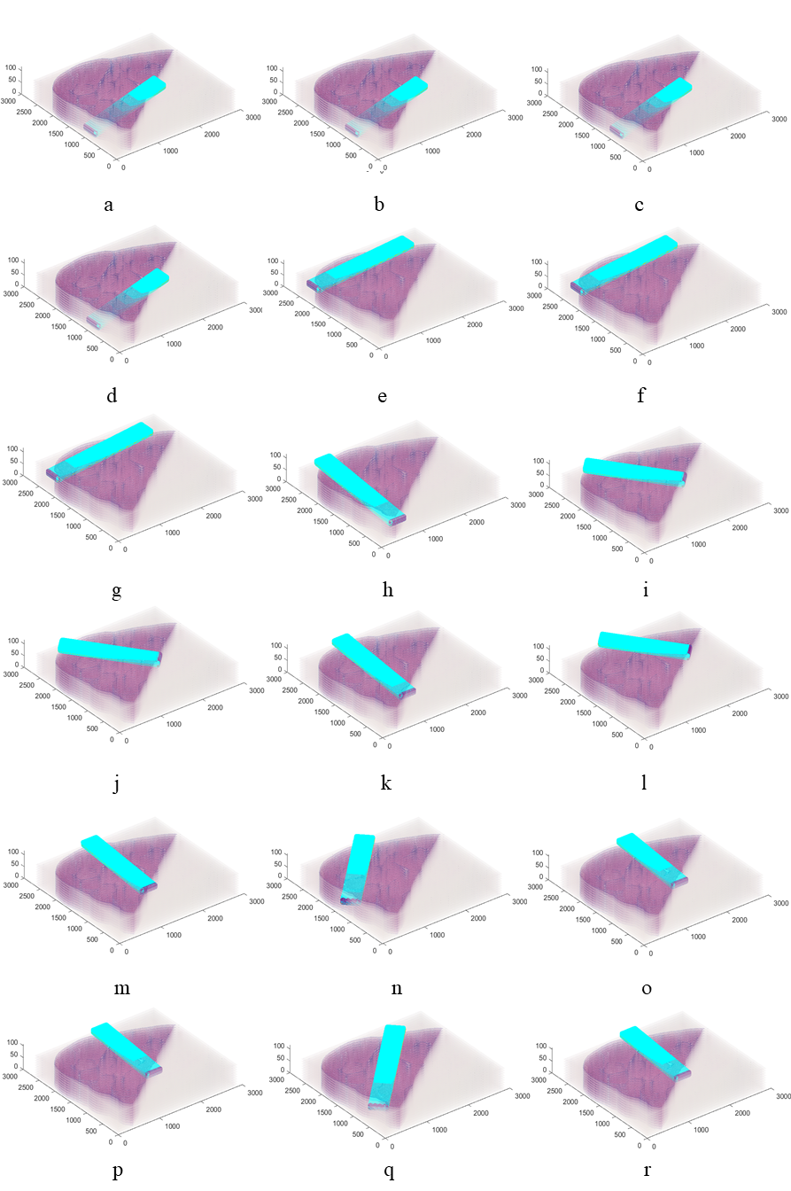
I II III
I
IV V VI
(a)
(b)
VII VIII IX
X XI XII
XIII XIV XV
XVI XVII XVIII
(b) (c)

