Slide 1
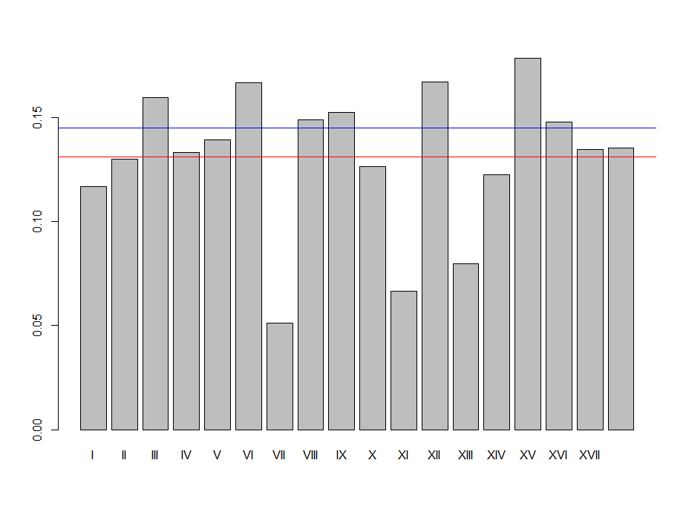
Mean of 18 probes
3D Tissue fibrosis ratio
Liver fibrosis ratio
Probe index

