Slide 1
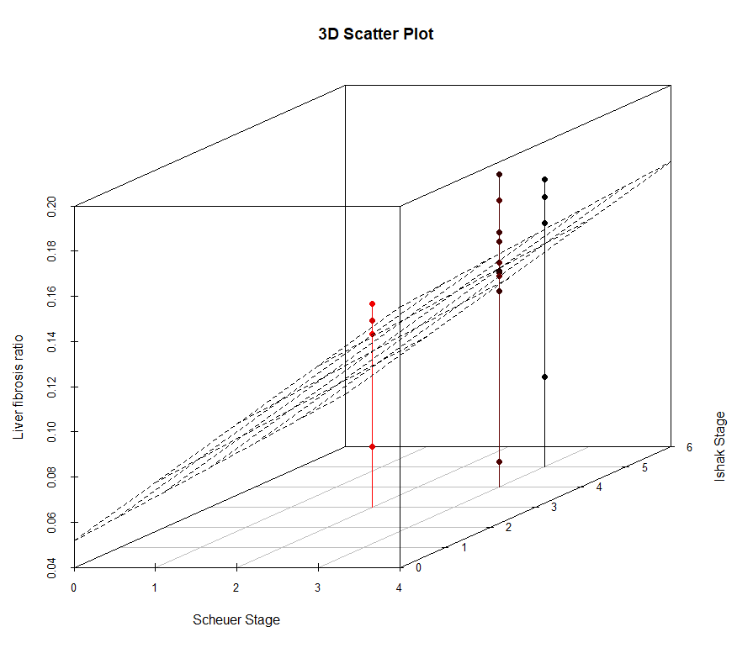
Liver fibrosis ratio
Ishak Stage
Scheuer Stage
(a)

Slide 2
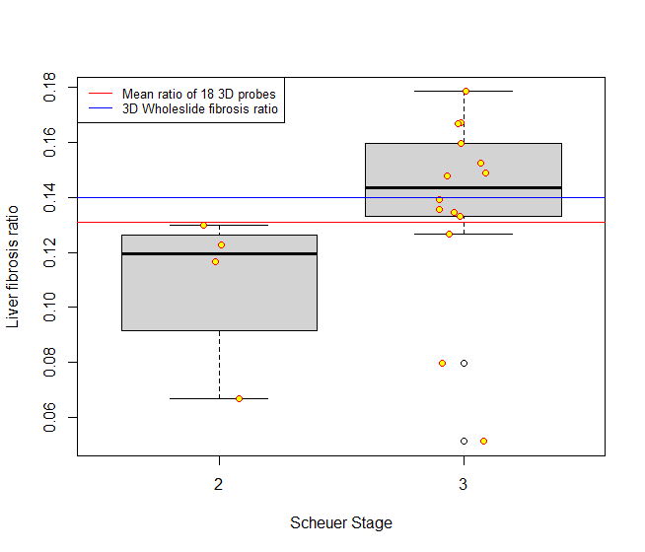
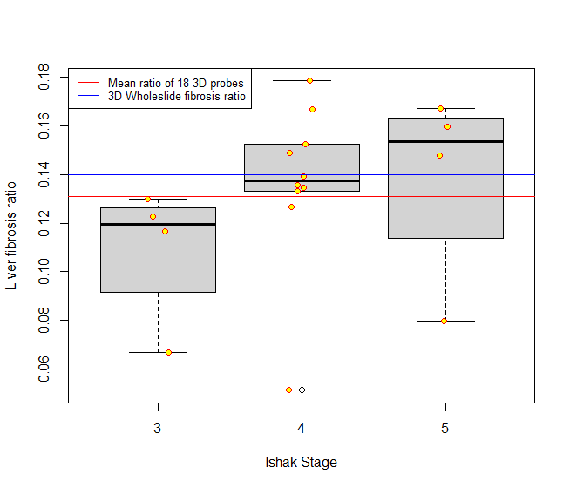
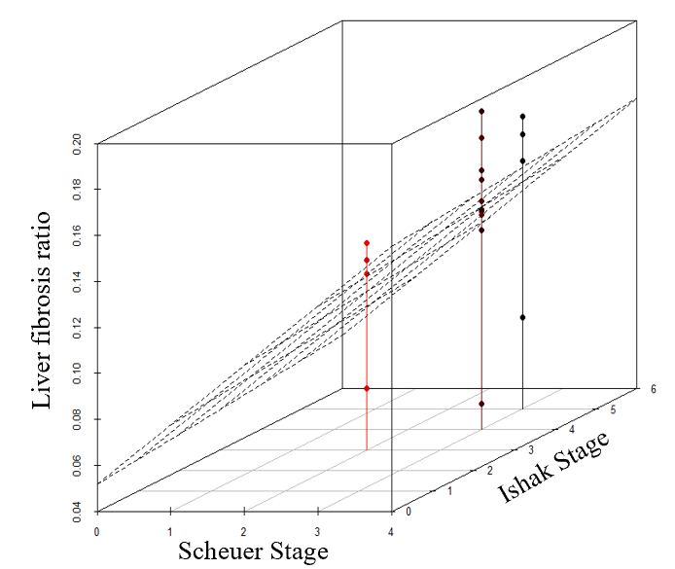
Mean of 18 probes
Mean of 18 probes
3D Tissue fibrosis ratio
3D Tissue fibrosis ratio
Liver fibrosis ratio
Liver fibrosis ratio
Scheuer Stage
Ishak Stage
(a) (b) (c)

