Slide 1
Packet-Loss-Feedback: An Effective Way to Improve Energy Efficiency for Long Concurrent Transmission
Qiang Li
Advisor: Omprakash Gnawali
11/09/2014

Slide 2
Outline
Introduction
Previous Work: CXFS Protocol
Packet-loss-feedback(PLF)
Evaluation of 3 Variants of PLF
Conclusion
Future Work

Slide 3
Outline
Introduction
Previous Work: CXFS Protocol
Packet-loss-feedback(PLF)
Evaluation of 3 Variants of PLF
Conclusion
Future Work

Slide 4
Introduction
Traditional Way for Wireless Communication
Conflict Avoid/Detection
Keep Status
Concurrent Transmission
Constructive Interference
Flooding (No status)
Example: Glossy Flooding

Slide 5
Introduction
Why Concurrent Transmission?
Pros
Reliable
No need to keep status
Cons
Synchronization
Energy consumption
Problem: How to lower down power consumption?

Slide 6
Outline
Introduction
Previous Work: CXFS Protocol
Packet-loss-feedback(PLF)
Evaluation of 3 Variants of PLF
Conclusion
Future Work

Slide 7
CXFS Protocol: Basic Concepts
Time Slot and Frame
Three Basic Roles
Master, slot owner, leaf node
Basic Idea: Reduce Forwarder Set Size
Use hop-count as metric
Use triangle Inequity to determine if a mote should forward or sleep

Slide 8
CXFS Protocol: Basic Idea
Case 1
Case 2
Master
Master
ID
SD
ID
Leaf
SD
X
Slot Owner
X
SI
SI
Slot Owner
Leaf
Forwarding Criteria: SI + ID <= SD + tolerance

Slide 9
CXFS Protocol
Restriction
Hop-count not stable
Tolerance
Still unnecessary forwarding nodes

Slide 10
Outline
Introduction
Previous Work: CXFS Protocol
Packet-loss-feedback(PLF)
Evaluation of 3 Variants of PLF
Conclusion
Future Work

Slide 11
PLF: Basic Idea
Inspired by TCP flow/congestion control
Protocol based on CXFS
Generate Forwarder Set using CXFS algorithm
2-Phase-Optimization to Reduce CXFS Forwarder Set Size
Leave Phase
After forwarding a data packet, each forwarder will try to leave forwarder set randomly with a specific probability until packet loss happens;
Return Phase
Motes who left forwarder set check if their leave is related with packet loss. If yes, the motes should return to forwarder set, vice versa.
For each stream (master, slot owner), only one 2-Phase-Optimization

Slide 12
PLF: Design Tradeoff
Improve Energy Efficiency at the expense of PRR
Intentionally introduce packet loss;
Smaller forwarder set is more vulnerable to network dynamic/interference;
Stream must be long enough
The optimization cost is independent with stream length;
The longer stream is, the lower the relative cost

Slide 13
PLF: 3 Variants
Variant 1(PLF-Win1): window size = 1
A mote will return to forwarder set if the packet sent from slot owner immediately after its leave is lost; otherwise it will leave permanently;
Variant 2(PLF-Win5-I): window size = 5
If PRR of 5 consecutive packets sent immediately after a mote leaves the forwarder set is lower than a threshold (60%), this mote will return to forwarder set;
Variant 3(PLF-Win5-G): window size = 5
If there is a packet loss happened in window, this mote will return; and if PRR of this window is lower than a threshold, all motes will act as CXFS motes in the remaining stream;

Slide 14
PLF: Purpose of 3 Variants
Aggressiveness in Energy Conservation
PLF-Win1 > PLF-Win5-I > PLF-Win5-G
High PRR oriented
PLF-Win1 > PLF-Win5-I > PLF-Win5-G

Slide 15
Outline
Introduction
Previous Work: CXFS Protocol
Packet-loss-feedback(PLF)
Evaluation of 3 Variants of PLF
Conclusion
Future Work

Slide 16
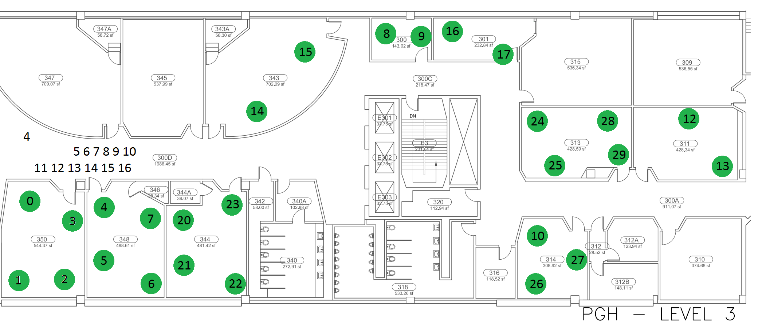
Evaluation
Testbed: consist of 27 Bacon Motes, deployed in an Academic Building

Slide 17
Evaluation
Experiment Settings
Set mote 0 as Master;
Each mote will send 100 packets to Master;
Each slot consists of 80 frames;
Forwarder randomly leave forwarder set at Probability = 30%;
Transmission Power –6 dBm;
For each variant we run 3 rounds and take the average;
We tried to run experiments at same time slot;

Slide 18
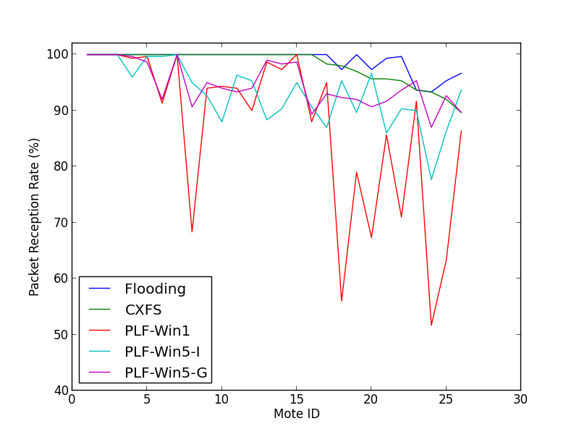
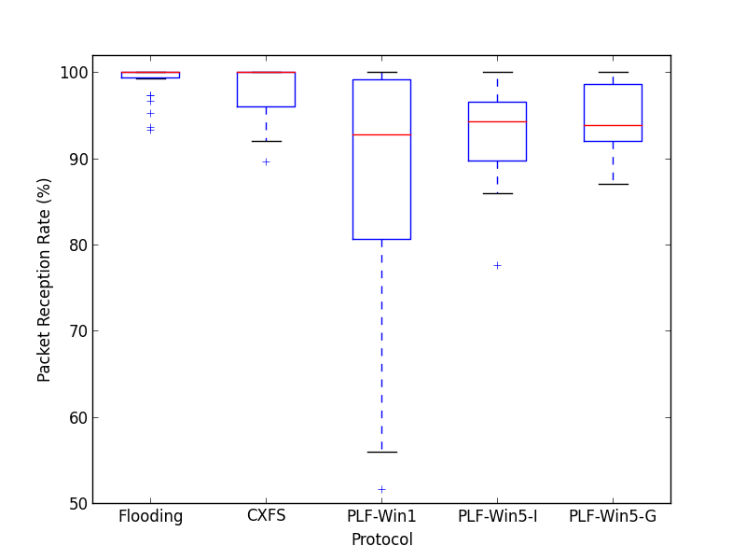
Evaluation: PRR of Each Mote
Average PRR of Each Mote
Aggregate PRR for each setting

Slide 19
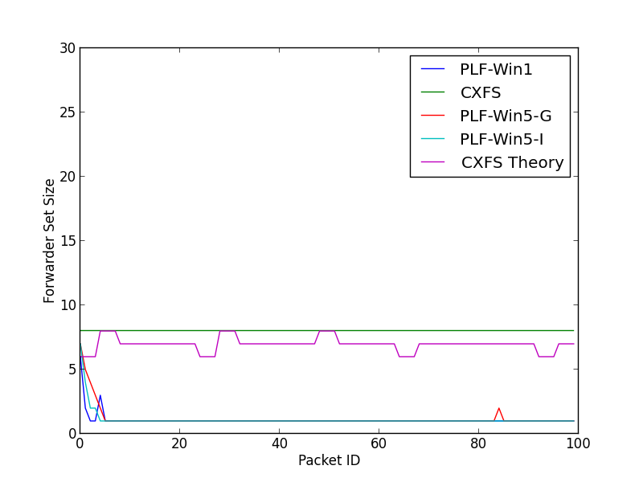
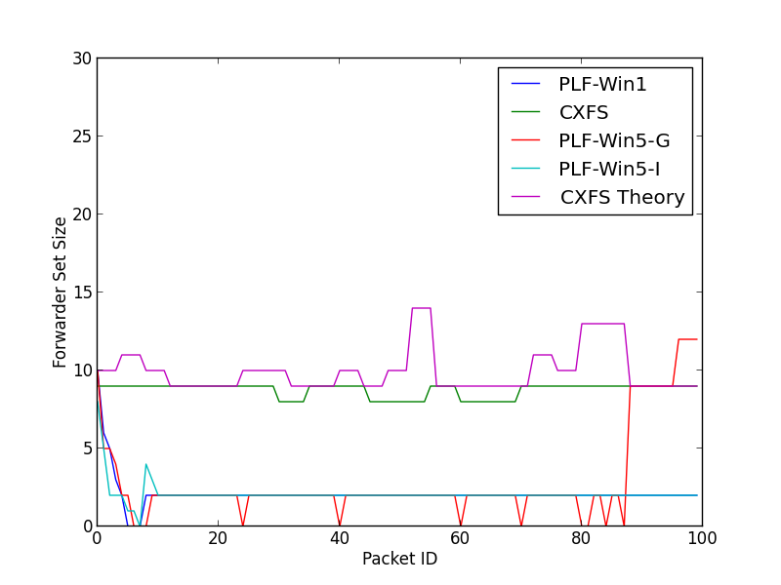
Evaluation: Forwarder Set Size(I)
Typical near-end mote

Slide 20
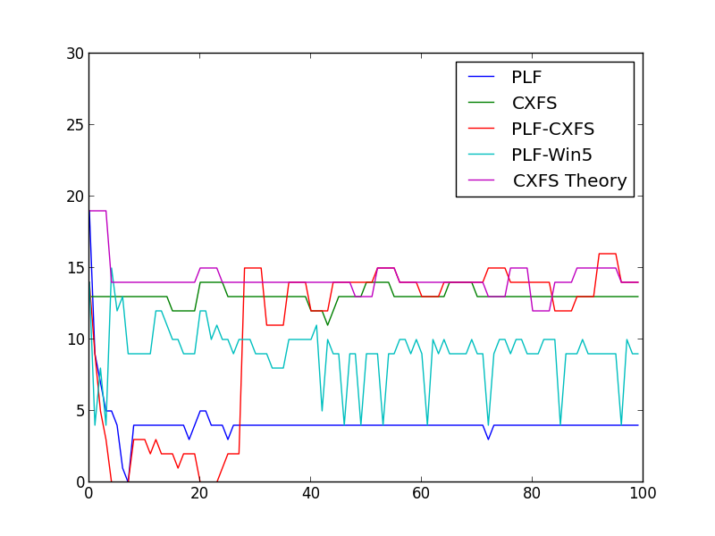
Evaluation: Forwarder Set Size(II)
Typical far-end mote

Slide 21
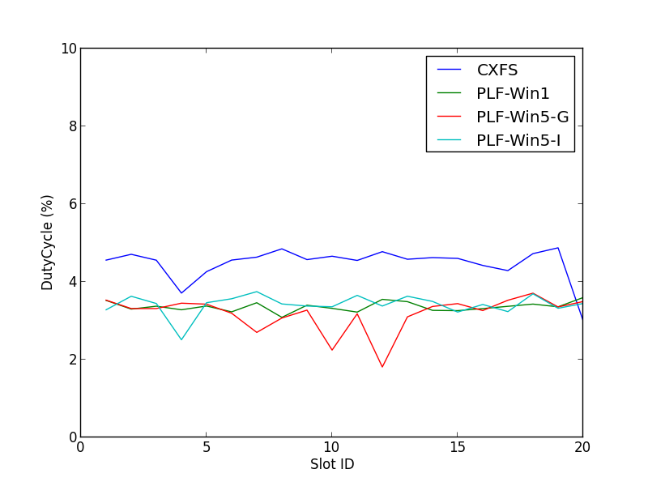
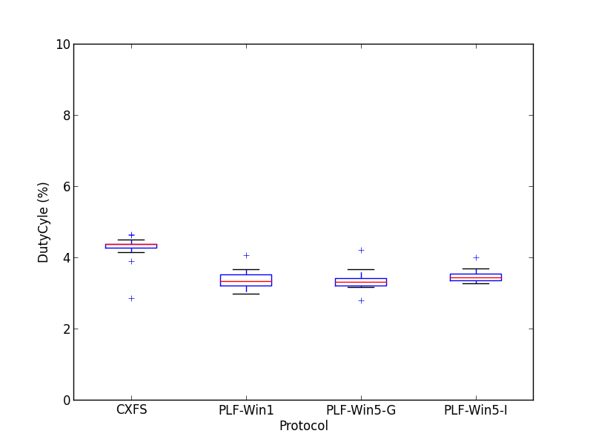
Evaluation: Duty Cycle
Duty Cycle of a typical mote across all slots
Duty Cycle of a typical mote

Slide 22
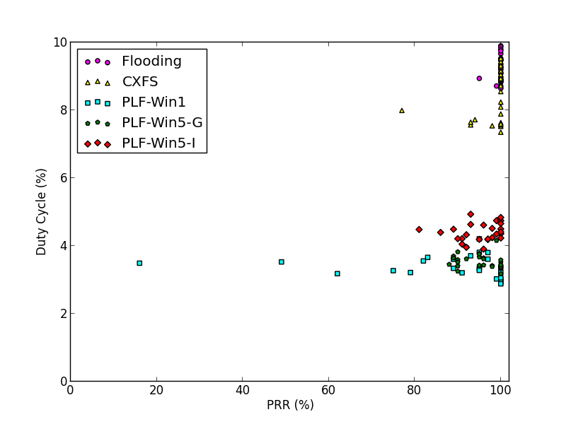
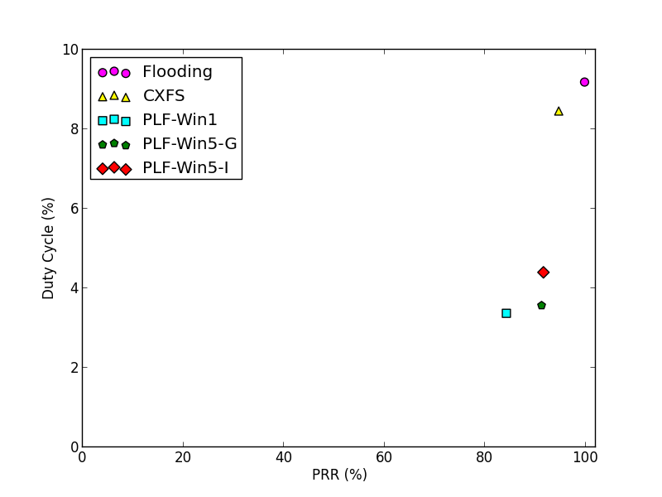
Evaluation: Overall Comparison

Slide 23
Outline
Introduction
Previous Work: CXFS Protocol
Packet-loss-feedback(PLF)
Evaluation of 3 Variants of PLF
Conclusion
Future Work

Slide 24
Conclusion
PLF reduces duty cycle of the whole network significantly at reasonable expense of PRR;
PLF-Win1 is most aggressive in energy conservation, but is more vulnerable to network dynamic;
PLF-Win5-I and PLF-Win5-G are more balanced in energy consumption and acceptable PRR.

Slide 25
Outline
Introduction
Previous Work: CXFS Protocol
Packet-loss-feedback(PLF)
Evaluation of 3 Variants of PLF
Conclusion
Future Work

Slide 26
Future Work
How different probability(for example, 15%) will affect duty cycle and PRR?
Implement PLF on other testbed to make sure these results are platform/topology independent;

Slide 27
Other Work
Paper:
1. “ On the Effectiveness of Energy Metering on Every Node ” by Qiang Li, Marcelo Martins, Omprakash Gnawali, and Rodrigo Fonseca. In Proceedings of the 9th International Conference on Distributed Computing in Sensor Systems (DCOSS 2013) , May 2013.
Demo:
1. “ Demo Abstract: Twonet - Large-Scale Wireless Sensor Network Testbed with Dual-Radio Nodes ” by Qiang Li, Dong Han, Omprakash Gnawali, Philipp Sommer and Branislav Kusyand. In ACM Conference on Embedded Networked Sensor Systems (SenSys 2013) , November 2013.

Slide 28
Reference
[1] F. Ferrari, M. Zimmerling, L. Mottola, and L. Thiele. Low-power wireless bus. In 10th ACM Conf. on Embedded Networked Sensor Systems (SenSys 12), 2012.
[2] F. Ferrari, M. Zimmerling, L. Thiele, and O. Saukh. Efficient network flooding and time synchronization with glossy. In Proceedings of the 10th International Conference on Information Processing in Sensor Networks (IPSN), Chicago, IL, USA, 2011. ACM/IEEE.
[3] F. Osterlind, L. Mottola, T. Voigt, N. Tsiftes, and A. Dunkels. Straw-man: resolving collisions in bursty low-power wireless networks. In Proceedings of the 11th international conference on Information Processing in Sensor Networks, pages 161–172. ACM, 2012.
[4] D. Son, B. Krishnamachari, and J. Heidemann. Experimental study of concurrent transmission in wireless sensor networks. In Proceedings of the ACM Sensys, Nov.2006. [5] Doug Carlson, Marcus Chang, Yin Chen, Andreas Terzis, Omprakash Gnawali. Forwarder Selection in Multi-Transmitter Networks, In Proceedings at DCOSS 2013, Cambridge, MA USA.

