Slide 1
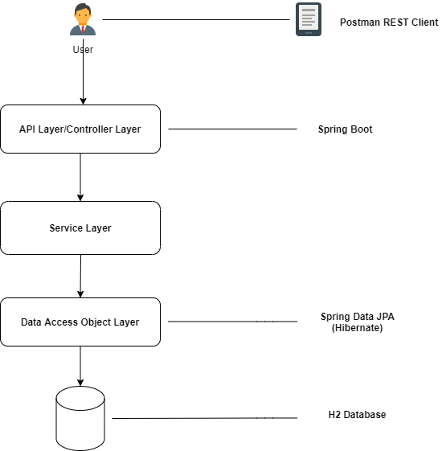
High Level Architecture

Slide 2
Tools and Technologies Used
Spring Boot
JDK- 11
Spring Framework
Spring-search
JPA
Maven
IDE-Eclipse
H2 Embedded Database

Slide 3
Restful API
Sr.No | API name | HTTP Method | Path | Status Code | Description
1 | GET Vehicles | GET | /vehicles | 200(OK) | All Vehicles list
2 | Post Vehicle | POST | /vehicles | 201(created) | A new vehicle creates
3 | GET Vehicle | GET | /vehicles/{id} | 200(OK) | One vehicle
4 | PUT Vehicle | PUT | /vehicles/{id} | 200(OK) | Update
5 | Delete Vehicle | DELETE | /vehicles/{id} | 204(No content) | Delete one vehicle
6 | Search Vehicle | GET | /vehicles/search?search=param:value | 200(OK) | All Vehicles list By search

Slide 4
TimeLine
Design the RESTFUL API for a vehicle listing: for a vehicle listing (create, update, delete, get and find/search)
Create
Update
Delete
Get
Find/Search
Design the table- Vehicle:
Registration (mandatory)
Year
Make
Model
Colour
Price

Slide 5
TimeLine
Integrate into the TradeMe API at https://developer.trademe.co.nz/.
The next step to update the integrate work.
{
"mark": “BMW",
"model": “320i",
"year": "2012",
"colour":"Black",
"price":13000
}
Design the table- Vehicle Test data:
{
"mark": "Jeep",
"model": "Cherokee",
"year": "2016",
"colour": "Blue",
"price":10000
}

