Slide 1
Transaction
Andy

Slide 2
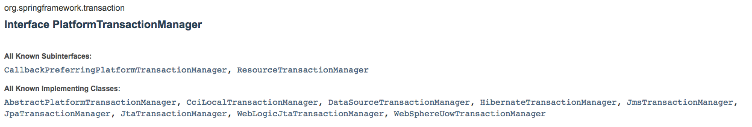
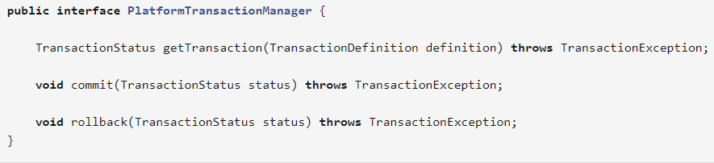
What Spring Transaction?
Global Transaction & Local Transaction
How does Spring resolve the disadvantages of them?
PlatformTransactionManager
Notes:
3 things: getTransaction(), commit(), rollback()

Slide 3
What does Spring tx do? How does Spring tx do it?
Determine commit and rollback
Handle exceptions – using AOP
Declarative Transaction Management
XML
Annotation
Programmatic Transaction Management
Question: Which one to use?

Slide 4
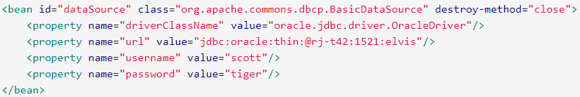
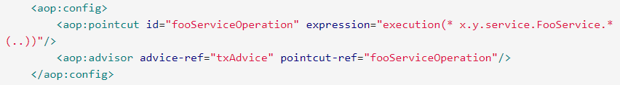
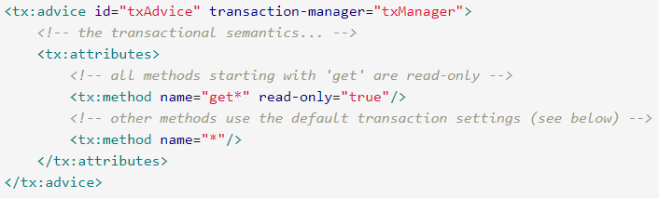
Declarative TX management --- XML
1. Define Data Source
2. Platform-
TransactionManager
uses datasource
3.Use AOP to define
pointcut
4. Define how Spring tx
Management be applied
To pointcut

Slide 5
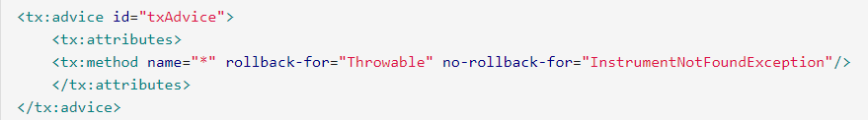

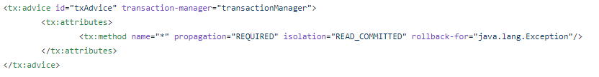
<tx:advice>

Slide 6
Declarative TX management --- Annotation
1. Define Data Source
2. Platform-
TransactionManager
uses datasource
3.Mark “annotation-
Driven”

Slide 7
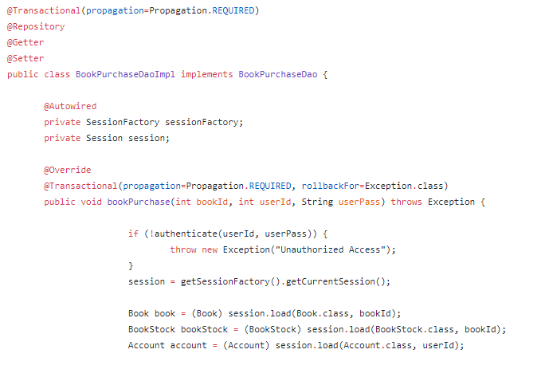
Declarative TX management --- Annotation

Slide 8
Propagation
Isolation
REQUIRED: Must run in a transaction, create new if no transaction exist
REQUIRED_NEW: Always create a new transaction
SUPPORTS: Run in current transaction or no transaction is needed
NOT_SUPPORTED: do not run in a transaction
MANDATORY: Must run in a transaction or an exception will be thrown
Default: Follow underlying database
READ_UNCOMMITTED: Can read uncommitted data
READ_COMMITTED: Only read committed data

Slide 9
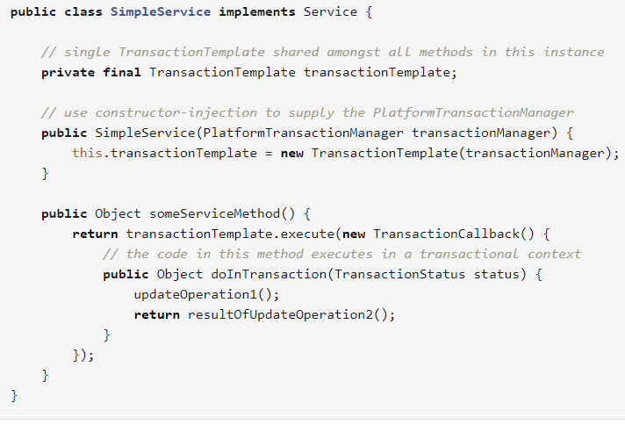
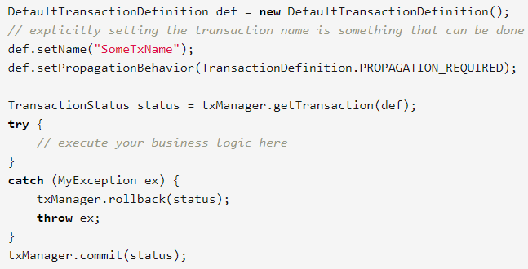
* Programmatic tx management
Use “TransactionTemplate” use default “PlatformTransactionManager”

