Slide 1
Aspect Programming
Andy

Slide 2
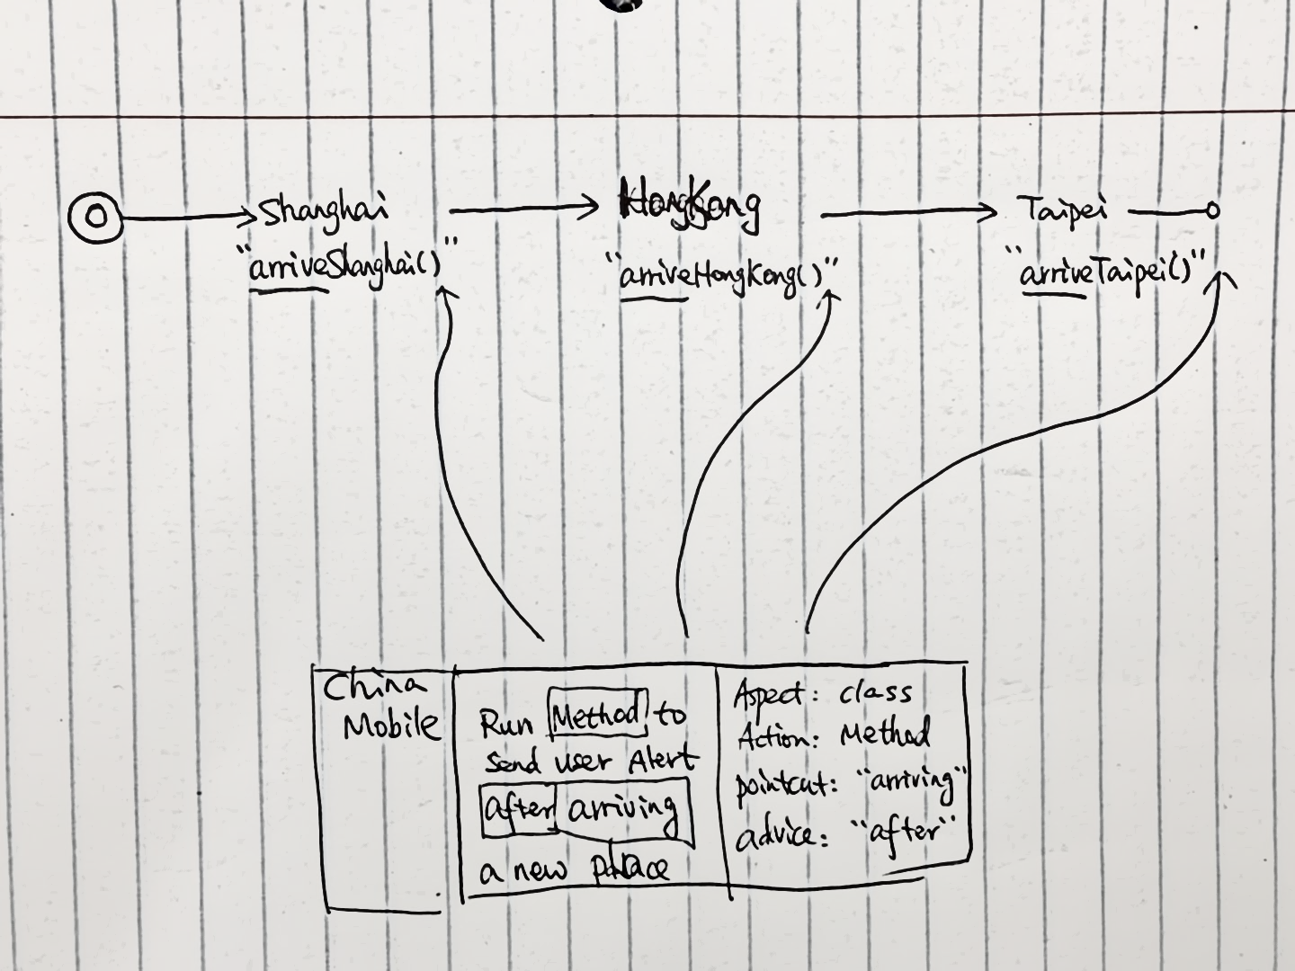
AOP: Aspect Oriented Programming
Aspect: class to define all aop self methods
Pointcut: expression to find all main application methods to insert AOP
Advice: before/after/around/after throwing – when to execute aop methods when the application pointcut is found

Slide 3
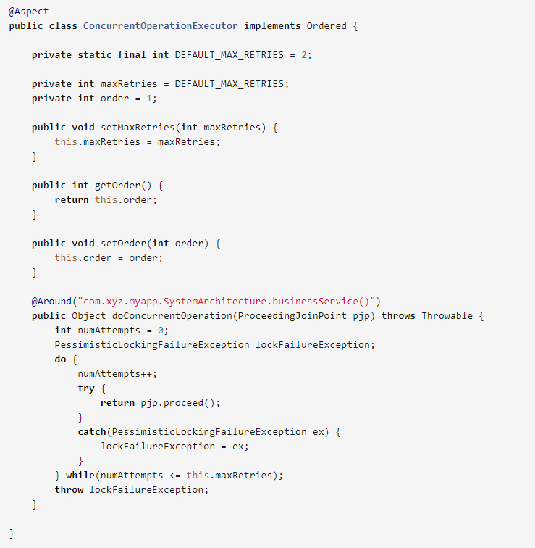
Annotation (annotation + class)

Slide 4
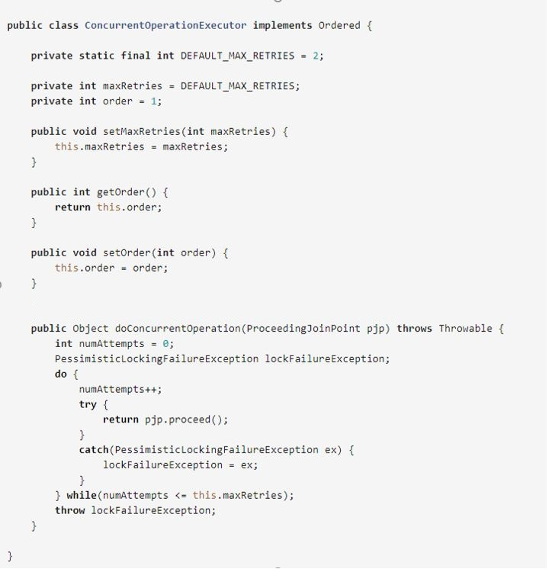
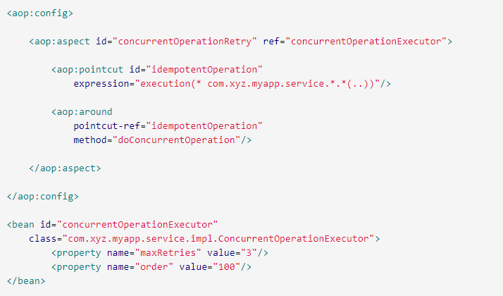
XML (config+class)

Slide 5
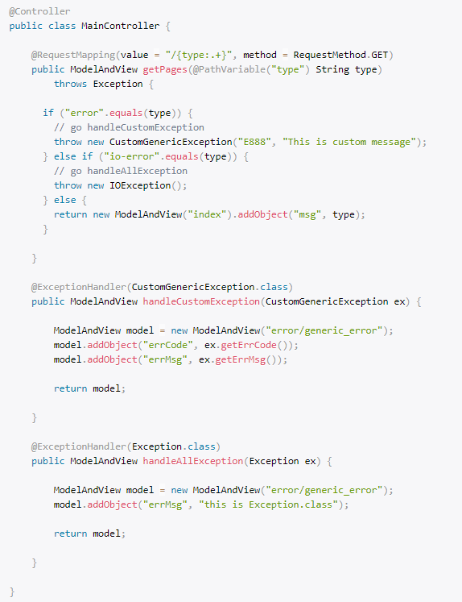
@ExceptionHandler (intercept a particular exception inside one class)

Slide 6
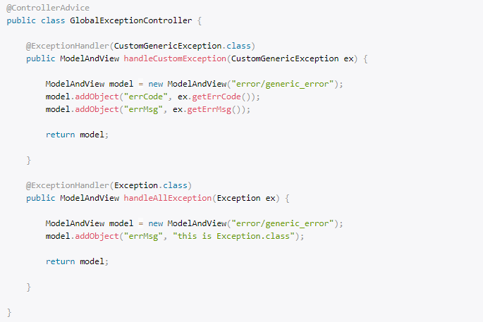
@ExceptionHandler (intercept a particular exception in whole application )

