Slide 1
Service Layer
Andy

Slide 2
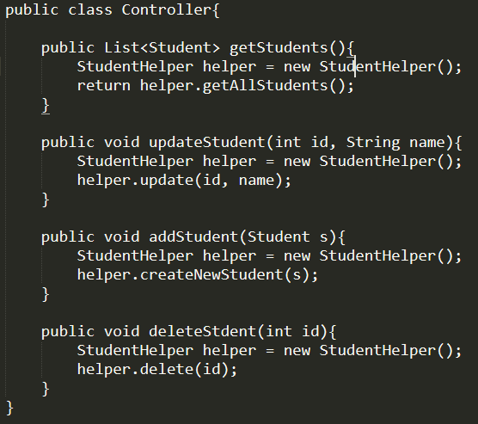
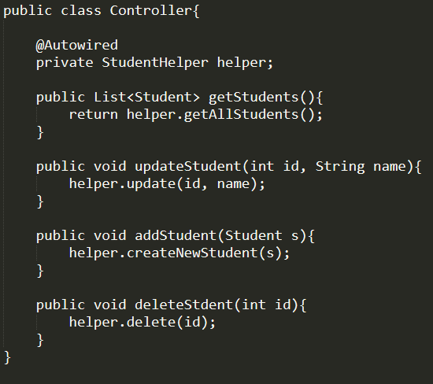
Different ways to get reference

Slide 3






Spring IoC (Inversion of Control)
class
IoC Container
(Bean Factory)
Notes:
How does Spring manages dependency injection:
Two parts: IoC container is like a big bucket storing all beans/instances + Spring inject the beans to your class based on your autowired reference

Slide 4
Spring Dependency Injection
Bean Creation
Container: ApplicationContext vs BeanFactory
Bean Initialization --- XML vs Annotation
Bean Scope
Bean Injection
Bean Injection --- XML vs Annotation

Slide 5
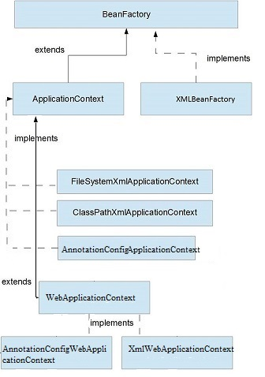
ApplicationContext vs BeanFactory
BeanFactory
Bean instantiation/wiring
ApplicationContext
Bean instantiation/wiring
Automatic BeanPostProcessor registration
Automatic BeanFactoryPostProcessor registration
Convenient MessageSource access (for i18n)
ApplicationEvent publication
Example: https://gist.github.com/bigme666/5210042

Slide 6
ApplicationContext vs BeanFactory
Example – How to Use
ApplicationContext ctx = new ClassPathXmlApplicationContext(“beans.xml”)
HelloBean hello = (HelloBean) ctx.getBean(“hello”);
hello.sayHello(“John”)
BeanFactory factory = new XmlBeanFactory(new ClassPathResource(“beans.xml”)
HelloBean hello = (HelloBean) factory.getBean(“hello”)
hello.getMessage();

Slide 7
Bean Creation – XML vs Annotation
<bean id=“studentHelper“
name=“myStudentHelperBean”
class=“com.demo.service.StudentHelper">
</bean>
<alias name=“studentHelper” alias=“studentHelperAlias”> </alias>
@Configuration
public class HelperManagement {
@Bean
public StudentHelper studentHelper() {
return new StudentHelper();
}
}

Slide 8
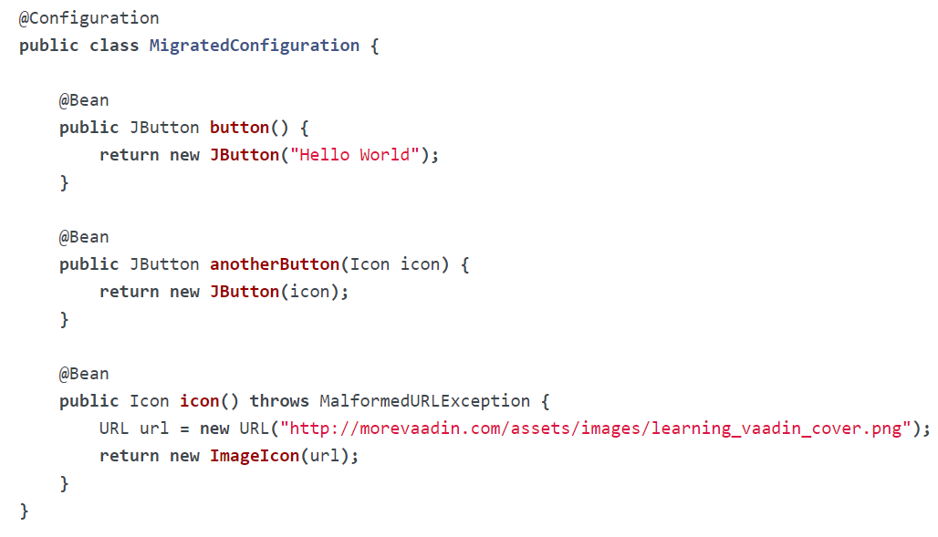
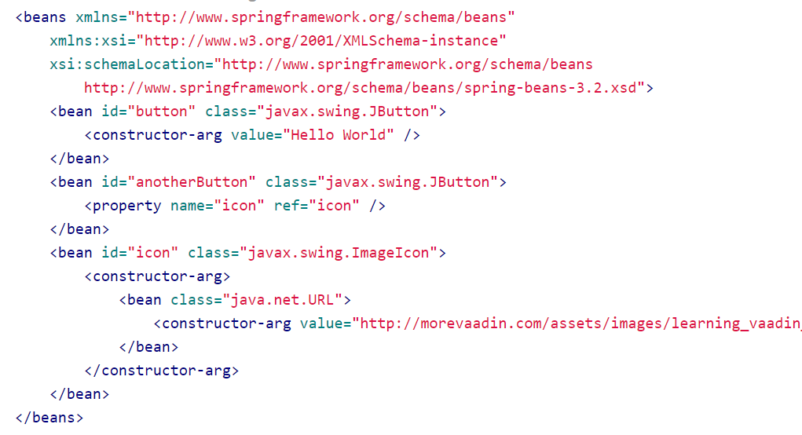
Bean Creation – XML vs Annotation
Question: XML or Annotation?

Slide 9
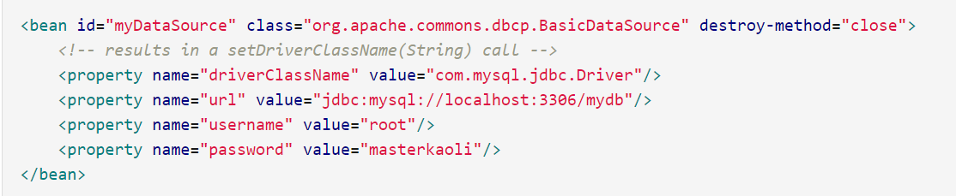
A special bean
Data Source
Notes:
HomeWork: research on how to use set, list, map as bean in XML configuration

Slide 10
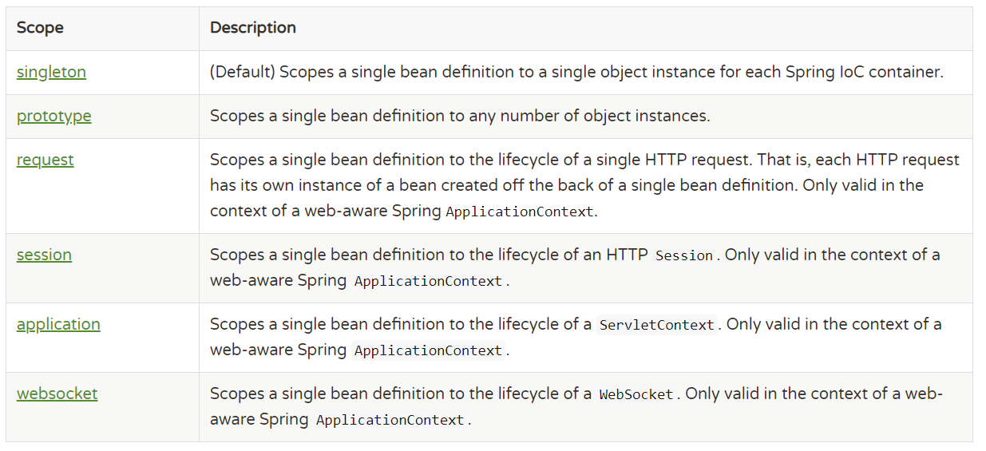
Bean Scope
** The Delegate Mechanism
Question: Is Spring Singleton Bean thread-safe?

Slide 11
Bean Scope
Implementation
Annotation:
@Scope(“prototype”)
@Bean
public User getUser(){}
XML:
<bean id=“user” class=“example.User” scope=“prototype”/>

Slide 12
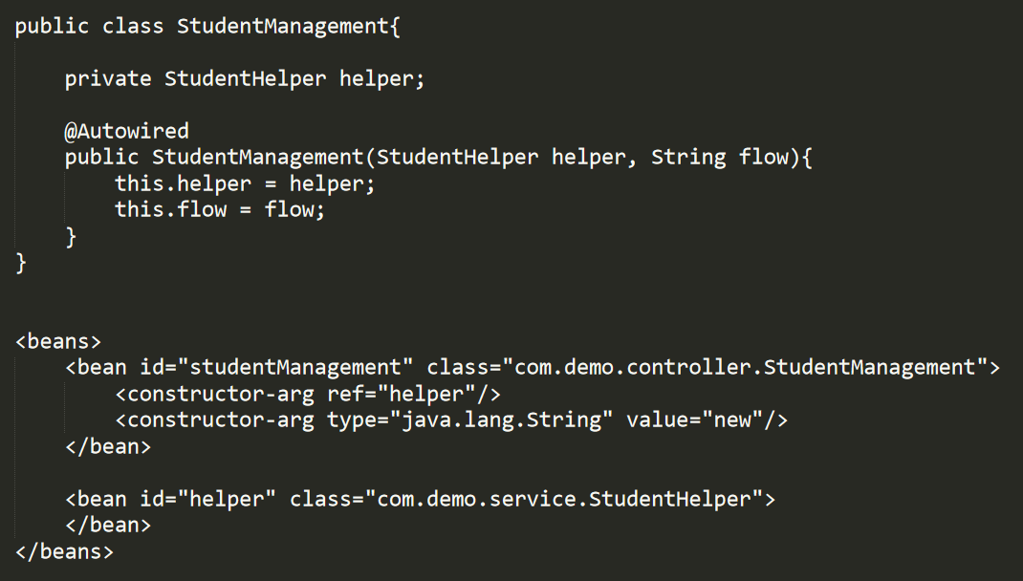
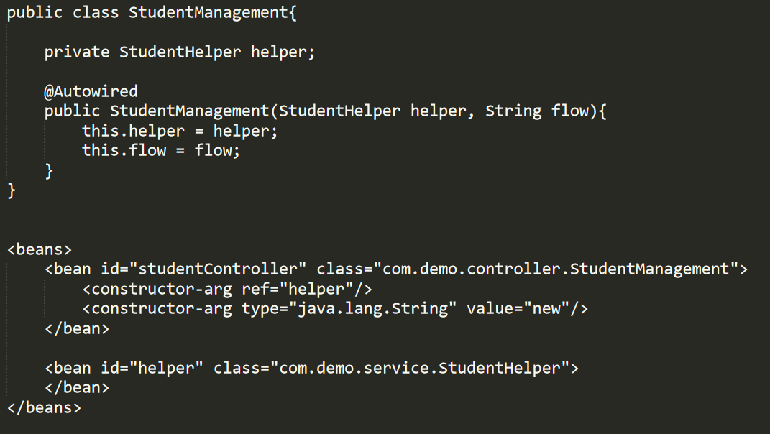
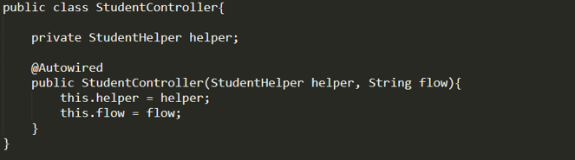
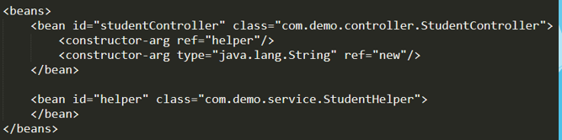
Dependency Injection : Constructor-based
Annotation:
XML:

Slide 13
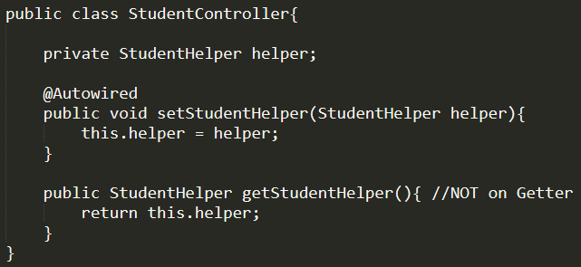
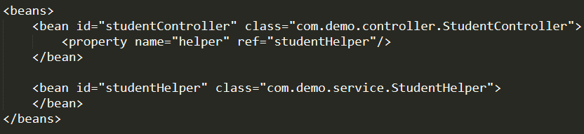
Dependency Injection : Setter-based
Annotation:
XML:

Slide 14
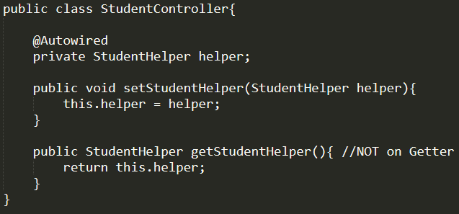
Dependency Injection : Field-based
Annotation:
XML: Not Supported
*Note: Field-based is based on Java reflection, not Spring supported DI type

Slide 15
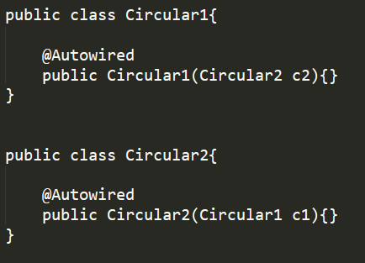
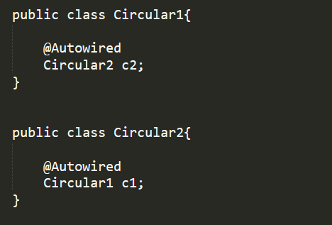
Constructor-based vs Setter-based Circular Dependency
Constructor-based
BeanCurrentlyInCreationException
Setter-based
No exception
Notes:
Difference between Constructor-based and Setter-based
Constructor-based is injected when the Class Bean is initialized/constructed.
Setter-based is injected when the dependency is used

Slide 16
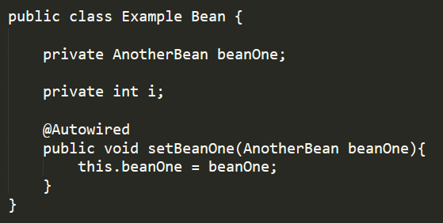
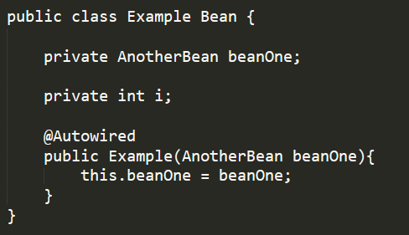
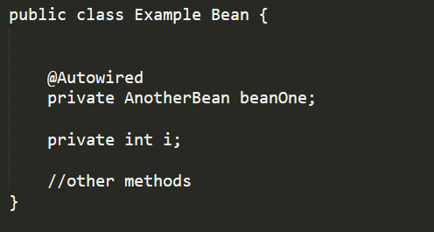
How does @Autowired work
MODE:
No -- default
byType
byName
Constructor
Setter
Constructor
Field
Notes:
Field is Java Reflection based and not suggested, but the mostly used

Slide 17
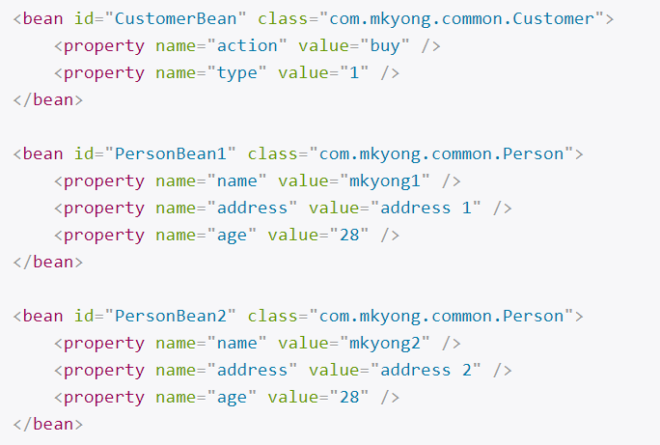
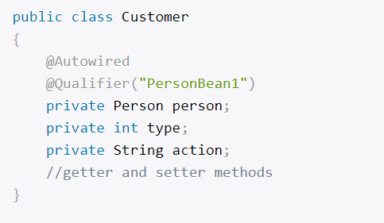
@Autowired + @Qualifier
Fallback: When byType finds multiple match, it will by default use byName

Slide 18
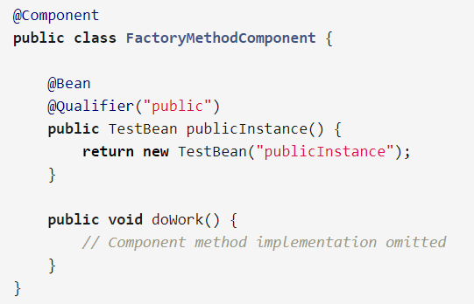
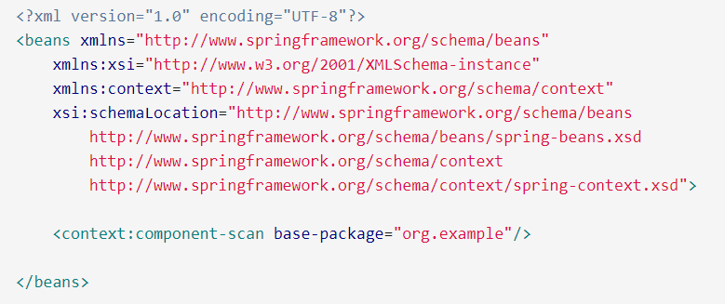
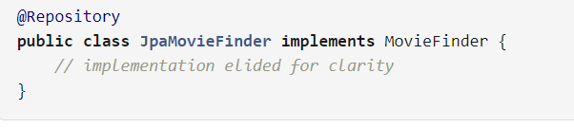
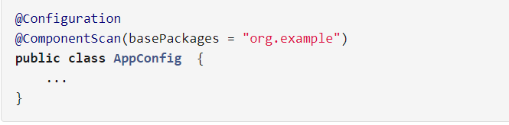
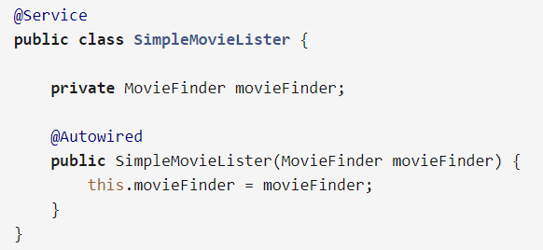
@Component & ComponentScan
Question? @Component vs @Bean ?

Slide 19
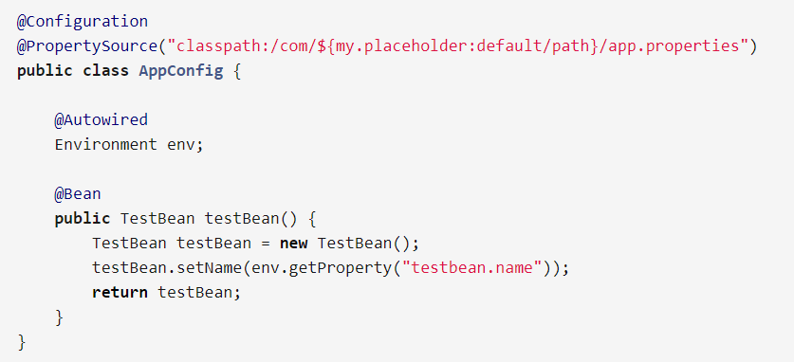
@PropertySource

Slide 20
End of IoC Container

