Slide 1
Data Access
Andy

Slide 2
Diagram of components
Data Access Frameworks
C.R.U.D
Conn
To
DB
table
Service
Procedure
Data Source
Data Access
Transaction

Slide 3
Data Access Frameworks
Content
JDBC + Spring JDBC(JdbcTemplate)
Hibernate
JPA + Spring Data JPA

Slide 4
JDBC

Slide 5
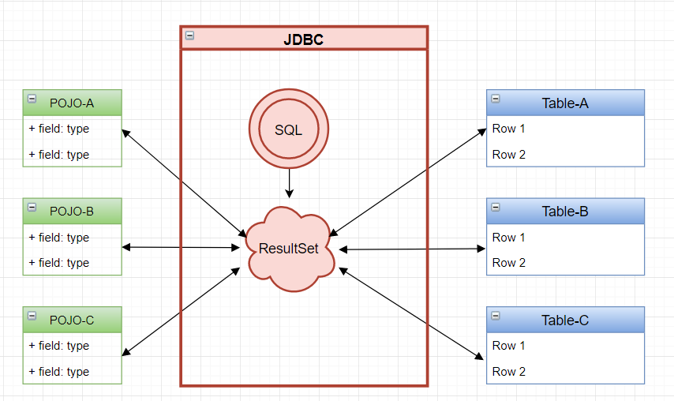
JDBC

Slide 6
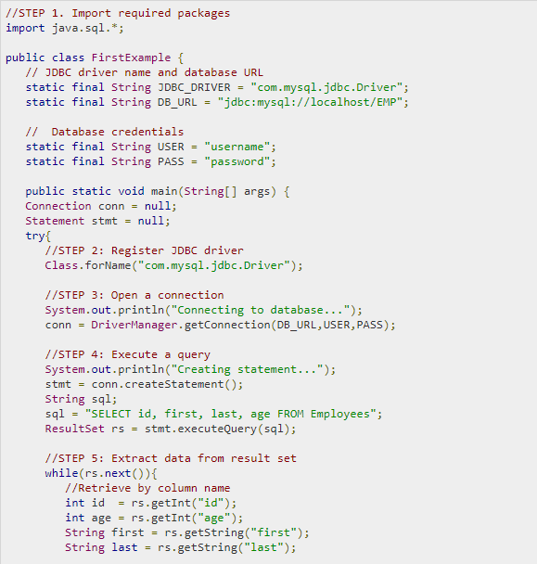
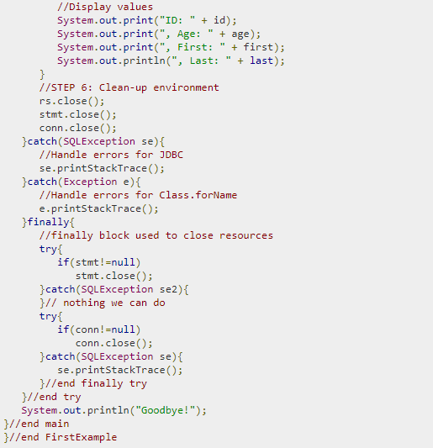
JDBC

Slide 7
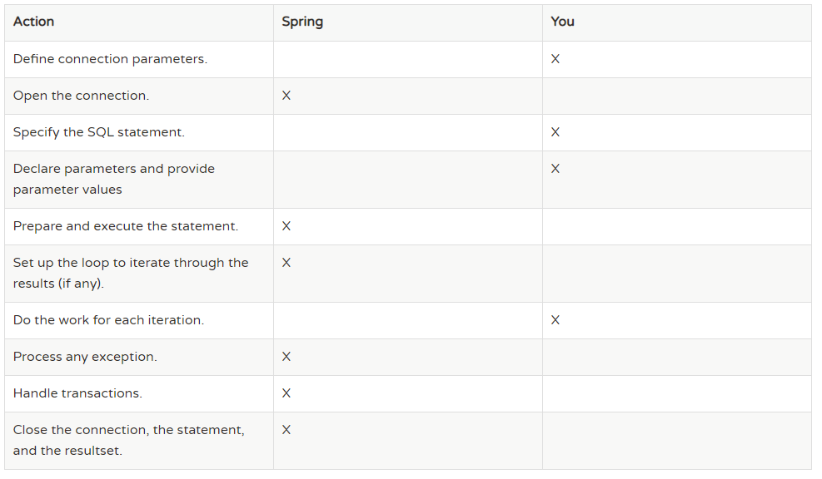
Why Spring JDBC?

Slide 8
Data Access - CRUD
JdbcTemplate
NamedParameterJdbcTemplate
SimpleJdbcInsert & SimpleJdbcCall
MappingSqlQuery, SqlUpdate,
StoredProcedure

Slide 9
CRUD
Basic CRUD Operations
JdbcTemplate
NamedParameterJdbcTemplate
SimpleJdbcInsert
SimpleJdbcCall
Batch Process
Stored Procedure and function
Notes:
https://www.logicbig.com/tutorials/spring-framework/spring-data-access-with-jdbc/spring-call-stored-procedure.html
FOR STORED PROCEDURES

Slide 10
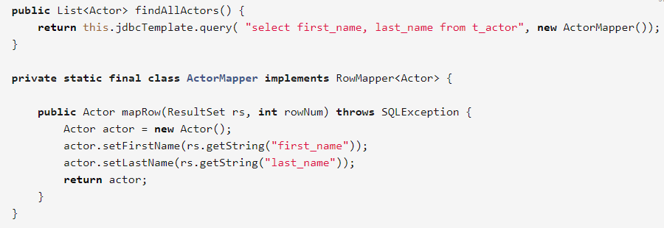
JdbcTemplate: select: query()

Slide 11
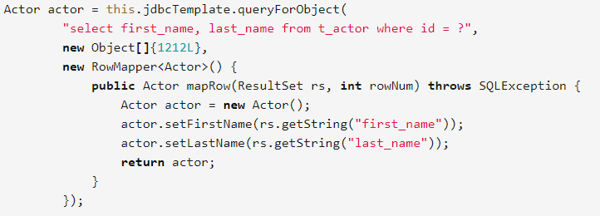
JdbcTemplate: select: queryForObject()

Slide 12
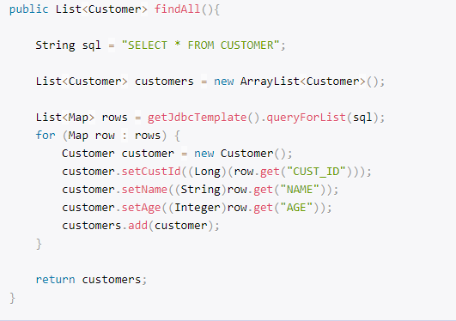
JdbcTemplate:select:queryForList()

Slide 13



JdbcTemplate: Update/Insert/Delete
Insert/Update/Delete (“update”)
Notes:
jdbcTemplate is thread-safe

Slide 14
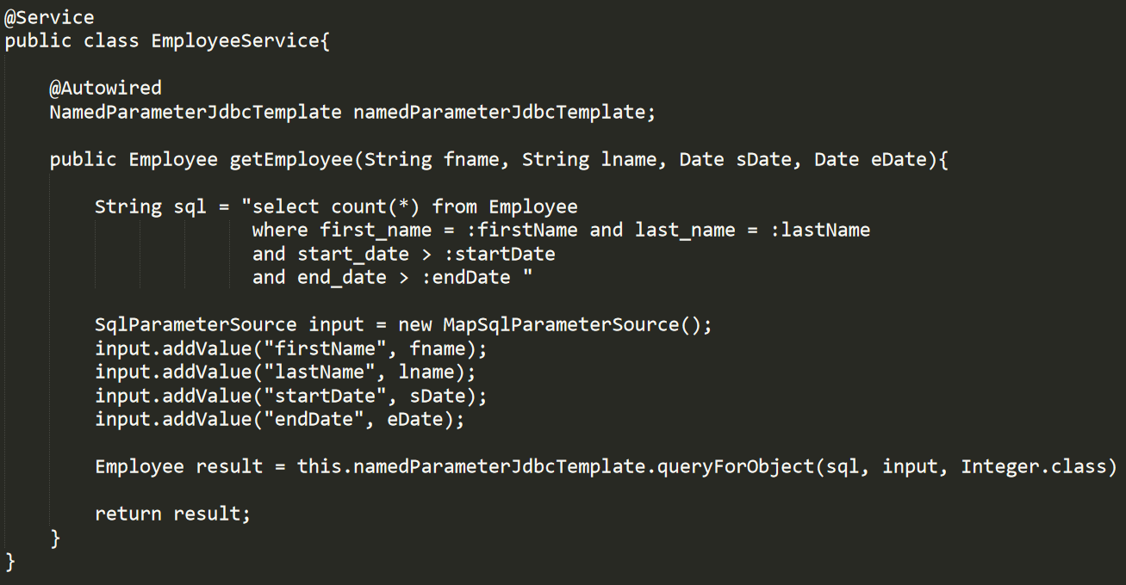
NamedParameterJdbcTemplate
Notes:
exampleActor has to be set with values
exampleActor can have fields more than just firstName and lastName

Slide 15
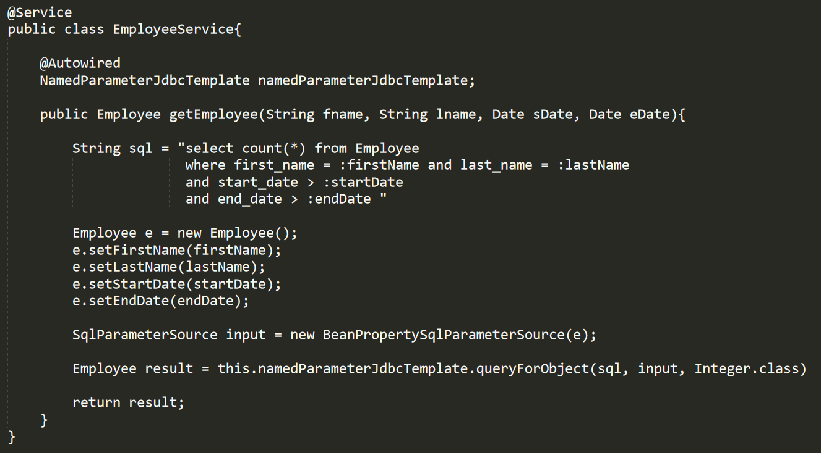
NamedParameterJdbcTemplate
Notes:
exampleActor has to be set with values
exampleActor can have fields more than just firstName and lastName

Slide 16
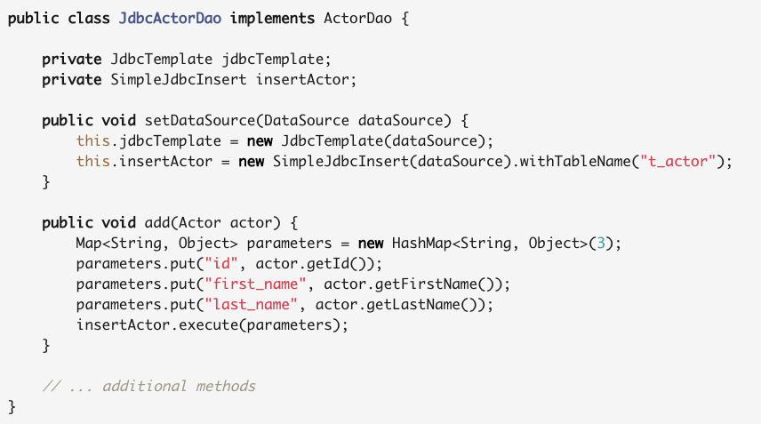
* SimpleJdbcInsert
Notes:
Execute takes only a map and the map key has to be the same as the table columns..
It can also work with SqlParameterSource and MapSqlParameterSource as input just as in NamedParameterJdbcTemplate

Slide 17
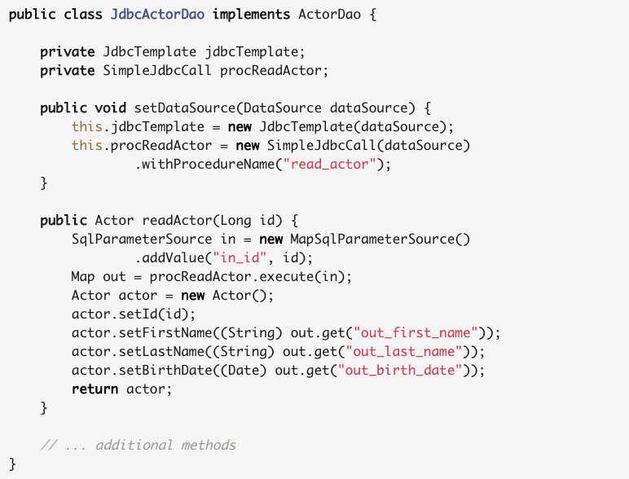
* Stored Procedure: SimpleJdbcCall

Slide 18
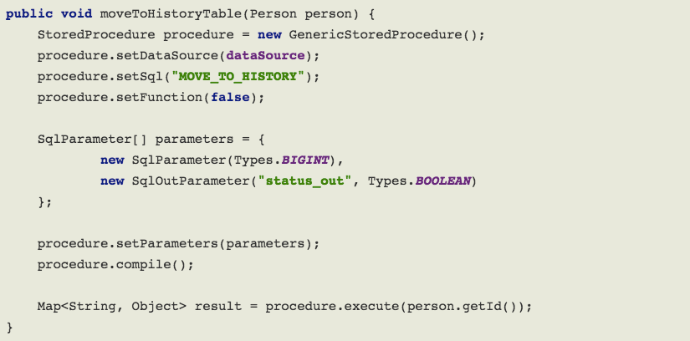
* Stored Procedure: StoredProcedure
Notes:
StoredProcedure is an abstract class

Slide 19
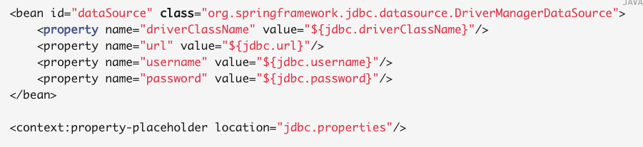
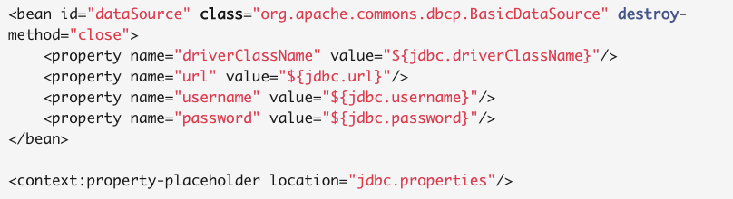
Data Source
Notes:
How to call??
Which one to use?

Slide 20
Hibernate

Slide 21
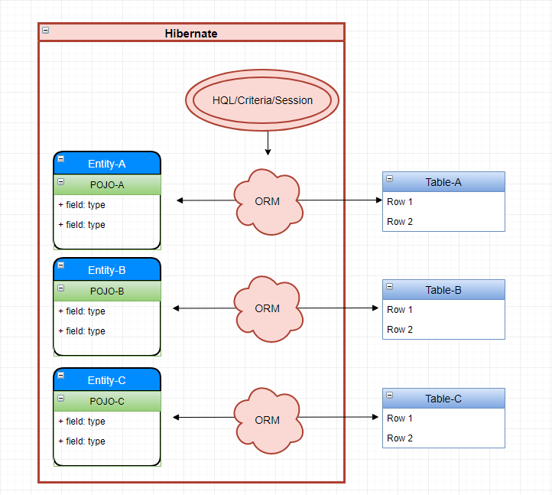
Hibernate

Slide 22
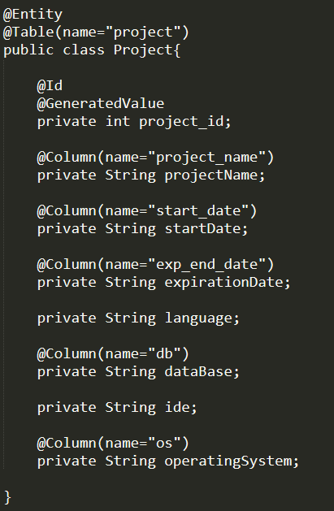
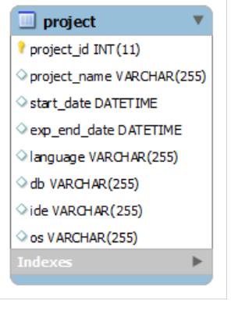
Entity Mapping

Slide 23
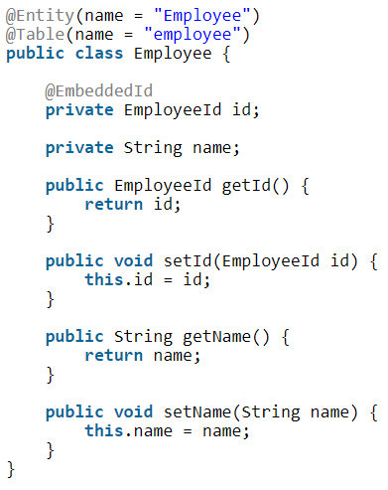
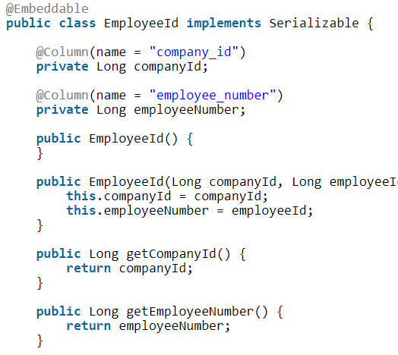
Entity Mapping: Composite Primary Key

Slide 24
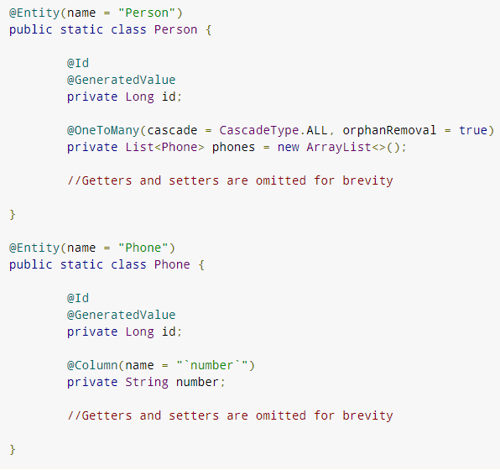
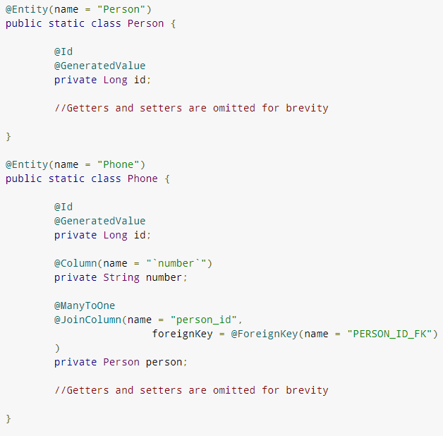
Association: one-to-many and many-to-one
Notes:
@OneToOne

Slide 25
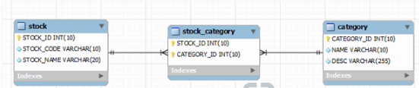
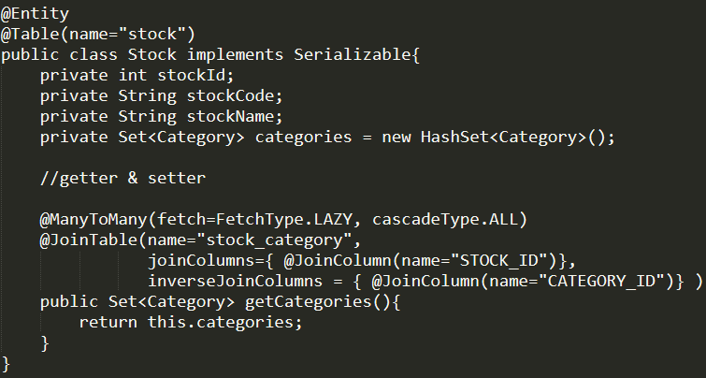
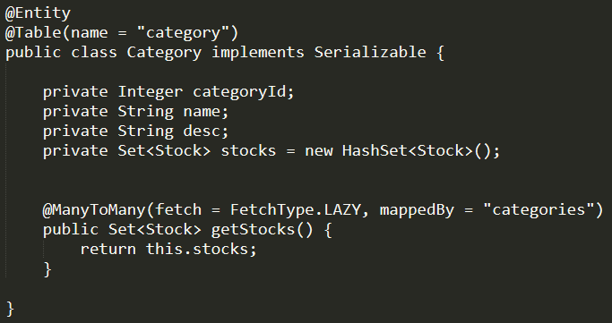
Association: Many-to-Many
In Database:
In Hibernate:

Slide 26
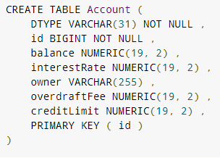
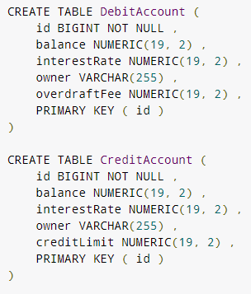
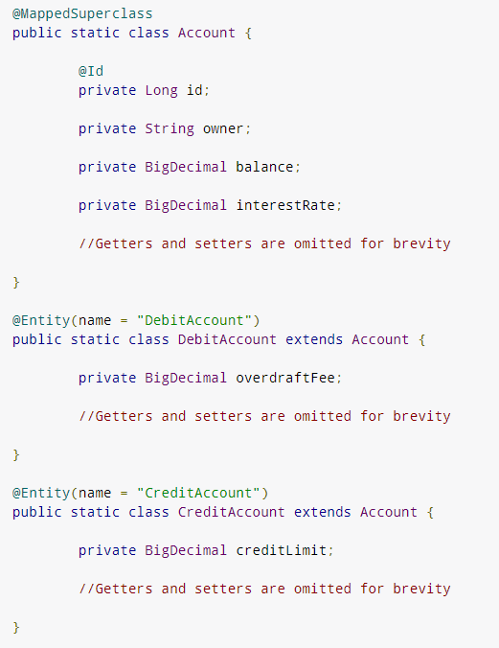
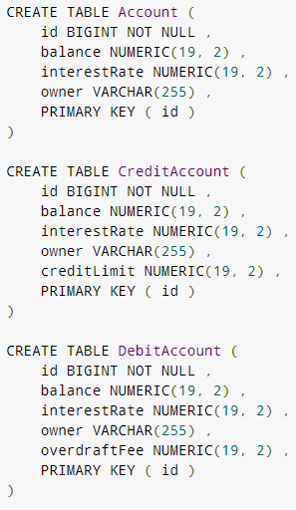
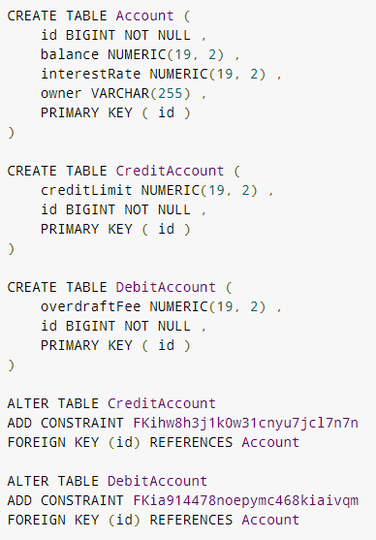
Entity Mapping: Inheritance
Mapped SuperClass
Single table
Table per class
Joined table
4 types
Notes:
FOR SCHEMA GENERATION
Single Table – is general good design
Joined Table – not good, because mapping @ManyToMany is heavy
Table-per-class – not efficient at all, have to use joins etc, should be avoided

Slide 27
Hibernate Core Concepts
Entity Mapping
CRUD → HQL/Criteria
Session
Transaction
SessionFactory
Proxy
Persistence Context
Notes:
1. Session vs Transaction
REAL EXAMPLE:: Bank Deposit

Slide 28
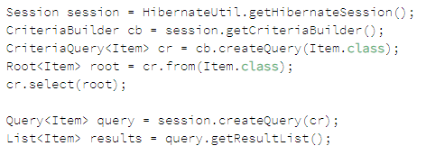

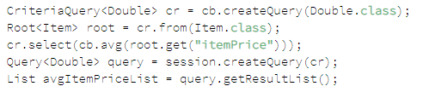
*CRUD: Criteria API
select
Chain expression
Sort
aggregate

Slide 29
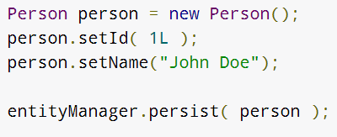
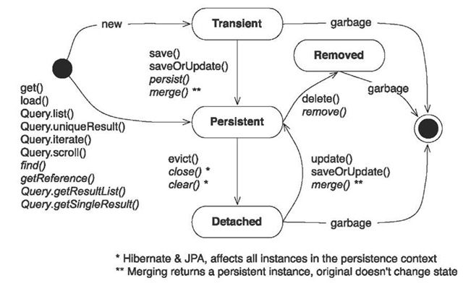
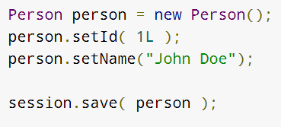
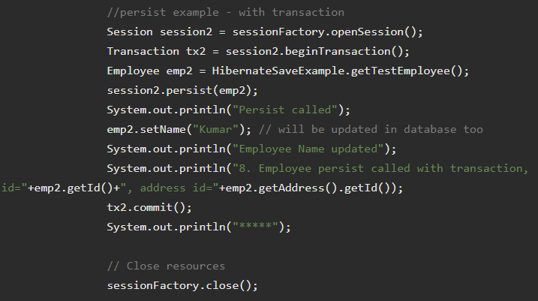

Persistence Context
Notes:
Persist ?

Slide 30
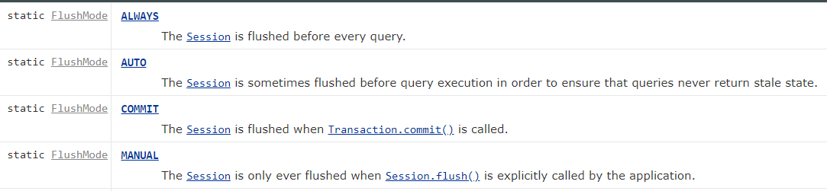
Flush Mode

Slide 31
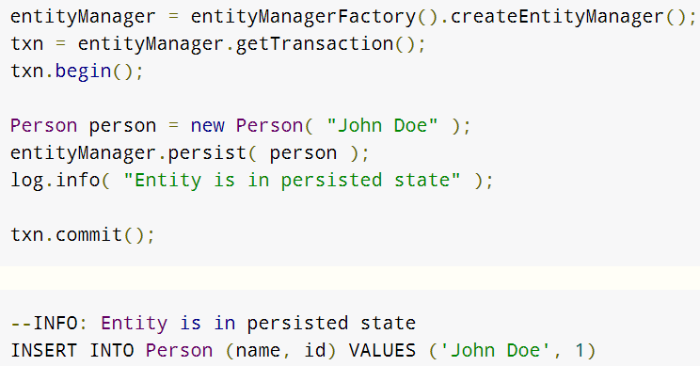
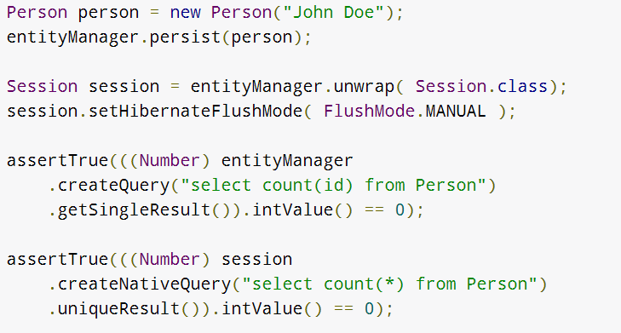
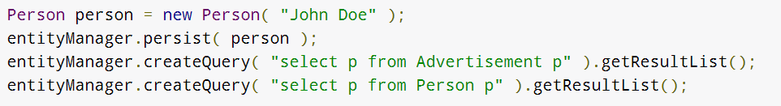
Example
Apply: Auto/Commit/Always/Manual
How to set Flushing Mode

Slide 32
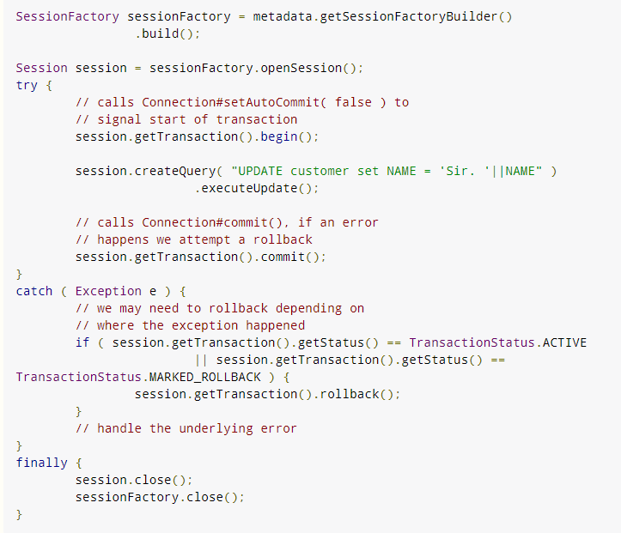
Transaction
a boilerplate session code

Slide 33
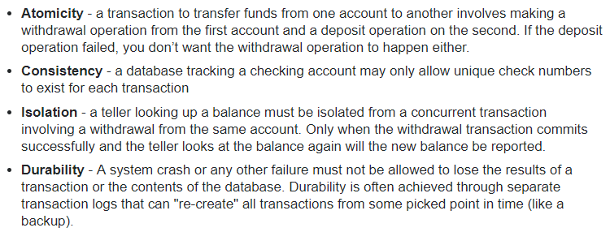
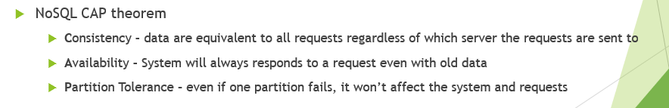
Database ACID
Transaction
Primary key
Locking
Replication

Slide 34
Locking
Concern:
A transaction reads data, update data and then commit the data. During commit, it needs to make sure the data is not stale – not modified by other concurrent on-going transaction.
What if it happens?
Rollback current transaction
Types of locking in hibernate
Optimisitic Locking and Pessimistic Locking

Slide 35
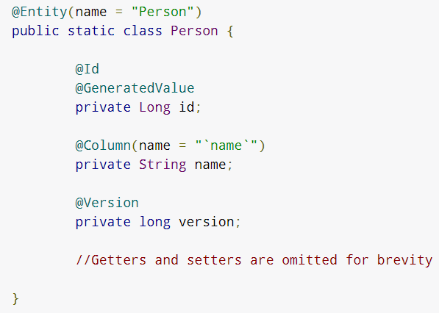
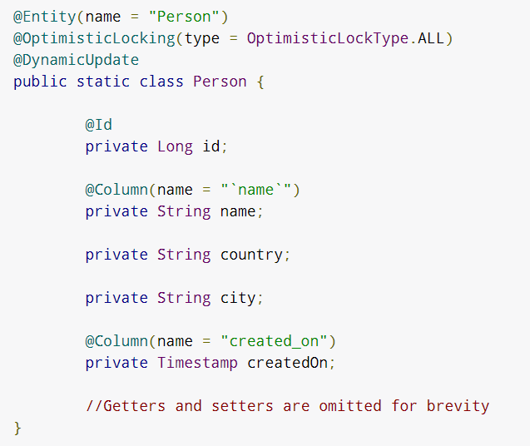
Optimistic Locking
Version
All
Dirty
timestamp
Approach 1: Version
Approach 2: OptimisticLocking with DynamicUpdate

Slide 36
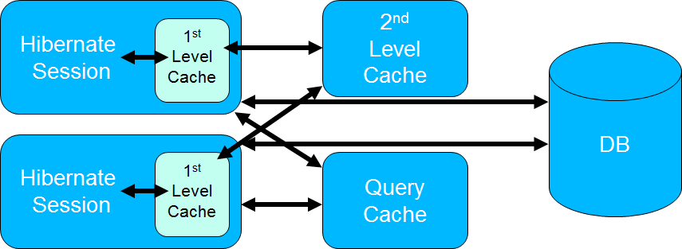
Caching
Two level cache
1st level cache: stays in session level. Purpose: minimize database visit
2nd level cache: stays in sessionFactory. Purpose: cross session use
Notes:
Session starts -> 1 level cache -> 2nd level cache -> Database
-> Database -> 1,2 level cache
The query cache is the only one which does not store entities. It caches query results and contains only entity references and scalar values. You need to activate the cache by setting the hibernate.cache.use_query_cache property in the persistence.xml file and set the cacheable property on the Query.

Slide 37
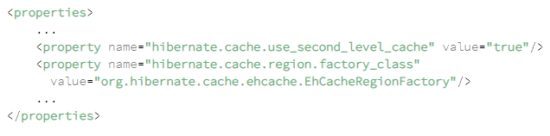
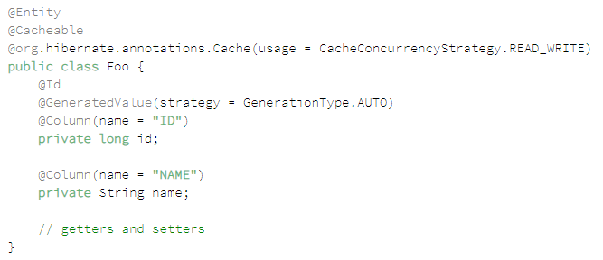
Configure 2nd level Cache

Slide 38
Performance Tuning
Use logging to track visiting to database
Optimize HQL or Native SQL Query
FetchType = LAZY
Use cache, but before using 2nd level cache, try to put heavy operation to database
Bulk updates/deletes

Slide 39
JPA & Spring Data JPA

Slide 40
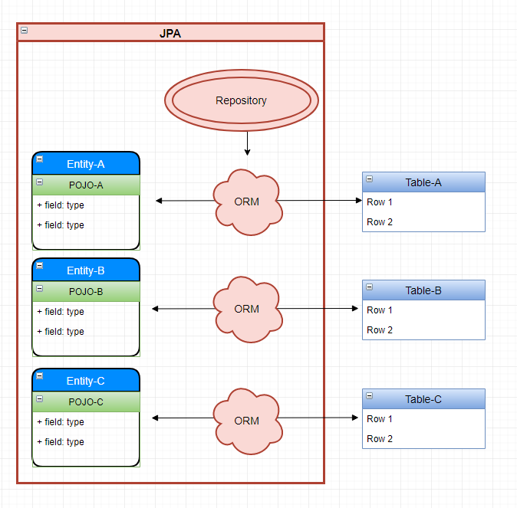
JPA

Slide 41
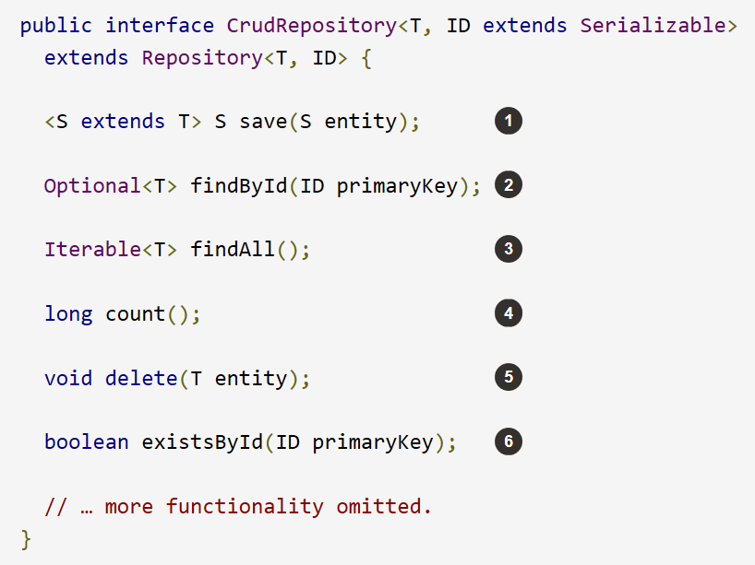
Why JPA?
JPA is to eliminate SQL in java
By using Naming Convention in Java Method

Slide 42
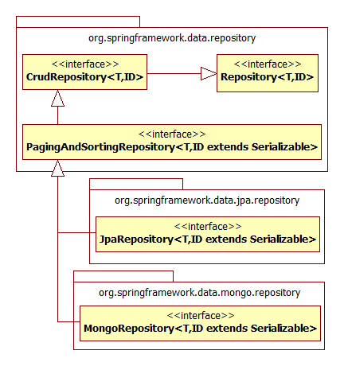
Repository
CrudRepository
PagingAndSortingRepository
JpaRepository
JpaRepository returns a list
CrudRepository returns Iterable
Notes:
When to use which?

Slide 43




4-step Declaration
2
3
4
1
1. Enable JPA Scan → 2. Extends Repository → 3. Define CRUD Query → 4. Inject into Service
Notes:
@EnableJpaRepositories(“com.acme.repositories”)

Slide 44

JPA Naming Convention: Select

Slide 45

JPA Naming Convention: Insert/Update/Delete
Notes:
Check out this example:: https://github.com/eugenp/tutorials/tree/master/persistence-modules/spring-data-jpa/src/main/java/com/baeldung/boot/daos

Slide 46

Pagination
Notes:
Pagination is used when processing large amount of data in rest service

Slide 47

Your Own Query

Slide 48
Example – End of Spring DAO

