Slide 1
J2EE
Andy

Slide 2
Contents
Database(RDBMS / *NoSQL*) – SQL, PLSQL
JDBC
Jersey Rest Service
Front-End technologies
Git and Github
CICD

Slide 3
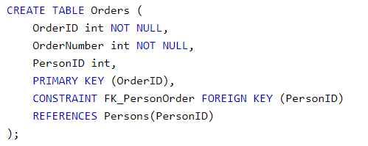
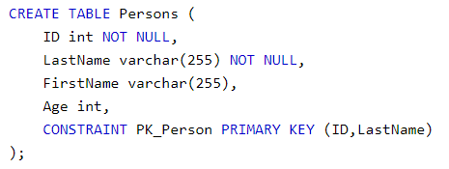


Database
Primary Key, Foreign Key, Unique Key
Interview Question: difference between them

Slide 4
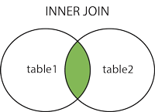
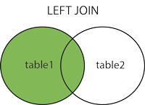
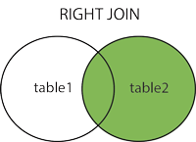
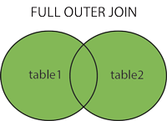
Database
Type of Joins (inner join, left join, right join, full outer join)
Notes:
SQL:: https://www.w3schools.com/sql/default.asp
PL/SQL:: https://www.tutorialspoint.com/plsql/index.htm

Slide 5
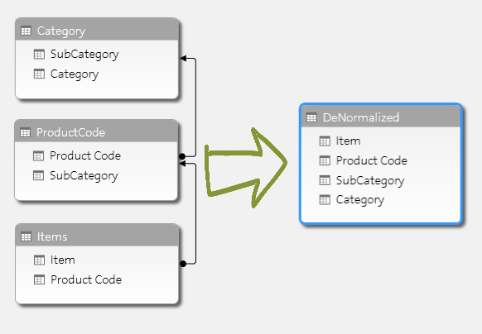
Database
Normalization vs De-normalization

Slide 6
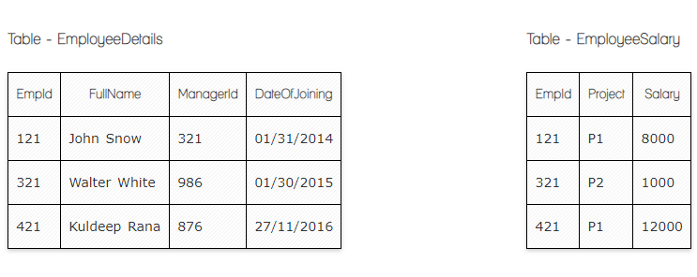
Database
Clob vs Blob
Truncate vs Delete vs Drop
View vs Materalized View vs Table
https://artoftesting.com/interviewSection/sql-queries-for-interview.html

Slide 7
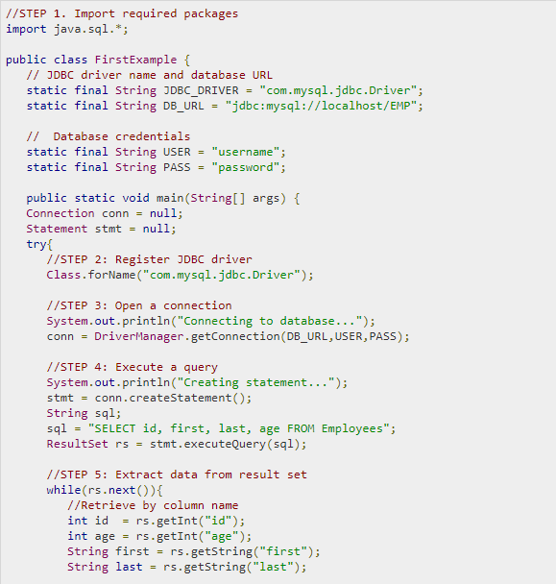
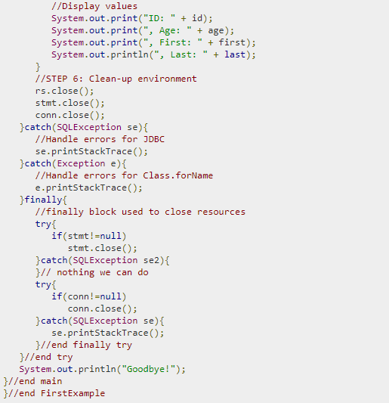
JDBC

Slide 8
RDBMS vs NoSQL
Relational Database | NoSQL Database
Structure Data (table based) | Unstructured Data (document, column based)
Supports Transactions | Does not support Transactions
Store Medium to Large Data | Store Huge Amount of Data
Relative Fixed Query Language (SQL) | Different Query languages
Performance Low | Performance High
Design Principle: ACID | Design Principle: CAP
Example: MySQL, Oracle, SQL Server | Example: MongoDB, Cassandra, Reddis
Question: Which one to choose?

Slide 9
MongoDB vs Cassandra
NoSQL vs SQL -> which one to choose?
NoSQL -> document/column based UNSTRUCTURED data
NoSQL :
1. NoSQL is good at handling unstructured data, large amount of documents
2. NoSQL is not ideal for transaction handling – not good for accounting related data
ACID – Atomicity, Consistency, Isolation, Durability
Common NoSQL db to learn: MongoDB, Cassandra, Couchbase, Redis
NoSQL CAP theorem
Consistency – data are equivalent to all requests regardless of which server the requests are sent to
Availability – System will always responds to a request even with old data
Partition Tolerance – even if one partition fails, it won’t affect the system and requests
MongoDB vs Cassandra

Slide 10
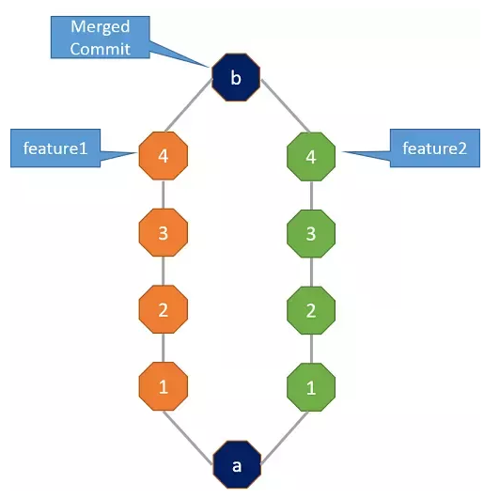
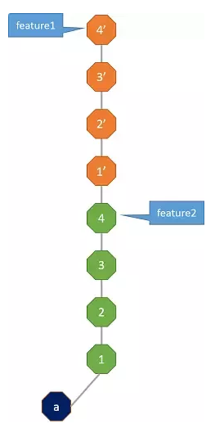
Git rebase vs merge
Git rebase, merge

Slide 11
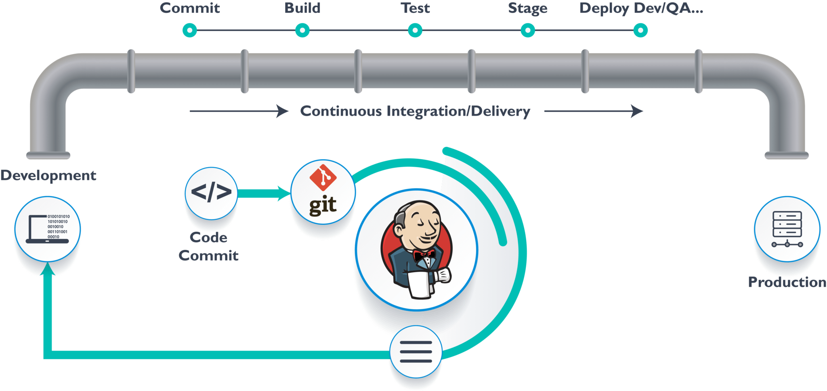
CICD

Slide 12
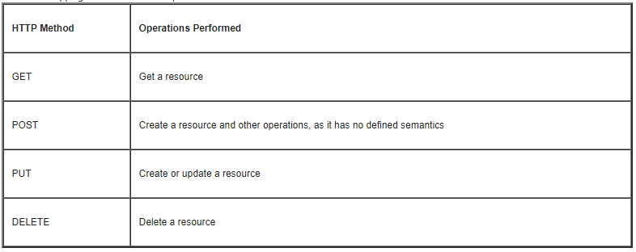
Jersey Rest Service

Slide 13
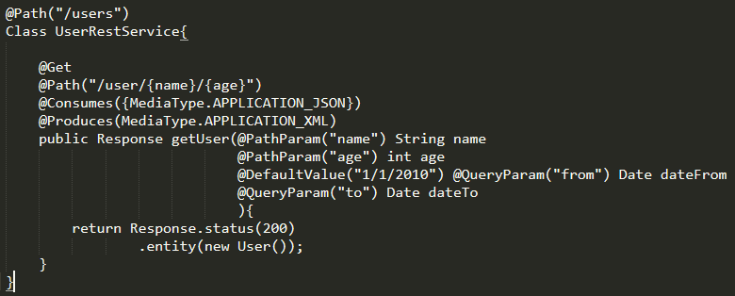
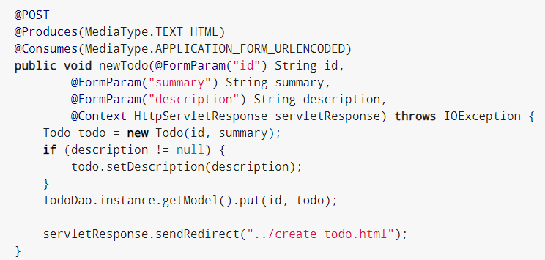
Jersey Rest Service
Get vs Post

Slide 14
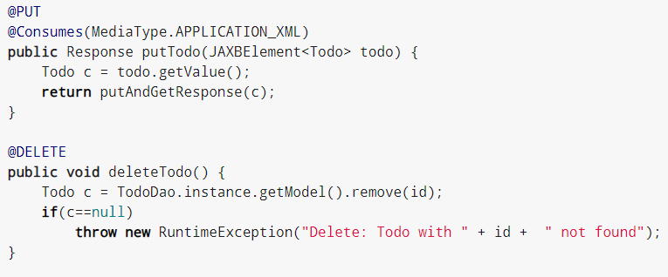
Jersey Rest Service
Put vs Delete

Slide 15
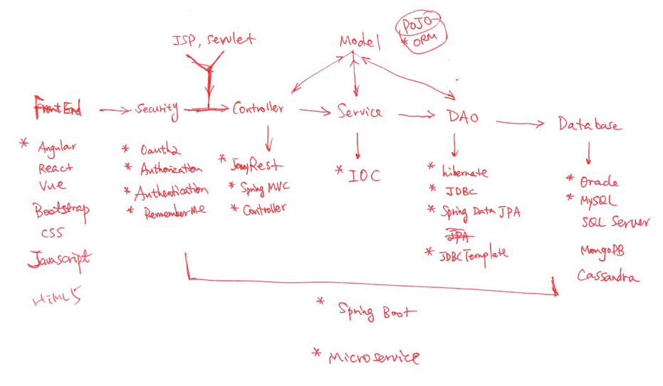
Architecture Review

