Slide 1
W1-Python Intro & TensorFlow Data Pre-proccess
Qingrun Zhang

Slide 2
Outline

Slide 3
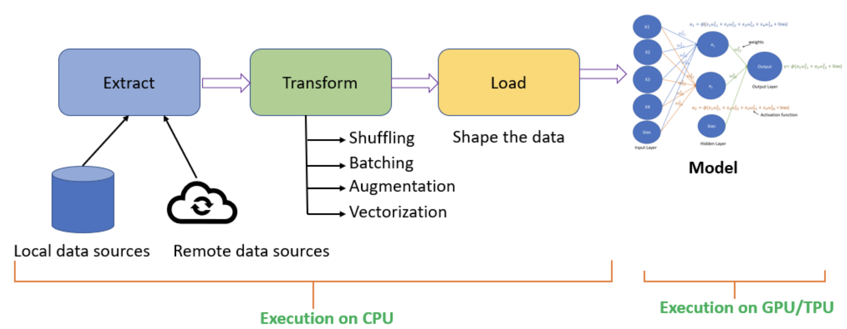
Use tf.data to build an efficient input pipeline
Source: https://towardsdatascience.com/how-to-reduce-training-time-for-a-deep-learning-model-using-tf-data-43e1989d2961
Notes:
When creating an input data pipeline, typically, we perform the ETL(Extract, Transform, and Load) process.
Extract. extract the data from different data sources like local data sources, which can be from a hard disk or extract data from remote data sources like cloud storage.It handles everything from downloading the raw data to parsing and splitting it, giving us a dataset. Transform allows to shuffle, perform augmentation, convert data to tensors etc. Loading the data involves cleaning the data and shaping it into a format that we can pass to the deep learning model for training.
How you load the data can significantly impact on the performance of the training pipelines.

