Slide 1
Data 603 Statistical Modelling with Data
(Week 3)
Dr. Qingrun Zhang
Assistant Professor
Department of Mathematics and Statistics
University of Calgary

Slide 2
MULTIPLE LINEAR REGRESSION
PART III: MODEL SELECTION

Slide 3

Model Selection
Stepwise model selection methods
Forward Selection
Backwards Elimination
Criteria for model selection
p-values
R², adjusted R²
Mallows’s Cp Criterion
AIC (Akaike’s information criterion)

Slide 4

Stepwise Regression-Forward Selection
Step 1 The software program fits all possible one-variable models of the form
The independent variable that produces the largest (absolute) t -value is then declared the best one-variable predictor of 𝑌. Call this independent variable 𝑋₁.

Slide 5
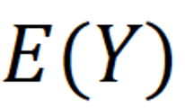
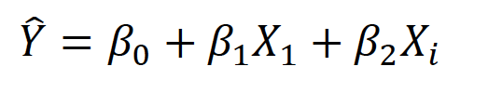
Stepwise regression forward selection
Step 2 The stepwise program now begins to search through the remaining (𝑝−1) independent variables for the best two-variable model of the form
This is done by fitting all two-variable models containing 𝑋₁ and each of the other (𝑝−1) options for the second variable 𝑋_{𝑖}. The t-values for the test 𝐻₀:𝛽₂=0 are computed for each of the 𝑝−1 models (corresponding to the remaining independent variables, 𝑋_{𝑖},𝑖=2,3,...,𝑝−1), and the variable having the largest 𝑡 is retained. Call this variable 𝑋₂.

Slide 6

Stepwise Regression Forward Selection
Before proceeding to Step 3, the stepwise routine will go back and check the t-value of $\hat{β_{1}}$after $\hat{β_{2}}X2$ has been added to the model. If the t-value has become nonsignificant at some specified 𝛼 level (say 𝛼=0.3), the variable 𝑋₁ is removed and a search is made for the independent variable with a 𝛽 parameter that will yield the most significant t-value in the presence of $\hat{β_{2}}X_{2}$.
Step 3 The stepwise regression procedure now checks for a third independent variable to include in the model with 𝑋₁ and 𝑋₂. That is, we seek the best model of the form

Slide 7


Backward Elimination Procedure
Step1: The Backward procedure initially fits a model containing terms for all potential independent variables
The variable with the smallest t (or F) statistic for testing 𝐻0:𝛽𝑖=0 is identified and dropped from the model if the t-value is less than some specified critical value or p-value more than a cut-off
The model with the remaining (𝑝−1) independent variables is fit in step 2, and again, the variable associated with the smallest nonsignificant t-value is dropped. This process is repeated until no further nonsignificant independent variables can be found.

Slide 8

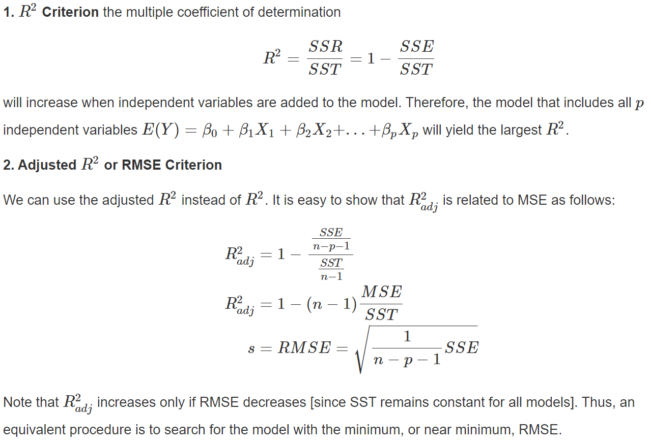
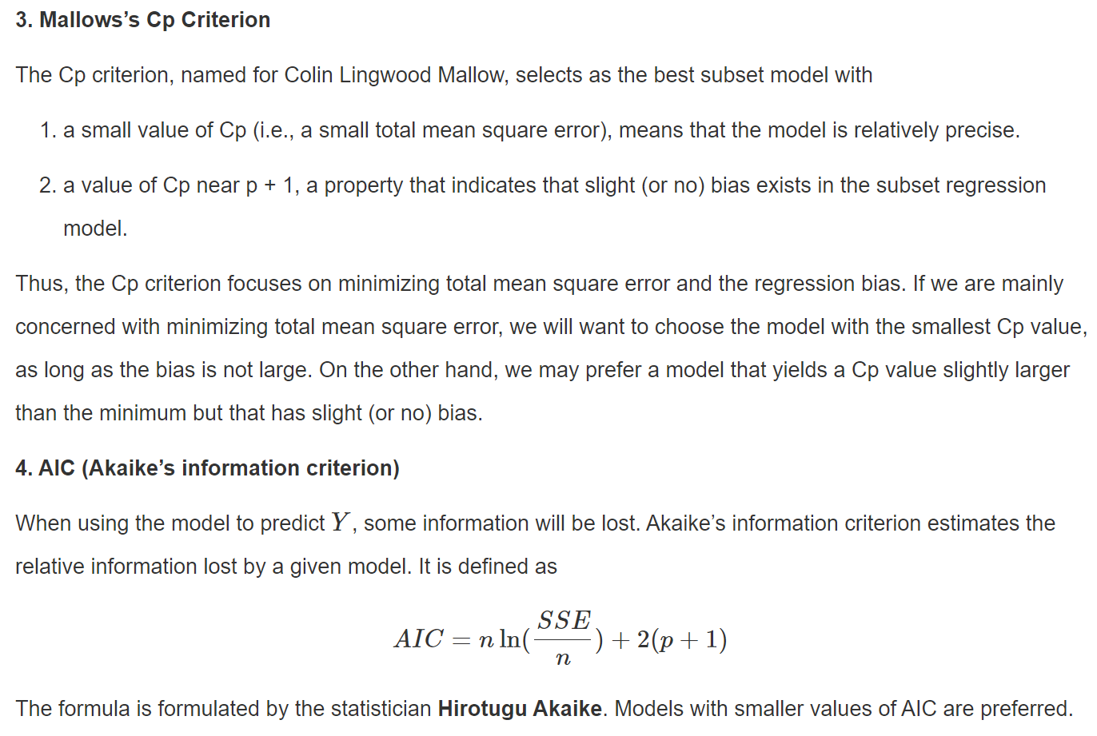
All Possible Regressions Selection Procedure

Slide 9
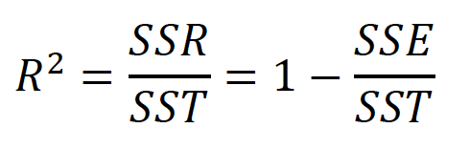
Criteria for model selection
𝑅² Criterion the multiple coefficient of determination
R² will increase when independent variables are added to the model. Therefore, the model that includes all 𝑝 independent variables 𝐸(𝑌)=𝛽₀+𝛽₁𝑋₁+𝛽₂𝑋₂+...+𝛽_{𝑝}𝑋_{𝑝} will yield the largest 𝑅².

Slide 10
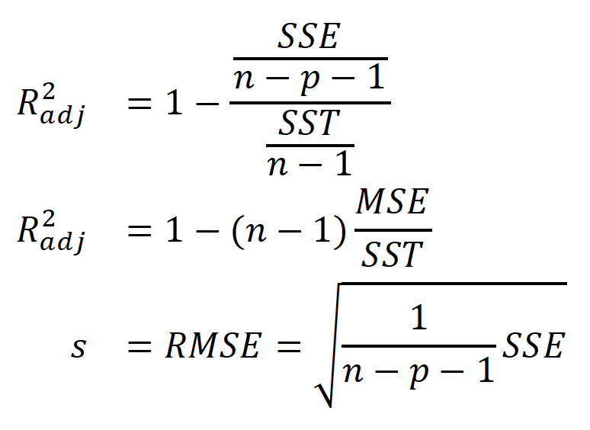
Adjusted R²
Adjusted 𝑅² or RMSE Criterion
$$R_{a}^{2}=R^{2}−\left(\frac{p−1}{n−p}\right)\left(1−R^{2}\right)$$

Slide 11


AIC (Akaike’s information criterion)
Akaike’s information criterion estimates the relative information lost by a given model.
$$AIC=−2\ln{(\hat{L})}+2p$$
Models with smaller values of AIC are preferred.

Slide 12
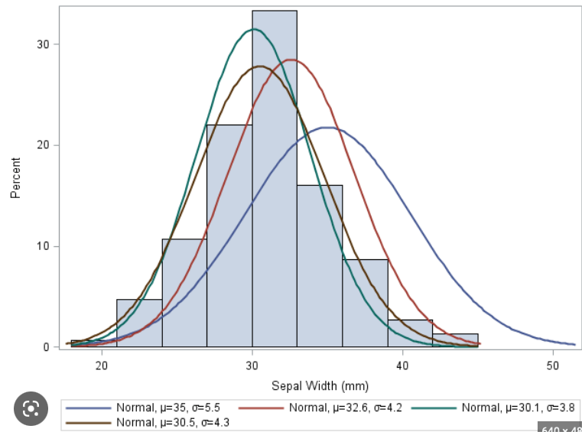
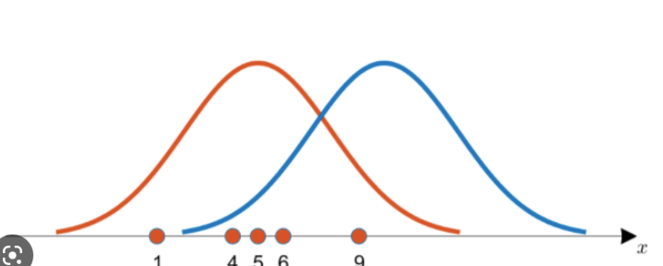
Wait, what is the “L” in the formula?!
L = Likelihood (w.r.t. parameters)
= how likely we can observe the data
Question: likelihood on what? Y? X? residual?

Slide 13


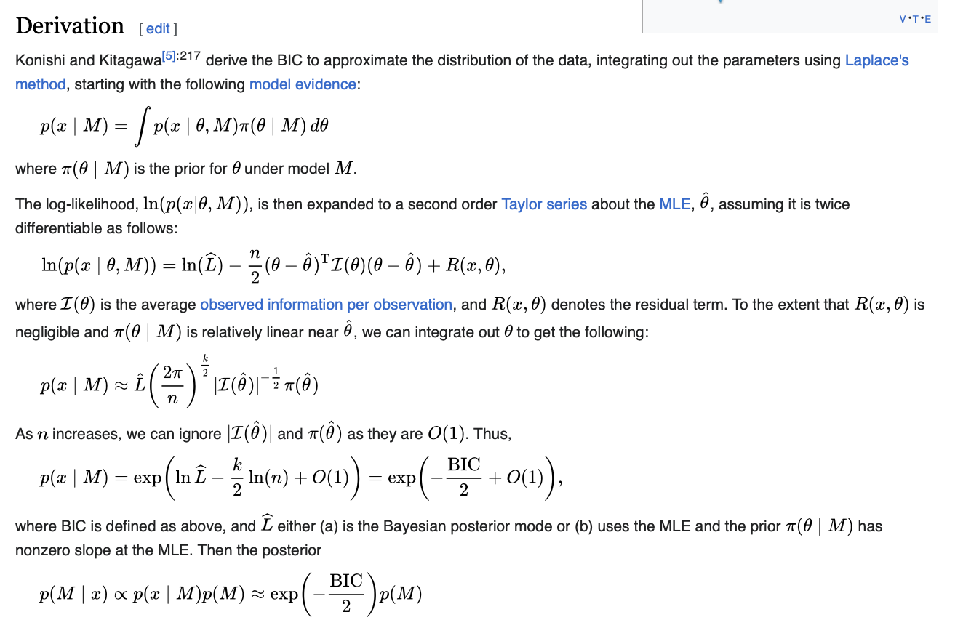

BIC (Bayesian information criterion)
Akaike’s information criterion estimates the relative information lost by a given model.
$$BIC=−2\ln\left(\hat{L}\right)+2\ln\left(n\right)p$$
Models with small values of BIC are preferred.

Slide 14
Mallows’s C_{p} Criterion
Mallows’s C_{p} addresses the issue of overfitting.
$$C_{p}=\frac{{SSE}_{p}}{{\hat{σ}}_{ε}^{2}}−n+2p=\frac{{SSE}_{p}}{{MSE}_{k}}−n+2p$$
Here, p full model parameter numbers, k is the subset model with k adjustable model parameters, n is the sample size
If the subset model is correct, the C_{p} should be about equal to p(smaller is better)
Only useful when n >>k
An estimation for $χ2$

Slide 15
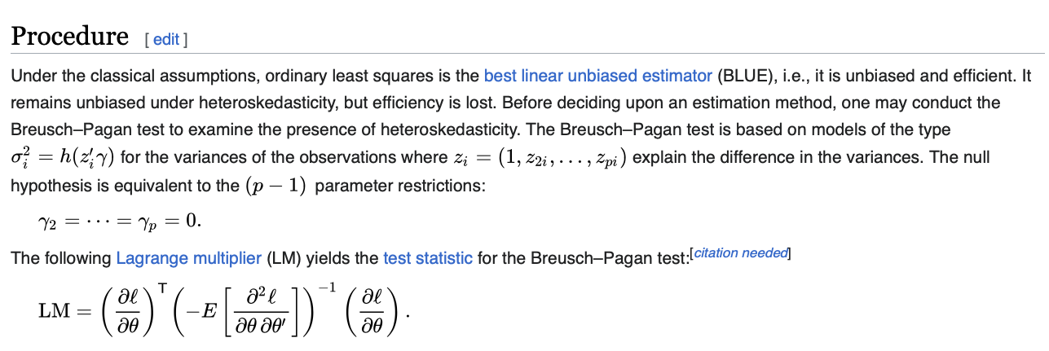
Mallows’s C_{p} Criterion

Slide 16
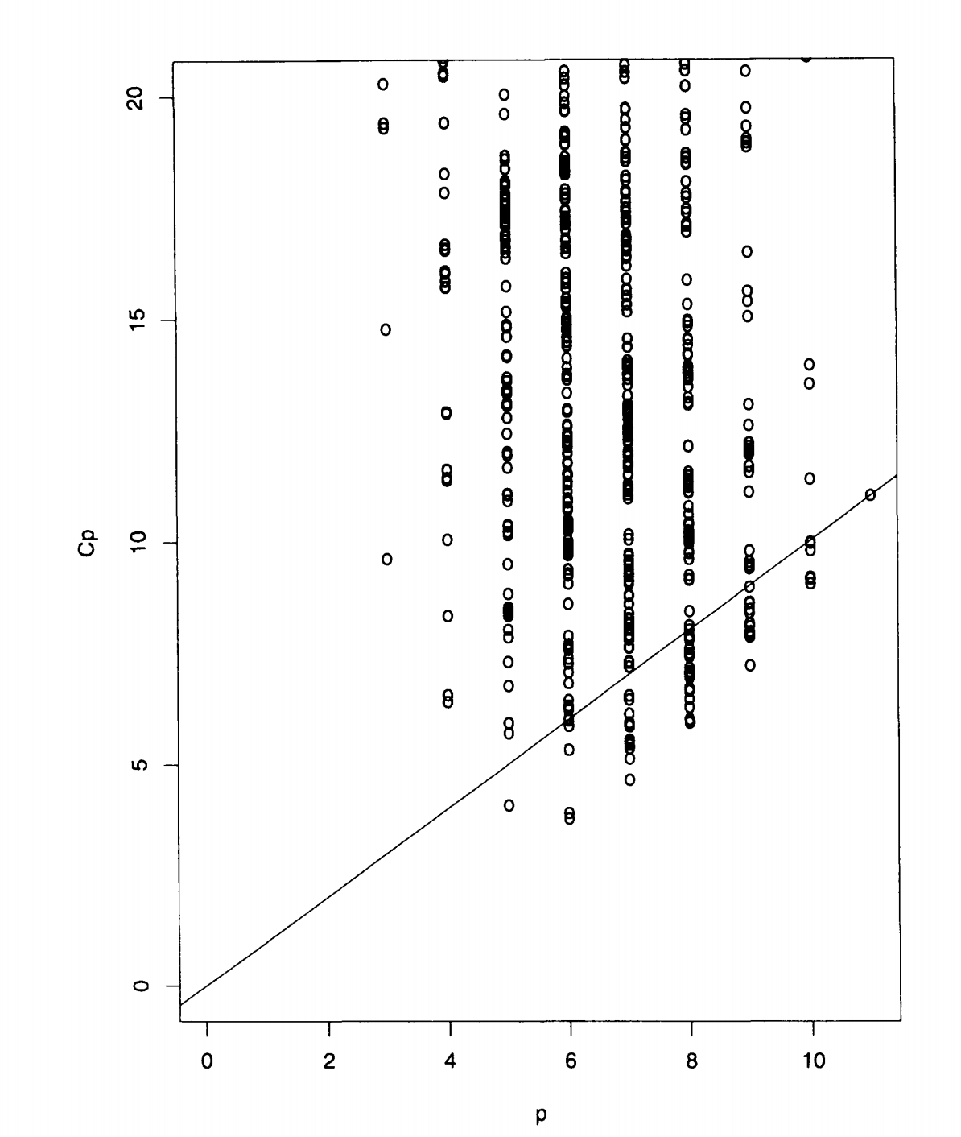
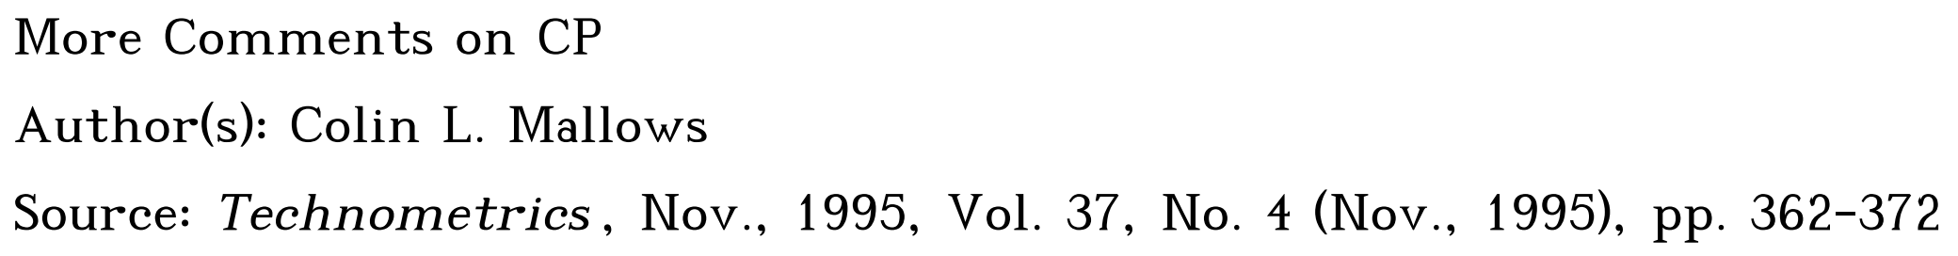
Mallows’s C_{p}
Model with k parameters, calculate Cp for every subset model
If Cp < p, it is a good candidate model

Slide 17
All Possible Regressions Selection Procedure

Slide 18
In-Class Practice Problem 13

Slide 19
Improvement of the model chosen.
After using model selection by automatic methods or all possible regression methods, we might not have the best fit model yet, as we consider only main effects on independent variables. After eliminating some variables that are not important out of the model, we consider interaction terms and/or high order multiple regression model to improve the model.

Slide 20
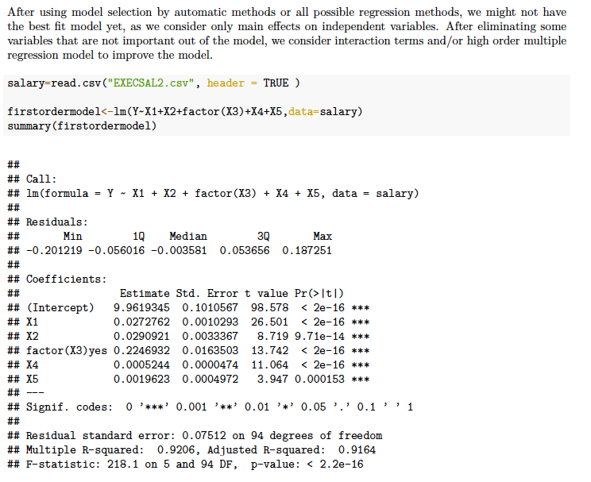

Slide 21
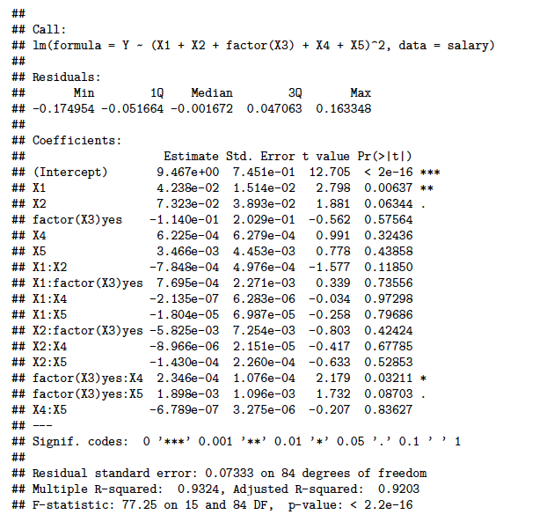

Slide 22
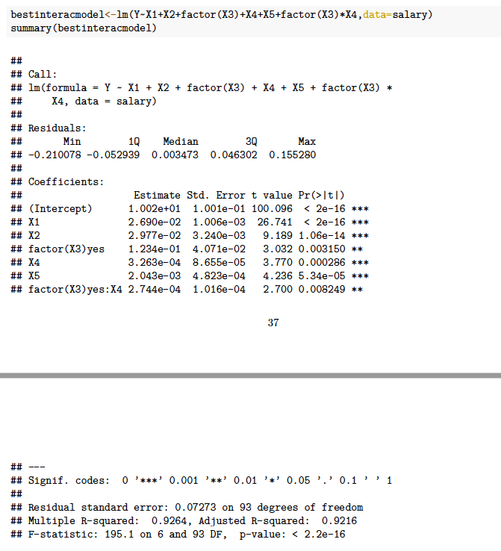

Slide 23
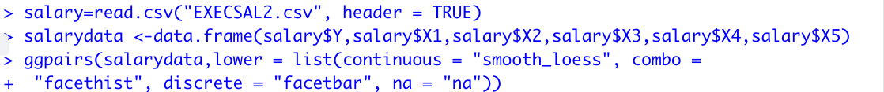

Slide 24
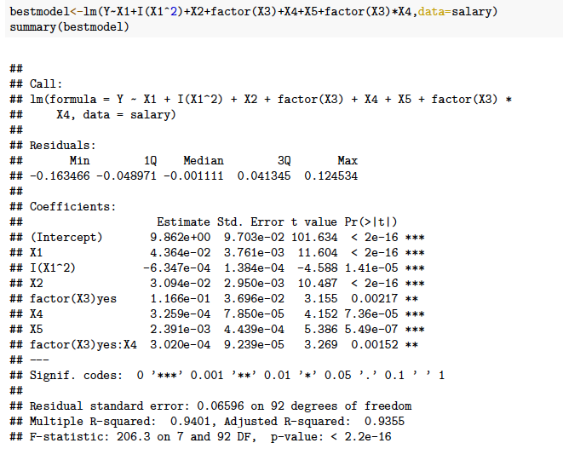

Slide 25
In-Class Practice Problem 15
Clerical staff work hours. In any production process in which one or more workers are engaged in a variety of tasks, the total time spent in production varies as a function of the size of the work pool and the level of output of the various activities.
For example, in a large metropolitan department store, the number of hours worked (Y) per day by the clerical staff may depend on the following
variables:
X1 = Number of pieces of mail processed (open, sort, etc.)
X2 = Number of money orders and gift certificates sold,
X3 = Number of window payments (customer charge accounts) transacted ,
X4 = Number of change order transactions processed ,
X5 = Number of checks cashed ,
X6 = Number of pieces of miscellaneous mail processed on an ‘’as available’’ basis , and
X7 = Number of bus tickets sold
The data are provided in CLERICAL.csv file count for these activities on each of 52 working days.
Conduct a Stepwise Regression Procedure and All-Possible-Regressions procedure of the data using R software package.

Slide 26
The end of TOPIC 3

