Slide 1
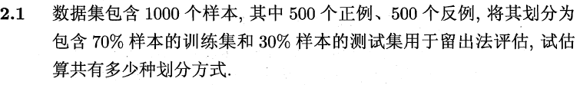

西瓜书习题
Name | Definition
Sens (recall) 查全率 TPR | TP / (TP + FN), how pos are recovered
Precision 查准率 | TP / (TP + FP), how we can trust prediction
Specificity TNR | TN / (TN + FP), how we are clear to Negative group
F1 | Combined metric of recall and precision → 2*R*P / (R+P)
Micro vs Macro | Weighted by sample size Vs non weighted
PPV | Precision
NPV | TN / (TN + FN)
$∁\left({350 \atop 500}\right)$ * $∁\left({350 \atop 500}\right)$
Ground Truth | Prediction
 | Positive | Negative
Positive | True Positive(TP) | False Negative(FN)
Negative | False Positive(FP) | True Negative (TN)

Slide 2
Method | Pros | cons
Min−Max 规范化 | Simpler to calculate No need to recalibrate if the new comer is not greater of less than max / min | Sensitive to outlier
Z-score | Less sensitive to outlier | More compute Recalibrate with new comers

Slide 3
Statistic questions

Slide 4
1. How do you assess the statistical significance of an insight?
perform hypothesis testing
state the null hypothesis and alternative hypothesis
calculate the p-value
the level of the significance (alpha) and if the p-value is less than the alpha

Slide 5
.Explain what a long-tailed distribution
A long-tailed distribution is a type of heavy-tailed distribution that has a tail (or tails) that drop off gradually slower
product sales (i.e. best selling products vs others).
least frequently occurring values make up the majority of the population, more mindful of outliers
conflicts with some machine learning techniques with the assumption that the data is normally distributed.

Slide 6
3. What is the Central Limit Theorem? Explain it. Why is it important?
The central limit theorem states that the sampling distribution of the sample mean approaches a normal distribution as the sample size gets larger no matter what the shape of the population distribution

Slide 7

4. What is the statistical power?
‘Statistical power’ refers to the power of a binary hypothesis, which is the probability that the test rejects the null hypothesis given that the alternative hypothesis is true. [2]

Slide 8
5. Explain selection bias
proper randomization is not achieved
resulting in a sample that is not representative of the population.
significantly skew results and provide false insights about a particular population group.
time interval: selecting a specific time frame that supports the desired conclusion. e.g. conducting a sales analysis near Christmas.

Slide 9
Is mean imputation of missing data acceptable practice? Why or why not?
Mean imputation is the practice of replacing null values in a data set with the mean of the data.
Mean imputation is generally bad practice because it doesn’t take into account feature correlation.
Second, mean imputation reduces the variance of the data and increases bias in our data. This leads to a less accurate model and a narrower confidence interval due to a smaller variance.

Slide 10
8. What is an outlier?
An outlier is a data point that differs significantly from other observations.
Z-score/standard deviations: if we know that 99.7% of data in a data set lie within three standard deviations Interquartile Range (IQR)
less than Q1–1.5*IRQ or greater than Q3 + 1.5*IQR

Slide 11
9. How do you handle missing data? What imputation techniques do you recommend?
Delete rows with missing data
Predicting the missing values
Using an algorithm which supports missing values, like random forests

Slide 12
11. Explain likely differences between administrative datasets and datasets gathered from experimental studies.
Administrative datasets are typically datasets used by governments or other organizations for non-statistical reasons.
regularly updated
may not capture all of the data

Slide 13
notice a spike in uploads, What might you think is the cause of this, and how would you test it?
A new feature may have been implemented
process of uploading photos before was not intuitive and was improved
costumes for Halloween.
conduct hypothesis testing

Slide 14
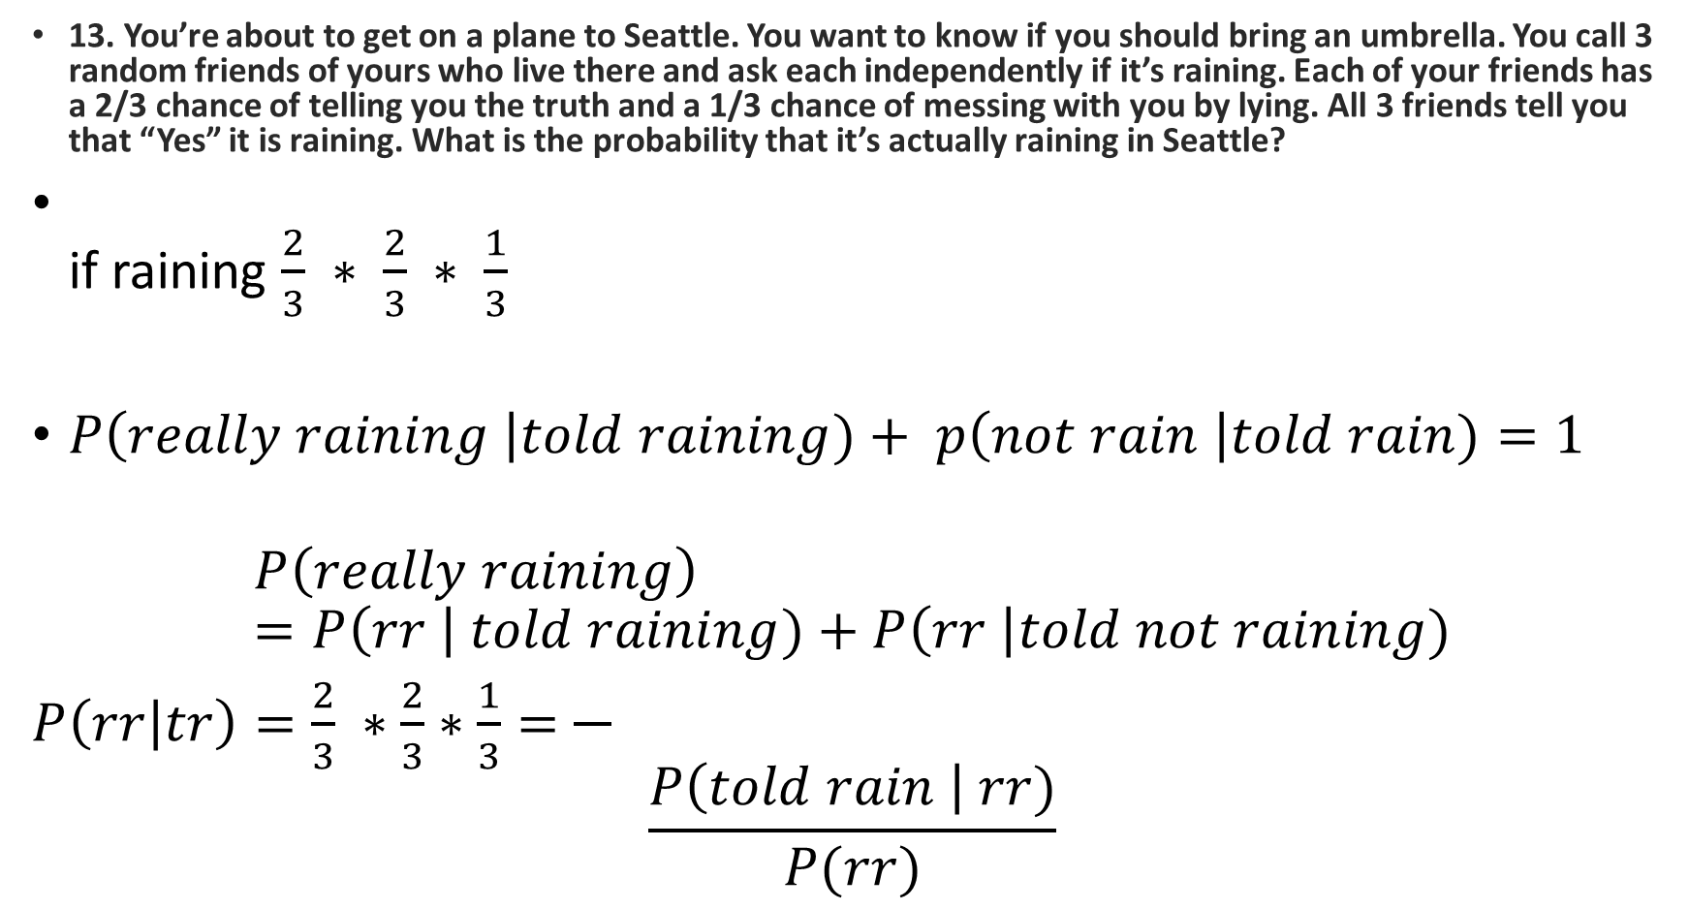
13. You’re about to get on a plane to Seattle. You want to know if you should bring an umbrella. You call 3 random friends of yours who live there and ask each independently if it’s raining. Each of your friends has a 2/3 chance of telling you the truth and a 1/3 chance of messing with you by lying. All 3 friends tell you that “Yes” it is raining. What is the probability that it’s actually raining in Seattle?
if raining $\frac{2}{3} ∗ \frac{2}{3} ∗ \frac{1}{3}$
$P\left(really raining \right|told raining)+ p\left(not rain \right|told rain)=1$
$$P\left(really raining\right)=P\left(rr \right| told raining)+P\left(rr \right|told not raining)$$
$P\left(rr | tr\right)=\frac{2}{3} ∗\frac{2}{3}∗\frac{1}{3}=\frac{}{}$
$$\frac{P\left(told rain \right| rr)}{P(rr)}$$

Slide 15
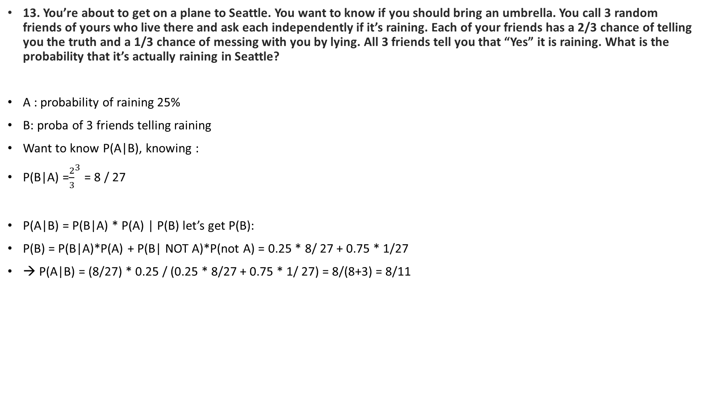
13. You’re about to get on a plane to Seattle. You want to know if you should bring an umbrella. You call 3 random friends of yours who live there and ask each independently if it’s raining. Each of your friends has a 2/3 chance of telling you the truth and a 1/3 chance of messing with you by lying. All 3 friends tell you that “Yes” it is raining. What is the probability that it’s actually raining in Seattle?
A : probability of raining 25%
B: proba of 3 friends telling raining
Want to know P(A|B), knowing :
P(B|A) =${\frac{2}{3}}^{3}$ = 8 / 27
P(A|B) = P(B|A) * P(A) | P(B) let’s get P(B):
P(B) = P(B|A)*P(A) + P(B| NOT A)*P(not A) = 0.25 * 8/ 27 + 0.75 * 1/27
→ P(A|B) = (8/27) * 0.25 / (0.25 * 8/27 + 0.75 * 1/ 27) = 8/(8+3) = 8/11

Slide 16
13. There’s one box — has 12 black and 12 red cards, 2nd box has 24 black and 24 red; if you want to draw 2 cards at random from one of the 2 boxes, which box has the higher probability of getting the same color? Can you tell intuitively why the 2nd box has a higher probability
Second one, second chance = 23 / (23+ 24) if not (11 / 23) less than previous proba

Slide 17
15. What is: lift, KPI, robustness, model fitting, design of experiments, 80/20 rule?
KPI: stands for Key Performance Indicator, which is a measurable metric used to determine how well a company is achieving its business objectives. Eg. error rate.
Robustness: generally robustness refers to a system’s ability to handle variability and remain effective.
80/20 rule: also known as the Pareto principle; states that 80% of the effects come from 20% of the causes. Eg. 80% of sales come from 20% of customers.

Slide 18
19. Give an example where the median is a better measure than the mean
When there are a number of outliers that positively or negatively skew the data.

Slide 19
20. Given two fair dices, what is the probability of getting scores that sum to 4? to 8?
P(sum = 4) = P(d1=1,d2 = 3)
1,3 2,2 3,1 → 1/12
2,6 3,5 4,4 5,3 6,2

Slide 20
21. What is the Law of Large Numbers?
The Law of Large Numbers is a theory that states that as the number of trials increases, the average of the result will become closer to the expected value.

Slide 21
22. How do you calculate the needed sample size?

Slide 22
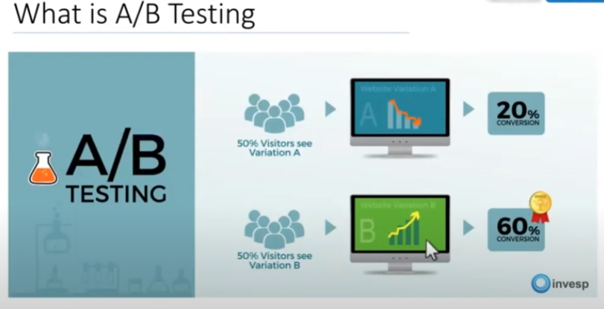
A/B Testing
可以快速迭代
50人左右的公司
Hypothesis test, 假设新的产品比旧的好一点
迭代的一直提升自己的网站
A/B testing 是和产品直接相关的，公司的flow，用一下产品
A/B testing is a form of hypothesis testing and two-sample hypothesis testing to compare two versions, the control and variant, of a single variable. It is commonly used to improve and optimize user experience and marketing.
Step:
1. 确定指标， customer funnel（漏斗）. A/B test 怎么对指标产生影响 。journey toward the purchase of a good or service
2.define a metric click through rate, conversion rate, renewal rate …
3. form hypothesis, 实验的idea， business insight
4. Formulate test plan, make a target(5%?), select a region, app or website
5. Create variation, 和其他部门合作
6. run experiment, chose alpha, chose power, chose sample size
7. analyze result, 对其他的指标有没有影响
8. conclude, should we use new interface. Iterative process

Slide 23
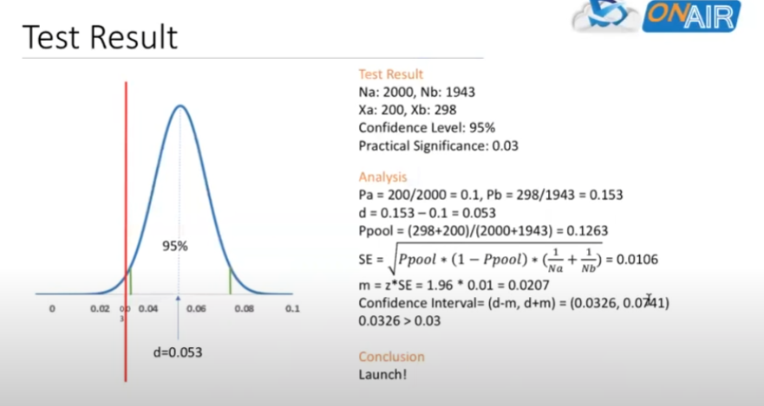
A/B Testing
怎么确保每个test是独立的.
完全独立
不同的bucket
Beta, 1- beta是power

Slide 24
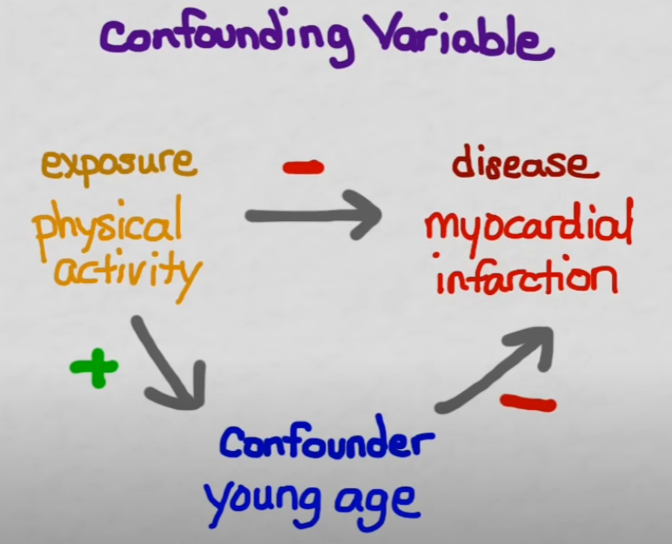
Coufounding
variable that influences both the dependent variable and the independent variable, causing a spurious association, a mathematical relationship in which two or more variables are associated but not causally related.

Slide 25
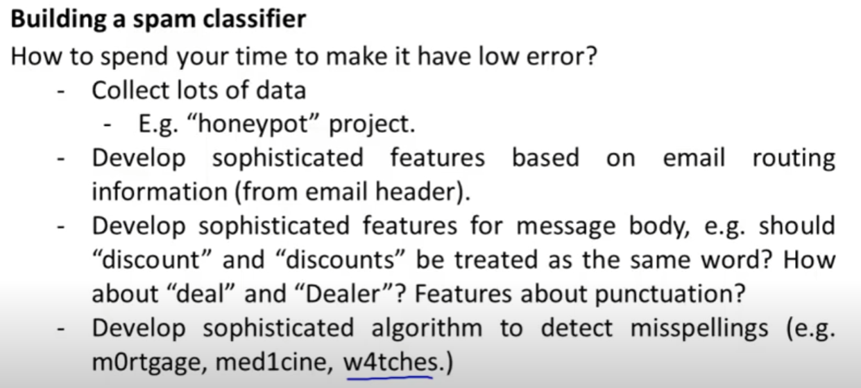
Machine Learning System Design

Slide 26
Machine Learning System Design
Break down problems into blocks
What can be solved with ML and what not
Define metrics
Data cleaning, data preparation, logging, evaluation metrics, featutre sstore
Deploying? Complexity, leaderboard, Kaggle

Slide 27
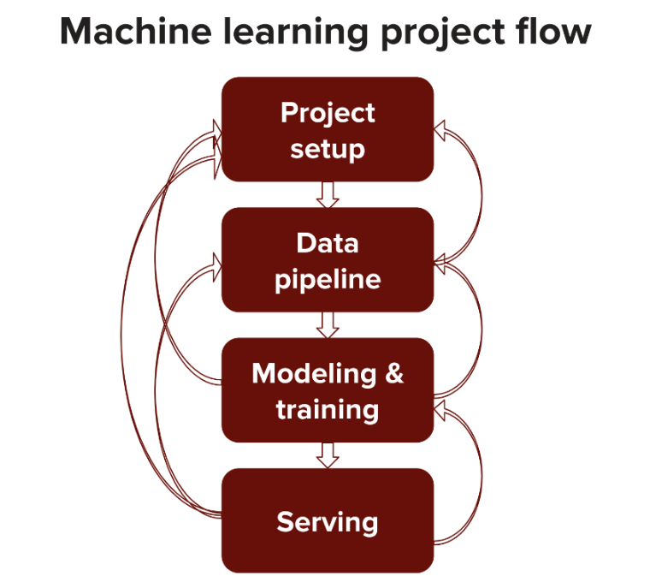

Slide 28
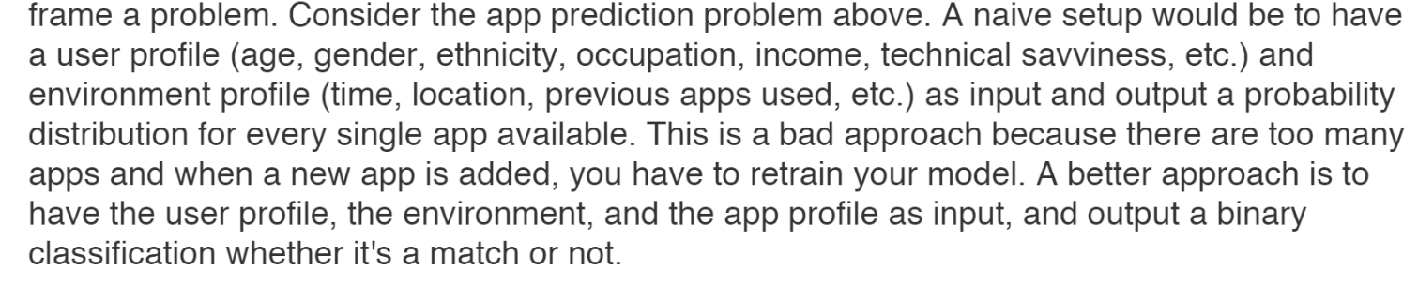
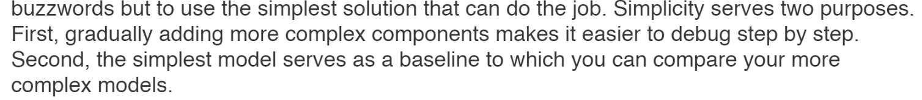

Slide 29


Slide 30
31. An HIV test has a sensitivity of 99.7% and a specificity of 98.5%. A subject from a population of prevalence 0.1% receives a positive test result. What is the precision of the test (i.e the probability he is HIV positive)?
A: has HIV → .1%
B: test positive → P(B|A)*P(A) + P(B| not A)*P(not A) =
Sensitivity means P(B|A) = 99.7
Specificity means P(not B| not A) = 98.5% → P(B| not A) = 1.5%
P(A|B) = (P(B|A) * P(A)) / P(B) = 6.24%

Slide 31
32. You are running for office and your pollster polled hundred people. Sixty of them claimed they will vote for you. Can you relax?
1. proper randomization
2. binomial dist, var: sqrt((1-p)*p/n)
0.6 +- 1.96 * sqrt((0.4)*0.6/100)

Slide 32
34. The homicide rate in Scotland fell last year to 99 from 115 the year before. Is this reported change really noteworthy?
Poisson distribution
a 95% confidence interval implies a z score of 1.96
one standard deviation = sqrt(115) = 10.724
Therefore the confidence interval = 115+/- 21.45 = [93.55, 136.45]. Since 99 is within this confidence interval, we can assume that this change is not very noteworthy.

Slide 33
Linear regression
Relationship between dependant and independent variables are linear, not quadric or sine cosine
infer causal relationships
When the output variable is continuous, then it is a regression problem whereas when it contains discrete values, it is a classification problem.

Slide 34
