Slide 1
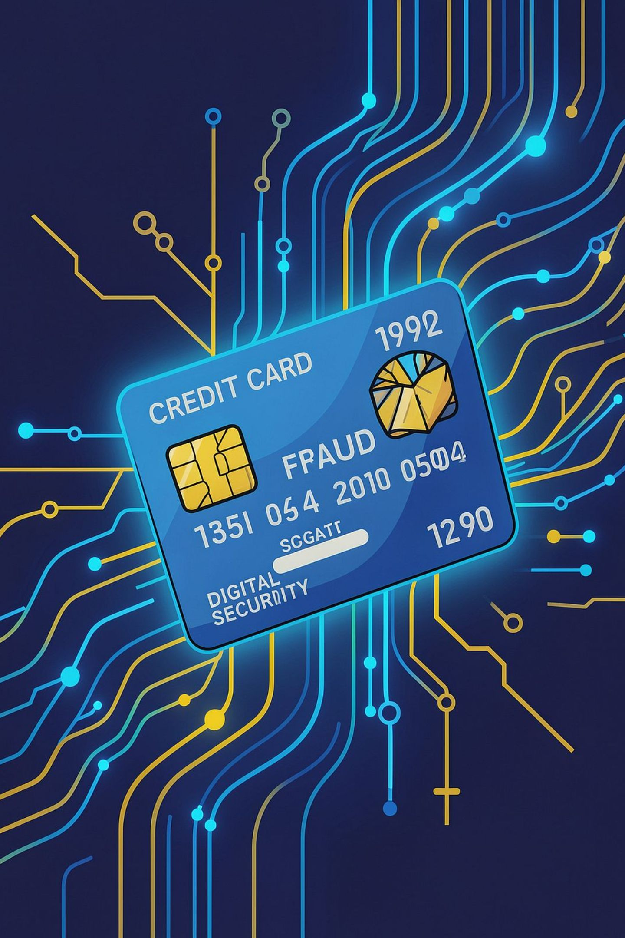
Credit Card Fraud Detection
End-to-End Data Analytics — Python · SQL · Power BI
BANKING / FINANCIAL SERVICES
284,807 TRANSACTIONS

Slide 2
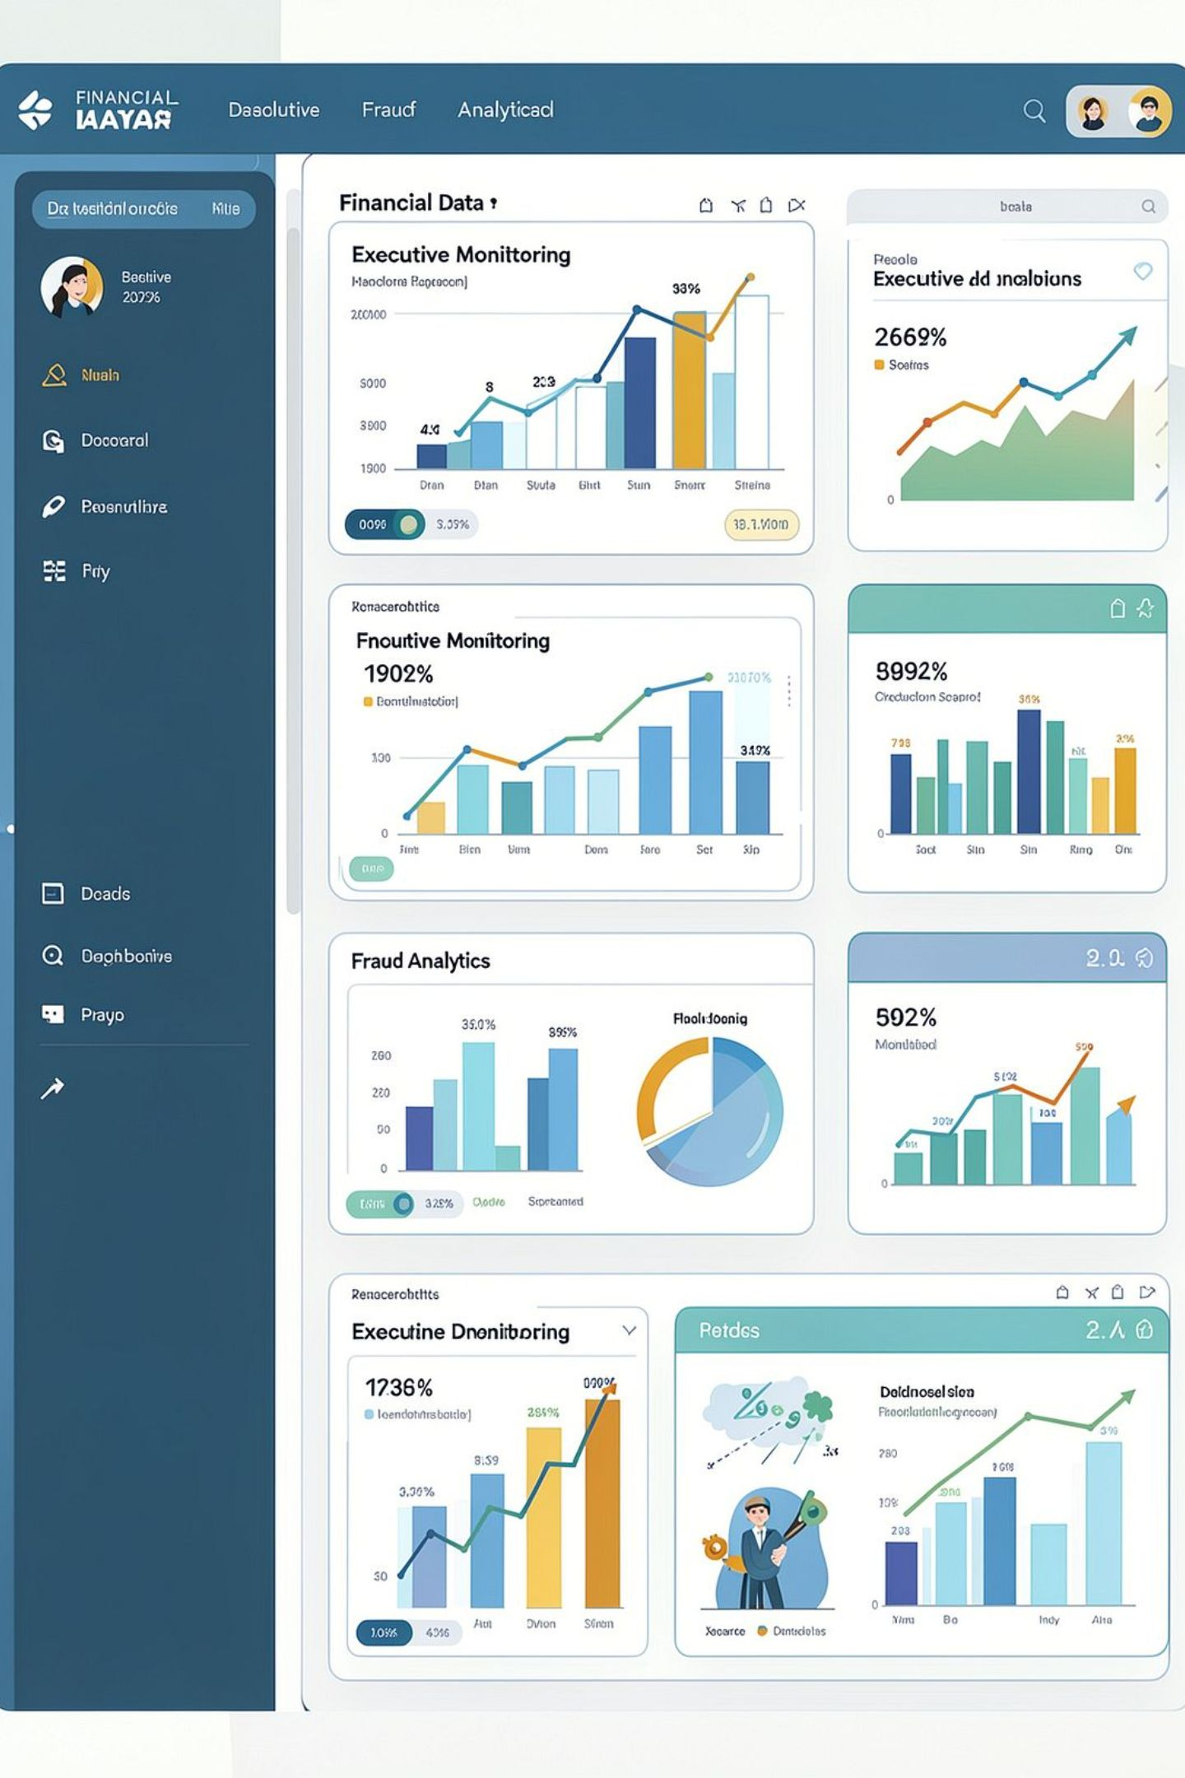
Executive Summary
284,807
Total Transactions
492
Fraud Transactions
0.17%
Fraud Rate
$25.16M
Total Amount
Severe class imbalance — fraud is rare but valuable to detect. Dashboard: Executive + Fraud Analytics pages.

Slide 3

Business Problem & Objectives
Core Questions
Fraud rate & time variation
Transaction value behavior
PCA feature associations
Objectives
Clean & validate dataset
Python EDA + SQL analysis
Power BI dashboards
Fraud-monitoring recommendations

Slide 4

Dataset & Methodology
Python Prep
Python Analysis
SQL Aggregation
Power BI
Load, clean, dedupe, EDA
Correlation, feature checks
KPIs, slicers, executive visuals
Structured joins and fraud queries
31 columns: Time, V1–V28 (PCA-transformed), Amount, Class. 1,081 duplicates removed. Note: Time = elapsed seconds, not calendar timestamp.

Slide 5
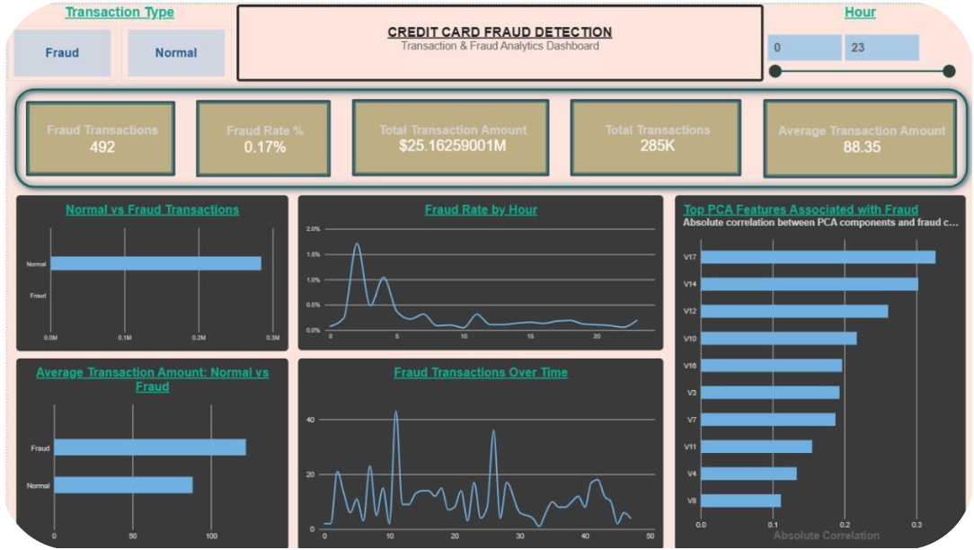

PAGE 1
Executive Dashboard
Key Visuals
Normal vs. Fraud transaction bar chart
Fraud rate trend by hour
Top PCA features by correlation
Average amount: Normal vs. Fraud
Fraud transactions show higher average amount than normal transactions.

Slide 6
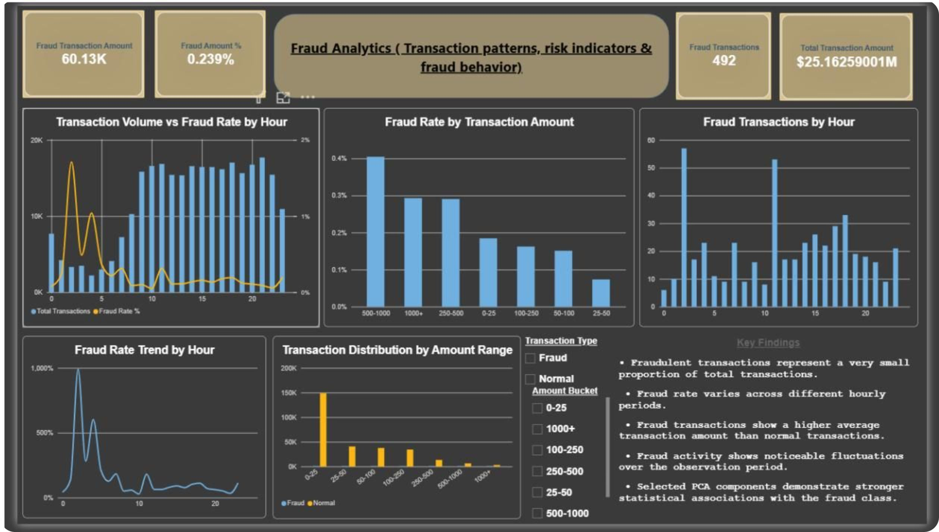
PAGE 2
Fraud Analytics Dashboard
$60.13K
0.239%
Fraud Amount
Fraud Amount %
Peak Hours
Highest Risk
Hour 2 & Hour 12
$500–$1,000 bucket

Slide 7
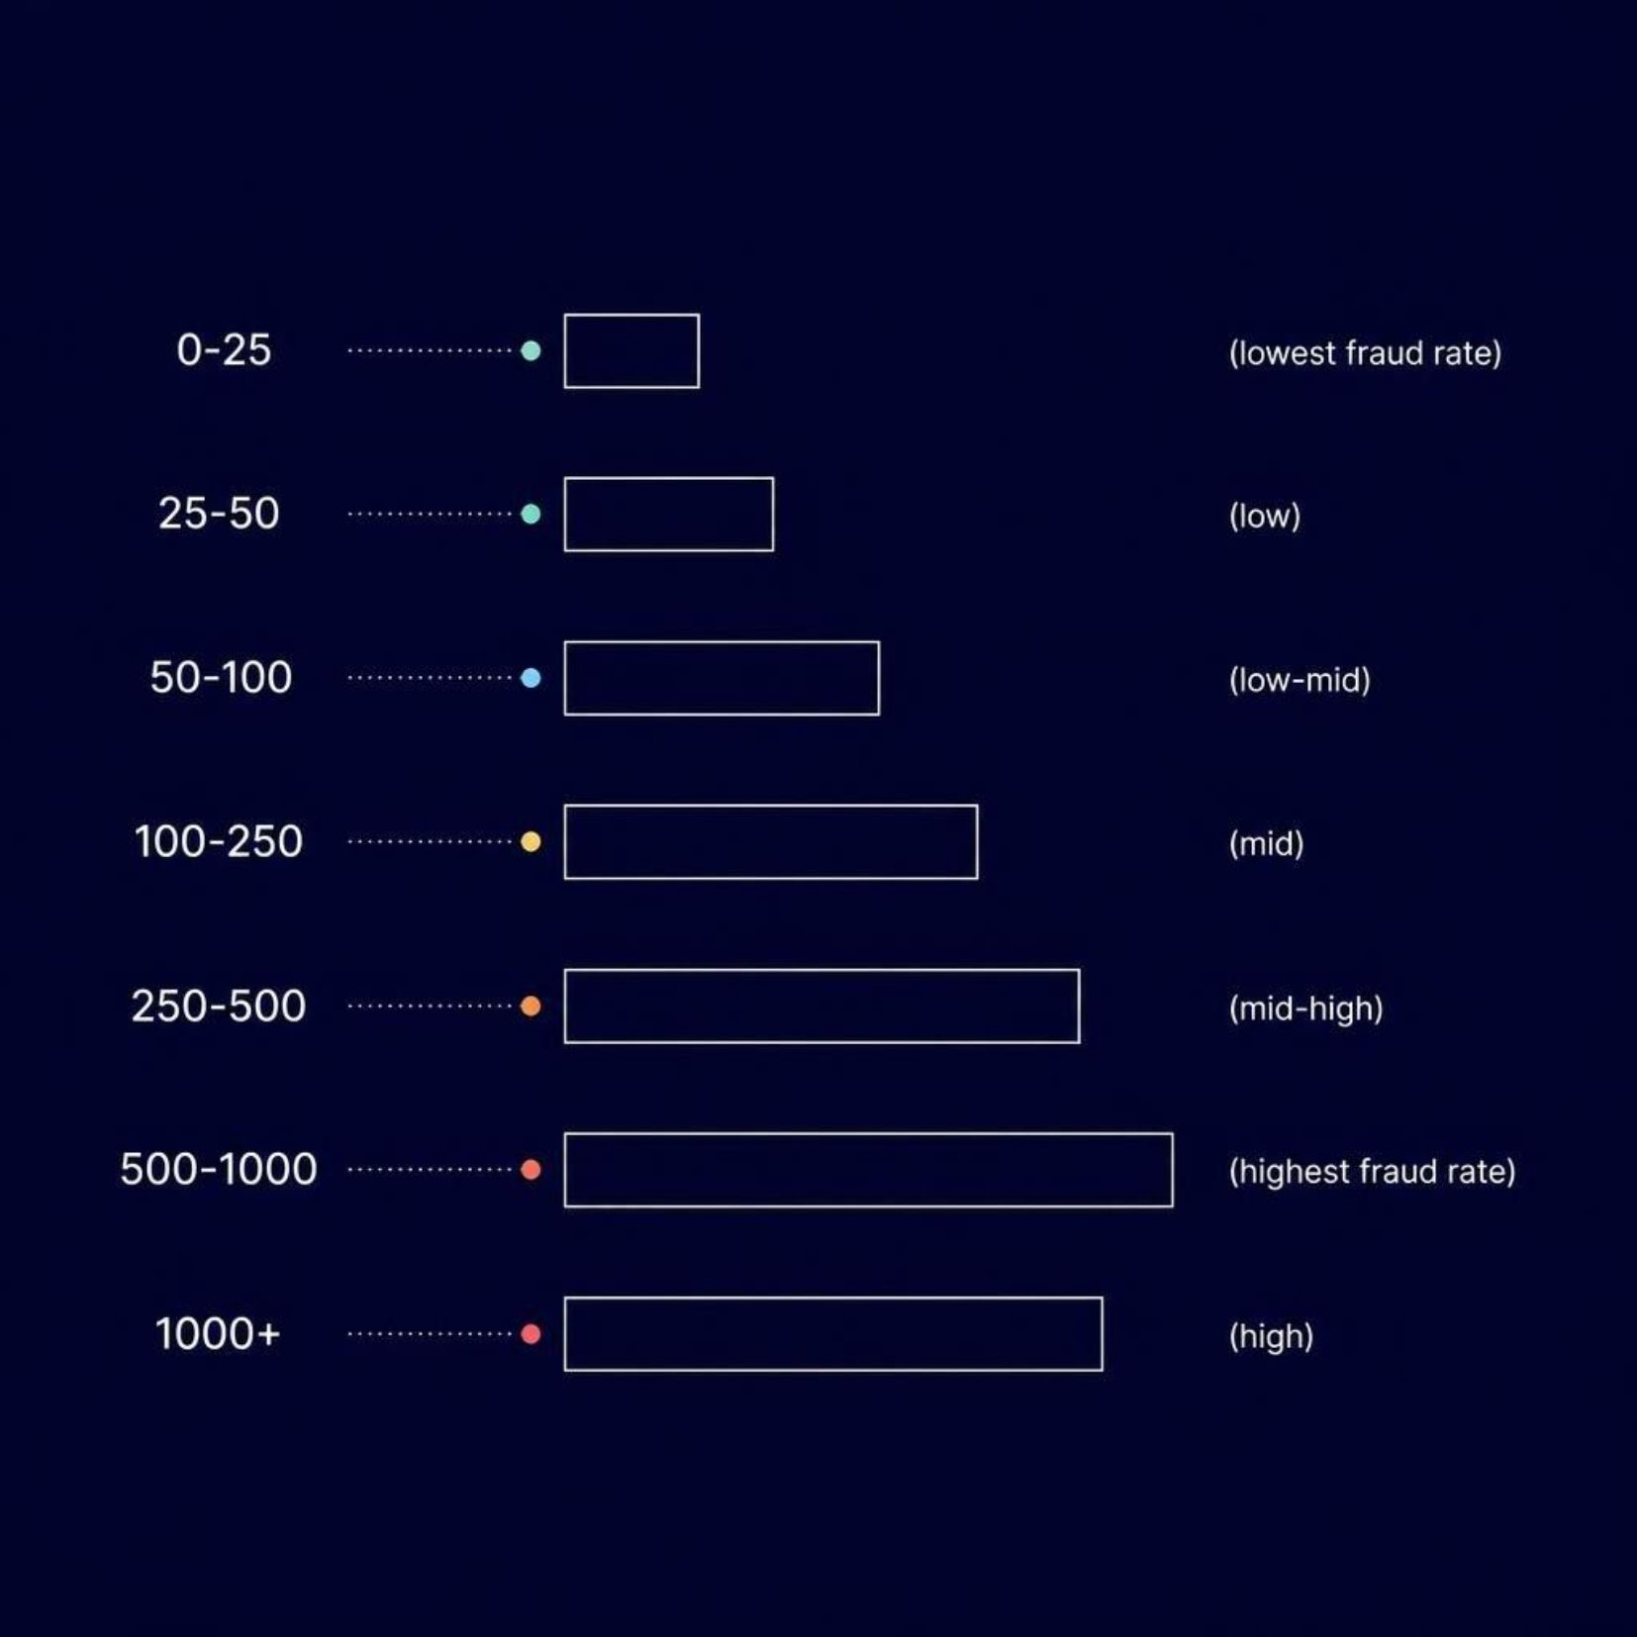
Detailed Fraud Findings
Financial Exposure
Fraud = 0.17% of volume but 0.239% of value — fraud is disproportionately high-value.
Amount Ranges
$500–$1,000 bucket shows highest fraud rate, followed by $1,000+ and $250–$500.

Slide 8





Business Recommendations
Multi-Signal Scoring
1
Combine amount, time, PCA features into a risk score.
Monitor Fraud Spikes
2
Automate alerts for sudden fraud rate increases.
Right Metrics
3
Precision, Recall, F1, ROC-AUC — not accuracy.
Power BI Monitoring
4
Management dashboard + Python/ML risk scores in production.

Slide 9
Technical Implementation
Python
Measure | Purpose
Total Transactions | Count all rows
Fraud Rate % | Fraud ÷ Total
Fraud Amount % | Fraud Amt ÷ Total Amt
Pandas: load, clean, EDA
Correlation: rank PCA features
Power BI
DAX: Fraud Rate %, Fraud Amount %
Calculated columns: Hour, Amount Bucket
Interactive slicers

Slide 10
Limitations & Next Steps
Current Limitations
Next Phase
V1–V28: anonymized PCA — no business labels
Time = elapsed seconds, not calendar
No merchant, device, or location context
Logistic Regression & Random Forest models
Stratified split + imbalance techniques
Page 3: ML Performance (Confusion Matrix, ROC-AUC)

