Slide 1
Modeling: regression

Slide 2
Variables affecting crime
• Population density and degree of urbanization.
• Variations in composition of the population
• Economic conditions, including median income, poverty level, and job availability.
• Administrative and investigative emphases of law enforcement.
• Policies of other components of the criminal justice system (i.e., prosecutorial, judicial, correctional, and probational).
Population density
Median age
Poverty rate
Unemployment rate
Police officer rate
Reference: https://ucr.fbi.gov/nibrs/2012/resources/variables-affecting-crime

Slide 3
Violent crime
year | region | crime_rate | pop_density | pol_officer_rate | pov_rate | unemp_rate
1995 | alabama | 632.4 | 83.80295567 | 2.13 | 20.1 | 5.6
1995 | alaska | 770.9 | 1.0589543 | 1.88 | 7.1 | 7.9
1995 | arizona | 713.5 | 37.11655902 | 2.05 | 16.1 | 4.4
1995 | arkansas | 553.2 | 47.70043207 | 1.87 | 14.9 | 4.5
1995 | california | 966 | 202.5286428 | 1.98 | 16.7 | 7.7
1995 | colorado | 440.2 | 36.12297429 | 2.24 | 8.8 | 3.9
1995 | connecticut | 405.9 | 675.9545924 | 2.21 | 9.7 | 5.1
1995 | delaware | 725 | 366.7519182 | 2.86 | 10.3 | 4.7
1995 | district of columbia | 2661.4 | 9081.967213 | 6.66 | 22.2 | 8.6
1995 | florida | 1071 | 262.3479082 | 2.56 | 16.2 | 6.2
File name: ‘Combine_vio.csv’

Slide 4
Property crime
year | region | crime_rate | pop_density | pol_officer_rate | pov_rate | unemp_rate
1995 | alabama | 4215.7 | 83.80295567 | 2.13 | 20.1 | 5.6
1995 | alaska | 4982.9 | 1.0589543 | 1.88 | 7.1 | 7.9
1995 | arizona | 7500.1 | 37.11655902 | 2.05 | 16.1 | 4.4
1995 | arkansas | 4137.7 | 47.70043207 | 1.87 | 14.9 | 4.5
1995 | california | 4865.1 | 202.5286428 | 1.98 | 16.7 | 7.7
1995 | colorado | 4956.1 | 36.12297429 | 2.24 | 8.8 | 3.9
1995 | connecticut | 4097.3 | 675.9545924 | 2.21 | 9.7 | 5.1
1995 | delaware | 4433.8 | 366.7519182 | 2.86 | 10.3 | 4.7
1995 | district of columbia | 9512.1 | 9081.967213 | 6.66 | 22.2 | 8.6
1995 | florida | 6630.6 | 262.3479082 | 2.56 | 16.2 | 6.2
File name: ‘Combine_prop.csv’

Slide 5
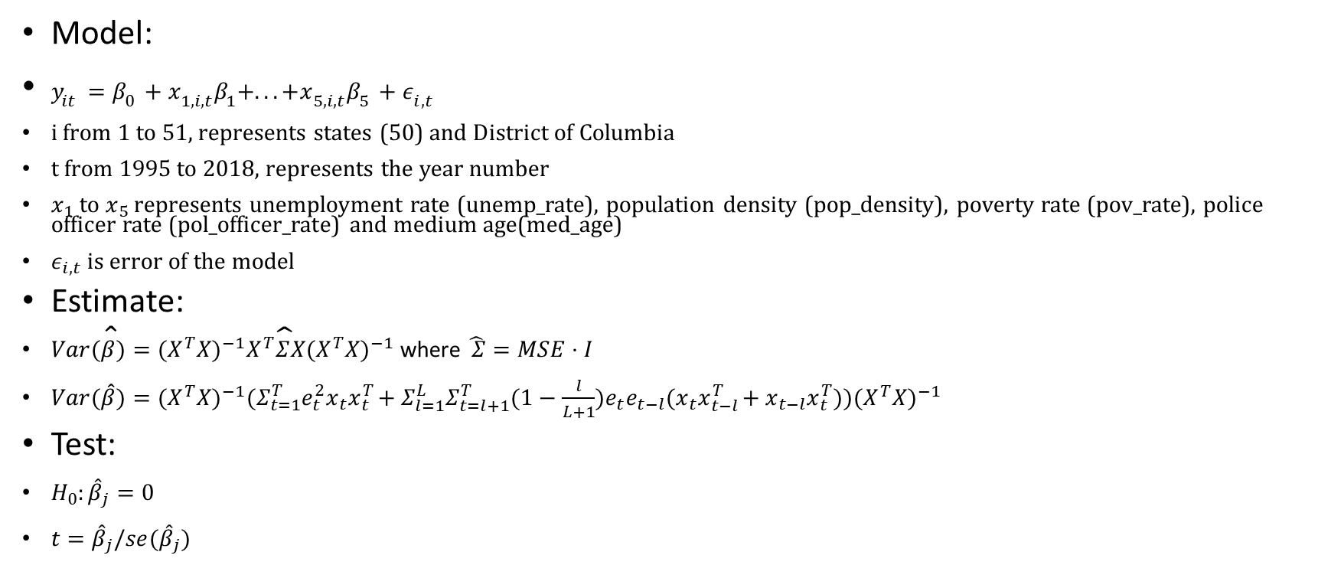
model 1: time series regression model
First function: plm_inferenct_state_level (line 6 ~ 72)
Model:
$y_{it}=β_{0}+x_{1,i,t}β_{1}+...+x_{5,i,t}β_{5}+ε_{i,t}$
i from 1 to 51, represents states (50) and District of Columbia
t from 1995 to 2018, represents the year number
$x_{1}$ to $x_{5}$ represents unemployment rate (unemp_rate), population density (pop_density), poverty rate (pov_rate), police officer rate (pol_officer_rate) and medium age(med_age)
$ε_{i,t}$ is error of the model
Estimate:
$Var(\hat{β})=(X^{T}X)^{−1}X^{T}\hat{Σ}X(X^{T}X)^{−1}$ where$\hat{ Σ}=MSE⋅I$
$Var(\hat{\hat{β}})=(X^{T}X)^{−1}(Σ_{t=1}^{T}e_{t}^{2}x_{t}x_{t}^{T}+Σ_{l=1}^{L}Σ_{t=l+1}^{T}(1−\frac{l}{L+1})e_{t}e_{t−l}(x_{t}x_{t−l}^{T}+x_{t−l}x_{t}^{T}))(X^{T}X)^{−1}$
Test:
$H_{0}:{\hat{β}}_{j}=0$
$t={\hat{β}}_{j}/se({\hat{β}}_{j})$
function code file name: ‘regression_func.R’ document: ‘method_documentation&summary.pdf’

Slide 6
model 1: time series regression result: violent crime
[1] “North Dakota”
 | point estimation | standard error | t-statistics | p-value | significant
pop_density | 1.13345803 | 0.08733724 | 12.977946 | 4.56E-12 | TRUE
pol_officer_rate | -0.39862001 | 0.11523657 | -3.459145 | 2.13E-03 | TRUE
pov_rate | 0.02127663 | 0.05412762 | 0.3930827 | 6.98E-01 | FALSE
unemp_rate | 0.13513875 | 0.03203674 | 4.2182433 | 3.27E-04 | TRUE
med_age | 0.38988672 | 0.04465431 | 8.731222 | 9.26E-09 | TRUE
Complete result is in ‘regression_output.xlsx’

Slide 7
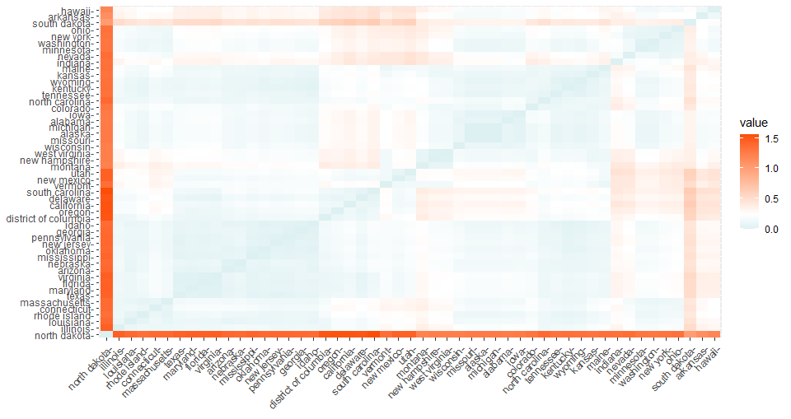
Result for violent crime

Slide 8
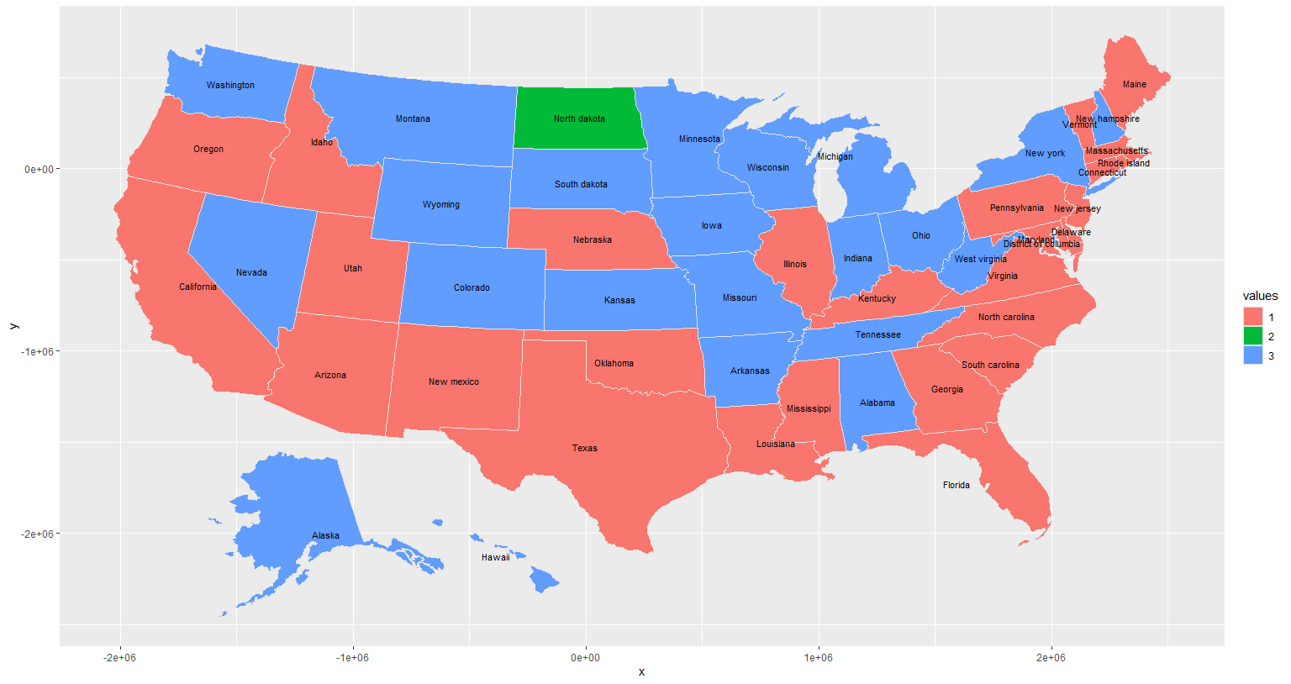
Coefficient of violent crime by states

Slide 9
model 1: time series regression result: violent crime
[1] "Nevada"
 | point estimation | standard error | t-statistics | p-value | significant
pop_density | 0.080525792 | 0.05682827 | 1.417002 | 0.16988622 | FALSE
pol_officer_rate | 0.058691616 | 0.02681616 | 2.188666 | 0.03903501 | TRUE
pov_rate | 0.09511433 | 0.04248761 | 2.238637 | 0.03514891 | TRUE
unemp_rate | -0.005115414 | 0.0275618 | -0.185598 | 0.85438711 | FALSE
med_age | -0.18622709 | 0.06681779 | -2.787089 | 0.01047601 | TRUE
[1] "Pennsylvania"
 | point estimation | standard error | t-statistics | p-value | significant
pop_density | -0.14280272 | 0.05305631 | -2.6915313 | 0.013026769 | TRUE
pol_officer_rate | 0.02339736 | 0.005712334 | 4.0959363 | 0.000443191 | TRUE
pov_rate | -0.01358206 | 0.006697943 | -2.0277954 | 0.054319601 | FALSE
unemp_rate | 0.01975757 | 0.009387052 | 2.1047687 | 0.046440901 | TRUE
med_age | 0.04219266 | 0.048981682 | 0.8613967 | 0.397911349 | FALSE

Slide 10
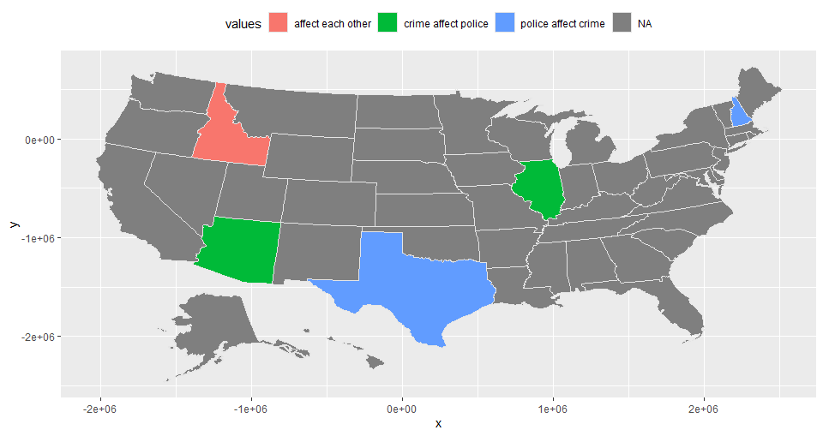
Granger causality test for police officer rate vs violent crime

Slide 11
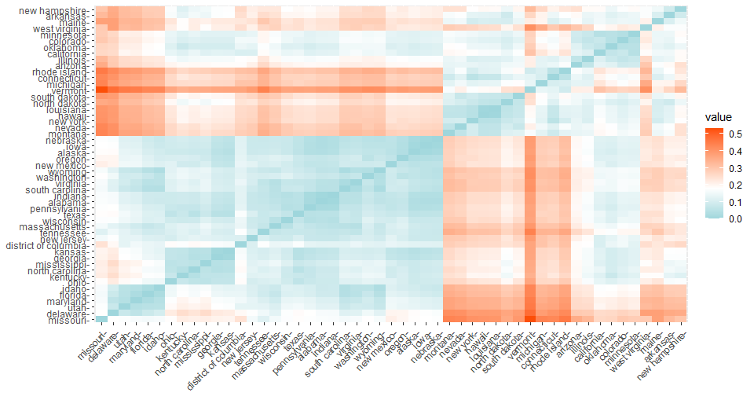
Result for property crime

Slide 12
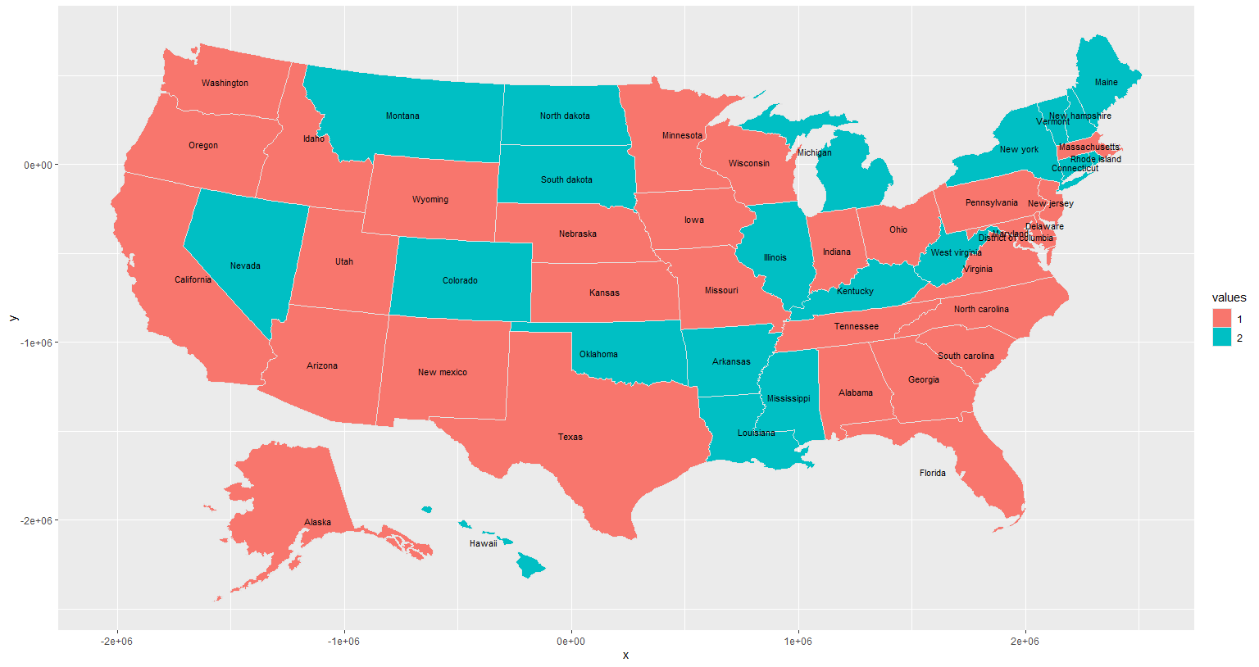
Coefficient of violent crime by states

Slide 13
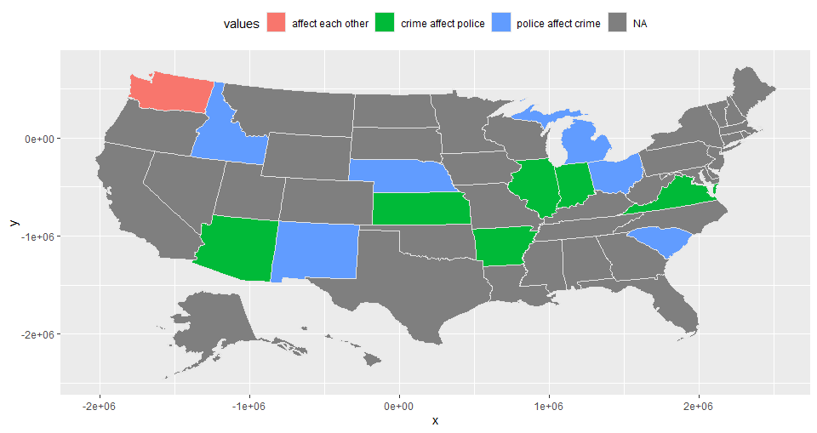
Granger causality test for police officer rate vs property crime

Slide 14

model 2: panel data regression model
First function: plm_inferenct_overall (line 76 ~ 129)
$y_{t}=x_{t}^{T}β_{t}+ε_{t}$
where $β_{t}=(β_{0,t},β_{1,t},...,β_{p,t})$, p is the number of predictors. Here, p=5.
$β_{p,t}=C_{p}+ε_{t}$
$Var(\hat{C_{p}})=(X^{T}X)^{−1}S(X^{T}X)^{−1} where S=(Σ_{t=1}^{T}e_{t}^{2}+Σ_{l=1}^{L}Σ_{t=l+1}^{T}2(1−\frac{l}{L+1})e_{t}e_{t−l}/T$
$se\left(\hat{C_{p}}\right)=\sqrt{\frac{MSE}{T}}$
$se\left(\hat{C_{p}}\right)=\sqrt{\frac{{(X}^{T}X)^{−1}S(X^{T}X)^{−1}}{T}}$
Test:
$t=\frac{C_{p}}{se(C_{p})}$
function code file name: ‘regression_func.R’ document: ‘method_documentation&summary.pdf’

Slide 15
model 2: panel data regression result: violent crime
 | point estimation | standard error | t-statistics | p-value | significant
intercept | -4.02129639 | 0.16975603 | -23.688681 | 0.00E+00 | TRUE
pop_density | -0.14133105 | 0.05091461 | -2.775845 | 1.07E-02 | TRUE
pol_officer_rate | 0.32779987 | 0.07426576 | 4.413876 | 2.01E-04 | TRUE
pov_rate | 0.06979036 | 0.009605421 | 7.265726 | 2.15E-07 | TRUE
unemp_rate | 0.14380091 | 0.009022827 | 15.937455 | 6.39E-14 | TRUE
med_age | -0.04334538 | 0.004604959 | -9.412762 | 2.36E-09 | TRUE

Slide 16
model 2: panel data regression result: property crime
 | point estimation | standard error | t-statistics | p-value | significant
intercept | -2.07738 | 0.22804722 | -9.1094291 | 4.31E-09 | TRUE
pop_density | -0.01485604 | 0.01787844 | -0.8309472 | 4.15E-01 | FALSE
pol_officer_rate | 0.06446643 | 0.021161613 | 3.0463852 | 5.73E-03 | TRUE
pov_rate | 0.06434089 | 0.015155689 | 4.2453291 | 3.06E-04 | TRUE
unemp_rate | 0.03425506 | 0.00475191 | 7.2086935 | 2.44E-07 | TRUE
med_age | -0.03866972 | 0.004723764 | -8.1862088 | 2.88E-08 | TRUE

Slide 17
Review of our products
1. Interactive Map
2. Animated Bar Plot
3. State Trends Graph
4. Clustering Map
5. Regression Analysis

