Slide 1
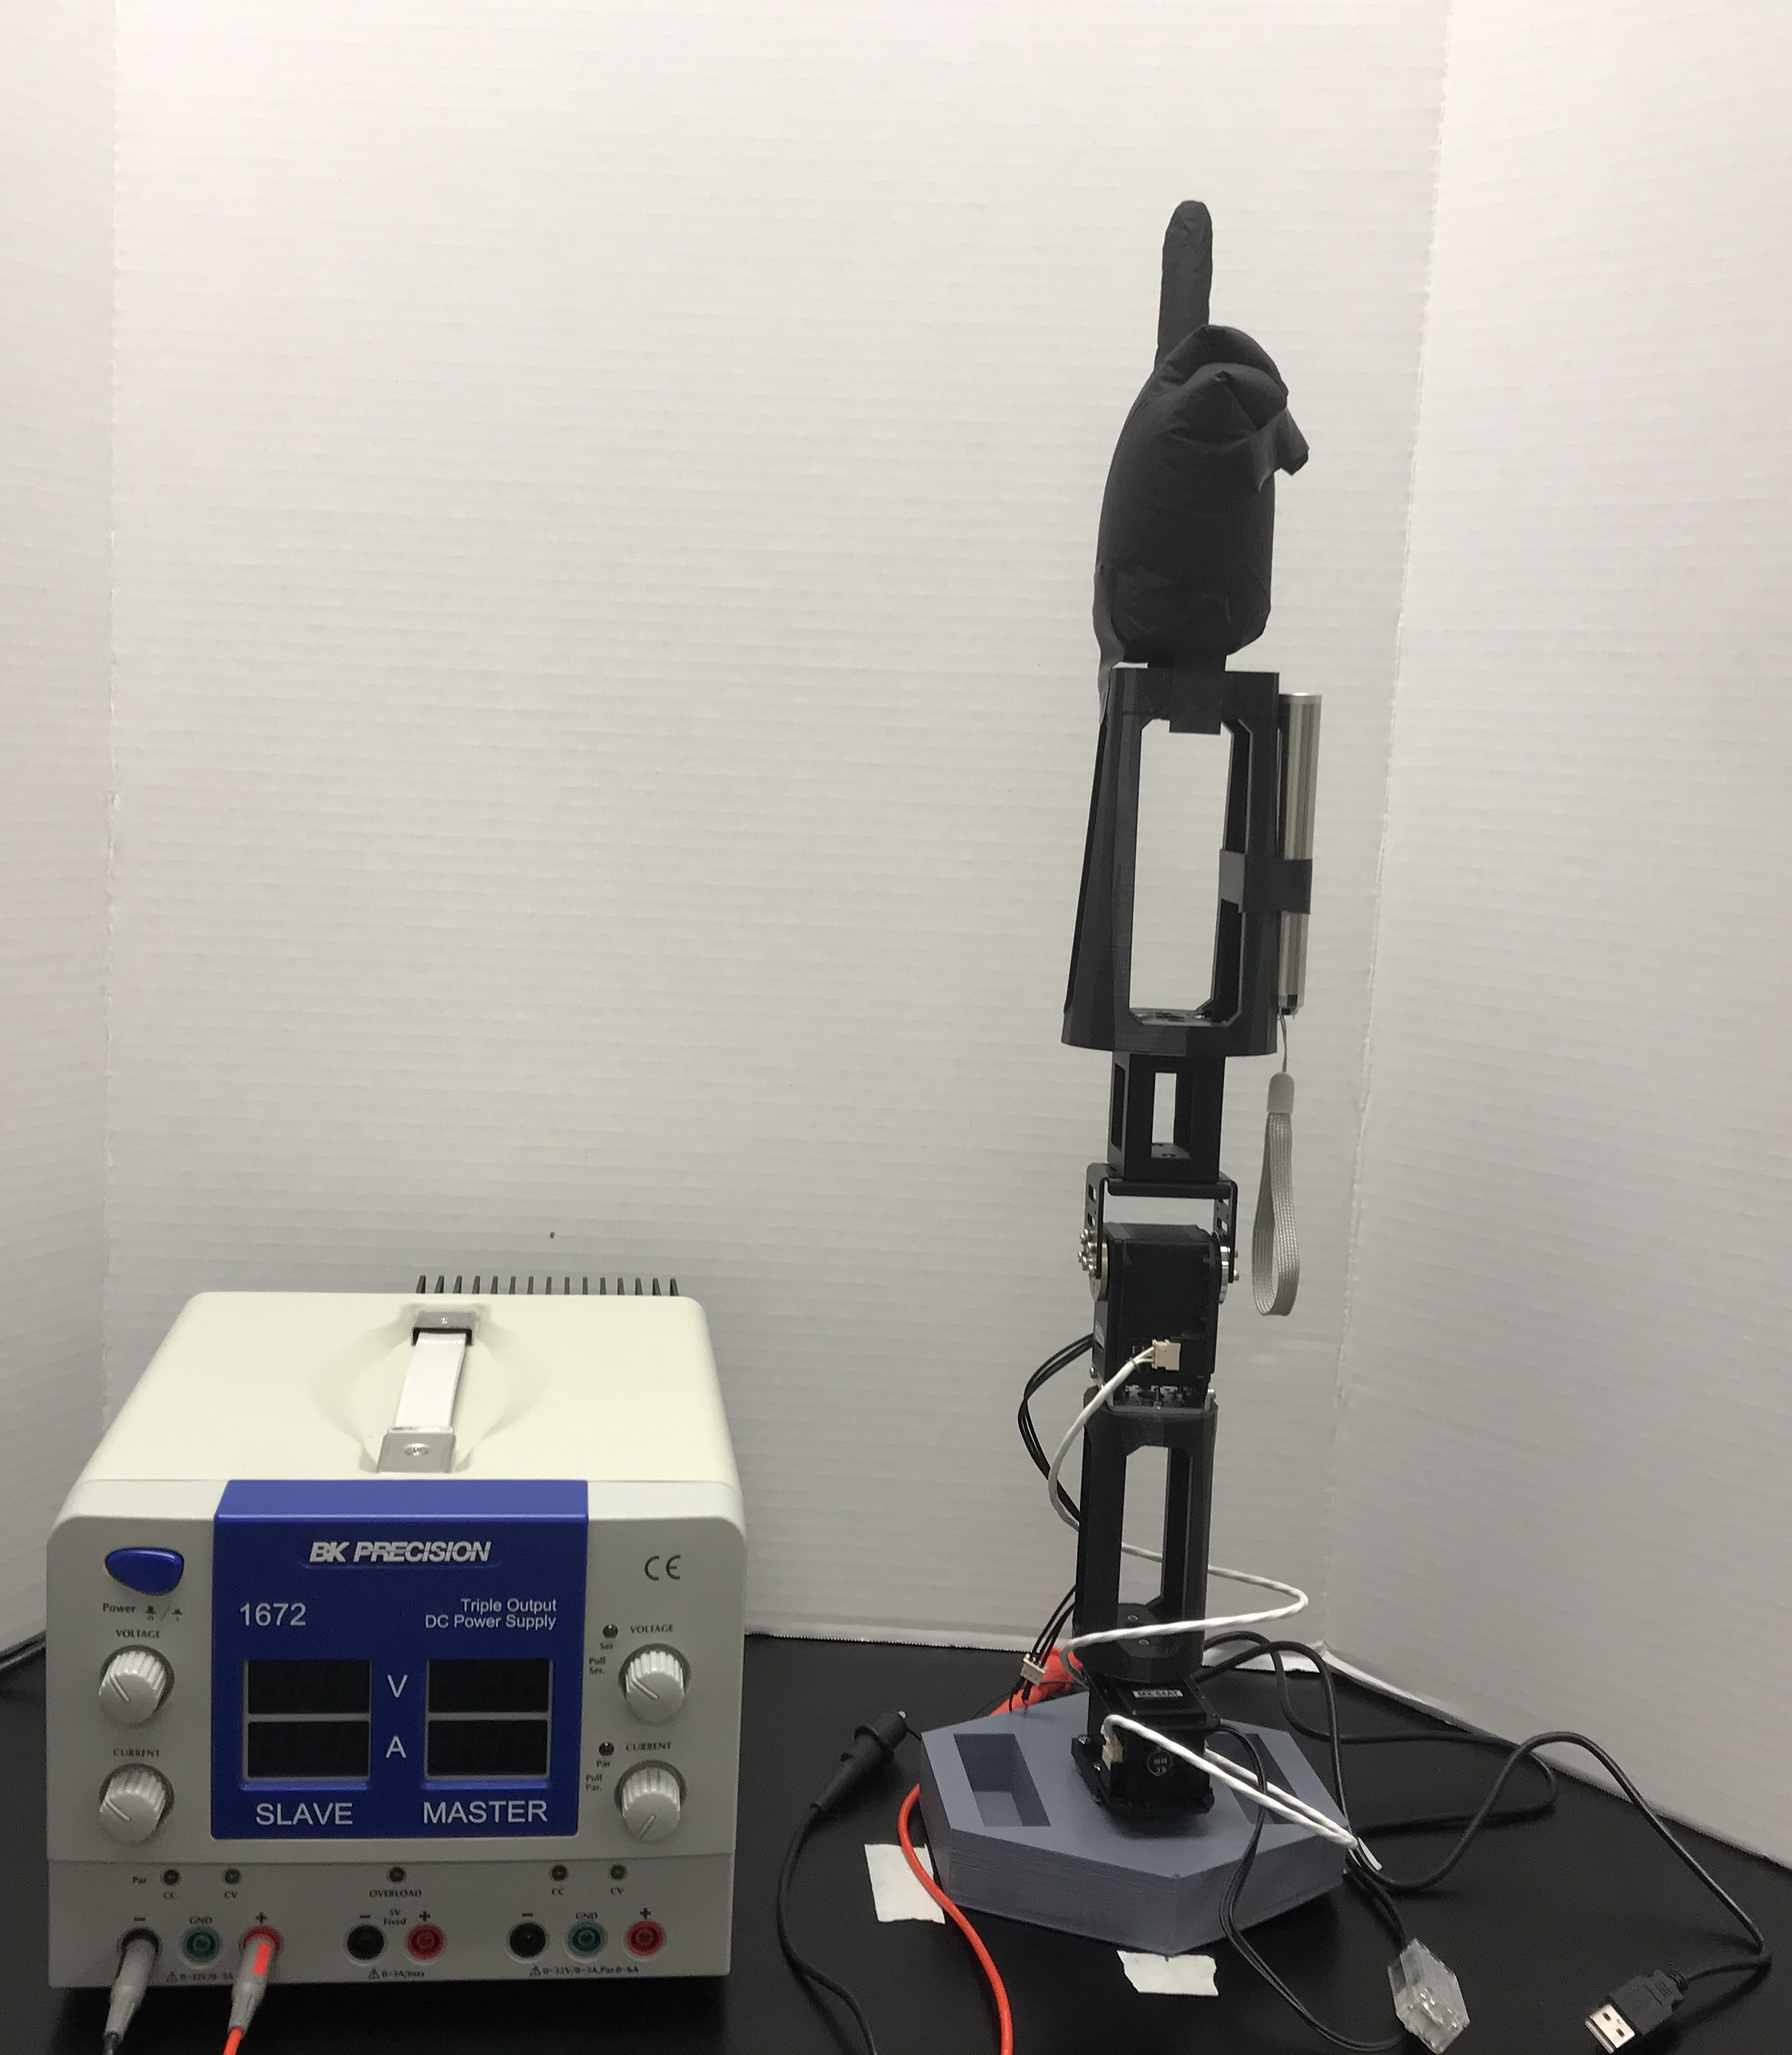
Pointing Hand
Power Supply (12 V)
Laser
Robotic Arm (2 DOF)

Slide 2
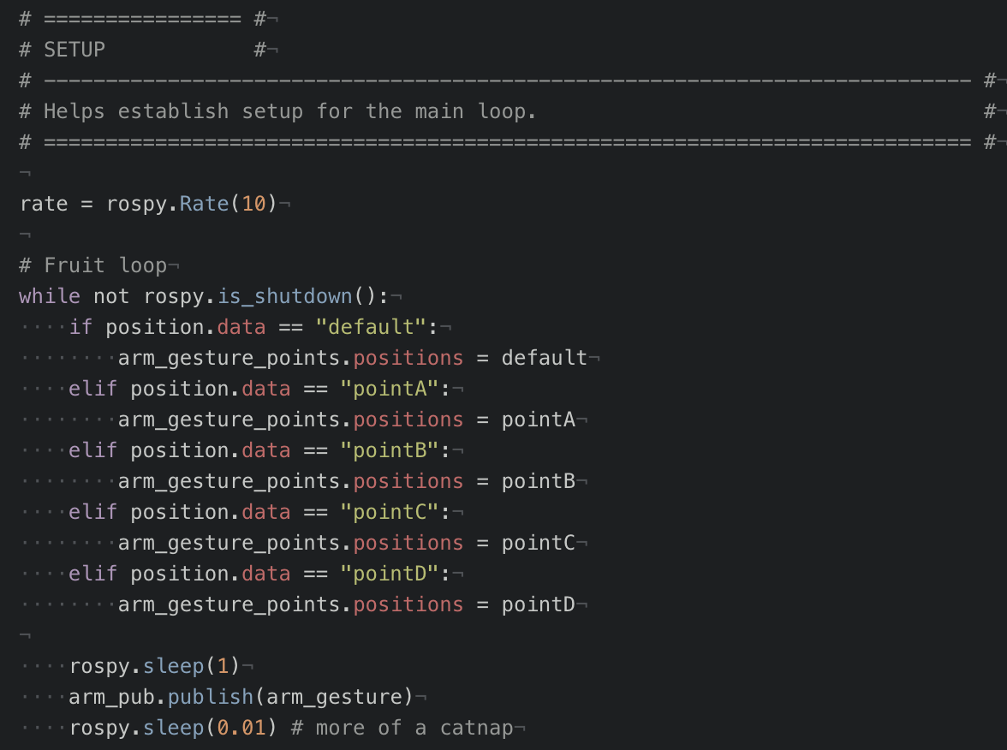
Functionality of Main Loop:
Points A-D are predetermined in the file.
A command is published to /arm_gestures channel and is saved to position.data.
The position message is evaluated in the main loop.
arm_gesture points are set according to the message received.

Slide 3
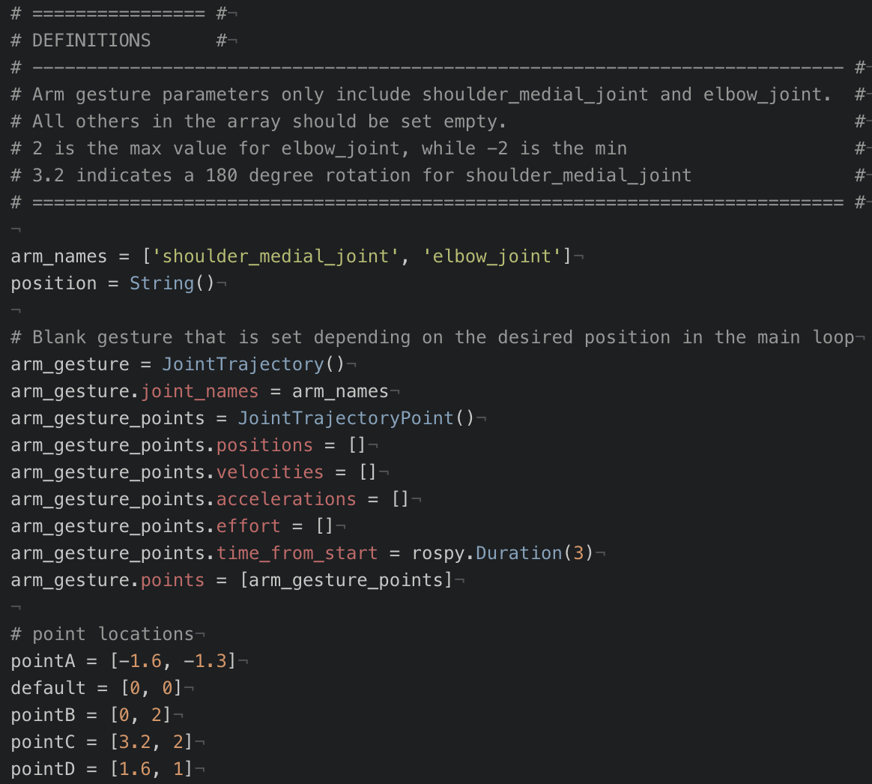
Variable Definitions:
One JointTrajectory variable (arm_gesture) is used to move all points.
Arm_gesture_points.positions is overwritten by each point location and depends on the message received from /arm_gestures channel.

