Slide 1

Liquibase
Liquibase
A database refactoring tool
Rikard Wigforss, HiQ
Joel Andersson, HiQ
Notes:
<number>

Slide 2
<number>
Agenda
Problem description and motivation for database refactoring tools.
A real life story from a product company
Database refactoring tools
Liquibase introduction
DEMO 1: Install database automatically with Liquibase.
Change Log
Change Sets and Liquibase tags
Liquibase commands
DEMO 2: Liquibase commands
Best practices and experiences
Testing with Liquibase
Integrations
DEMO 3: Run maven plugin to upgrade database
Notes:
<number>

Slide 3
<number>
The Problem
State of the database
What changes as been applied when?
To which version of the software does the database comply to?
State of the migration SQL scripts
Do the scripts actually going to work?
Traceability
Who wrote a particular script?
Why was a particular script created?
Multiple version upgrade
How do I upgrade from 1.5 to 2.4?
Automation
How can integrate the upgrade into a release / build process?
Multiple database vendor support.
Do I need to create scripts for each database vendor the software supports?
To solve these problems you need a tool!
Notes:
<number>

Slide 4
<number>
A Product Company Story
The database upgrade SQL scripts where kept on a file share, which developer would edit and save on the file share (on for each module).
No traceability at all
Very cumbersome to do a multiple version upgrade
Most upgrade script did not work the first time
Changes (corrections) did not always go back to the script of the file share
Find the previous version by ordering restore from the backup tapes!
The Scripts where moved into subversion.
Version handling
Author and change traceability
A database change system was written in-house to deal with some of the problems
Author traceability
Locking of released changes
Multiple version upgrades
ChangeLog in database
Liquibase was introduced and integrated into the build / release processes..
Notes:
<number>

Slide 5
<number>
Database Refactoring Tools
Liquibase (+active, github)
DBMaintainer
Flyway
(+simple, -linear schema version, -branching and merging, -implicit ordering, -no rollback)
Dbdeploy (last update 2011/4)
MigrateDB
Typical Features
Upgrade database DDL
Integration with Ant / Maven
Notes:
<number>

Slide 6
Liquibase
Liquibase is an open source, database-independent library for tracking, managing and applying database changes.
Notes:
Java based
Database refactoring and change management tool
Tries to solve the problem of tracking database changes.
Needs to support branching and merging
Need to support multiple developers
Support output of SQL
Each change is tracked independently
Requires process change, every change made needs to be applied to tth
Database changes are defined in XML.
Integrates well with build tools such as ant and maven.
Can be run standalone or embedded into the application (if written in java)
Supports many databases (oracle, mysql, pgsql, mssql, and others)

Slide 7
<number>
Liquibase Introduction
Java based command line tool.
Features
XML based
Vendor neutral
Checksum check
Variable substitution
Profiles
Pre and Post conditions
Notes:
<number>

Slide 8
DEMO
Notes:
<number>

Slide 9
Database Change Log
Defines all changes applied to the database.
Changes are grouped into change sets which is the smallest unit of change that is tracked and can be rolled back.
When run, the change log is compared with a list of applied changes in the database, and all the unapplied changes are executed.
A change set is uniquely identified by the id and author attributes as well as the filename.
XML based, but can SQL statements can be embedded and normal SQL files included.
Preconditions may be defined which can be used to, for example, only allow the change log to be applied on a particular database.
Supports variable substitution using properties defined on command line or in a properties file.
The change log may either be applied directly to the target database or indirectly by generating the corresponding SQL.

Slide 10
Example Database Change Log

Slide 11
Change Sets
The smallest unit of change that is tracked and can be rolled back.
A change set is uniquely identified by the id and author attributes as well as the filename.
Preconditions may be defined which can be used to, for example, only allow the change set to be applied when a given table exists.
Contains a set of changes to be applied in a single transaction.
Changes may be defined either using a set of predefined refactoring commands or embedded SQL statements.
Use of the refactoring commands is recommended in order for the changes to be database independent.
Custom refactoring commands may be implemented in Java.

Slide 12
Available Refactoring Commands
Structural
Add Column
Rename Column
Modify Column
Drop Column
Alter Sequence
Create Table
Rename Table
Drop Table
Create View
Rename View
Drop View
Merge Columns
Create Stored Procedure
Data Quality
Add Lookup Table
Add Not-Null Constraint
Remove Not-Null Constraint
Add Unique Constraint
Drop Unique Constraint
Create Sequence
Drop Sequence
Add Auto-Increment
Add Default Value
Drop Default Value
Referential Integrity
Add Foreign Key Constraint
Drop Foreign Key Constraint
Drop All Foreign Key Constraints
Add Primary Key Constraint
Drop Primary Key Constraint
Non-Refactoring Transformations
Insert Data
Load Data
Load Update Data
Update Data
Delete Data
Tag Database
Stop
Architectural
Create Index
Drop Index
Custom
Modifying Generated SQL
Custom SQL
Custom SQL File
Custom Refactoring Class
Execute Shell Command

Slide 13
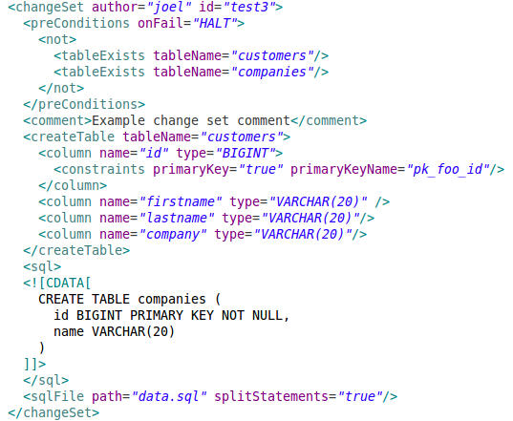
Example Change Set

Slide 14
Running Liquibase
Standalone jar file:
$ java -jar liquibase.jar \
--driver=org.h2.Driver
--classpath=/path/to/h2.jar \
--changeLogFile=changelog1.xml \
--url=jdbc:h2:file:db/test \
--username=sa \
--password=sa \
update
Liquibase shell script:
liquibase.properties
url: jdbc:h2:file:db/test
classpath: /path/to/h2.jar
changeLogFile: changelog1.xml
username: sa
password: sa
context: default
$ liquibase update

Slide 15
DATABASECHANGELOG
mysql> select * from DATABASECHANGELOG;
+------+--------+-----------+---------------------+------------------------------------+--------------+----------+------+-----------+
| ID | AUTHOR | FILENAME | DATEEXECUTED | MD5SUM | DESCRIPTION | COMMENTS | TAG | LIQUIBASE |
+------+--------+-----------+---------------------+------------------------------------+--------------+----------+------+-----------+
| v1:1 | joel | db/v1.xml | 2012-05-07 12:34:13 | 3:6ea16dda4990ecf22da6b8ee95544ad5 | Create Table | | NULL | 2.0.4 |
| v1:2 | joel | db/v1.xml | 2012-05-07 12:34:13 | 3:c0da33d2053bc454a814680a3b0eda84 | Create Table | | NULL | 2.0.4 |
| v1:3 | joel | db/v1.xml | 2012-05-07 12:34:13 | 3:d081561056c921f09d478e518176c2f1 | Load Data | | NULL | 2.0.4 |
| v1:4 | joel | db/v1.xml | 2012-05-07 12:34:13 | 3:4e1d17c185462322ba210c5bb7f88478 | Load Data | | NULL | 2.0.4 |
+------+--------+-----------+---------------------+------------------------------------+--------------+----------+------+-----------+
4 rows in set (0.00 sec)
Maintains the list of applied change sets.
Created automatically if it does not already exist.
The id, author, and filename constitutes the primary key.
Checksum is used to detect if any changes have been made to the change set after it was applied.

Slide 16
Menagerie Sample Database
mysql> select * from pet;
+----------+--------+---------+------+------------+------------+
| name | owner | species | sex | birth | death |
+----------+--------+---------+------+------------+------------+
| Fluffy | Harold | cat | f | 1993-02-04 | NULL |
| Claws | Gwen | cat | m | 1994-03-17 | NULL |
| Buffy | Harold | dog | f | 1989-05-13 | NULL |
| Fang | Benny | dog | m | 1990-08-27 | NULL |
| Bowser | Diane | dog | m | 1979-08-31 | 1995-07-29 |
| Chirpy | Gwen | bird | f | 1998-09-11 | NULL |
| Whistler | Gwen | bird | NULL | 1997-12-09 | NULL |
| Slim | Benny | snake | m | 1996-04-29 | NULL |
| Puffball | Diane | hamster | f | 1999-03-30 | NULL |
+----------+--------+---------+------+------------+------------+
9 rows in set (0.00 sec)
mysql> select * from event;
+----------+------------+----------+-----------------------------+
| name | date | type | remark |
+----------+------------+----------+-----------------------------+
| Fluffy | 1995-05-15 | litter | 4 kittens, 3 female, 1 male |
| Buffy | 1993-06-23 | litter | 5 puppies, 2 female, 3 male |
| Buffy | 1994-06-19 | litter | 3 puppies, 3 female |
| Chirpy | 1999-03-21 | vet | needed beak straightened |
| Slim | 1997-08-03 | vet | broken rib |
| Bowser | 1991-10-12 | kennel | NULL |
| Fang | 1991-10-12 | kennel | NULL |
| Fang | 1998-08-28 | birthday | Gave him a new chew toy |
| Claws | 1998-03-17 | birthday | Gave him a new flea collar |
| Whistler | 1998-12-09 | birthday | First birthday |
+----------+------------+----------+-----------------------------+
10 rows in set (0.00 sec)

Slide 17
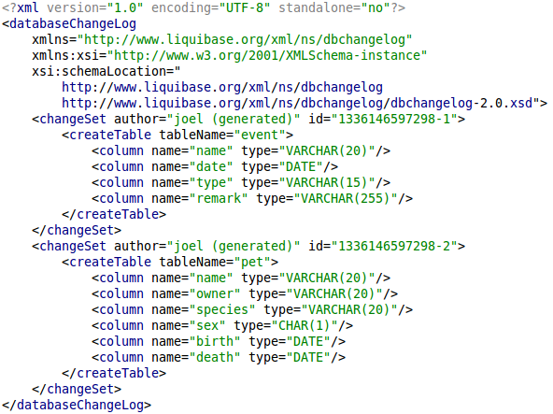
Generate Change Log

Slide 18
Change Sets
A change set contains a list of changes to execute and an unique identifier consisting of the id and author attributes as well as the filename in the change set is defined.
DB-100.xml
<changeSet id=”DB-100:1” author=”joel”>
<comment>Create user table</comment>
<createTable name=”users”>
<column name=”name” type=”VARCHAR”/>
</createTable>
</changeSet>
Change sets are normally executed as a single transaction, but some operations may be auto-comitting in some implementations (eg. DDL statements in Oracle).

Slide 19
<number>
Commands
update
updateSQL
tag
rollback
rollbackSQL
export
diff
Notes:
<number>

Slide 20
diff
Currently, LiquiBase runs the following comparisons:
Version Differences
Missing/unexpected tables
Missing/unexpected views
Missing/unexpected columns
Missing/unexpected primary keys
Missing/unexpected unique constraints
Missing/unexpected foreign Keys
Missing/unexpected sequences
Missing/unexpected indexes
Column definition differences (data type, auto-increment, etc.)
View definition differences
Data differences (limited), not checked by default
It does not (currently) check
Non-foreign key constraints (check, etc)
Stored Procedures
Data type length
LiquiBase can diff different database types, but the results may be skewed due to differences in case and data types.

Slide 21
Running

Slide 22
Applying Changes
Each change set has a unique identifier
Applied changes are stored in a databasechangelog table.
Liquibase reads the changes in the changelog sequentially, checks if the change has been run and executes it if it has not.
databasechangelog

Slide 23
databasechangelog
></drop>

Slide 24
rollback
rollbackCount[SQL]
Rollbacks the given number of changes either directly to the database, or outputting the SQL for review.
rollbackToDate[SQL]
Rollbacks the database to the state it was at the given date/time (yyyy-mm-dd hh:mm:ss).
rollback[SQL] <tag>
Rollbacks the database to the state it was when the <tag> was applied.
futureRollbackSQL
Outputs the SQL required to rollback the database to the current state after the changes in the changelog has been applied.
updateTestingRollback
Updates the database with the changes in the changelog, then rolls them back, before applying them again.

Slide 25
DEMO
Upgrade a database…
Notes:
<number>

Slide 26
<number>
Best Practices and Experiences
DDL (structure) and Data in different change log files.
Always create Rollback scripts.
Always use the comment tag and write whatever you would do with normal a commit comment.
Decide upon an ID strategy and communicate it well.
Make sure reference to an issue number ends up in the comment or the ID.
Always tag your database after an upgrade with version number
Treat your liquibase scripts as any other software artifacts. In java that would be creating a as a maven artifact as a jar file with the scripts. It will then be released together with the software.
When creating DDL keep on item per changeSet in order to be able rollback successfully.
Avoid vendor specific changessets if possible, when using <sql></sql> use ANSI SQL.
Use database neutral data types when possible.
When introducing Liquibase be sure to set the standards in your first scripts, other will use your scripts as a template!
When switching from hibernate generate DDL to Liquibase and switching hibernate to validate, some databases has poor dialects that needs to be patched, especially Numeric / Decimal problem.
Notes:
<number>

Slide 27
<number>
Testing
Databases can be upgraded (with maven plugin) in an CI envrionment
Unit test can be written to run liquibase at build, on local developer environment
Liquibase can be integrated into existing DAO unit tests, for example unitils.
Notes:
<number>

Slide 28
<number>
Integration
Maven
Ant
Spring
Grails
Notes:
<number>

Slide 29
DEMO
Let maven do it…
Notes:
<number>

Slide 30
Application areas
Notes:
<number>

Slide 31
Industries
Notes:
<number>

Slide 32
HiCons
Notes:
<number>

