Slide 1



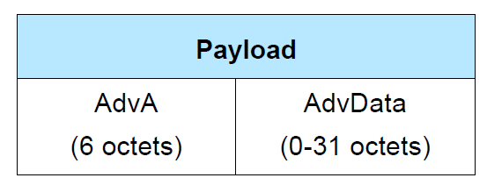





e.g.0b0010 → ADV_NONCONN_IND
e.g. 0b00111 → ADV_EXT_IND, AUX_ADV_IND, etc.

