Slide 1


SQLite

Slide 2
What is SQLite
SQLite is an embedded, server-less relational database management system.
It is an in-memory open-source library with zero configuration and does not require any installation.
In SQLite, a database is stored in a single file - a trait that distinguishes it from other database engines. This fact allows for a great deal of accessibility: copying a database is no more complicated than copying the file that stores the data, sharing a database can mean sending an email attachment.
One of the main benefits of using SQLite is that it is very easy to get started with. To create a new database in SQLite, you simply need to create a new file on your filesystem and connect to it using the sqlite3 API.

Slide 3
History
2000 - In the spring 2000, D. Richard Hipp designed SQLite while working for General Dynamics on contract with the United States Navy.
Hipp was designing software used for a damage-control system aboard guided-missile destroyers.
2000 - First Release: Version 1.0 (2000-08-17).
2024 - Latest Release: Version 3.45.2 (2024-03-12).

Slide 4
SQLite History
SQLite was designed to be a lightweight and simple database engine that could be easily embedded into other applications. It was created as an alternative to more complex and heavyweight database engines, such as MySQL and PostgreSQL. Over the years, SQLite has gained widespread adoption and is now one of the most widely used database engines in the world. It is used in many applications, including web browsers, mobile phones, and a wide variety of other software.
SQLite is an open-source software project, and the source code is available under the terms of the SQLite license, which is a permissive, public domain-like license. This has contributed to its widespread adoption, as developers are free to use and modify the source code as they see fit.

Slide 5
Features of SQLite:
ACID (atomic, consistent, isolated, and durable) transactions - The transactions follow ACID properties i.e. atomicity, consistency, isolation, and durability even after system crashes and power failures.
Zero-configuration: no setup or administration is needed.
Implements most of SQL92.
Complete database is stored in a single file.
Supports terabyte-sized databases and gigabyte-sized strings and blobs.
Small and lightweight: Starting size of the file/db is less than 1MB (~ 400kb).
Self-contained: no external dependencies.
Open source: C source code is in the public domain.
Cross-platform

Slide 6
SQLite Datatypes
Most SQL database systems use static typing; i.e., the type of a value is determined by the column in which the value is stored. SQLite uses a more general dynamic type system – the type of a value is associated with the value itself, not with its column. Think of column types as hints. It is possible to store a string in an integer column and vice versa.
SQLite does not have a separate Boolean storage class. Boolean values are stored as integers 0 (false) and 1 (true).
SQLite does not have a storage class set aside for storing dates and/or times. Instead, the built-in date and time functions of SQLite are capable of storing dates and times as TEXT, REAL, or INTEGER values.
Each column in a SQLite database is assigned one of the following type affinities:
TEXT ; NUMERIC; INTEGER; REAL; BLOB

Slide 7
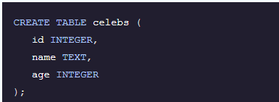
Drawbacks to SQLite
SQLite’s signature portability unfortunately makes it a poor choice when many different users are updating the table at the same time (to maintain integrity of data, only one user can write to the file at a time). It also may require some more work to ensure the security of private data due to the same features that make SQLite accessible. Furthermore, SQLite does not offer the same exact functionality as many other database systems, limiting some advanced features other relational database systems offer. SQLite does not validate data types - Where many other database software would reject data that does not conform to a table’s schema, SQLite allows users to store data of any type into any column.
SQLite creates schemas, which constrain the type of data in each column, but it does not enforce them. The example below shows that the id column expects to store integers, the name column expects to store text, and the age column expects to store integers:​
However, SQLite will not reject values of the wrong type. We could accidentally insert the wrong data types in the columns. Storing different data types in the same column is a bad habit that can lead to errors that are difficult to fix, so it’s important to be strict about your schema even though SQLite will not enforce it.​​

Slide 8
SQLite Limitations
Limited concurrency: SQLite uses file-based locking to control access to the database, which can lead to performance issues when multiple clients are trying to read and write to the database simultaneously. This makes it less suitable for use in highly concurrent systems.
No support for stored procedures: SQLite does not support stored procedures, which are pre-compiled SQL statements that can be executed on the server. This means that all SQL code must be sent to the server and compiled at runtime, which can be less efficient than using stored procedures.
No support for triggers*: SQLite does not support triggers, which are database actions that are automatically triggered by specified events (such as the insertion of a row into a table). This means that you have to manually implement any logic that needs to be triggered by specific events.
*It only supports FOR EACH ROW triggers.
Limited support for data types: SQLite has a relatively small set of data types compared to other database engines. It does not support many of the more advanced data types, such as arrays and JSON, that are available in other databases.
Limited scalability: SQLite is not designed to be a high-concurrency, high-transaction-rate database engine. It is more suited for use in smaller-scale, low-concurrency systems, and may not be able to scale to handle very large amounts of data or very high levels of concurrency.

Slide 9
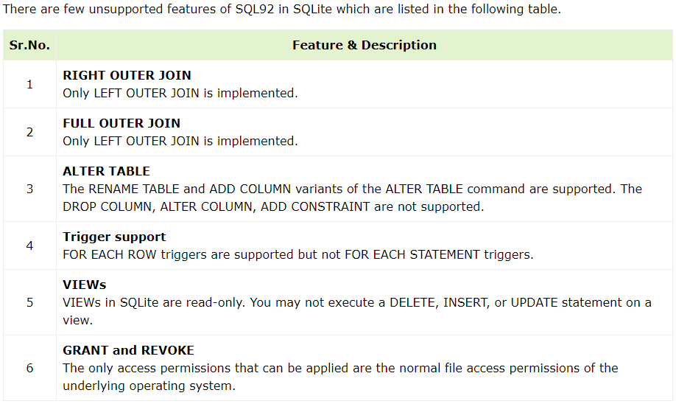
SQLite Limitations
Do Not support RIGHT nor FULL OUTER JOIN.
Using the ALTER table statement, you can only add a column or rename a table.
Do Not support FOR EACH STATEMENT triggers. It only supports FOR EACH ROW triggers.
VIEWs are read-only, and you can't write INSERT, DELETE, or UPDATE statements into the view.
Allows only normal file access permissions. It does not support GRANT and REVOKE commands as SQLite reads and writes to the disk files.

Slide 10
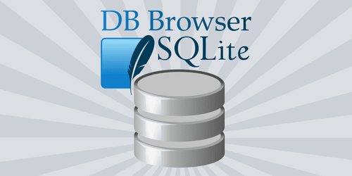
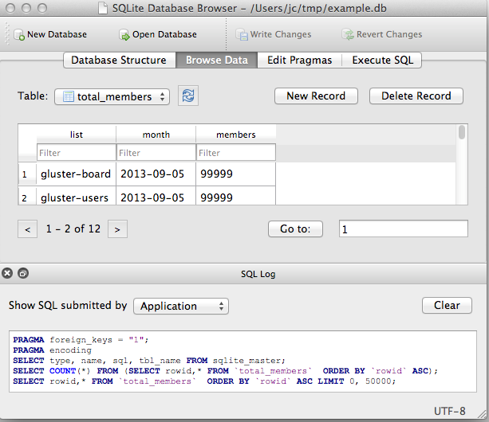
DB Browser for SQLite
DB Browser for SQLite (DB4S) is a high quality, visual, open source tool to create, design, and edit database files compatible with SQLite.
DB4S is for users and developers who want to create, search, and edit databases. DB4S uses a familiar spreadsheet-like interface, and complicated SQL commands do not have to be learned.
https://sqlitebrowser.org

Slide 11
Why SQLite?
There are several reasons why you might choose to use SQLite in your project:
Ease of use: SQLite is very easy to get started with, as it requires no setup or configuration. You can simply include the library in your project and start using it.
Embeddability: SQLite is designed to be embedded into other applications. It is a self-contained, serverless database engine, which means you can include it in your application without the need for a separate database server.
Lightweight: SQLite is a very lightweight database engine, with a small library size (typically less than 1MB). This makes it well-suited for use in applications where the database is embedded directly into the application binary, such as mobile apps.
Serverless: As mentioned earlier, SQLite is a serverless database engine, which means there is no need to set up and maintain a separate database server process. This makes it easy to deploy and manage, as there are no additional dependencies to worry about.
Cross-platform: SQLite is available on many platforms, including Linux, macOS, and Windows, making it a good choice for cross-platform development.

Slide 12
Why SQLite?
Open-source: SQLite is an open-source software and does not require any license.
Standalone: SQLite stores all of the data in a single file on the filesystem, which makes it easy to copy or backup the database.
High reliability: SQLite has been widely tested and used in production systems for many years and has a reputation for being a reliable and robust database engine. transactions are fully ACID-compliant, allowing safe access from multiple processes or threads.

Slide 13
Uses for/Applications of SQLite
Even considering the drawbacks, the benefits of being able to access and manipulate a database without involving a server application are huge.
SQLite is used worldwide for testing, development, and in any other scenario where it makes sense for the database to be on the same disk as the application code.
When to Use SQLite:
Due to its small code print and efficient usage of memory, SQLite is used to develop embedded software for devices like cell phones, TVs, cameras and other electronic gadgets.
It can manage low to medium-traffic HTTP requests.
SQLite can change files into smaller size archives with lesser metadata.
SQLite is used as a temporary dataset to get processed with some data within an application.
Beginners use SQLite for learning and training purposes, as it requires no installation and configuration.
As it has no complication for configuration and easily stores file in an ordinary disk file, so it can be used as a database for small to medium sized websites.
It is faster and accessible through a wide variety of third-party tools, so it has great applications in different software platforms.

Slide 14
Well-Known Users of SQLite
• Google Chrome
• Mozilla Firefox
• Bosch multimedia systems
• Adobe
• Airbus
• VENTANA SP400
List of the well-known user: https://www.sqlite.org/famous.html

Slide 15
Sources:
https://www.sqlite.org/
https://en.wikipedia.org/wiki/SQLite
https://www.codecademy.com/article/what-is-sqlite
https://www.geeksforgeeks.org/introduction-to-sqlite/
https://www.tutorialspoint.com/sqlite/sqlite_overview.htm
https://www.slideshare.net/emanuelebartolesi/sqlite-overview
https://slideplayer.com/slide/12248075/
https://www.slideshare.net/slideshow/sqlite-44918931/44918931
https://www.slideshare.net/MaheshSharma38/a-brief-introduction-to-sqlite-ppt
https://www.sqlitetutorial.net/
https://www.simplilearn.com/tutorials/sql-tutorial/what-is-sqlite

