Slide 1
ANCIENT EGYPT
Ancient Egypt
Group Activity
Colisiwe
Lerato Diane
Phenyo Phakedi
Mfundo Mncwabe

Slide 2
Brief
Assessment Task | Part 2
2D.AN: Design the character of Rameses and design him a Throne Room
GD.FD: Design a book cover for the Encyclopaedia of Ancient Egypt, and a series poster art (minimum 3) promoting the launch of the latest version of the book
Front cover, book cover, and spine design.
The poster
INT.MD: Design a 3-5 page micro-site for the launch. You may use your own images, as well as images provided by the animators and designers. We should be able to navigate your site. Please include the following pages:
A Rameses character,
A Rameses throne room,
A background design,
a book cover for the Encyclopaedia of Ancient Egypt,
a poster series promoting the launch of the book

Slide 3
Research
Text placeholder

Slide 4
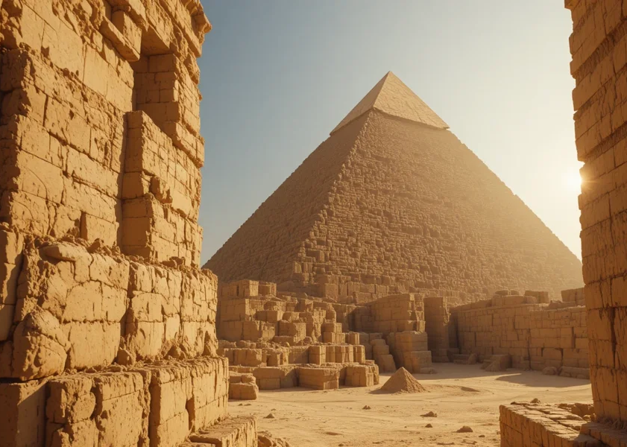
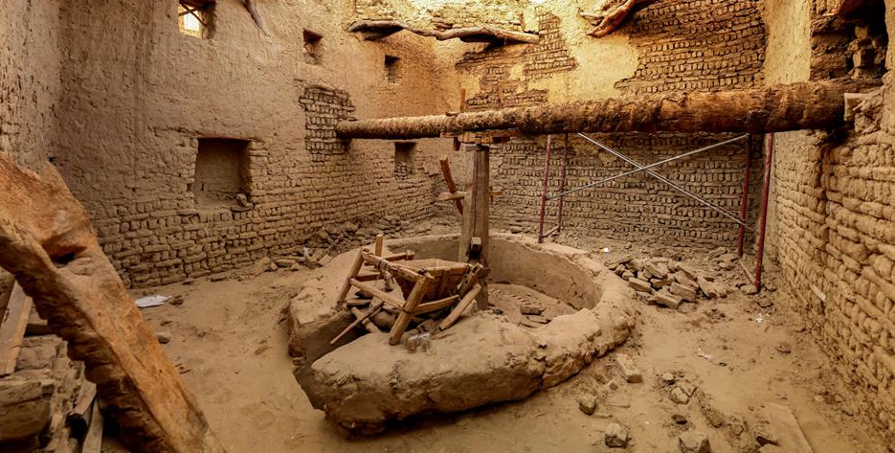
Lifestyle
All of Egypt was subjugated under one ruler, the Pharoah, who was god, king and high priest all rolled into one.
The triangular shape of pyramids that were built, show the hierarchy and control of one over many.
Most people in ancient Egypt were farmers. They lived with their families in houses made of mud bricks that were near the Nile River.
The Nile flooded each year, leaving behind fertile soil for planting crops like wheat, barley, lettuce, flax, and papyrus. As the Egyptians learned how to move river water to their fields, they were able to grow more food, including grapes, apricots, olives, and beans.

Slide 5
The king was god on earth in the form of man, and no distinction was made between god and king. It was because of this that the ancient Egyptian belief system created and supported the political and social hierarchy.
The king was known as a pharaoh. He was the most powerful person in ancient Egypt. The pharaoh was the political and religious leader of the ancient Egyptian people.
When the ancient Egyptians started trading, they needed to keep record of what they bought and sold. This led to the development of their alphabet. At first they used picture writing called hieroglyphics where each picture stood for a sound

Slide 6
Bibliography
Source Title | Source Type | Author/Link
Sahistory | Website | https://sahistory.org.za/article/way-life-ancient-egypt

