Slide 1
angular-material

Slide 2
layout
responsive CSS layout is built on flexbox
the layout element attribute directive defines the direction of element’s immediate children.
allowed values: row | column
default value:row

Slide 3
layout
<div layout=”row”>
<div>hanni</div>
<span>nachmiass</span>
</div>

Slide 4
layout
<div layout=”row”>
<section>
<div >hanni</div>
<span>nachmiass</span>
</section>
</div>

Slide 5
layout
add these attributes to layout children to customize size and position within the layout container:
flex - it will flex (stretch) to fill the available area. can add percent: flex=33
restricted to 33%,66%,and multiples of five
for 0%-100%

Slide 6
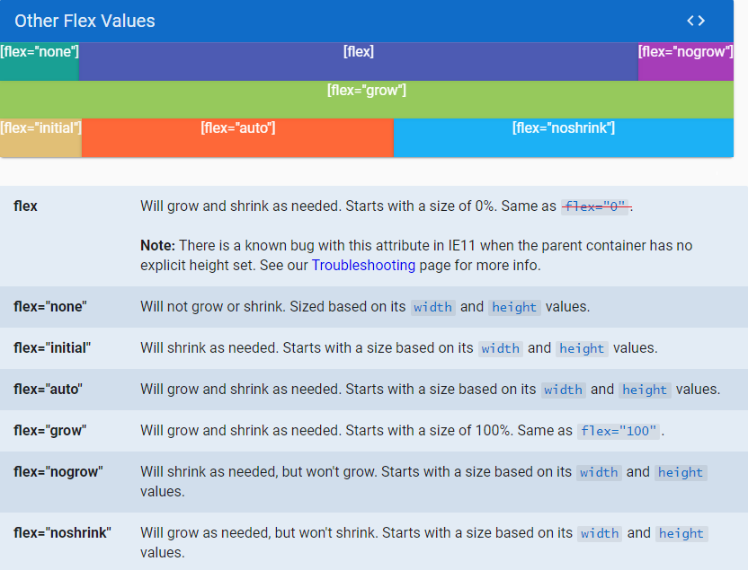
layout
other options:
flex - will grow and shrink as needed.starts with a size of 0%
flex =

Slide 7
layout
flex-offset: create offset percentage.
equivalent to margin-left with respect to
preceding element or containers left boundary

Slide 8
layout
flex-order - sets order position within the layout container.
allowed values : integer from -20 to +20

Slide 9
layout
<div layout=”row”>
<span flex=”30” flex-offset=”10”>hanni</span>
<span flex=”60”>nachmiass</span>
</div>

Slide 10
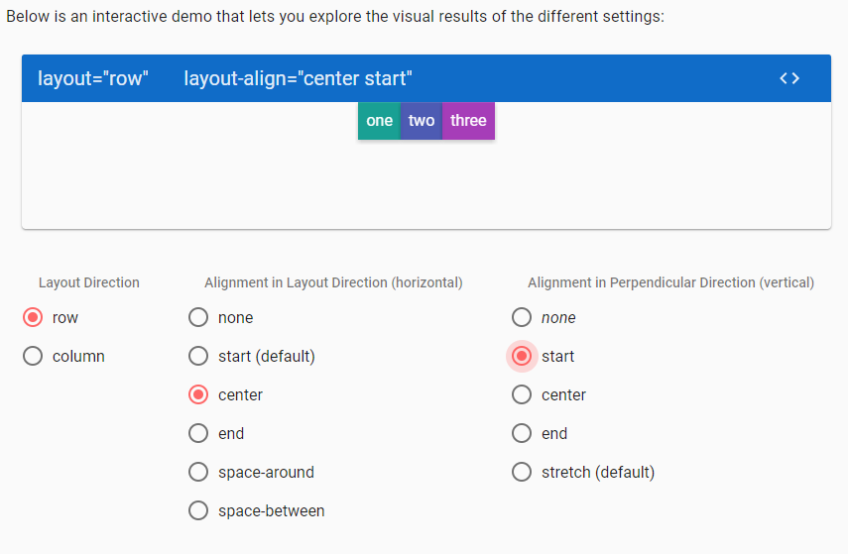
layout
layout-align

Slide 11
layout
layout-margin:
adds margin around each flex child
it also adds a margin to the layout container
itself
layout-padding:
(same as layout-margin)
layout-fill: forces layout element to fill its parent container

Slide 12
layout
<div layout="row" layout-padding layout-margin layout-fill>
<span flex style="background-color:red">hanni</span>
<span flex style="background-color:blue">nachmiass </span>
</div>

Slide 13
md-input-container
parent of any input or textarea element.
should contain only one element
<md-input-container>
<label>name</label>
<input ng-model=”ctrl.name”>
</md-input-container>

Slide 14
md-select
can be used within <md-input-container>
or as a standalone component by using
md-no-underline class

Slide 15
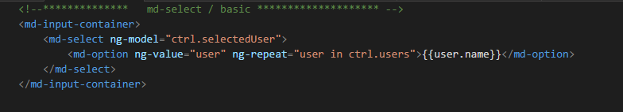
md-select

Slide 16
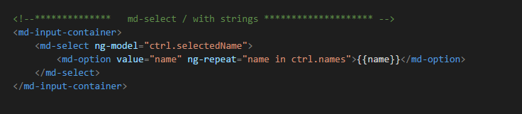
md-select

Slide 17
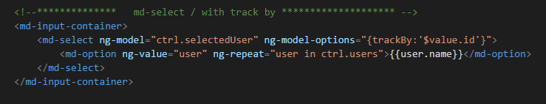
md-select

Slide 18
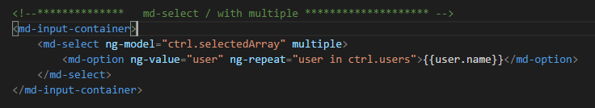
md-select

Slide 19
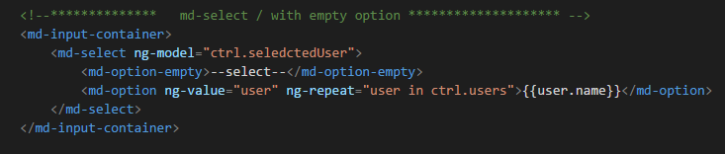
md-select

Slide 20
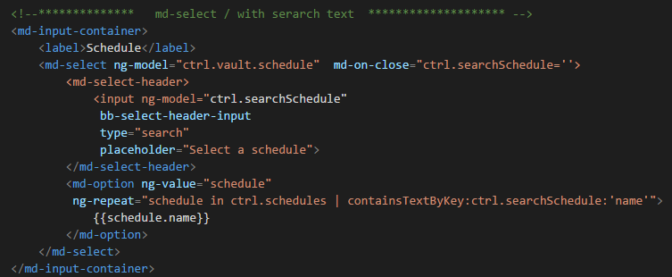
md-select

Slide 21
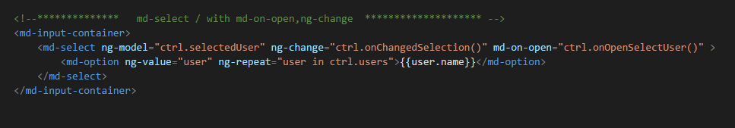
md-select

Slide 22
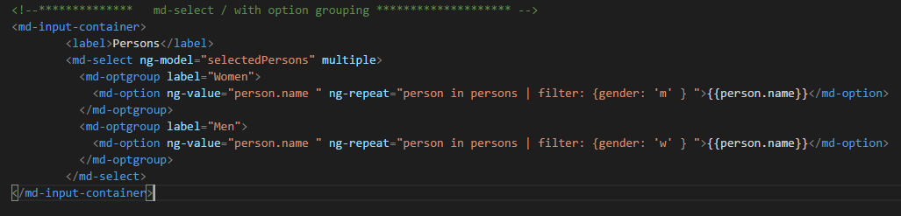
md-select

Slide 23
$mdDialog
the service support alert,confirm,prompt and custom dialogs
single service to show and hide dialogs
other services $mdToast,$mdBottomSheet
have similar api

Slide 24
$mdDialolg
$mdDialog.show({
templateUrl:”/hanniNachmiass.html”,
controller:” hnController as ctrl”,
locals:{
name:”hanni”
}}).then(function(res){
console.log(res)
})

Slide 25
$mdDialog
$mdDialog.hide({name:”hanni”,age:58});

Slide 26
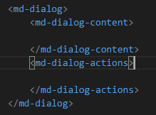
$mdDialog
custom dialog template:

Slide 27
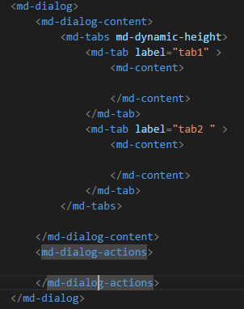
$mdDialog
with md-tabs:

Slide 28
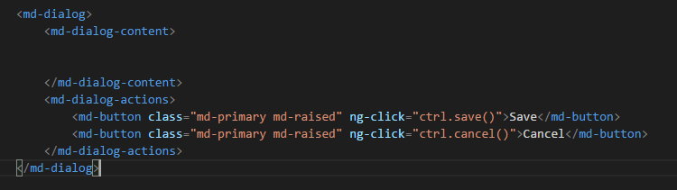
$mdDialog
with buttons :

Slide 29
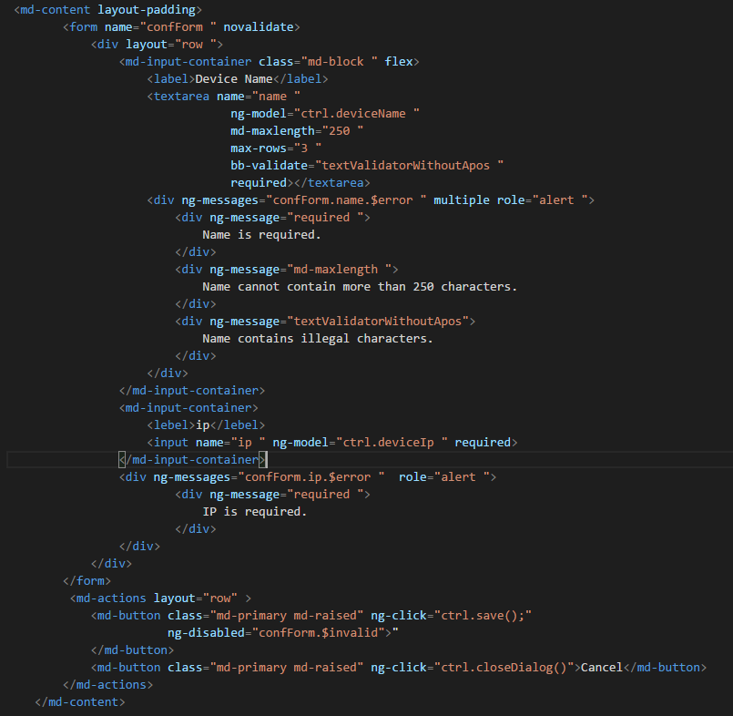
form validations

