Slide 1



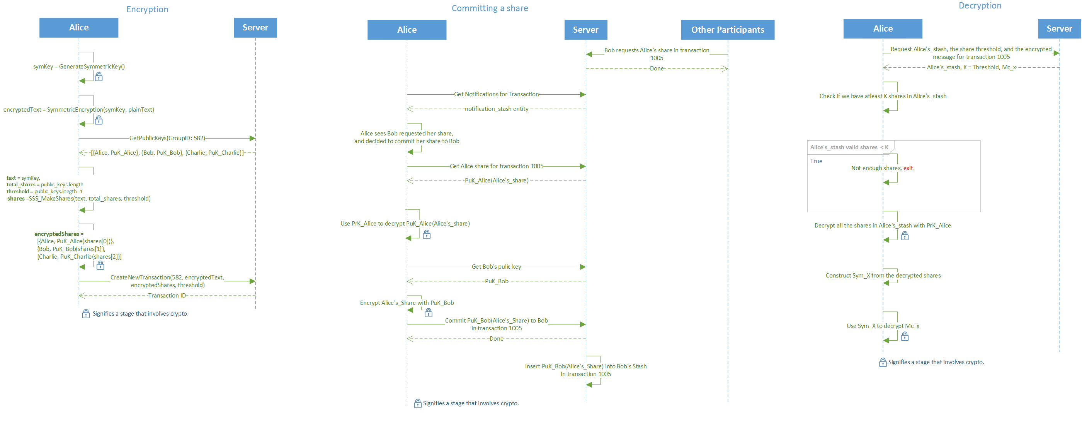
סיון תשע"ו - July 2016
BetweenUs – בֵּינֵינוּ
Data sharing between participants in a secure manner
מוגש על ידי:
לירן בן גידה – LiranBG@gmail.com
נדב לוצטו – Nadav2051@gmail.com
בהנחיית:
ד"ר ירון וינסברג, IBM
Code: @ https://github.com/liranbg/BetweenUs or
This project focuses on the privacy and security issues with Cloud Computing
Social-sharing services store data in a plain and non-encrypted manner
Malicious admins within the organizations have the ability to look at any data, violating users’ privacy
Encryption
Assuming N participants, threshold K while 2 <= K <= N
Generating new symmetric key (AES) and encrypting the input data
Splitting the encrypted data into N shares (SSS)
Querying the server for all participants public keys
Encrypting each share with a public key and assign it to a participant accordingly (RSA)
Requesting the server to create a new transaction
Committing Share:
Querying the server for own share
Decrypting the encrypted share using own private key (RSA)
Querying the server for requestee public key
Encrypting own share with the given public key (RSA)
Committing the encrypted share back to the server, to be added for the requestee stash.
Decrypting:
Querying the server for all shares in own stash
If number of shares >= K:
Decrypt all shares using the private key
Join all shares to get the asymmetric key
Decrypt the encrypted input data with the asymmetric key
Terminology:
SSS: Shamir secret sharing
AES: Asymmetric block cipher algorithm
RSA: Public-Private symmetric cryptography algorithm
Share: SSS algorithm output
Stash: Data structure that holds current user shares
Threshold: Number of needed shares to reconstruct the SSS input

Slide 2
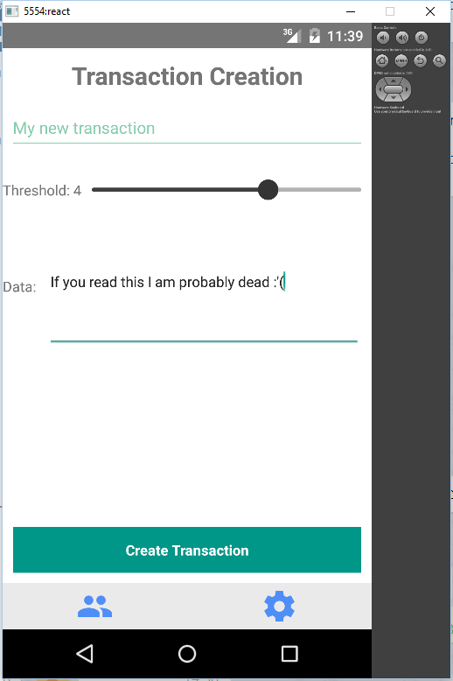
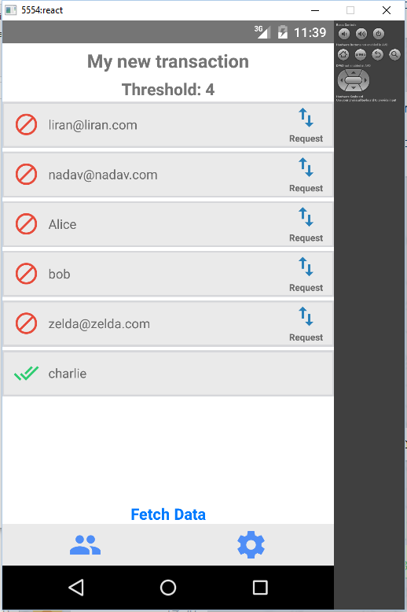
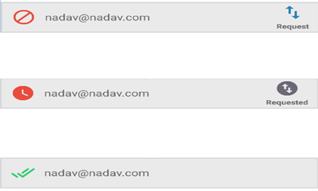
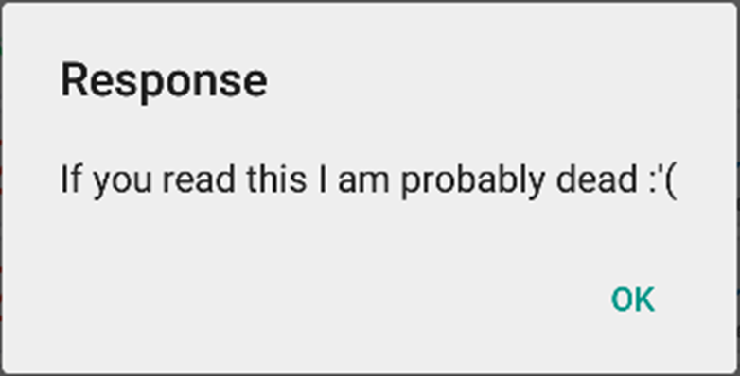
סיון תשע"ו - July 2016
BetweenUs – בֵּינֵינוּ
Data sharing between participants in a secure manner
מוגש על ידי:
לירן בן גידה – LiranBG@gmail.com
נדב לוצטו – Nadav2051@gmail.com
בהנחיית:
ד"ר ירון וינסברג, IBM
Code: @ https://github.com/liranbg/BetweenUs or
אלגוריתם
Encryption
Assuming N participants, threshold K while 2 <= K <= N
Generating new symmetric key (AES) and encrypting the input data
Splitting the encrypted data into N shares (SSS)
Querying the server for all participants public keys
Encrypting each share with a public key and assign it to a participant accordingly (RSA)
Requesting the server to create a new transaction
Committing Share:
Querying the server for own share
Decrypting the encrypted share using own private key (RSA)
Querying the server for requestee public key
Encrypting own share with the given public key (RSA)
Committing the encrypted share back to the server, to be added for the requestee stash.
Decrypting:
Querying the server for all shares in own stash
If number of shares >= K:
Decrypt all shares using the private key
Join all shares to get the asymmetric key
Decrypt the encrypted input data with the asymmetric key
Terminology:
SSS: Shamir secret sharing
AES: Asymmetric block cipher algorithm
RSA: Public-Private symmetric cryptography algorithm
Share: SSS algorithm output
Stash: Data structure that holds current user shares
Threshold: Number of needed shares to reconstruct the SSS input
יצירה ופענוח של טרנזקציה
ניצור טרנזקציה עם החברים לקבוצה, ונקבע את סף הפיענוח על 4
נבקש ממשתתפי הקבוצה את חלקם כך שנוכל לפענח את ההודעה
נפענח את ההודעה

Slide 3
סיון תשע"ו - July 2016
BetweenUs – בֵּינֵינוּ
Data sharing between participants in a secure manner
מוגש על ידי:
לירן בן גידה – LiranBG@gmail.com
נדב לוצטו – Nadav2051@gmail.com
בהנחיית:
ד"ר ירון וינסברג, IBM
Code: @ https://github.com/liranbg/BetweenUs or
אלגוריתם
יצירה ופענוח של טרנזקציה
ניצור טרנזקציה עם החברים לקבוצה, ונקבע את סף הפיענוח על 4
נבקש ממשתתפי הקבוצה את חלקם כך שנוכל לפענח את ההודעה
נפענח את ההודעה

