Slide 1

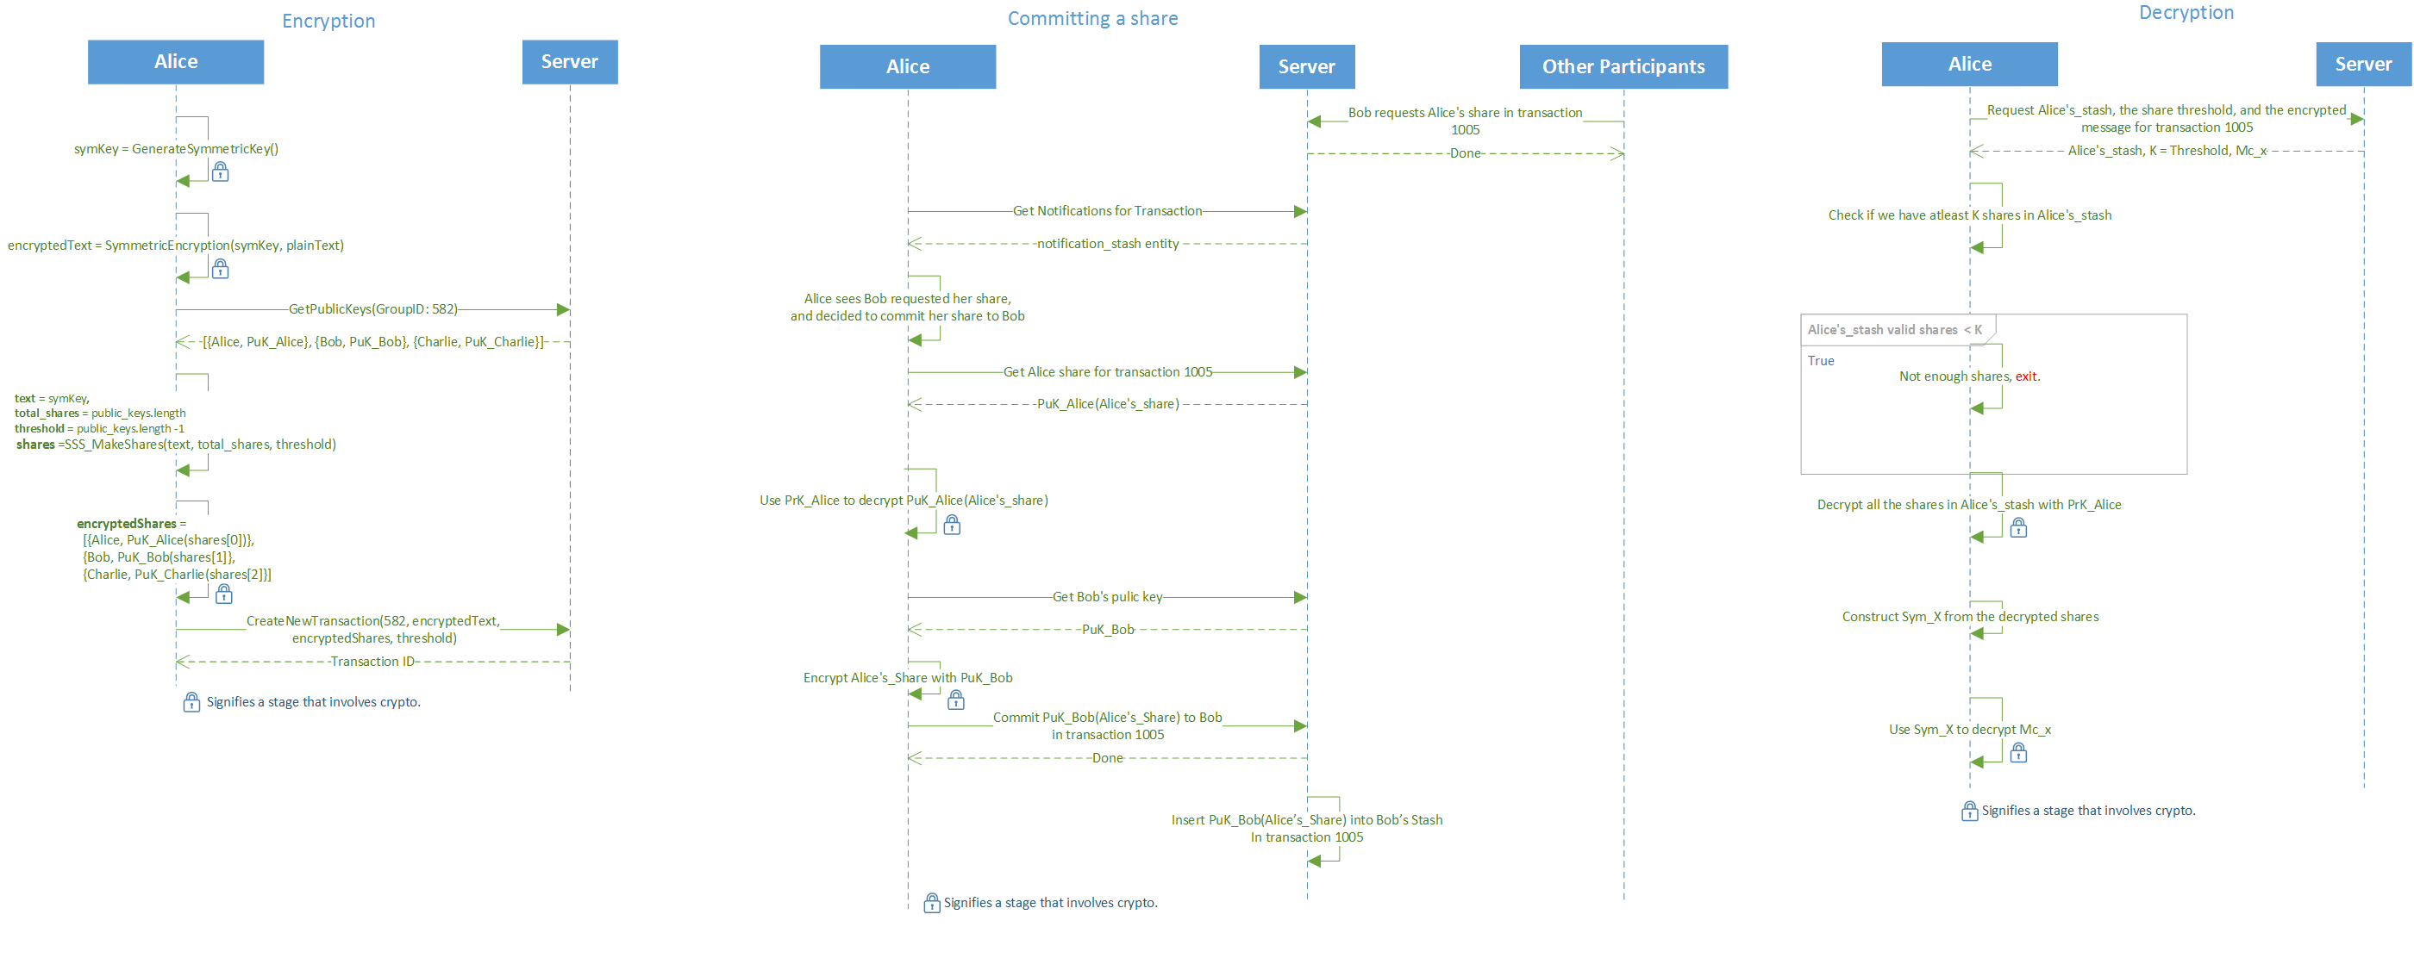
המחלקה להנדסת תוכנה
סיון תשע"ו - July 2016
BetweenUs – בֵּינֵינוּ
Data sharing between participants in a secure manner
מוגש על ידי:
לירן בן גידה – LiranBG@gmail.com
נדב לוצטו – Nadav2051@gmail.com
בהנחיית:
ד"ר ירון וינסברג, IBM
@ https://github.com/liranbg/BetweenUs
This project focuses on the privacy and security issue with Cloud Computing
Social services stores and retain the information passed by and through them in plain non-encrypted manner.
Malicious administrator in the service can peek into the data, thus risking the user security and privacy.
Encryption
Assuming N participants, threshold K while 2 <= K <= N
Generating new symmetric key (AES) and encrypting the input data
Splitting the encrypted data into N shares (SSS)
Querying the server for all participants public keys
Encrypting each share with a public key and assign it to a participant accordingly (RSA)
Requesting the server to create a new transaction
Committing Share:
Querying the server for own share
Decrypting the encrypted share using own private key (RSA)
Querying the server for requestee public key
Encrypting own share with the given public key (RSA)
Committing the encrypted share back to the server, to be added for the requestee stash.
Decrypting:
Querying the server for all shares in own stash
If number of shares >= K:
Decrypt all shares using the private key
Join all shares to get the asymmetric key
Decrypt the encrypted input data with the asymmetric key
Terminology:
SSS: Shamir secret sharing
AES: Asymmetric block cipher algorithm
RSA: Public-Private symmetric cryptography algorithm
Threshold: Number of needed shares to reconstruct the SSS input
Share: SSS algorithm output
Stash: Stored users shares in

